Slide 1
Closing the Loop with Zephyr: Real-Time Flyback Control Using Zero-Latency Interrupts and CMSIS-DSP
S. Jaritz
Zephyr Project Meetup: Vienna, Austria (17th June 2026)

Slide 2
The story
Problems with getting special IC in time of crisis
Idea to use easy replaceable parts and off the shelf MCUs
Applied to the real world problem of the PMU for embedded solutions
Zephyr offers a great platform to connect and extend the PMU with new features and also offers the promise of less painful migration between MCUs

Slide 3
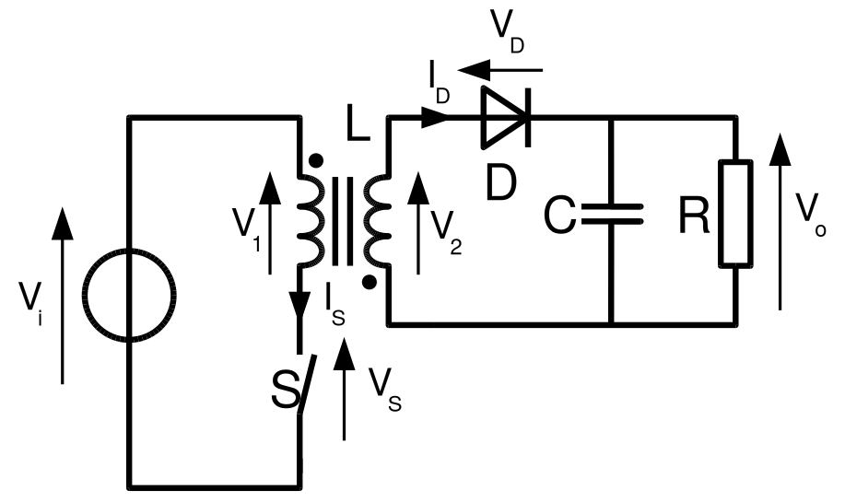
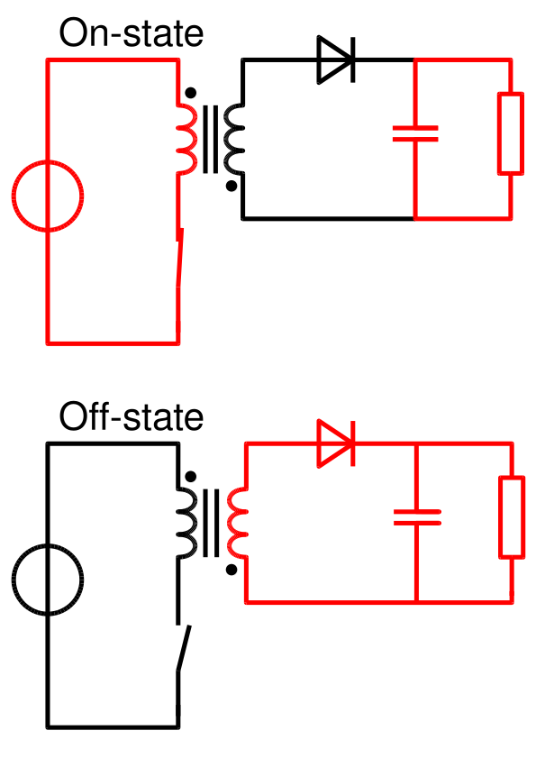
What is a flyback converter?
AC/DC or DC/DC converter with galvanic isolation
Picture source wikipedia

Slide 4
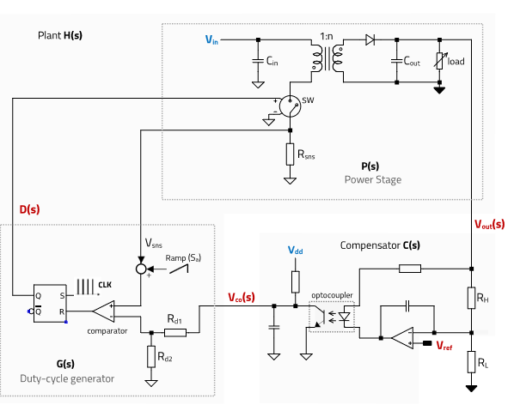
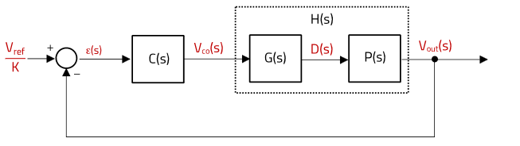
What is a real flyback converter?
Pictures source Würth ANP113a | 2023/08/18

Slide 5
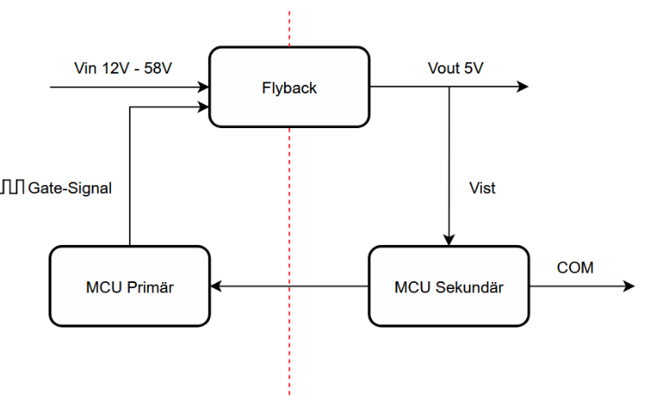

Concept
Master Thesis: “Entwurf eines diskreten Wide-Input-Flyback-
Konverters für langzeitstabile Industrieanwendungen” - Marco Stundner

Slide 6
Requirements for the firmware
Control the duty cycle by sampling the PWM feedback up to 300kHz
Implement a PID controller
Over/Under-current protection
Basic signal filtering

Slide 7
Our MCU
Pi 2350(with flash) – 1.1€
  150MHz ARM Cortex-M33
  PWM peripheral (generation and capture)
  DMA, UART, I2C, ADC
T_pwm = 1/300000s = 3.33µs
Cycles = 3.33µs * 150MHz = 500 cycles

Slide 8
Some things we need to know
ISR based approach → PWM sampling, processing, PWM output → need highest prio
ISR can be globally disabled (irq_lock() / arch_irq_lock()) → jitter
Code that is run from flash goes through caching→ cache optimisation
Float32 and Q15 hardware support (with Q15 2-3x faster than float32)

Slide 9
Design the signal path - ISR
CONFIG_ZERO_LATENCY_IRQS=y
Low latency ISR with highest prio
CONFIG_SRAM_VECTOR_TABLE=y
Move ISR vertor table to SRAM → avoid flash cache issue
__ramfunc static void pwm_wrap_isr(const void *arg)
IRQ_DIRECT_CONNECT(PWM_IRQ_WRAP, 0, pwm_wrap_isr, 0);
irq_enable(PWM_IRQ_WRAP);

Slide 10
Design the processing 1/5
CONFIG_FPU=y
CONFIG_CMSIS_DSP=y
CONFIG_CMSIS_DSP_FILTERING=y
CONFIG_CMSIS_DSP_CONTROLLER=y
Q15 fixed point math
PID controller and biquad based filter(IIR filter 2nd order)

Slide 11
Design the processing 2/5
arm_pid_instance_q15 pid; // pid controller
q15_t setpoint; // reference for the pid controller
arm_biquad_casd_df1_inst_q15 lp; // low pass filter
uint16_t y_prev; // y-1 sample

Slide 12
Design the processing 3/5
static inline q15_t filter(q15_t x)
{
q15_t in = x;
q15_t out;
arm_biquad_cascade_df1_q15(
&cntrl.lp,
&in,
&out,
1
);
return out;
}

Slide 13
Design the processing 4/5
/* =========================================================
* PWM DUTY UPDATE (10–90% clamp)
* ========================================================= */
static inline void update_pwm(uint32_t duty_ns)
{
const uint32_t wrap = 1u << 16;
uint32_t level = (duty_ns * wrap) / PWM_PERIOD_NS;
/* enforce duty limits */
const uint32_t min_level = (uint32_t)(DUTY_MIN_FRAC * wrap);
const uint32_t max_level = (uint32_t)(DUTY_MAX_FRAC * wrap);
if (level < min_level) level = min_level;
if (level > max_level) level = max_level;
pwm_set_gpio_level(PWM_OUT_GPIO, level);
}

Slide 14
Design the processing 5/5
__ramfunc static void pwm_wrap_isr(const void *arg)
{
ARG_UNUSED(arg);
q15_t y = read_feedback();
q15_t y_delayed = (q15_t)(cntrl.y_prev << 3);
cntrl.y_prev = y;
q15_t y_f = filter(y_delayed);
q15_t err = cntrl.setpoint - y_f;
q15_t u = arm_pid_q15(&cntrl.pid, err);
if (u > 25000) u = 25000;
if (u < -25000) u = -25000;
int32_t duty = ((int32_t)(u + 32768) * PWM_PERIOD_NS) >> 16;
if (duty < 0) duty = 0;
if (duty > (int32_t)PWM_PERIOD_NS) duty = PWM_PERIOD_NS;
update_pwm((uint32_t)duty);
pwm_clear_irq(cntrl.slice);
}

Slide 15
Result: Load and cycles
BEST CASE ≈ 128 cycles (~0.85 µs @ 150 MHz)
STD CASE ≈ 245 cycles (~1.63 µs @ 150 MHz)
WORST CASE ≈ 370 cycles (~2.47 µs @ 150 MHz)
CPU LOAD @ 150 MHz:
BEST: ~25%
STD: ~49%
WORST: ~74%

Slide 16
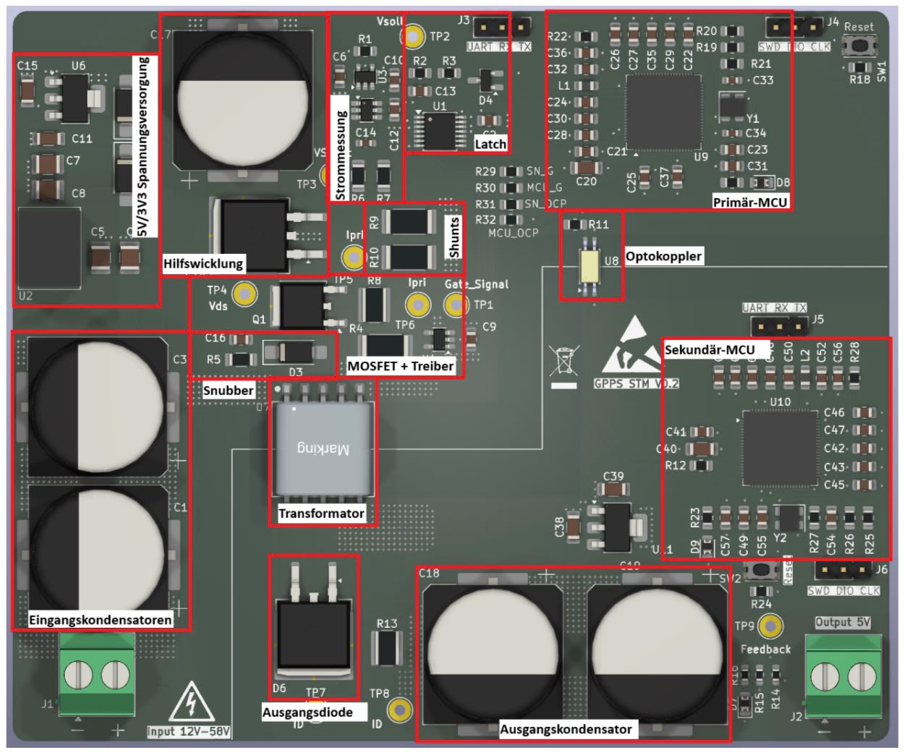
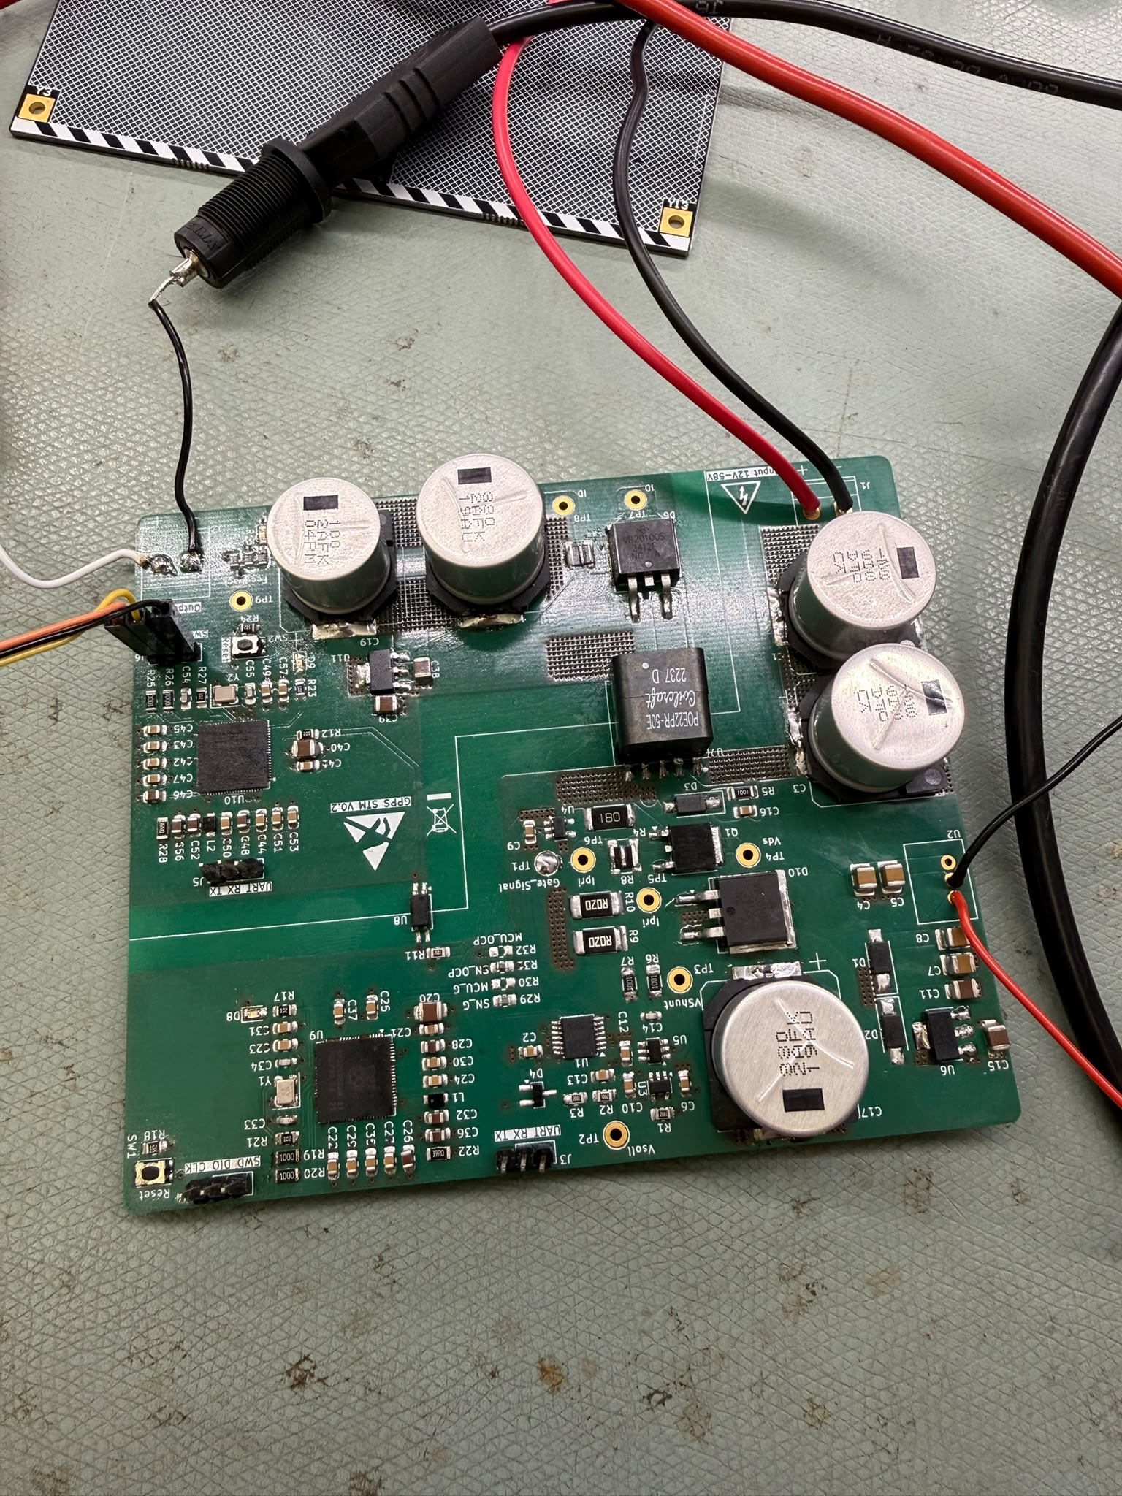
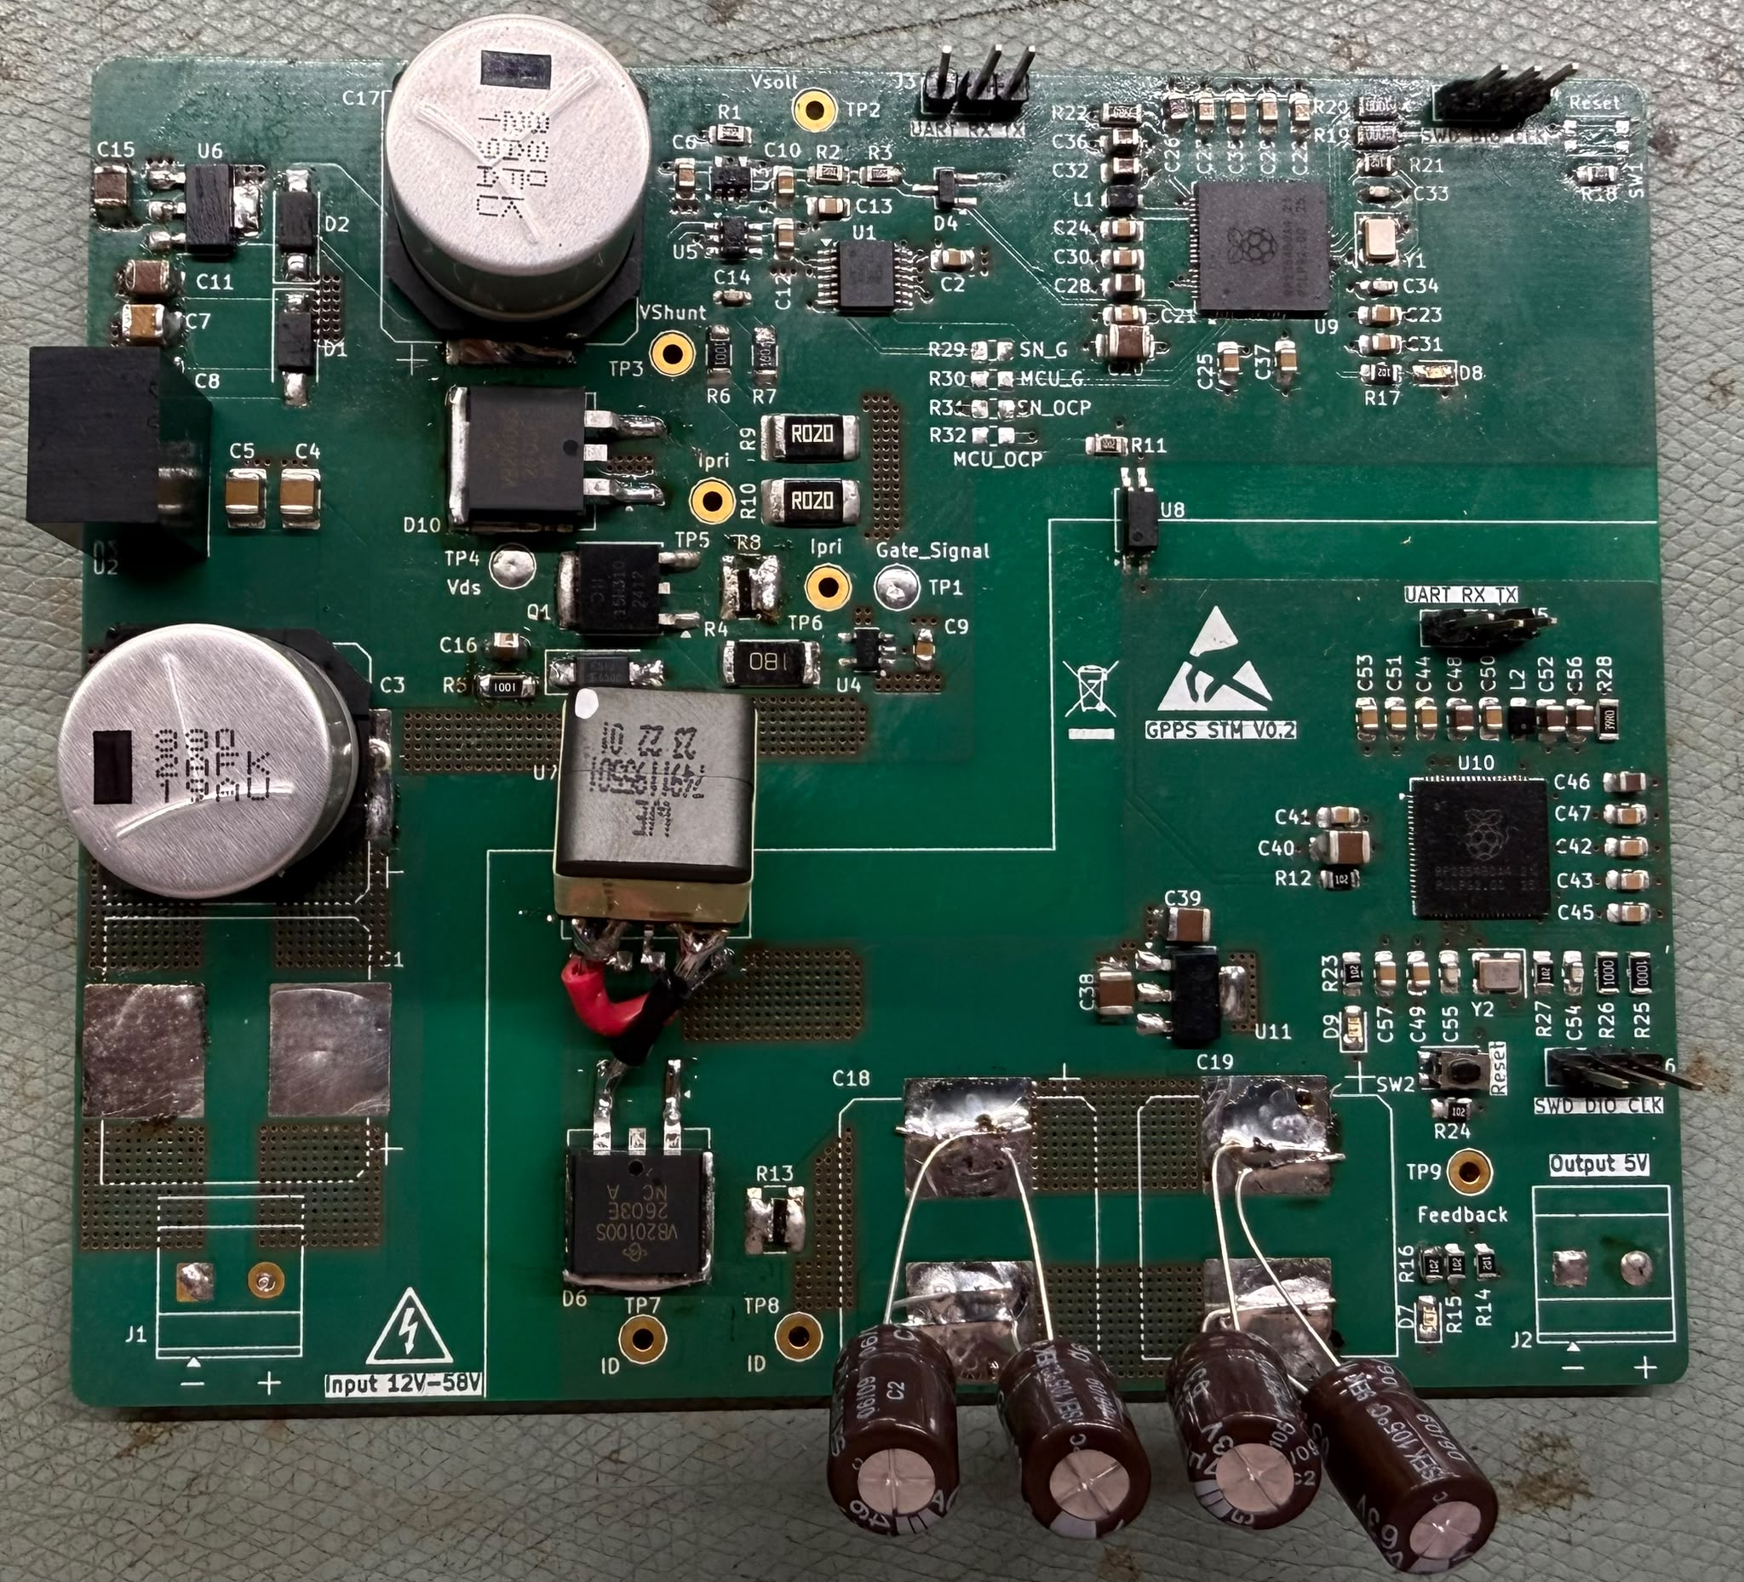
PCB action

Slide 17
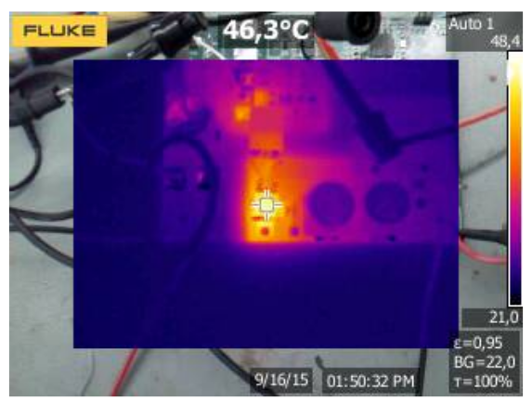

Magic Formula
+
+
=

Slide 18
Thanks – Let’s talk!

