Slide 1
Stef’s Updates
March 9 - March 15

Slide 2
Table of contents
Code Accessibility
Working on GitHub to keep everything in one place
Lake Trout Age-Weight
Boxplots of weight at age
General lake trout per lake
Lake Clark
FB4 Output
References

Slide 3
Code Accessibility
Working on GitHub to keep everything in one place
Using R version 4.5.2 (2025-10-31 ucrt).
Quarto is being used to create slides. This way, the R code for all plots in this presentation can be accessed at all times. The code is embedded in the pptx file, but they are not shown (see below).
View the code and download the data used for this presentation in the GitHub repository: https://github.com/StefTasayco/Lake-Trout-AK.git
The file name is “Age-weight.qmd”

Slide 4
Lake Trout Age-Weight
Boxplots of weight at age capture the range of possible model input values.
This analysis contributes to the approach that we discussed during the last Lake Trout team meeting where:
We combine all available lake trout data and pick an age that has robust data (e.g. 10, 20, 30).
Lake trout follow the von Bertalanffy growth model (VBGM). aka their growth should plateau as they grow older.
Therefore, we expect that age 10 lake trout will have a higher growth and consumption rate than age 30 lake trout.
The design profiles (one per age) are made using median and quartile weights for each age.
Run names for these design profiles are shown in the table.
These weight ranges represent our “generic lake trout” to use for all lakes.
Run name | Interpretation
age_xx_med_med | typical growth
age_xx_q1_q1 | steady growth at the low end of their mass
age_xx_q3_q3 | steady growth at the upper end of their mass
age_xx_q1_q3 | rapid growth
age_xx_q3_q1 | mass loss

Slide 5
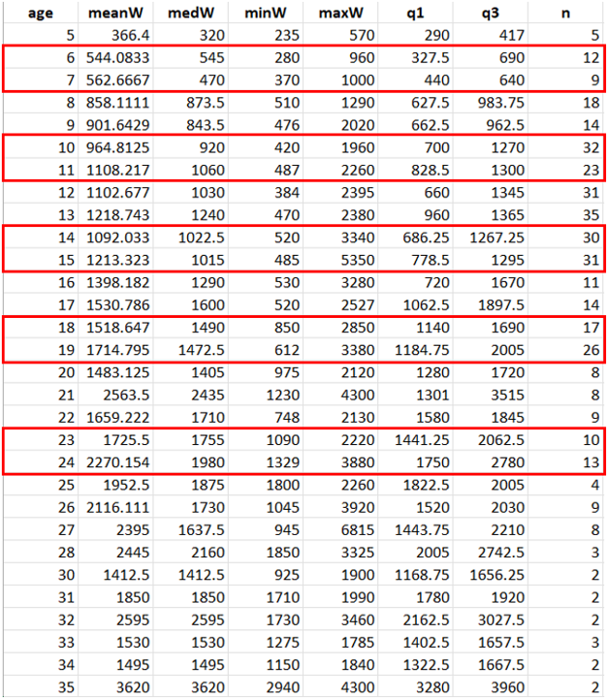
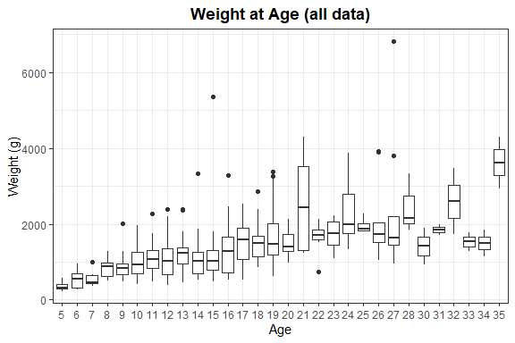
Boxplots of weight at age
All lake trout data, from all year and all lakes, was combined to make this boxplot.
This table shows summary stats of weight (g) at lake trout age. The red boxes show the ages I chose (based on robustness of data) for initial and final weight inputs.

Slide 6
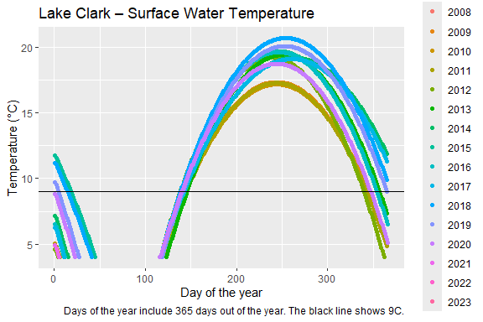
General lake trout per lake
Lake Clark
The first design profile was made using surface water temperatures from Lake Clark. A new temperature profile was made for Lake CLark to include all surface temperatures from all years.
The mean temperature for each day of year was taken and used for the temperature file. 9C becomes available on May 22nd and ends on Dec. 21st.
May 22 -Dec 21 the temperature was set to 9C.
All other days = mean surface temperatures from full dataset.

Slide 7
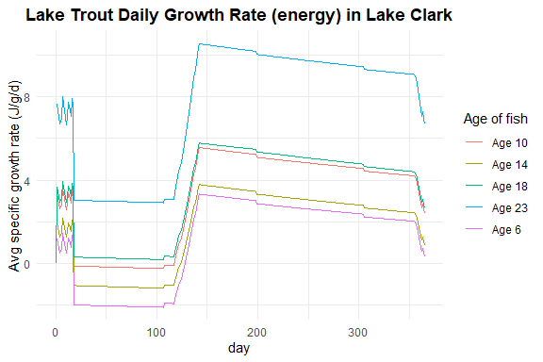
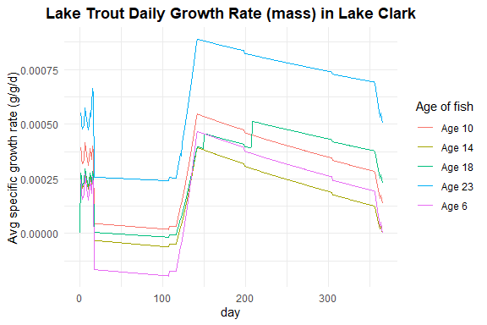
FB4 Output
Key takeaways:
These two plots do not support my initial assumption that younger lake trout have a higher growth rates. Age 6 has the lowest growth rate, while age 23 has the highest growth rate.
The interpretations for each run name is consistent with their p-values. For example:
age_14_med_med (typical growth) p-value = 0.33083
age_14_q1_q1 (steady growth at the low end of their mass) p-value = 0.381905
age_14_q3_q3 (steady growth at the upper end of their mass) p-value = 0.351765
age_14_q1_q3 (rapid growth) = 0.668207
age_14_q3_q1 (mass loss) = 0.086254
Next steps:
Creating temp profiles for Kijik Lake and Chelle Lake using same methods as above.
Calculating growing degree days (GDD) for each lake and using GDD as a predictor variable to compare FB4 outputs (each output represents a lake)
Looking through new temp data that Krista sent and plotting a thermocline for Lake Clark, Kijik, and Chelle first.
Keep looking around in literature for more diet data. I’ve been using the same diet schedule, and I want to play around with the diets more.

Slide 8
References

