Slide 1
PBI 1132
Meetups and Events page - change event separator to resolve issue with overlapping line on mobile devices

Slide 2
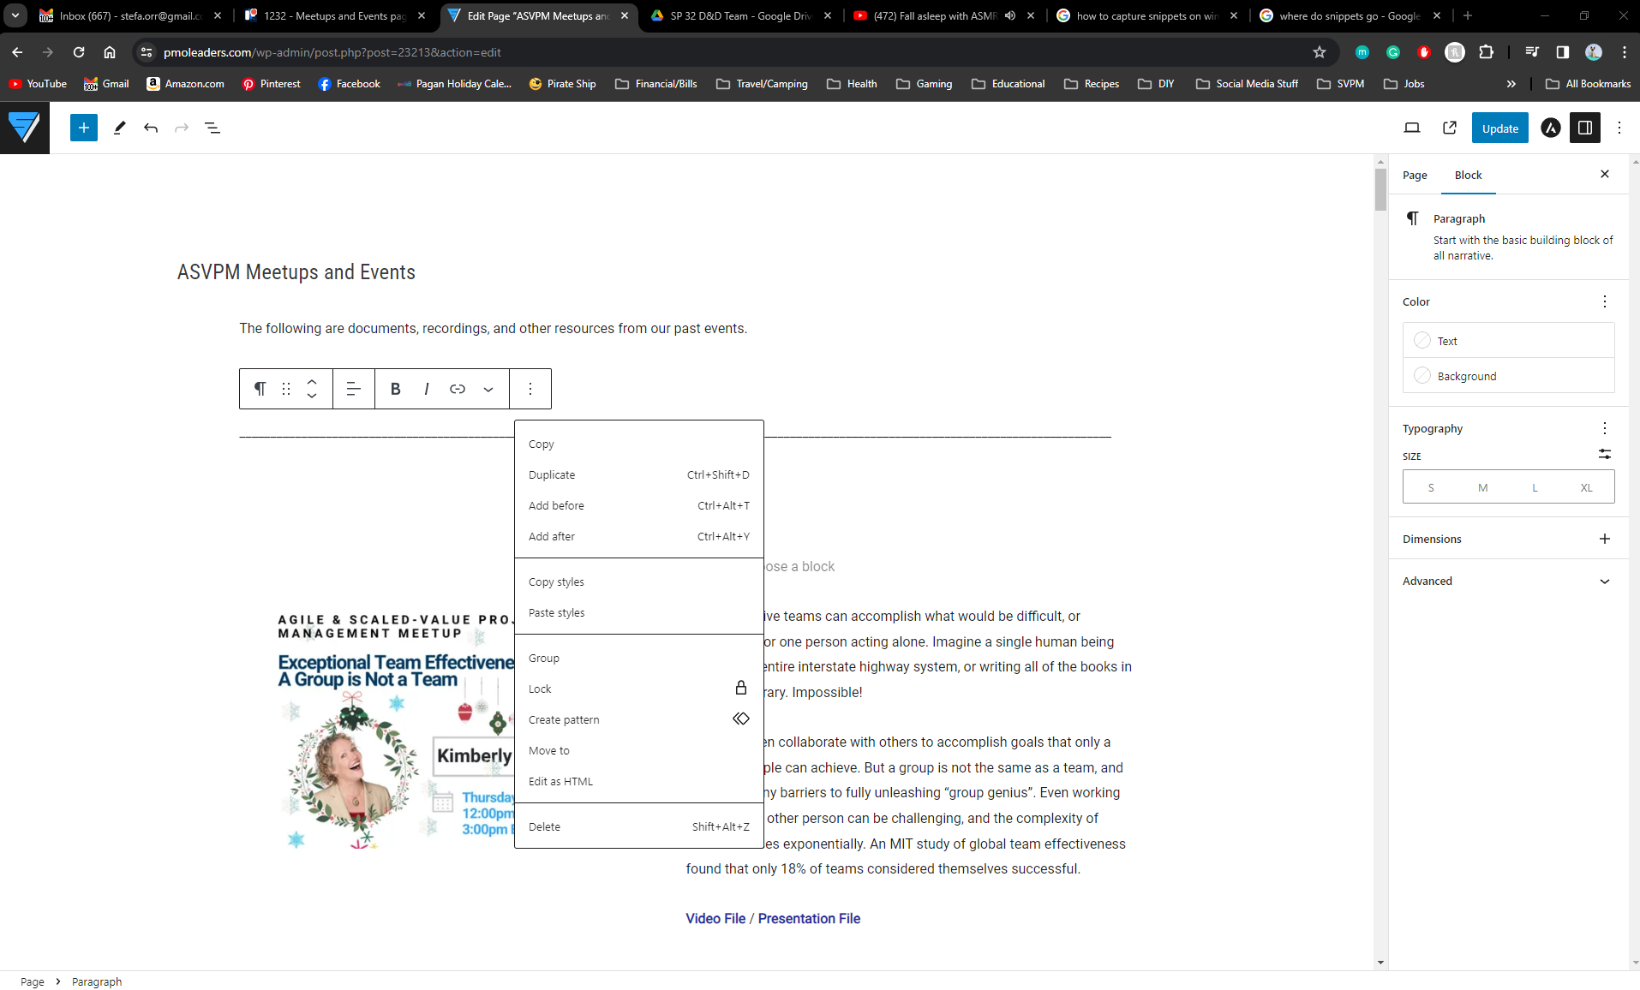
Once you have opened the Meetups and events page
Locate the lines that are in a paragraph block (text format)
Delete Paragraph Block that has the text that makes up the line (You can right click and delete that way)

Slide 3
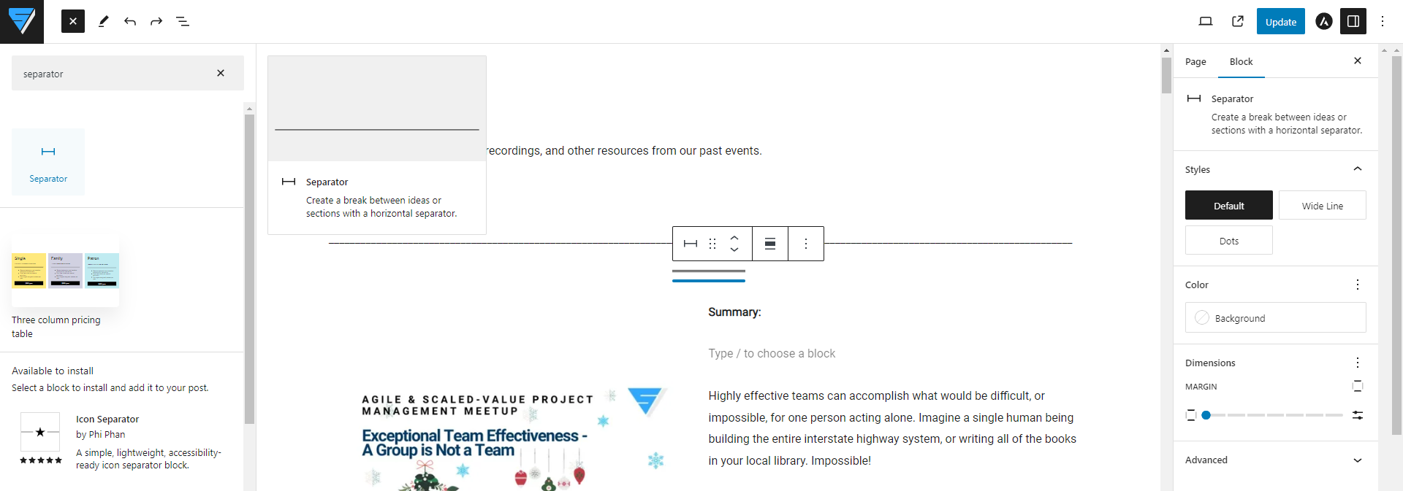
Click on the blue + button ( ) on the top left corner to add a new block.
You will want to search for a Separator block and add it where the text line was.

Slide 4
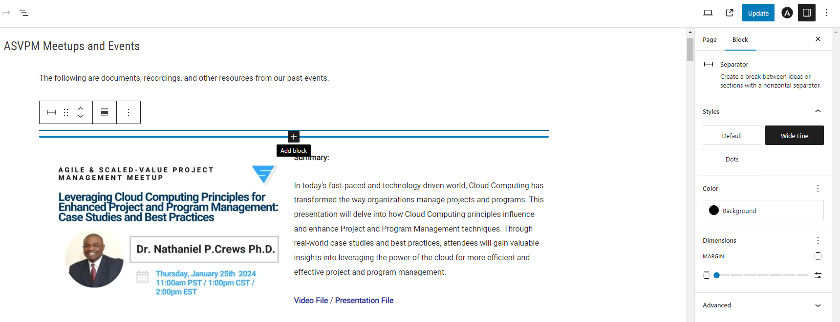
Once you have added the Separator Block
you will be able to edit the
Style and
Color using the block editing menu on the right side of the screen
Change the
Style to Wide Line
and the
Color to Black

Slide 5
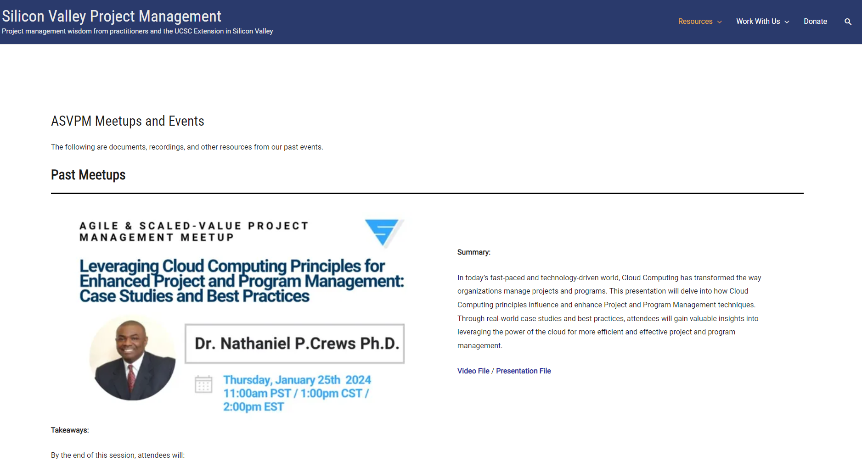
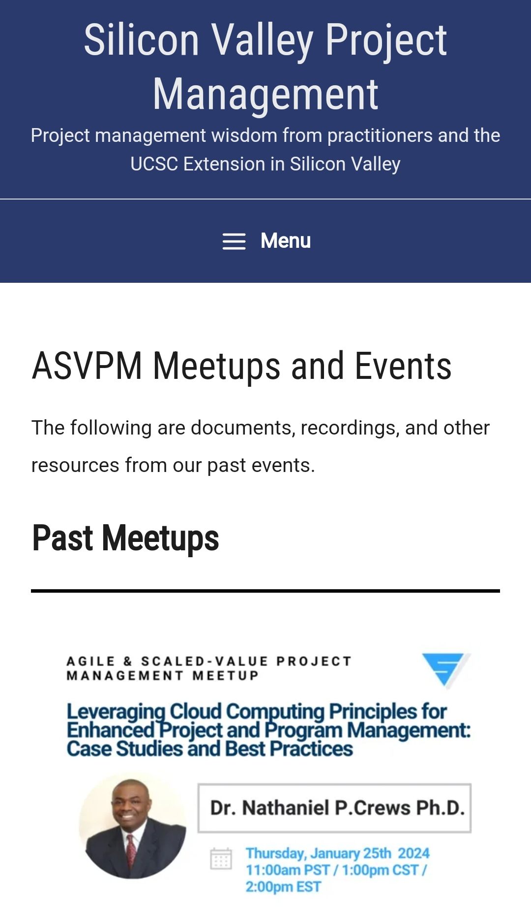
This is how your separator should
look on your browser now
This is how your separator should
look on your mobile device
By using a separator block vs. using a paragraph block with text in it, this means the separator will scale and display correctly based on the device you are using.

