Slide 1

DrectWeather: A Journey Through Travel & Weather Forecast
Project Leads:
Stefan Kniejski
Brian Paniagua
Eze Odimegwu

Slide 2




Introduction
In our fast-paced world, travel enthusiasts and adventure-seekers rely on travel and weather forecast applications to plan their journeys effectively. DrectWeather is your ultimate travel companion, combining cutting-edge data visualization with travel and weather forecast capabilities. In this data visualization story, we embark on a journey to explore the features that make DrectWeather indispensable for travelers. Let’s experience a seamless and informed voyage through its travel dashboard, real-time flight status updates and insightful weather forecasts.

Slide 3
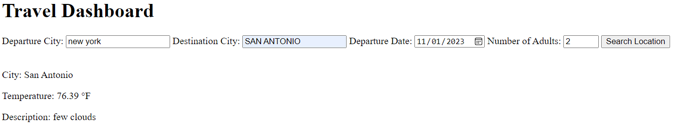
Part 1: Travel Dashboard Display
The journey begins with a visualization that showcases the travel dashboard that DrectWeather covers. This interactive tool will be used to input your departure and destination city of choice within the confines of the USA. A set departure date and number of adults will be needed to provide additional data analysis for travel and weather forecasting.

Slide 4

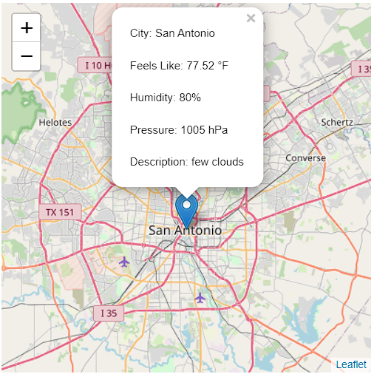

Part 2: Map Destination Metrics
As you delves deeper into your travel plans. DrectWeather provides an interactive map showcasing your final destination. It’s not just any map; it’s a dynamic visualization that pinpoints your destination and displays nearby attractions. You can zoom in to explore local point of interest, making it easier to plan your adventures. Clicking the icon provides a general idea of weather forecasts for the destination city.

Slide 5
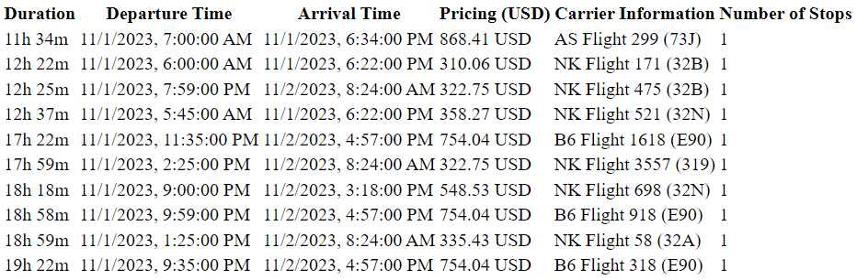
Flight Tracker / Status Updates
Currently displayed is the top 10 fastest flights headed to the destination city.
The relevant statistics measured shows duration, departure and arrival time, pricing and carrier information. There is a one stop restriction for all destination flights.

Slide 6
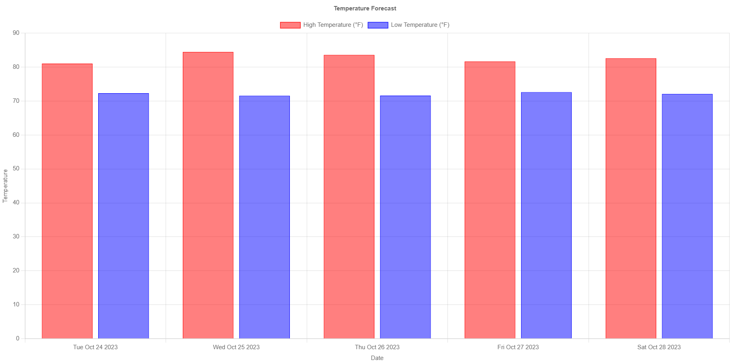
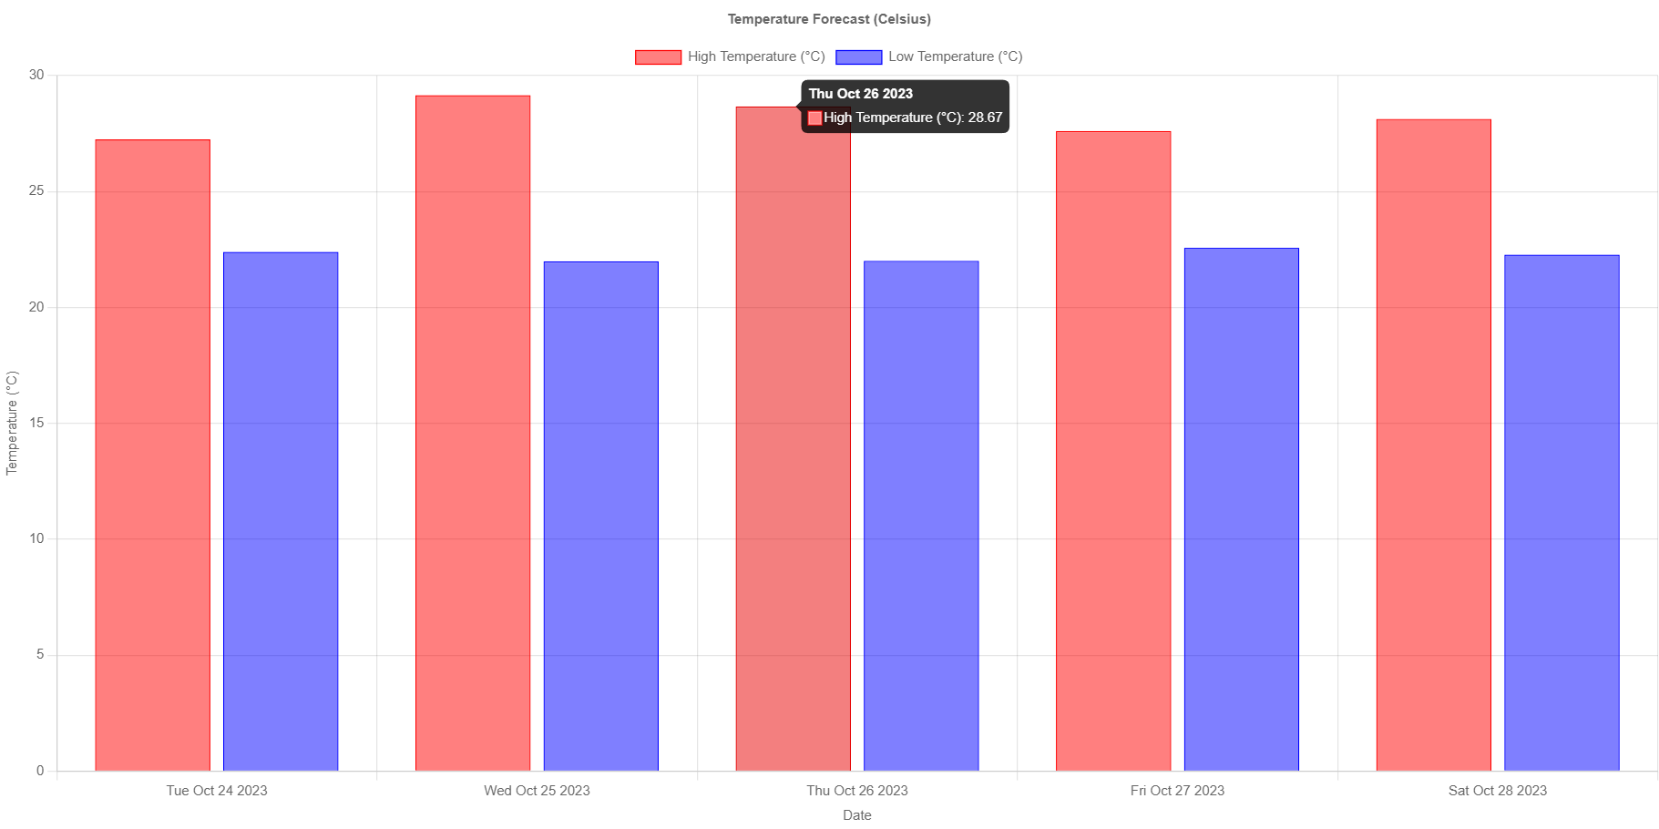
Temperature Travel Forecasts (F, C)
Travel forecasts displayed in Fahrenheit and Celsius for easier accessibility for users

Slide 7

Summary
With PowerPoint, you can create presentations and share your work with others, wherever they are. Type the text you want here to get started. You can also add images, art, and videos on this template. Save to OneDrive and access your presentations from your computer, tablet, or phone.

Slide 8


Thank You
Make mention of flight demo after presentation is over
Then present class with questions

Slide 9

Topic one
Subtitle

