Slide 1

DrectWeather: A Journey Through Travel & Weather Forecast
Project Leads:
Stefan Kniejski
Brian Paniagua
Eze Odimegwu

Slide 2




Introduction
In our fast-paced world, travel enthusiasts and adventure-seekers rely on travel and weather forecast applications to plan their journeys effectively. DrectWeather is your ultimate travel companion, combining cutting-edge data visualization with travel and weather forecast capabilities. In this data visualization story, we embark on a journey to explore the features that make DrectWeather indispensable for travelers. Let’s experience a seamless and informed voyage through its travel dashboard, real-time flight status updates and insightful weather forecasts.

Slide 3
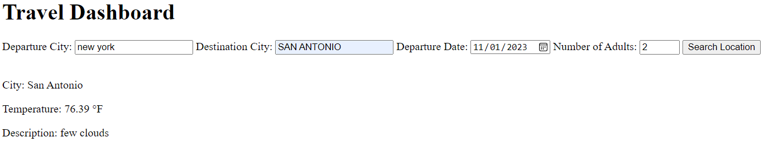
Part 1: Travel Dashboard Display
We start our adventure with the DrectWeather travel dashboard. At a glance, it displays essential information about your upcoming journey. You see your departure and destination details, departure date and choice in the number of adults traveling with you or otherwise. This real-time display ensures you’re well-prepared for your adventure!

Slide 4

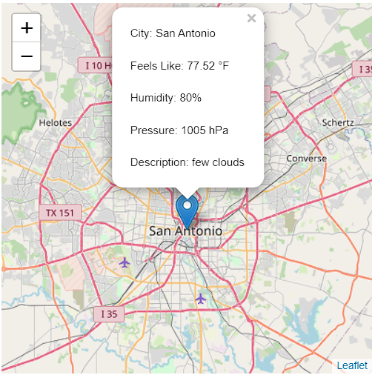

Part 2: Map Destination Metrics
As you delve deeper into your travel plans. DrectWeather provides an interactive map showcasing your destination. It’s not just any map; it’s a dynamic visualization that pinpoints your destination and displays nearby attractions. You can zoom in to explore local point of interest, making it easier to plan your adventures. Clicking the icon provides a general idea of weather forecasts for the destination city.

Slide 5
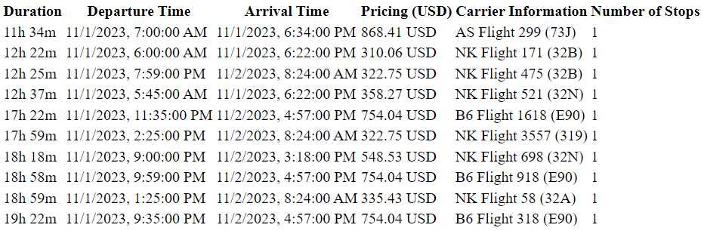
Part 3: Flight Tracker / Status Updates
Your journey is never complete without up-to-the-minute flight status updates. DrectWeather ensures you're always in the know with a live flight tracking feature. Currently displayed is the top 10 fastest flights headed to the destination city. The tracker displays your plane’s estimated duration, departure and arrival time, pricing, carrier information and total stops required.

Slide 6
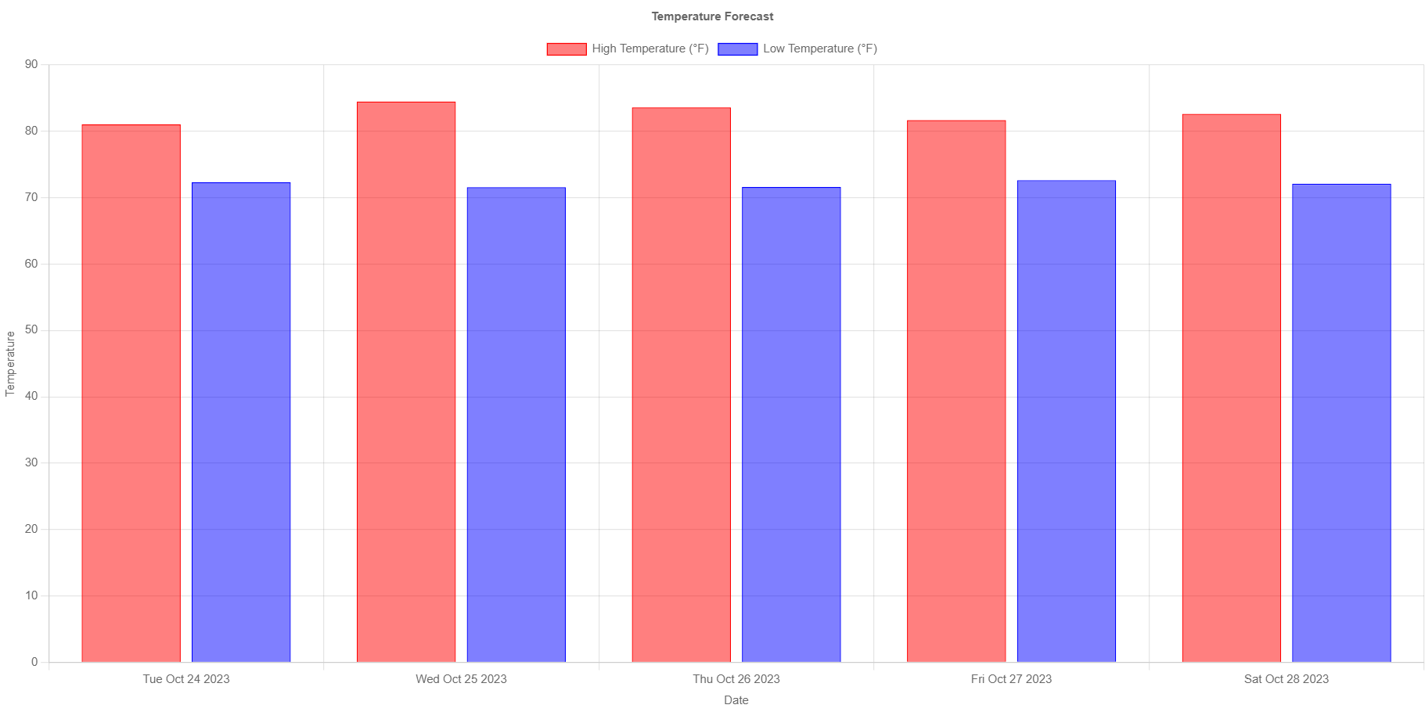
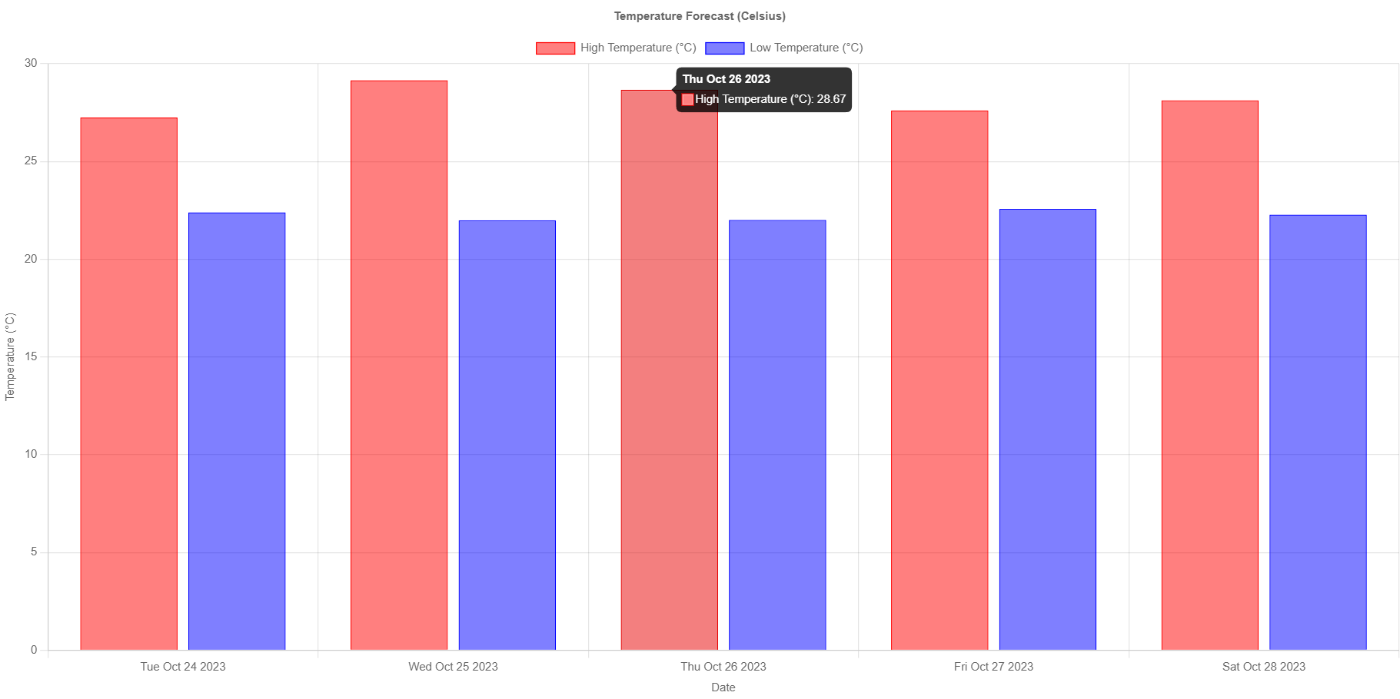
Part 4: Weather Insights Before Departure (Temps; F, C)
To plan for your journey effectively, DrectWeather equips you with a unique bar chart illustrating weather temperatures in the week leading up to your departure. The chart shows daily high and low temperatures, allowing you to pack and prepare for the conditions you'll encounter at your destination.

Slide 7

Conclusion
DrectWeather transforms travel and weather forecasting into an engaging experience. Its comprehensive data visualizations provide travelers with the tools they need to make the most of their journeys. From the travel dashboard to the interactive map, real-time flight status updates, and the insightful weather temperature chart, DrectWeather ensures your adventures are seamless, informed, and unforgettable. It’s time to set sail with DrectWeather, your key to exploring the world with clarity. Bon voyage!

Slide 8


And it’s a wrap!
Now to head over to the demo portion of this presentation. Thank you for listening.
Additional Data Sets for this project can be found here (IATA codes): https://www.nationsonline.org/oneworld/IATA_Codes/airport_code_list.htm

