Slide 1
Formal Verification with Lean
Ștefan-Octavian Radu
Advisor: Felix Herrmann
08.02.2024

Slide 2
Formal Verification
What is Formal Verification?
Proving through formal methods that a program behaves „as expected”.
Formal Methods?
the usage of mathematically rigorous techniques (i.e. proofs)
As Expected?
execution strictly follows a formal description of its behavior (specification)

Slide 3
Formal Verification
in the context of Programming Languages
formal modelling of the semantics (meaning) of the programming language
3 ways:
operational semantics
axiomatic semantics
denotational semantics

Slide 4
Axiomatic Semantics (Floyd-Hoare Logic)
useful for reasoning about concrete programs
framework for deducing valid formulas in a mechanical way
Hoare Triple:
(precondition) {P} C {Q} (postcondition)
(command)
“Whenever P holds before the execution of C, Q will hold after the execution, or C does not terminate”
thinking in terms of preconditions and postconditions
P, Q are formulas in first order logic
can only prove partial correctness

Slide 5



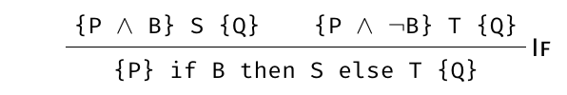
Axiomatic Semantics (Floyd-Hoare Logic)
based on derivation rules for an imperative programming language
etc.

Slide 6
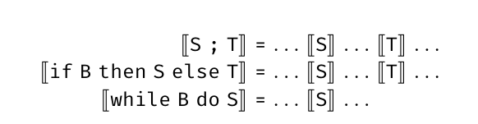
Denotational Semantics
“denotation” = the class of objects that a statement refers to (dict. def.)
describe meaning of programs (what a program means)
mapping to mathematical objects / functions
“idealised compiler”: source code to mathematics
compositionality
S, T on the right hand side of the equality only as arguments to ⟦⟧

Slide 7
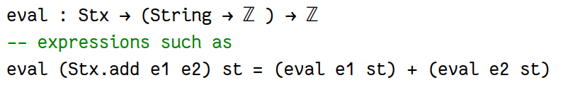
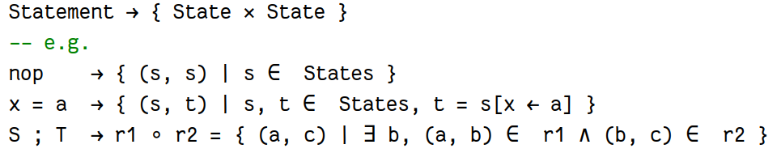
Denotational Semantics
For arithmetics
For a programming language
etc.

Slide 8
Operational Semantics
describes how a program is executed (what a program does)
big-step operational semantics (natural semantics)
transition from the initial state directly to the final state
(S, s) ⇒ t
Starting in a state s, executing S terminates in the state t
small-step operational semantics
transitions accounting for one step of execution
(S, s) ⇒ (T, t)
Starting in a state s and executing one step of S, leaves the program T to be executed in state t

Slide 9

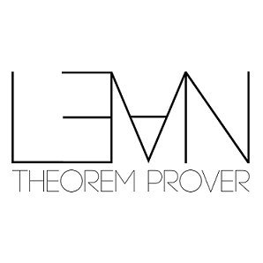

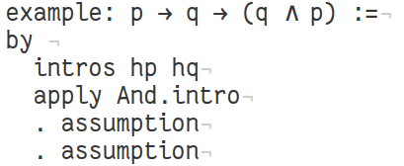
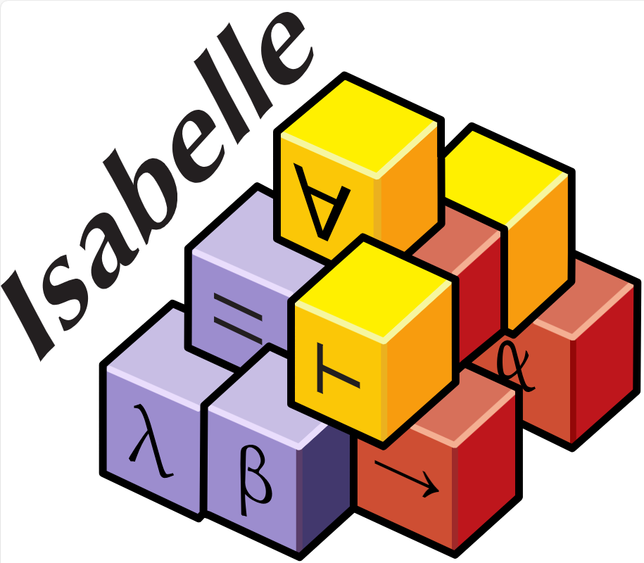

Proof Assistants / Interactive Theorem Provers
aid in the development of formal proofs
software tools:
Isabelle/HOL
Coq
Lean

Slide 10

About Lean
Interactive Theorem Prover
Developed at Microsoft Research
by Leonardo de Moura
also known for Z3 (smt solver), among others
Based on Dependent Type Theory
Also a standalone powerful general-purpose functional programming language
Lean is actually implemented in …
LEAN 🙀

Slide 11
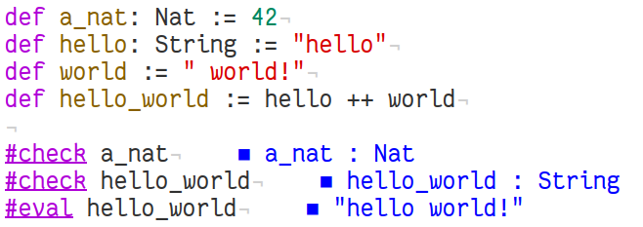
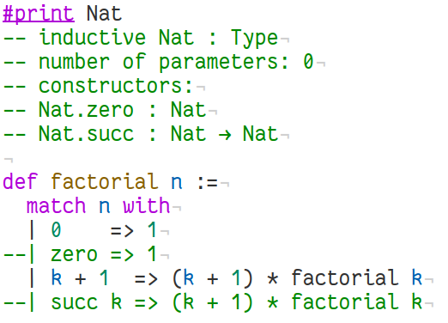
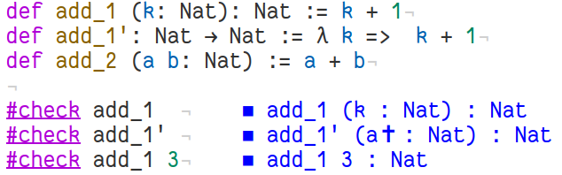
Functional programming in Lean
Functions and Definitions
simple definitions
Pattern Matching
functions in two ways

Slide 12
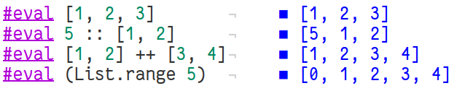
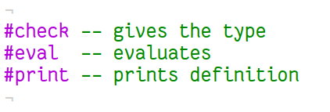
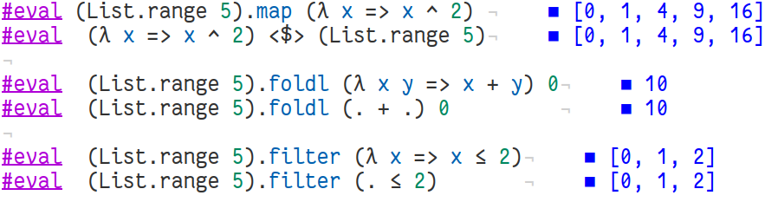
Functional programming in Lean
List operations
Special commands
Higher order functions
structures
type classes
inductive types
monads
…
etc.

Slide 13
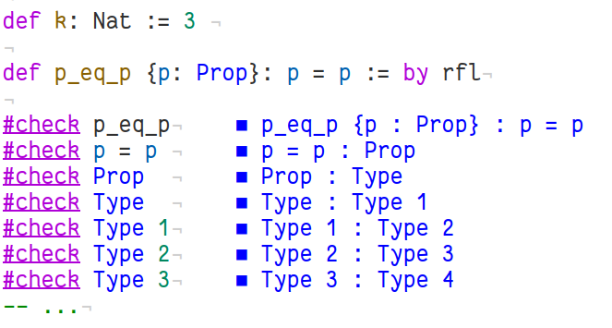
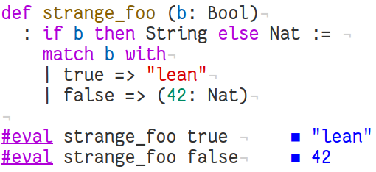
Dependent Types
Type Theory ⇒ Bertrand Russell
Types can depend of parameters
“Dependently typed programs are, by their nature, proof carrying code” - Altenkirch, McBride, McKinna, Why Dependent Types Matter

Slide 14
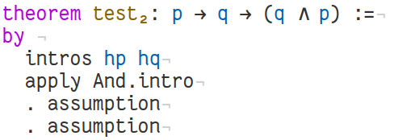



Tactic Mode

Slide 15
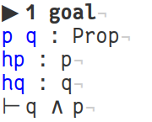
Tactic Mode

Slide 16
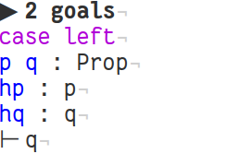
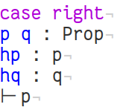
Tactic Mode

Slide 17
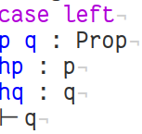

Tactic Mode

Slide 18

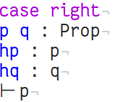
Tactic Mode

Slide 19
Big-Step Semantics
(S, s) ⇒ t
Starting in a state s, executing S terminates in the state t
…
what is S?

Slide 20
we need a programming language

Slide 21
Brainfuck
BF | Meaning
> | Increment the pointer.
< | Decrement the pointer.
+ | Increment the byte at the pointer.
- | Decrement the byte at the pointer.
. | Output the byte at the pointer.
, | Input a byte and store it in the byte at the pointer.
[ | Jump forward past the matching ] if the byte at the pointer is zero.
] | Jump backward to the matching [ unless the byte at the pointer is zero.
BF | C equivalent
> | ++p;
< | --p;
+ | ++*p;
- | --*p;
. | putchar(*p);
, | *p = getchar();
[ | while (*p) {
] | }

Slide 22
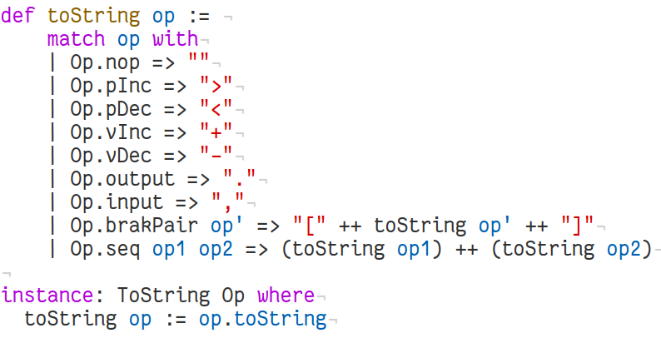
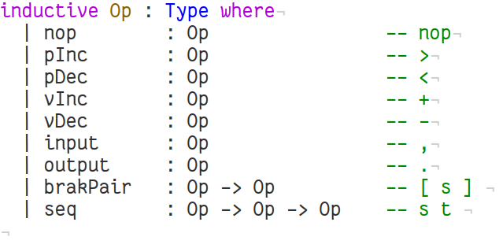
Define the Syntax

Slide 23
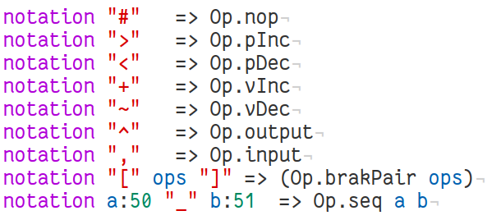
Define the Syntax

Slide 24
Big-Step Semantics
(S, s) ⇒ t
Starting in a state s, executing S terminates in the state t
…
what are s and t?

Slide 25
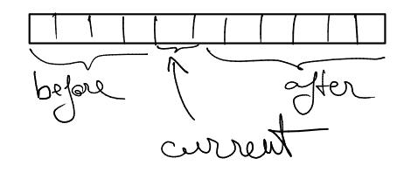
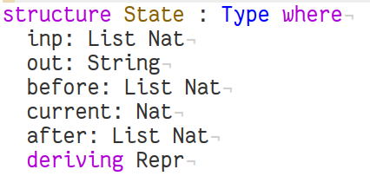
Define the state

Slide 26
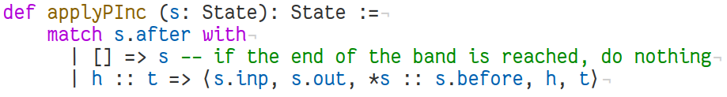
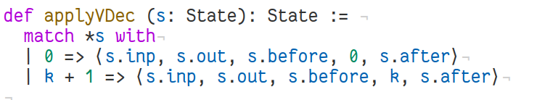
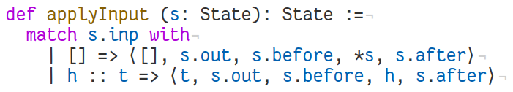
Define State Operations
>
–
etc.
;

Slide 27
Big-Step Semantics
(S, s) ⇒ t
Starting in a state s, executing S terminates in the state t
Derivation rules!
Warmup Theorem!

Slide 28
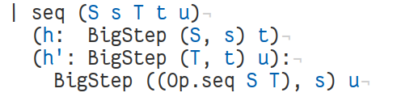

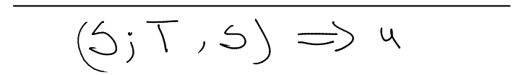

Proving Theorems
Warmup Theorem!

Slide 29
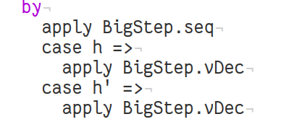

Proving Theorems
Warmup Theorem!

Slide 30
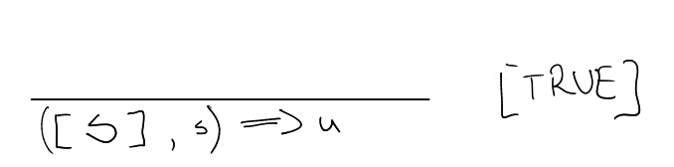

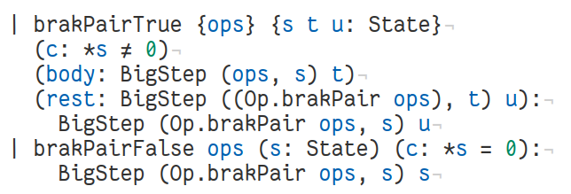
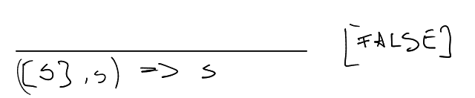
Proving Theorems

Slide 31
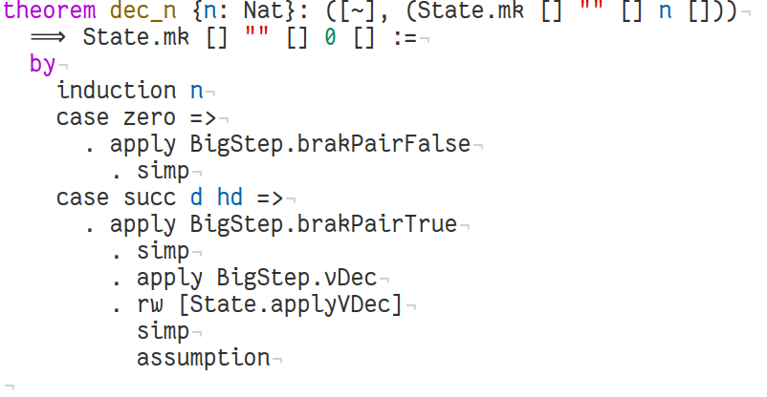
Proving Theorems

Slide 32
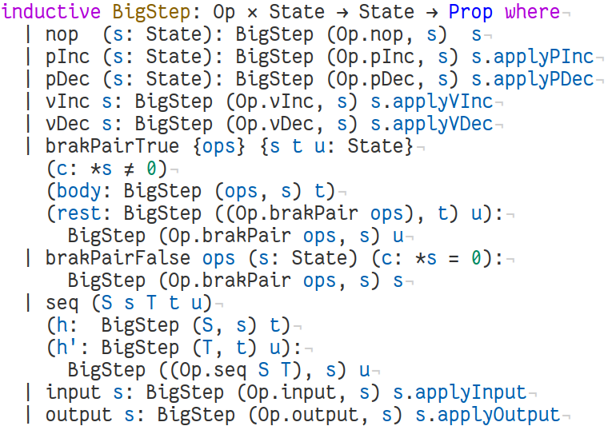
Complete Big-Step Semantics

Slide 33
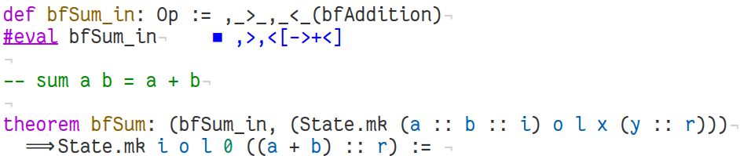
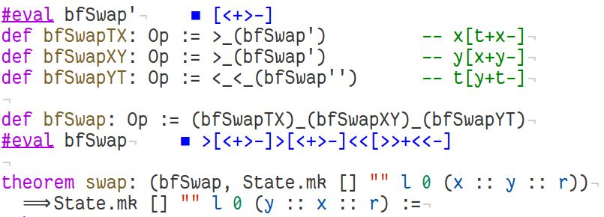
Other Theorems?

Slide 34
Termination

Slide 35
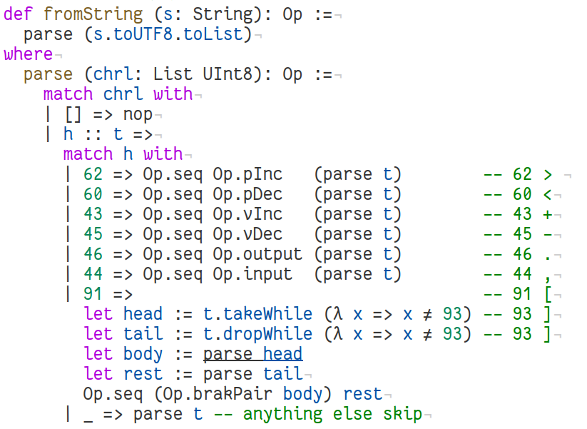
Termination

Slide 36
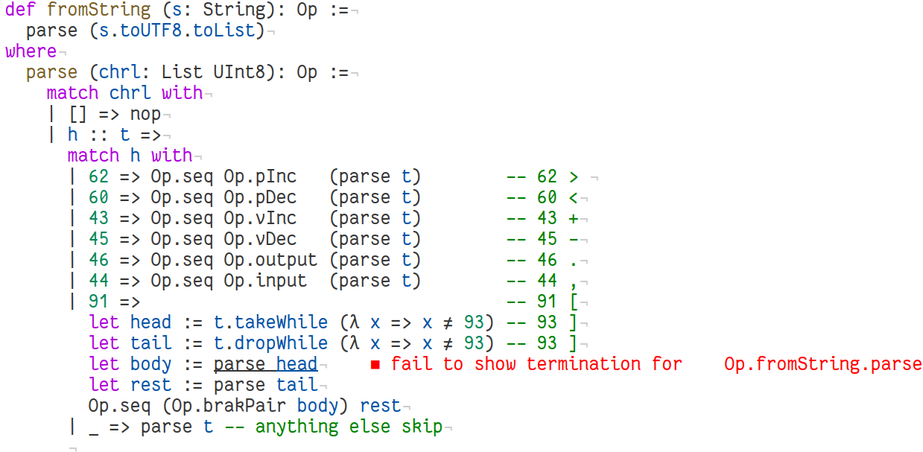
Termination

Slide 37
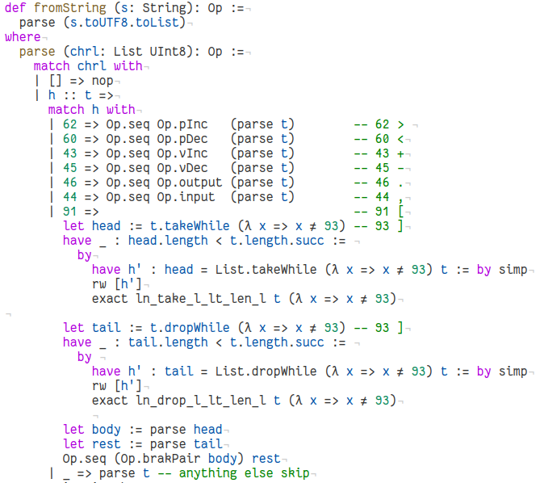
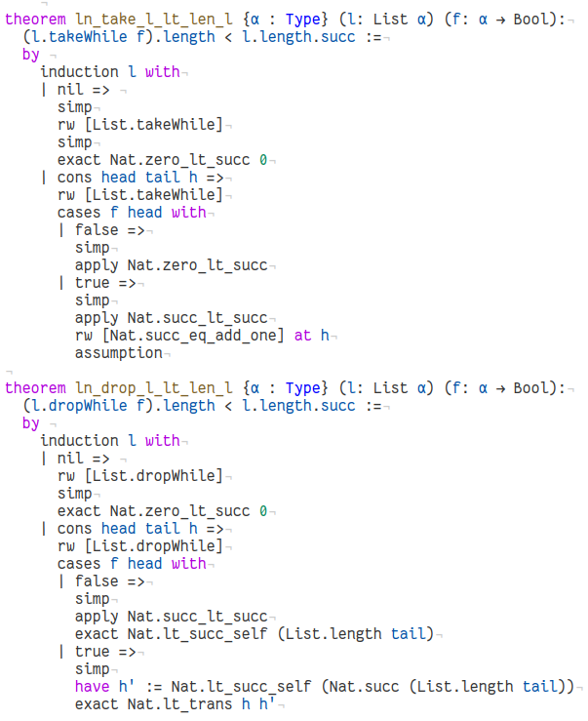
Termination

Slide 38
Termination
IT WORKS!!!
Only that it doesn’t 🙁

Slide 39
Resources
https://lean-lang.org/
https://adam.math.hhu.de/#/g/leanprover-community/nng4 https://leanprover-community.github.io/
https://github.com/leanprover-community/mathlib4
https://leanprover.zulipchat.com/

