Slide 1
Trusted Execution Environments
- an overview -
Ștefan-Octavian Radu
Advisor: Thomas Prantl
24.01.2024

Slide 2
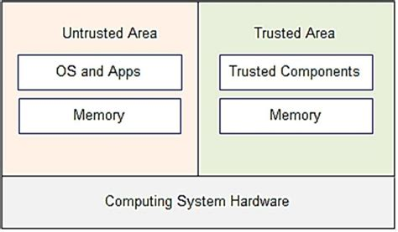
Key aspects
feature of modern processors
(hardware) isolated execution environment
integrity and privacy protection for
executed code
runtime states
stored data

Slide 3
Key Terms
Enclave
Trusted Computing Base (TCB)
Trusted Application (TA)
Trusted Execution Environment (TEE)
Trusted Platform Module (TPM)
Message Authentication Codes (MAC)
BUS

Slide 4
Hardware-based TEEs
most common, both in industry and in academia
spanning all architectures (Intel, AMD, ARM, RISC-V, etc.)
vast majority of applications run on:
Intel SGX
ARM TrustZone
4 security principles common across implementations
Verifiable Launch
Runtime Isolation
Secure Storage
Trusted IO

Slide 5
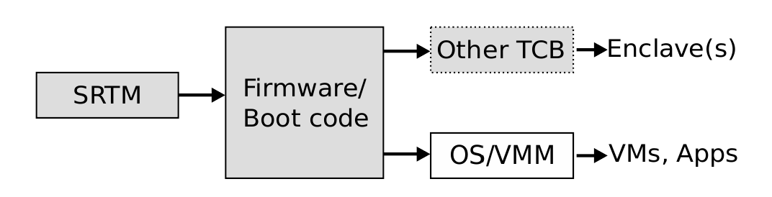
Verifiable Launch
Static Root of Trust Measurement (SRTM)
unbroken chain of trust since boot
hardware of immutable software
cannot guarantee mid-runtime state
Schneider et al. [3]

Slide 6
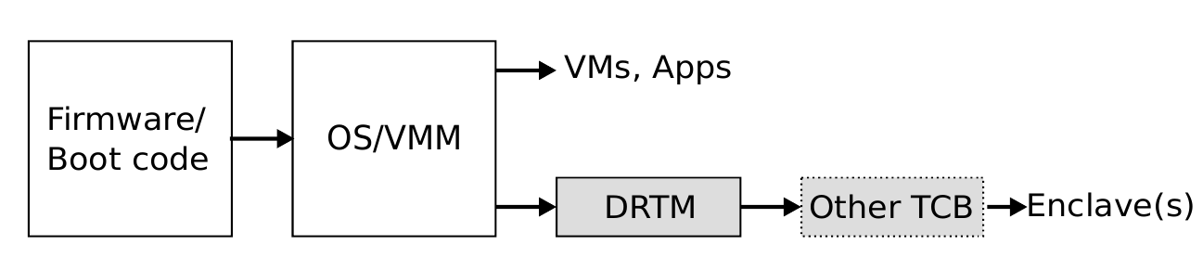
Verifiable Launch
Dynamic Root of Trust Measurement (DRTM)
does not trust prior execution
based on architectural extensions
freezing runtime → loading a signed module → TCB
Schneider et al. [3]

Slide 7
Verifiable Launch
Measurement
hashing the next component
storing the hash (TPM)
additional integrity checking (usually)
Attestation
a verifier checks the enclave upon starting
checks initial state, measurement and TCB against reference values
local / remote
Provisioning
optional steps of securely transferring secrets to the enclave

Slide 8
Runtime Isolation
CPU Isolation
secure context switch enforced by the TCB
saving the state
clearing the registers
loading of the next state
often based on architectural extensions or elevated privileges

Slide 9
Runtime Isolation
Memory Isolation
spatial partitioning
for TCB
enclaves with predictable requirements
spatio-temporal partitioning
dynamic reallocation of memory
access control
access control mechanism (MPU / MMU)
cryptographical means (esp. BUS)

Slide 10
Secure Storage
Sealing / Unsealing
encryption of state data across enclave instances
asymmetric key cryptography for (un)sealing a secret
symmetric key cryptography for (un)sealing data
most often based on TPM

Slide 11
Trusted IO
Trusted Path
secure communication channel between enclaves and external devices
memory access control of an external IO device
DMA
MMIO
end-to-end encryption
Trusted Architecture
strictly dependent on the external device

Slide 12
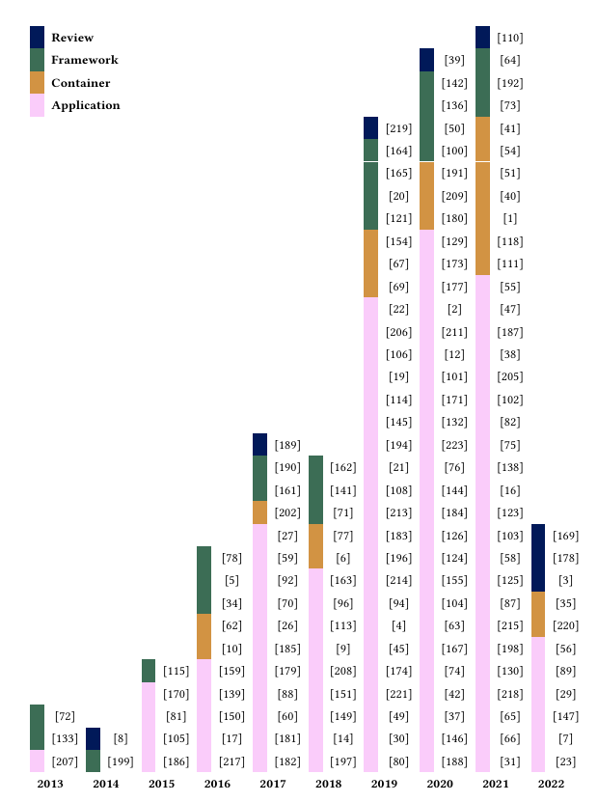
Usage
Steady increase in usage since 2013
from Paju et al.
[2]

Slide 13
Applications
Data analysis & Cloud
most data processing is done through AI
protection of sensitive information
healthcare data
financial data
protection against compromised infrastructure in the cloud
Authentication
Biometric (esp. on mobile devices)
fingerprint scanning
face recognition
voice recognition
storage of sensitive data
cryptographic private keys
ex. Apple passkey
Finance
Online payments
Mobile / Crypto Wallets
Peer-to-Peer (P2P) payments
point of sale terminals as mobile apps
blockchain clients

Slide 14
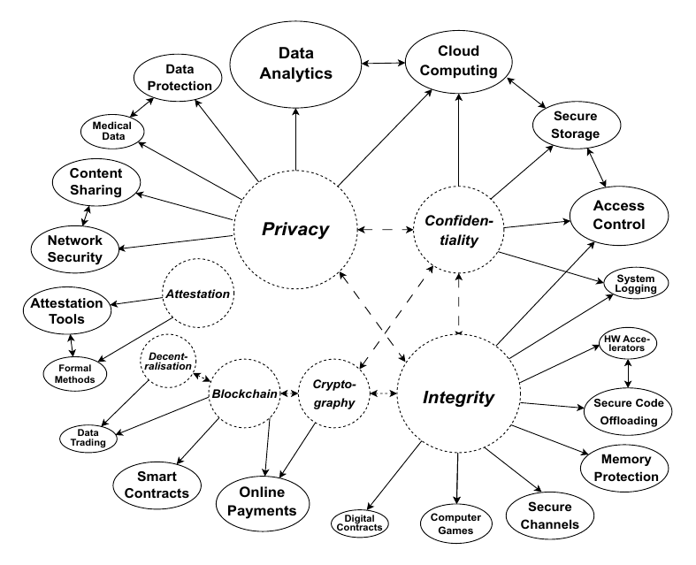
Applications
from Paju et al.
[2]

Slide 15
Application Development
Software development kits (SDKs)
majority (21 / 23) support either Intel SGX, or ARM TrustZone (or both)
two offer support for RISC-V (Keystone)
Limitations
SDK choice usually depends of the platform
developers often constrained to use proprietary tools (ex. Knox)
open source alternatives (ex. OP-TEE / Trusty TEE)
limited platform support
Programming language support
the majority support either C or C++
some offer Rust or even Go
Java support for android applications

Slide 16
Trusted Containers (Tcons)
Why?
adapting an app to run inside a TEE is difficult
framework-specific changes
architecture-specific changes
Downsides
increase the TCB
still limited platform support
mostly limited to Intel SGX
Solution
bridge the gap in TA development
run applications unmodified inside a TEE
automatic code modification

Slide 17
Vulnerabilities

Slide 18
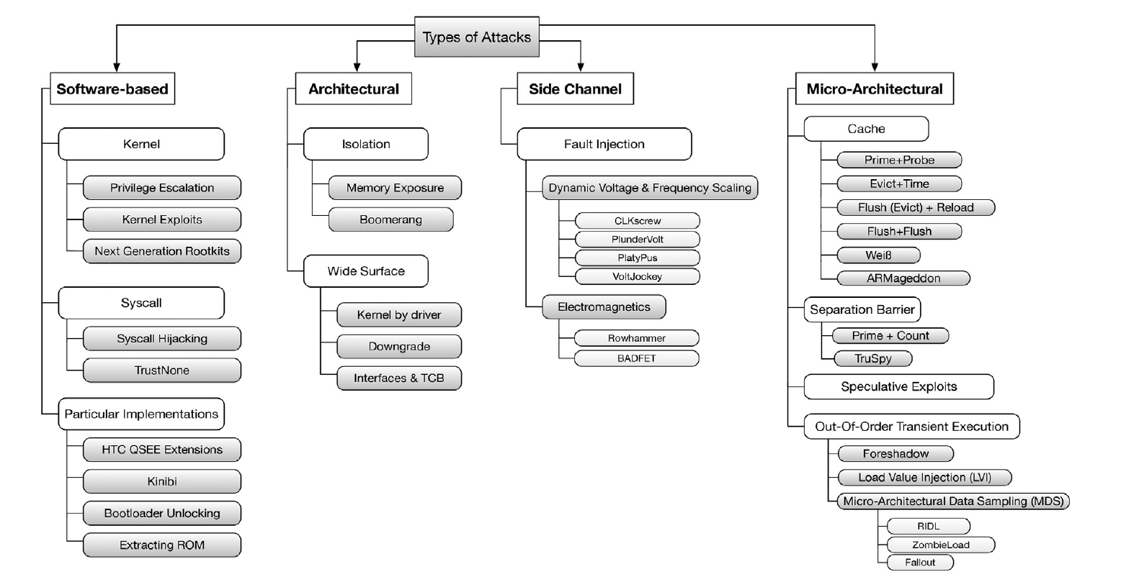
Vulnerabilities
from Muñoz et al.
[1]

Slide 19
References
Muñoz, A., Ríos, R., Román, R., López, J.: A survey on the (in)security of trusted execution en-vironments. Computers & Security 129, 103180 (2023), https://www.sciencedirect.com/science/article/pii/S0167404823000901
Paju, A., Javed, M.O., Nurmi, J., Savimäki, J., McGillion, B., Brumley, B.B.: Sok: A systematic review of tee usage for developing trusted applications. In: Proceedings of the 18th International Conference on Availability, Reliability and Security. ARES ’23, Association for Computing Machinery, New York, NY, USA (2023), https://doi.org/10.1145/3600160.3600169
Schneider, M., Masti, R.J., Shinde, S., Capkun, S., Perez, R.: Sok: Hardware-supported trusted execution environments (2022)

