Slide 1

advanced
JPA Entities

Slide 2

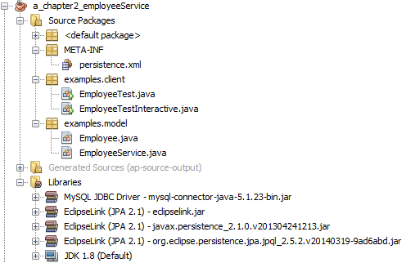
Specification: JSR-000220 Enterprise JavaBeans v.3.x Java Persistence API
advanced
JPA Entities
Transient
Removed
Persistent
Detached

Slide 3
Specification: JSR-000220 Enterprise JavaBeans v.3.x Java Persistence API
Entity Manager

Slide 4
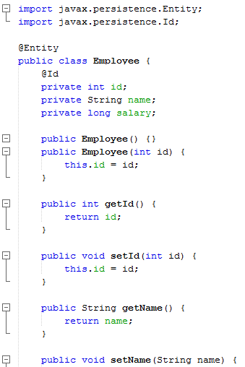
Specification: JSR-000220 Enterprise JavaBeans v.3.x Java Persistence API

Slide 5
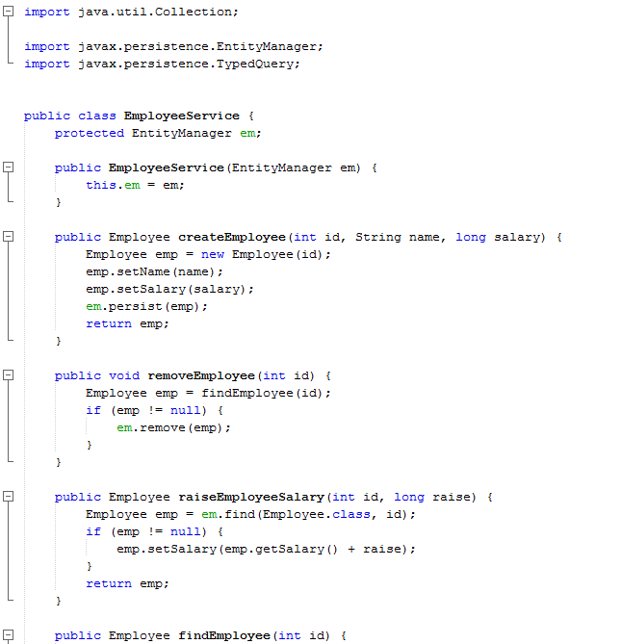
Specification: JSR-000220 Enterprise JavaBeans v.3.x Java Persistence API

Slide 6
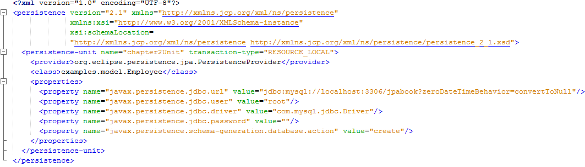
Specification: JSR-000220 Enterprise JavaBeans v.3.x Java Persistence API

Slide 7
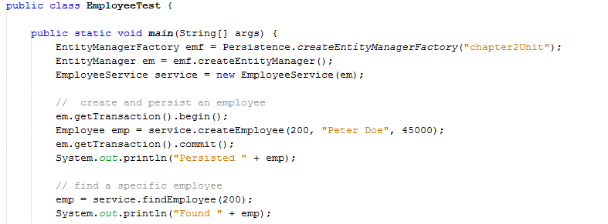
Specification: JSR-000220 Enterprise JavaBeans v.3.x Java Persistence API

Slide 8
Specification: JSR-000220 Enterprise JavaBeans v.3.x Java Persistence API

Slide 9
Specification: JSR-000220 Enterprise JavaBeans v.3.x Java Persistence API
@Entity
public class Employee {
@Id private int id;
private String name;
private long salary;
public Employee() {}
public Employee(int id) { this.id = id; }
public int getId() { return id; }
public void setId(int id) { this.id = id; }
public String getName() { return name; }
public void setName(String name) { this.name = name; }
public long getSalary() { return salary; }
public void setSalary (long salary) { this.salary = salary; }
}
@Entity
public class Employee {
@Id private int id;
private String name;
private long salary;
public Employee() {}
public Employee(int id) { this.id = id; }
public int getId() { return id; }
public void setId(int id) { this.id = id; }
public String getName() { return name; }
public void setName(String name) { this.name = name; }
public long getSalary() { return salary; }
public void setSalary (long salary) { this.salary = salary; }
}

Slide 10
Specification: JSR-000220 Enterprise JavaBeans v.3.x Java Persistence API
Creating an Entity
Adding these two annotations to the Employee class, we end up with an entity.
@Entity
public class Employee {
@Id private int id;
private String name;
private long salary;
public Employee() {}
public Employee(int id) { this.id = id; }
public int getId() { return id; }
public void setId(int id) { this.id = id; }
public String getName() { return name; }
public void setName(String name) { this.name = name; }
public long getSalary() { return salary; }
public void setSalary (long salary) { this.salary = salary; }
}
When we say that the @Id annotation is placed on the field or property, we mean
that the user can choose to annotate either the declared field or the getter method.
Annotations on setter methods will just be ignored

Slide 11
Specification: JSR-000220 Enterprise JavaBeans v.3.x Java Persistence API
Creating an Entity
Adding these two annotations to the Employee class, we end up with an entity.
@Entity
public class Employee {
@Id private int id;
private String name;
private long salary;
public Employee() {}
public Employee(int id) { this.id = id; }
public int getId() { return id; }
public void setId(int id) { this.id = id; }
public String getName() { return name; }
public void setName(String name) { this.name = name; }
public long getSalary() { return salary; }
public void setSalary (long salary) { this.salary = salary; }
}
When we say that the @Id annotation is placed on the field or property, we mean
that the user can choose to annotate either the declared field or the getter method.
Annotations on setter methods will just be ignored

Slide 12
Specification: JSR-000220 Enterprise JavaBeans v.3.x Java Persistence API
Creating an Entity
Adding these two annotations to the Employee class, we end up with an entity.
@Entity
public class Employee {
@Id private int id;
private String name;
private long salary;
public Employee() {}
public Employee(int id) { this.id = id; }
public int getId() { return id; }
public void setId(int id) { this.id = id; }
public String getName() { return name; }
public void setName(String name) { this.name = name; }
public long getSalary() { return salary; }
public void setSalary (long salary) { this.salary = salary; }
}
When we say that the @Id annotation is placed on the field or property, we mean
that the user can choose to annotate either the declared field or the getter method.
Annotations on setter methods will just be ignored

Slide 13
Specification: JSR-000220 Enterprise JavaBeans v.3.x Java Persistence API
Creating an Entity
Attributes that are part of a persistent entity but not intended to be
persistent can either be annotated with the @Transient annotation.
@Entity
public class Employee {
@Id private int id;
private String name;
private long salary;
public Employee() {}
public Employee(int id) { this.id = id; }
public int getId() { return id; }
public void setId(int id) { this.id = id; }
public String getName() { return name; }
public void setName(String name) { this.name = name; }
public long getSalary() { return salary; }
public void setSalary (long salary) { this.salary = salary; }
}
When we say that the @Id annotation is placed on the field or property, we mean
that the user can choose to annotate either the declared field or the getter method.
Annotations on setter methods will just be ignored

Slide 14
Specification: JSR-000220 Enterprise JavaBeans v.3.x Java Persistence API
Creating an Entity
the entity name will be defaulted to “Employee” and all entities of type
Employee will get stored in a table called EMPLOYEE
@Entity ( name= … )
public class Employee {
@Id private int id;
private String name;
private long salary;
public Employee() {}
public Employee(int id) { this.id = id; }
public int getId() { return id; }
public void setId(int id) { this.id = id; }
public String getName() { return name; }
public void setName(String name) { this.name = name; }
public long getSalary() { return salary; }
public void setSalary (long salary) { this.salary = salary; }
}
When we say that the @Id annotation is placed on the field or property, we mean
that the user can choose to annotate either the declared field or the getter method.
Annotations on setter methods will just be ignored

Slide 15
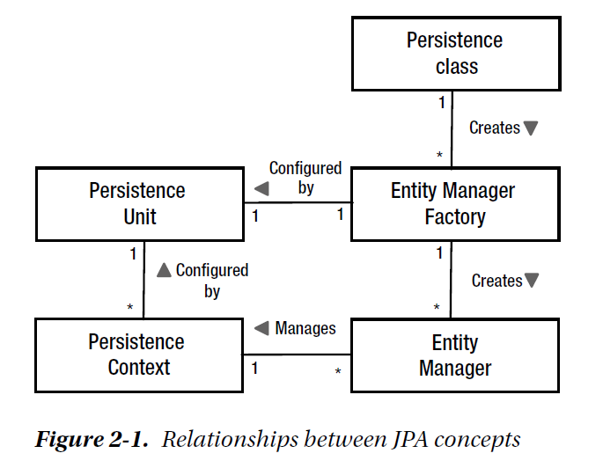
Specification: JSR-000220 Enterprise JavaBeans v.3.x Java Persistence API
Entity Manager
@Entity
public class Employee {
…

Slide 16
Specification: JSR-000220 Enterprise JavaBeans v.3.x Java Persistence API
Entity Manager
@Entity
public class Employee {
…

Slide 17

Specification: JSR-000220 Enterprise JavaBeans v.3.x Java Persistence API
Entity Manager

Slide 18
Specification: JSR-000220 Enterprise JavaBeans v.3.x Java Persistence API
Entity Manager

Slide 19
Specification: JSR-000220 Enterprise JavaBeans v.3.x Java Persistence API
Entity Manager

Slide 20
Specification: JSR-000220 Enterprise JavaBeans v.3.x Java Persistence API
Entity Manager

Slide 21
Specification: JSR-000220 Enterprise JavaBeans v.3.x Java Persistence API
Entity Manager
All entity managers come from factories of type javax.persistence.EntityManagerFactory

Slide 22
Specification: JSR-000220 Enterprise JavaBeans v.3.x Java Persistence API
Entity Manager
All entity managers come from factories of type javax.persistence.EntityManagerFactory

Slide 23
Specification: JSR-000220 Enterprise JavaBeans v.3.x Java Persistence API
Entity Manager
All entity managers come from factories of type javax.persistence.EntityManagerFactory

Slide 24

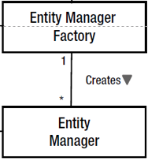
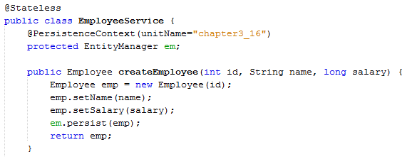
SE
JEE

Slide 25
SE
JEE

Slide 26
SE
JEE

Slide 27
SE
JEE

Slide 28
SE
JEE

Slide 29
SE
JEE

Slide 30
SE
JEE

Slide 31
SE
JEE

Slide 32
SE
JEE

Slide 33
The configuration for an entity manager is defined as a persistence unit.
SE
JEE

Slide 34
Specification: JSR-000220 Enterprise JavaBeans v.3.x Java Persistence API
Entity Manager
The configuration for an entity manager is defined as a persistence unit.

Slide 35
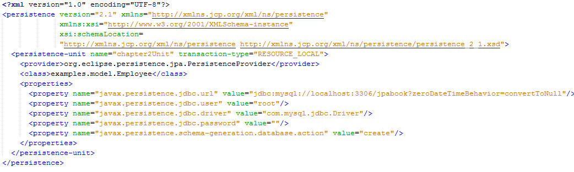
Specification: JSR-000220 Enterprise JavaBeans v.3.x Java Persistence API
Entity Manager
The configuration for an entity manager is defined as a persistence unit.

Slide 36
Specification: JSR-000220 Enterprise JavaBeans v.3.x Java Persistence API
Entity Manager

Slide 37
Specification: JSR-000220 Enterprise JavaBeans v.3.x Java Persistence API
Entity Manager

Slide 38
Specification: JSR-000220 Enterprise JavaBeans v.3.x Java Persistence API
Entity Manager

Slide 39
Specification: JSR-000220 Enterprise JavaBeans v.3.x Java Persistence API
Entity Manager

Slide 40
Specification: JSR-000220 Enterprise JavaBeans v.3.x Java Persistence API
Entity Manager

Slide 41
Specification: JSR-000220 Enterprise JavaBeans v.3.x Java Persistence API
Entity Manager

Slide 42
Specification: JSR-000220 Enterprise JavaBeans v.3.x Java Persistence API
Entity Manager

Slide 43
Specification: JSR-000220 Enterprise JavaBeans v.3.x Java Persistence API
Entity Manager

Slide 44
Specification: JSR-000220 Enterprise JavaBeans v.3.x Java Persistence API
Entity Manager

Slide 45
Specification: JSR-000220 Enterprise JavaBeans v.3.x Java Persistence API
Entity Manager
Configured factory object used to obtain entity managers

Slide 46
Specification: JSR-000220 Enterprise JavaBeans v.3.x Java Persistence API
Entity Manager
Configured factory object used to obtain entity managers

Slide 47
Specification: JSR-000220 Enterprise JavaBeans v.3.x Java Persistence API
Entity Manager
Configured factory object used to obtain entity managers

Slide 48
Specification: JSR-000220 Enterprise JavaBeans v.3.x Java Persistence API
Entity Manager
Main API object used to perform operations and queries on entities

Slide 49
Specification: JSR-000220 Enterprise JavaBeans v.3.x Java Persistence API
Entity Manager
Named configuration declaring the entity classes and data store info

Slide 50

Specification: JSR-000220 Enterprise JavaBeans v.3.x Java Persistence API
Entity Manager
Set of all entity instances managed by a specific entity manager

Slide 51
Specification: JSR-000220 Enterprise JavaBeans v.3.x Java Persistence API
Entity Manager
Set of all entity instances managed by a specific entity manager

Slide 52
Specification: JSR-000220 Enterprise JavaBeans v.3.x Java Persistence API
Entity Manager
Set of all entity instances managed by a specific entity manager

Slide 53
Specification: JSR-000220 Enterprise JavaBeans v.3.x Java Persistence API
Entity Manager
Set of all entity instances managed by a specific entity manager

Slide 54
Specification: JSR-000220 Enterprise JavaBeans v.3.x Java Persistence API

Slide 55
Specification: JSR-000220 Enterprise JavaBeans v.3.x Java Persistence API

Slide 56
Specification: JSR-000220 Enterprise JavaBeans v.3.x Java Persistence API

Slide 57
Specification: JSR-000220 Enterprise JavaBeans v.3.x Java Persistence API
Entity Manager
public Employee createEmployee(int id, String name, long salary) {
Employee emp = new Employee(id);
emp.setName(name);
emp.setSalary(salary);
em.persist(emp);
return emp;
}
When the persist( ) call completes, emp will
have become a managed entity within the entity
manager’s persistence context.
Calling persist( ) is all that is required to initiate it being persisted in the database.

Slide 58
Specification: JSR-000220 Enterprise JavaBeans v.3.x Java Persistence API
Entity Manager
public Employee createEmployee(int id, String name, long salary) {
Employee emp = new Employee(id);
emp.setName(name);
emp.setSalary(salary);
em.persist(emp);
return emp;
}
When the persist( ) call completes, emp will
have become a managed entity within the entity
manager’s persistence context.
Calling persist( ) is all that is required to initiate it being persisted in the database.

Slide 59
Specification: JSR-000220 Enterprise JavaBeans v.3.x Java Persistence API
Entity Manager
public Employee createEmployee(int id, String name, long salary) {
Employee emp = new Employee(id);
emp.setName(name);
emp.setSalary(salary);
em.persist(emp);
return emp;
}
When the persist( ) call completes, emp will
have become a managed entity within the entity
manager’s persistence context.
Calling persist( ) is all that is required to initiate it being persisted in the database.

Slide 60
Specification: JSR-000220 Enterprise JavaBeans v.3.x Java Persistence API
Entity Manager
public Employee createEmployee(int id, String name, long salary) {
Employee emp = new Employee(id);
emp.setName(name);
emp.setSalary(salary);
em.persist(emp);
return emp;
}
When the persist( ) call completes, emp will
have become a managed entity within the entity
manager’s persistence context.
Calling persist( ) is all that is required to initiate it being persisted in the database.

Slide 61
Specification: JSR-000220 Enterprise JavaBeans v.3.x Java Persistence API
Entity Manager
and the id or primary key that identifies the particular entity
We are passing in the class of the entity that is being sought
Employee emp = em.find(Employee.class, 158);
Once an entity is in the database, the next thing one typically wants to do is find it again.

Slide 62
Specification: JSR-000220 Enterprise JavaBeans v.3.x Java Persistence API
Entity Manager
and the id or primary key that identifies the particular entity
We are passing in the class of the entity that is being sought
Employee emp = em.find(Employee.class, 158);
Once an entity is in the database, the next thing one typically wants to do is find it again.

Slide 63
Specification: JSR-000220 Enterprise JavaBeans v.3.x Java Persistence API
Entity Manager
and the id or primary key that identifies the particular entity
We are passing in the class of the entity that is being sought
Employee emp = em.find(Employee.class, 158);
Once an entity is in the database, the next thing one typically wants to do is find it again.

Slide 64
Specification: JSR-000220 Enterprise JavaBeans v.3.x Java Persistence API
Entity Manager
and the id or primary key that identifies the particular entity
We are passing in the class of the entity that is being sought
Employee emp = em.find(Employee.class, 158);
When the call completes, the employee that gets returned will be a managed entity, meaning
that it will exist in the current persistence context associated with the entity manager

Slide 65
Specification: JSR-000220 Enterprise JavaBeans v.3.x Java Persistence API
Entity Manager
and the id or primary key that identifies the particular entity
We are passing in the class of the entity that is being sought
Employee emp = em.find(Employee.class, 158);
When the call completes, the employee that gets returned will be a managed entity, meaning
that it will exist in the current persistence context associated with the entity manager

Slide 66
Specification: JSR-000220 Enterprise JavaBeans v.3.x Java Persistence API
Entity Manager
and the id or primary key that identifies the particular entity
We are passing in the class of the entity that is being sought
Employee emp = em.find(Employee.class, 158);
When the call completes, the employee that gets returned will be a managed entity, meaning
that it will exist in the current persistence context associated with the entity manager

Slide 67
Specification: JSR-000220 Enterprise JavaBeans v.3.x Java Persistence API
Entity Manager
and the id or primary key that identifies the particular entity
We are passing in the class of the entity that is being sought
Employee emp = em.find(Employee.class, 158);
In the event that the object was not found, then the find( ) call simply returns null.
When the call completes, the employee that gets returned will be a managed entity, meaning
that it will exist in the current persistence context associated with the entity manager

Slide 68
Specification: JSR-000220 Enterprise JavaBeans v.3.x Java Persistence API
Entity Manager
This means that the calling application should have already loaded or accessed the entity and is now issuing
a command to remove it.
Employee emp = em.find(Employee.class, 158);
em.remove(emp);
In order to remove an entity, the entity itself must be managed, meaning that it is present in the persistence context.

Slide 69
Specification: JSR-000220 Enterprise JavaBeans v.3.x Java Persistence API
Entity Manager
This means that the calling application should have already loaded or accessed the entity and is now issuing
a command to remove it.
Employee emp = em.find(Employee.class, 158);
em.remove(emp);
In order to remove an entity, the entity itself must be managed, meaning that it is present in the persistence context.

Slide 70
Specification: JSR-000220 Enterprise JavaBeans v.3.x Java Persistence API
Entity Manager
This means that the calling application should have already loaded or accessed the entity and is now issuing
a command to remove it.
Employee emp = em.find(Employee.class, 158);
em.remove(emp);
In order to remove an entity, the entity itself must be managed, meaning that it is present in the persistence context.

Slide 71
Specification: JSR-000220 Enterprise JavaBeans v.3.x Java Persistence API
Entity Manager
This means that the calling application should have already loaded or accessed the entity and is now issuing
a command to remove it.
Employee emp = em.find(Employee.class, 158);
em.remove(emp);
In this example, we are first finding the entity using the find( ) call, which returns a managed instance of Employee, and then removing the entity using the remove( ) call on the entity manager.
In order to remove an entity, the entity itself must be managed, meaning that it is present in the persistence context.

Slide 72
Specification: JSR-000220 Enterprise JavaBeans v.3.x Java Persistence API
Entity Manager
This means that the calling application should have already loaded or accessed the entity and is now issuing
a command to remove it.
Employee emp = em.find(Employee.class, 158);
em.remove(emp);
In this example, we are first finding the entity using the find( ) call, which returns a managed instance of Employee, and then removing the entity using the remove( ) call on the entity manager.
In order to remove an entity, the entity itself must be managed, meaning that it is present in the persistence context.

Slide 73
Specification: JSR-000220 Enterprise JavaBeans v.3.x Java Persistence API
Entity Manager
This means that the calling application should have already loaded or accessed the entity and is now issuing
a command to remove it.
Employee emp = em.find(Employee.class, 158);
em.remove(emp);
In this example, we are first finding the entity using the find( ) call, which returns a managed instance of Employee, and then removing the entity using the remove( ) call on the entity manager.
In order to remove an entity, the entity itself must be managed, meaning that it is present in the persistence context.

Slide 74
Specification: JSR-000220 Enterprise JavaBeans v.3.x Java Persistence API
Entity Manager
Note the difference between this operation and the others. In this case we are not calling
into the entity manager to modify the object, but directly calling the object itself.
Employee emp = em.find(Employee.class, 158);
emp.setSalary(emp.getSalary() + 1000);
update
There are a few different ways of updating an entity, but for
now we will illustrate the simplest and most common case.

Slide 75
Specification: JSR-000220 Enterprise JavaBeans v.3.x Java Persistence API
Entity Manager
Note the difference between this operation and the others. In this case we are not calling
into the entity manager to modify the object, but directly calling the object itself.
Employee emp = em.find(Employee.class, 158);
emp.setSalary(emp.getSalary() + 1000);
update
There are a few different ways of updating an entity, but for
now we will illustrate the simplest and most common case.

Slide 76
Specification: JSR-000220 Enterprise JavaBeans v.3.x Java Persistence API
Entity Manager
Note the difference between this operation and the others. In this case we are not calling
into the entity manager to modify the object, but directly calling the object itself.
Employee emp = em.find(Employee.class, 158);
emp.setSalary(emp.getSalary() + 1000);
update
There are a few different ways of updating an entity, but for
now we will illustrate the simplest and most common case.

Slide 77
Specification: JSR-000220 Enterprise JavaBeans v.3.x Java Persistence API
Entity Manager
Note the difference between this operation and the others. In this case we are not calling
into the entity manager to modify the object, but directly calling the object itself.
Employee emp = em.find(Employee.class, 158);
emp.setSalary(emp.getSalary() + 1000);
update
There are a few different ways of updating an entity, but for
now we will illustrate the simplest and most common case.

Slide 78
Specification: JSR-000220 Enterprise JavaBeans v.3.x Java Persistence API
Entity Manager
Note the difference between this operation and the others. In this case we are not calling
into the entity manager to modify the object, but directly calling the object itself.
Employee emp = em.find(Employee.class, 158);
emp.setSalary(emp.getSalary() + 1000);
update
There are a few different ways of updating an entity, but for
now we will illustrate the simplest and most common case.

Slide 79
Specification: JSR-000220 Enterprise JavaBeans v.3.x Java Persistence API
Entity Manager
Note the difference between this operation and the others. In this case we are not calling
into the entity manager to modify the object, but directly calling the object itself.
Employee emp = em.find(Employee.class, 158);
emp.setSalary(emp.getSalary() + 1000);
There are a few different ways of updating an entity, but for
now we will illustrate the simplest and most common case.
This is where we have a managed entity and want to make changes to it

Slide 80
Specification: JSR-000220 Enterprise JavaBeans v.3.x Java Persistence API
Entity Manager
Note the difference between this operation and the others. In this case we are not calling
into the entity manager to modify the object, but directly calling the object itself.
Note the difference between this operation and the others.
Employee emp = em.find(Employee.class, 158);
emp.setSalary(emp.getSalary() + 1000);
There are a few different ways of updating an entity, but for
now we will illustrate the simplest and most common case.
This is where we have a managed entity and want to make changes to it

Slide 81
Specification: JSR-000220 Enterprise JavaBeans v.3.x Java Persistence API
Entity Manager
Note the difference between this operation and the others. In this case we are not calling
into the entity manager to modify the object, but directly calling the object itself.
Employee emp = em.find(Employee.class, 158);
emp.setSalary(emp.getSalary() + 1000);
There are a few different ways of updating an entity, but for
now we will illustrate the simplest and most common case.
This is where we have a managed entity and want to make changes to it

Slide 82
Specification: JSR-000220 Enterprise JavaBeans v.3.x Java Persistence API
Entity Manager
Note the difference between this operation and the others. In this case we are not calling
into the entity manager to modify the object, but directly calling the object itself.
Employee emp = em.find(Employee.class, 158);
emp.setSalary(emp.getSalary() + 1000);
There are a few different ways of updating an entity, but for
now we will illustrate the simplest and most common case.
This is where we have a managed entity and want to make changes to it

Slide 83
Specification: JSR-000220 Enterprise JavaBeans v.3.x Java Persistence API
Entity Manager
Note the difference between this operation and the others. In this case we are not calling
into the entity manager to modify the object, but directly calling the object itself.
Employee emp = em.find(Employee.class, 158);
emp.setSalary(emp.getSalary() + 1000);
For this reason it is important that the entity be a managed instance;
otherwise, the persistence provider will have no means of detecting the change,
and no changes will be made to the persistent representation of the employee.

Slide 84
Specification: JSR-000220 Enterprise JavaBeans v.3.x Java Persistence API
Entity Manager
Note the difference between this operation and the others. In this case we are not calling
into the entity manager to modify the object, but directly calling the object itself.
Employee emp = em.find(Employee.class, 158);
emp.setSalary(emp.getSalary() + 1000);
For this reason it is important that the entity be a managed instance;
otherwise, the persistence provider will have no means of detecting the change,
and no changes will be made to the persistent representation of the employee.

Slide 85
Specification: JSR-000220 Enterprise JavaBeans v.3.x Java Persistence API
Entity Manager
Note the difference between this operation and the others. In this case we are not calling
into the entity manager to modify the object, but directly calling the object itself.
Employee emp = em.find(Employee.class, 158);
emp.setSalary(emp.getSalary() + 1000);
For this reason it is important that the entity be a managed instance;
otherwise, the persistence provider will have no means of detecting the change,
and no changes will be made to the persistent representation of the employee.

Slide 86
Specification: JSR-000220 Enterprise JavaBeans v.3.x Java Persistence API
Entity Manager

Slide 87
Specification: JSR-000220 Enterprise JavaBeans v.3.x Java Persistence API

Slide 88
Specification: JSR-000220 Enterprise JavaBeans v.3.x Java Persistence API

Slide 89
Specification: JSR-000220 Enterprise JavaBeans v.3.x Java Persistence API

Slide 90
Specification: JSR-000220 Enterprise JavaBeans v.3.x Java Persistence API

Slide 91
Specification: JSR-000220 Enterprise JavaBeans v.3.x Java Persistence API

Slide 92
Specification: JSR-000220 Enterprise JavaBeans v.3.x Java Persistence API
The find( ) call is not a mutating operation, so it may be called any time, with or without a transaction.

Slide 93
Specification: JSR-000220 Enterprise JavaBeans v.3.x Java Persistence API
The find( ) call is not a mutating operation, so it may be called any time, with or without a transaction.

Slide 94
Specification: JSR-000220 Enterprise JavaBeans v.3.x Java Persistence API
The find( ) call is not a mutating operation, so it may be called any time, with or without a transaction.

Slide 95
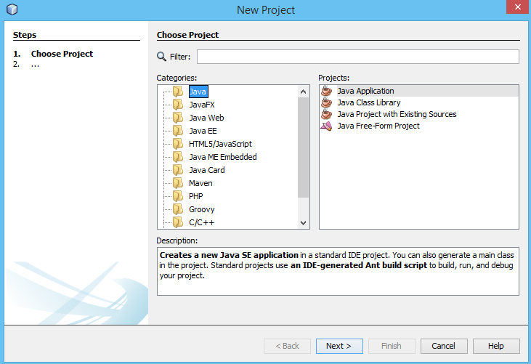
Specification: JSR-000220 Enterprise JavaBeans v.3.x Java Persistence API

Slide 96
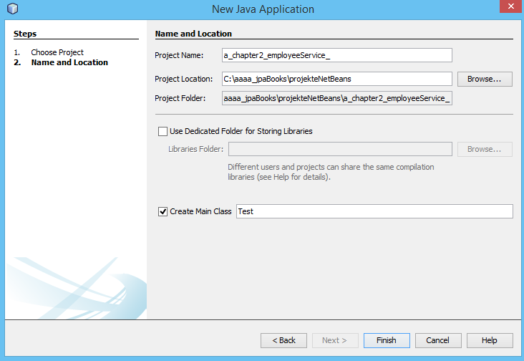
Specification: JSR-000220 Enterprise JavaBeans v.3.x Java Persistence API

Slide 97
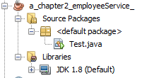
Specification: JSR-000220 Enterprise JavaBeans v.3.x Java Persistence API

Slide 98
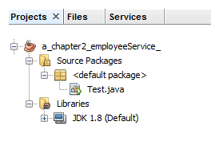
Specification: JSR-000220 Enterprise JavaBeans v.3.x Java Persistence API

Slide 99
Specification: JSR-000220 Enterprise JavaBeans v.3.x Java Persistence API

Slide 100
Specification: JSR-000220 Enterprise JavaBeans v.3.x Java Persistence API

Slide 101
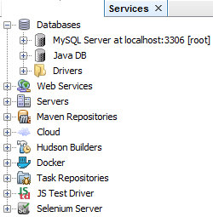
Specification: JSR-000220 Enterprise JavaBeans v.3.x Java Persistence API

Slide 102
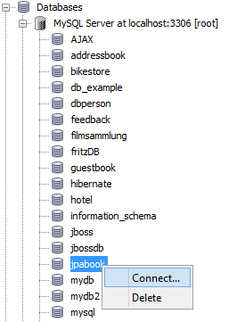
Specification: JSR-000220 Enterprise JavaBeans v.3.x Java Persistence API

Slide 103
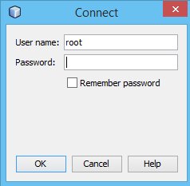
Specification: JSR-000220 Enterprise JavaBeans v.3.x Java Persistence API

Slide 104
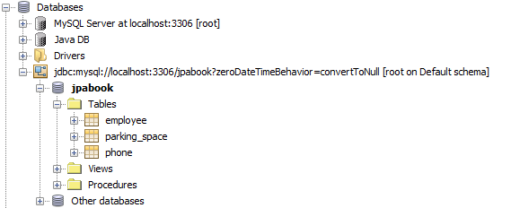
Specification: JSR-000220 Enterprise JavaBeans v.3.x Java Persistence API

Slide 105
Specification: JSR-000220 Enterprise JavaBeans v.3.x Java Persistence API

Slide 106
Specification: JSR-000220 Enterprise JavaBeans v.3.x Java Persistence API

Slide 107
Specification: JSR-000220 Enterprise JavaBeans v.3.x Java Persistence API

Slide 108
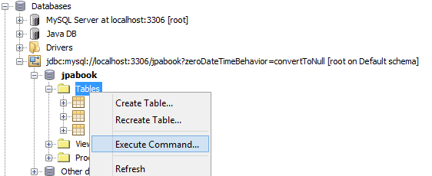
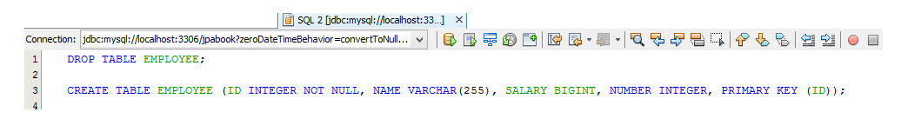
Specification: JSR-000220 Enterprise JavaBeans v.3.x Java Persistence API

Slide 109
Specification: JSR-000220 Enterprise JavaBeans v.3.x Java Persistence API

Slide 110
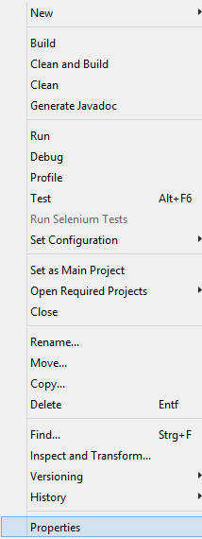
Specification: JSR-000220 Enterprise JavaBeans v.3.x Java Persistence API

Slide 111
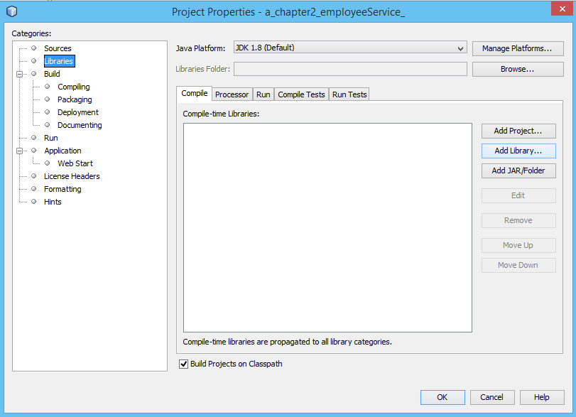
Specification: JSR-000220 Enterprise JavaBeans v.3.x Java Persistence API

Slide 112
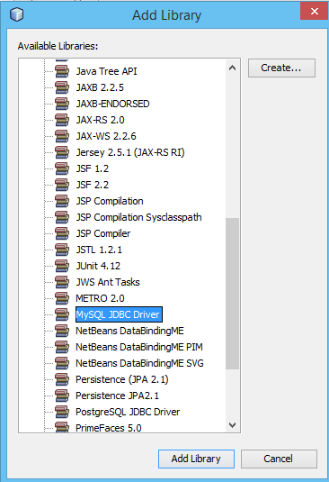
Specification: JSR-000220 Enterprise JavaBeans v.3.x Java Persistence API

Slide 113
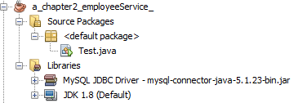
Specification: JSR-000220 Enterprise JavaBeans v.3.x Java Persistence API

Slide 114
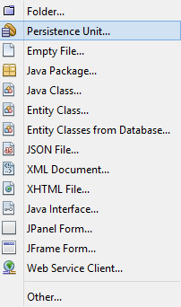
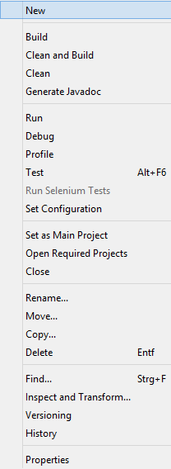
Specification: JSR-000220 Enterprise JavaBeans v.3.x Java Persistence API

Slide 115
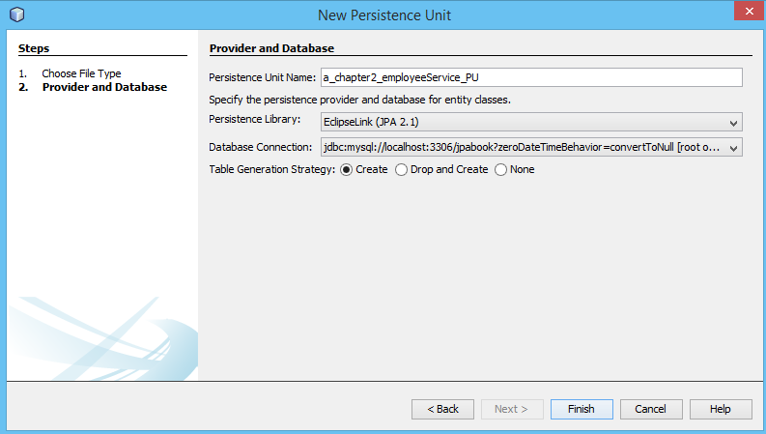
Specification: JSR-000220 Enterprise JavaBeans v.3.x Java Persistence API

Slide 116
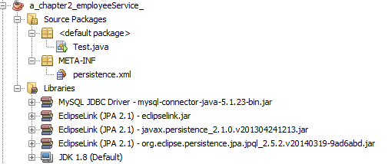
Specification: JSR-000220 Enterprise JavaBeans v.3.x Java Persistence API

Slide 117
Specification: JSR-000220 Enterprise JavaBeans v.3.x Java Persistence API

Slide 118
Specification: JSR-000220 Enterprise JavaBeans v.3.x Java Persistence API

Slide 119
Specification: JSR-000220 Enterprise JavaBeans v.3.x Java Persistence API

Slide 120
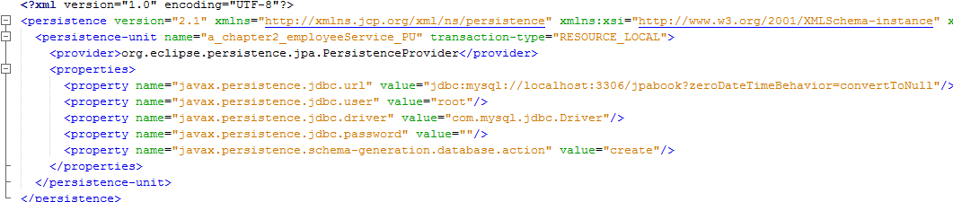
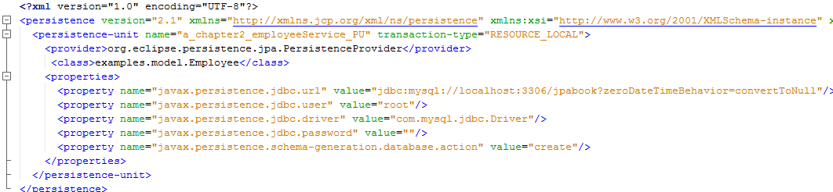
Specification: JSR-000220 Enterprise JavaBeans v.3.x Java Persistence API

Slide 121
Specification: JSR-000220 Enterprise JavaBeans v.3.x Java Persistence API

Slide 122
Specification: JSR-000220 Enterprise JavaBeans v.3.x Java Persistence API

Slide 123
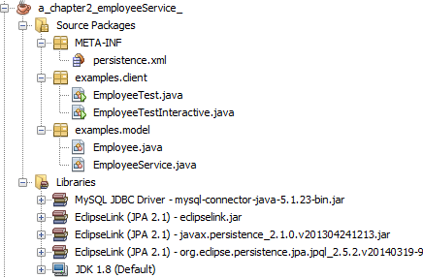
Specification: JSR-000220 Enterprise JavaBeans v.3.x Java Persistence API

Slide 124
Specification: JSR-000220 Enterprise JavaBeans v.3.x Java Persistence API

Slide 125
Specification: JSR-000220 Enterprise JavaBeans v.3.x Java Persistence API

Slide 126
Specification: JSR-000220 Enterprise JavaBeans v.3.x Java Persistence API

Slide 127
Specification: JSR-000220 Enterprise JavaBeans v.3.x Java Persistence API

Slide 128
Specification: JSR-000220 Enterprise JavaBeans v.3.x Java Persistence API

Slide 129
Specification: JSR-000220 Enterprise JavaBeans v.3.x Java Persistence API

Slide 130
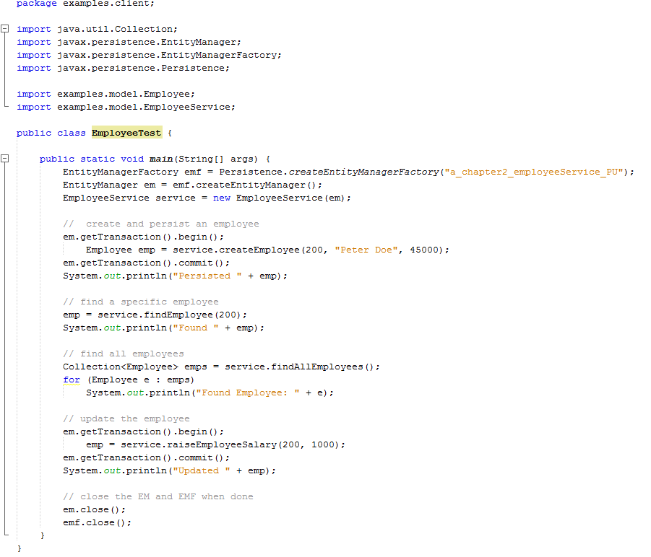
Specification: JSR-000220 Enterprise JavaBeans v.3.x Java Persistence API
exercise

Slide 131
Specification: JSR-000220 Enterprise JavaBeans v.3.x Java Persistence API
exercise

Slide 132
Specification: JSR-000220 Enterprise JavaBeans v.3.x Java Persistence API
exercise

Slide 133
exercise

