Slide 1

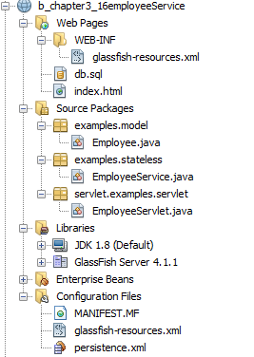
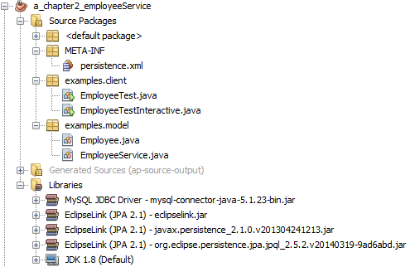
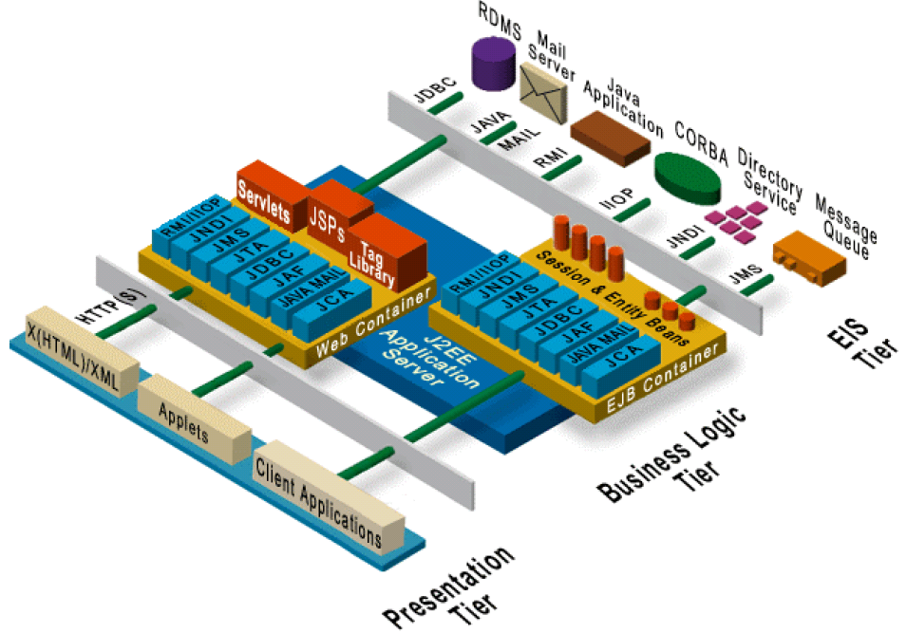
Specification: JSR-000220 Enterprise JavaBeans v.3.x Java Persistence API
JEE
SE

Slide 2
Specification: JSR-000220 Enterprise JavaBeans v.3.x Java Persistence API
JEE
SE

Slide 3
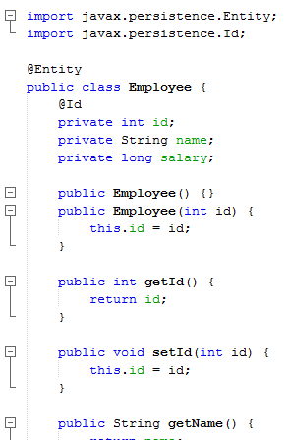
Specification: JSR-000220 Enterprise JavaBeans v.3.x Java Persistence API
JEE

Slide 4
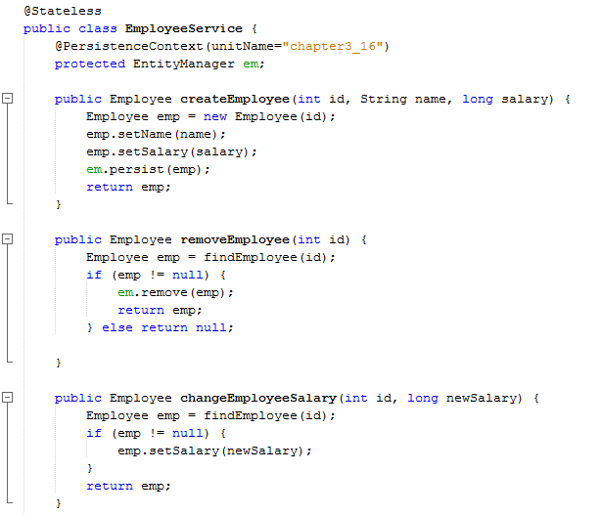
Specification: JSR-000220 Enterprise JavaBeans v.3.x Java Persistence API
JEE

Slide 5
Specification: JSR-000220 Enterprise JavaBeans v.3.x Java Persistence API
JEE

Slide 6
Specification: JSR-000220 Enterprise JavaBeans v.3.x Java Persistence API
JEE

Slide 7
Specification: JSR-000220 Enterprise JavaBeans v.3.x Java Persistence API
JEE

Slide 8
Specification: JSR-000220 Enterprise JavaBeans v.3.x Java Persistence API
JEE

Slide 9
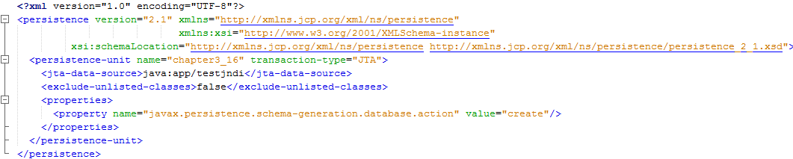
Specification: JSR-000220 Enterprise JavaBeans v.3.x Java Persistence API
JEE

Slide 10
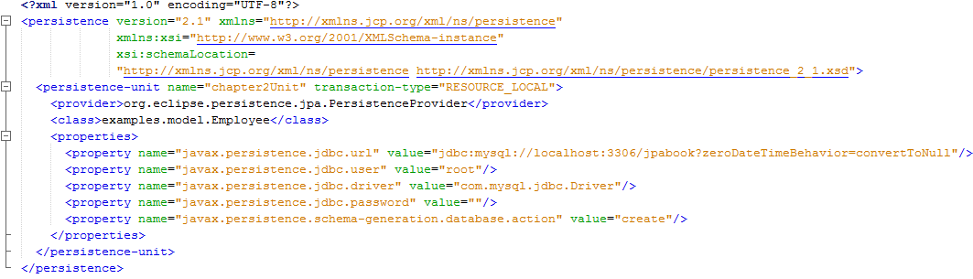
Specification: JSR-000220 Enterprise JavaBeans v.3.x Java Persistence API
JEE
SE

Slide 11
Specification: JSR-000220 Enterprise JavaBeans v.3.x Java Persistence API
JEE
SE

Slide 12
Specification: JSR-000220 Enterprise JavaBeans v.3.x Java Persistence API
JEE
SE

Slide 13
Specification: JSR-000220 Enterprise JavaBeans v.3.x Java Persistence API
JEE
SE

Slide 14
Specification: JSR-000220 Enterprise JavaBeans v.3.x Java Persistence API
MySQL
JEE
SE

Slide 15
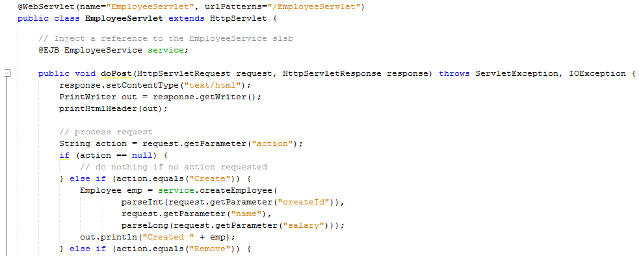
Specification: JSR-000220 Enterprise JavaBeans v.3.x Java Persistence API
JEE

Slide 16
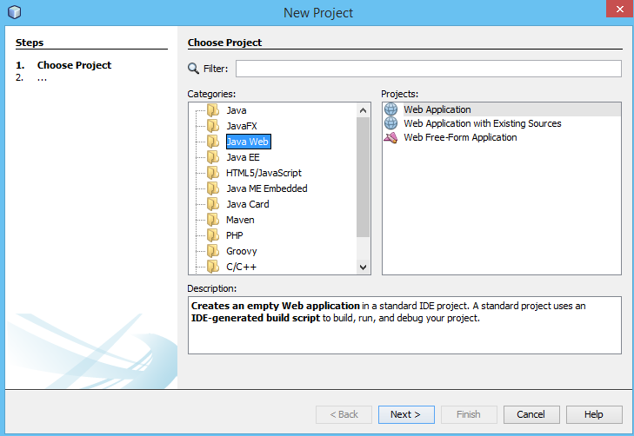
Specification: JSR-000220 Enterprise JavaBeans v.3.x Java Persistence API
JEE

Slide 17
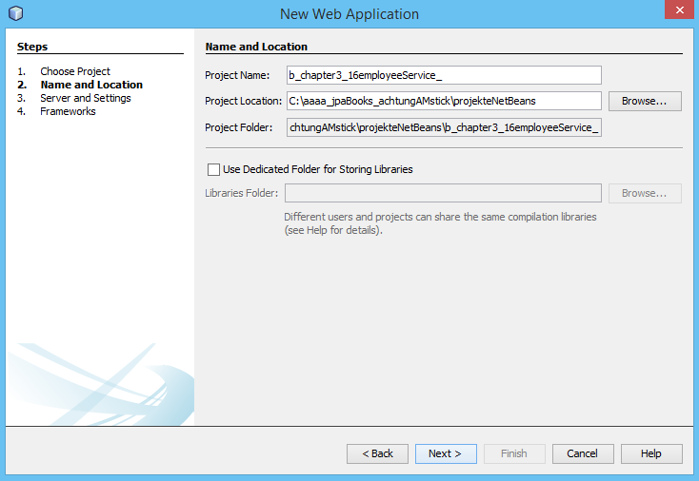
Specification: JSR-000220 Enterprise JavaBeans v.3.x Java Persistence API

Slide 18
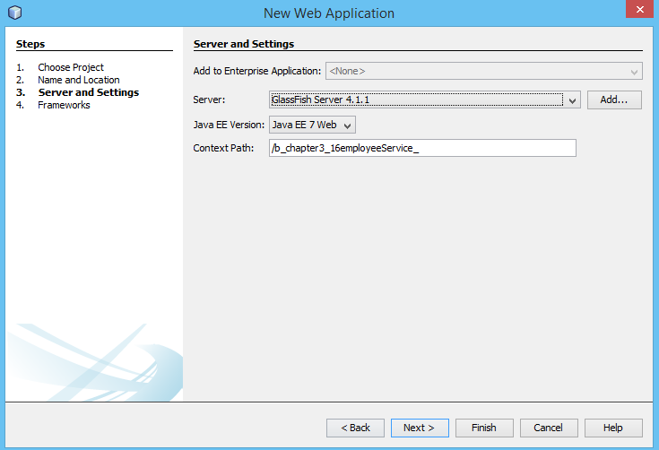
Specification: JSR-000220 Enterprise JavaBeans v.3.x Java Persistence API

Slide 19
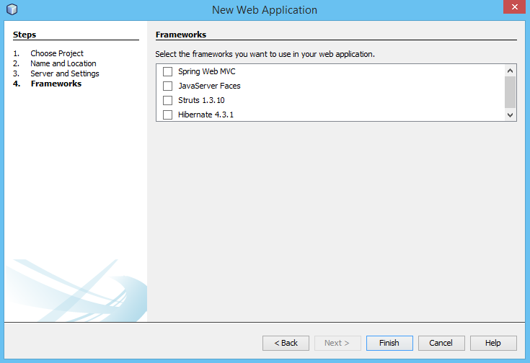
Specification: JSR-000220 Enterprise JavaBeans v.3.x Java Persistence API

Slide 20

Specification: JSR-000220 Enterprise JavaBeans v.3.x Java Persistence API

Slide 21
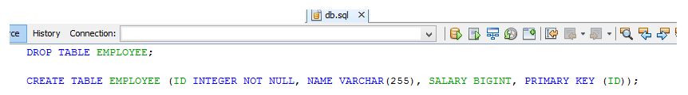
Specification: JSR-000220 Enterprise JavaBeans v.3.x Java Persistence API

Slide 22
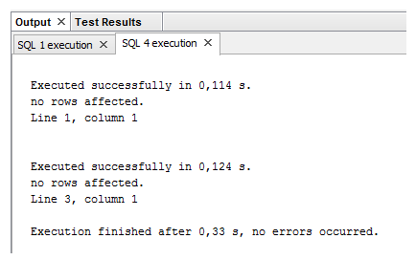
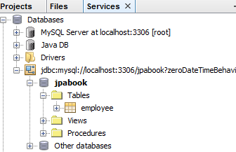

Specification: JSR-000220 Enterprise JavaBeans v.3.x Java Persistence API

Slide 23
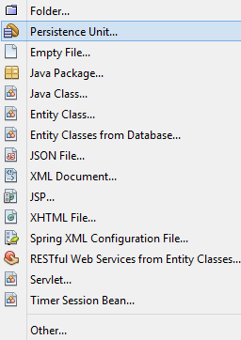
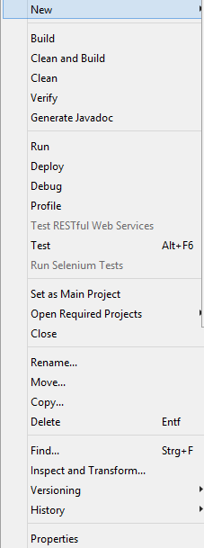
Specification: JSR-000220 Enterprise JavaBeans v.3.x Java Persistence API

Slide 24
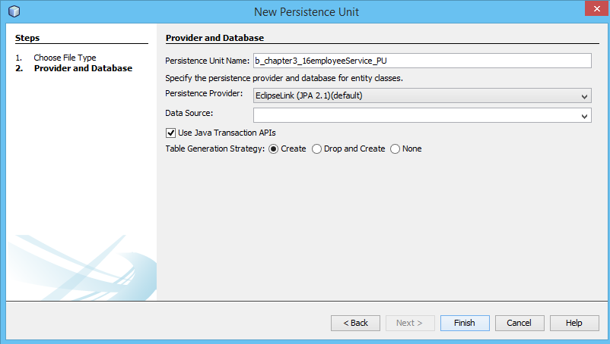
Specification: JSR-000220 Enterprise JavaBeans v.3.x Java Persistence API

Slide 25

Specification: JSR-000220 Enterprise JavaBeans v.3.x Java Persistence API

Slide 26
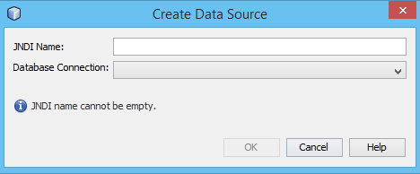
Specification: JSR-000220 Enterprise JavaBeans v.3.x Java Persistence API

Slide 27
Specification: JSR-000220 Enterprise JavaBeans v.3.x Java Persistence API

Slide 28
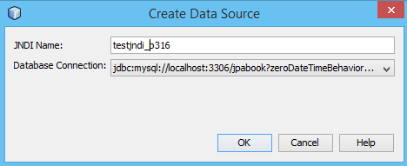
Specification: JSR-000220 Enterprise JavaBeans v.3.x Java Persistence API

Slide 29
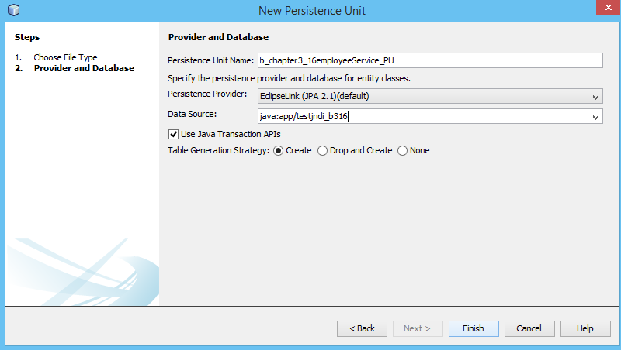
Specification: JSR-000220 Enterprise JavaBeans v.3.x Java Persistence API

Slide 30
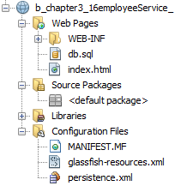
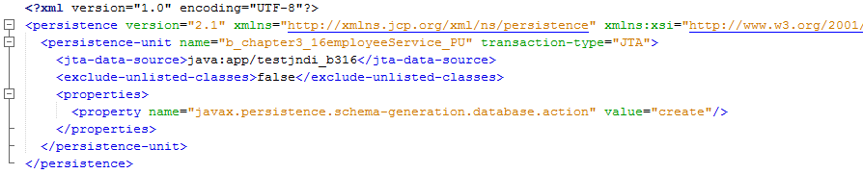
Specification: JSR-000220 Enterprise JavaBeans v.3.x Java Persistence API

Slide 31
Specification: JSR-000220 Enterprise JavaBeans v.3.x Java Persistence API

Slide 32
Specification: JSR-000220 Enterprise JavaBeans v.3.x Java Persistence API

Slide 33
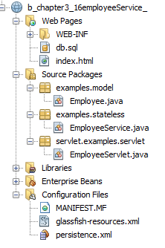
Specification: JSR-000220 Enterprise JavaBeans v.3.x Java Persistence API

Slide 34
Specification: JSR-000220 Enterprise JavaBeans v.3.x Java Persistence API

Slide 35
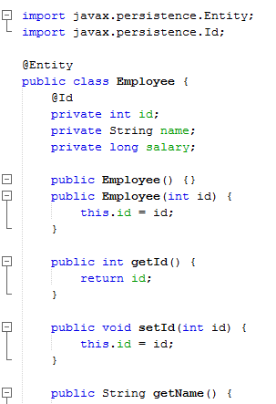
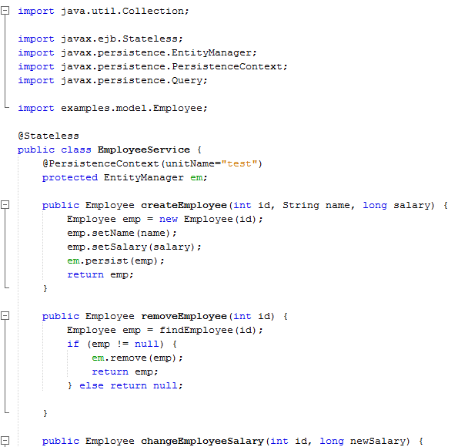
Specification: JSR-000220 Enterprise JavaBeans v.3.x Java Persistence API

Slide 36
Specification: JSR-000220 Enterprise JavaBeans v.3.x Java Persistence API

Slide 37
Specification: JSR-000220 Enterprise JavaBeans v.3.x Java Persistence API

Slide 38
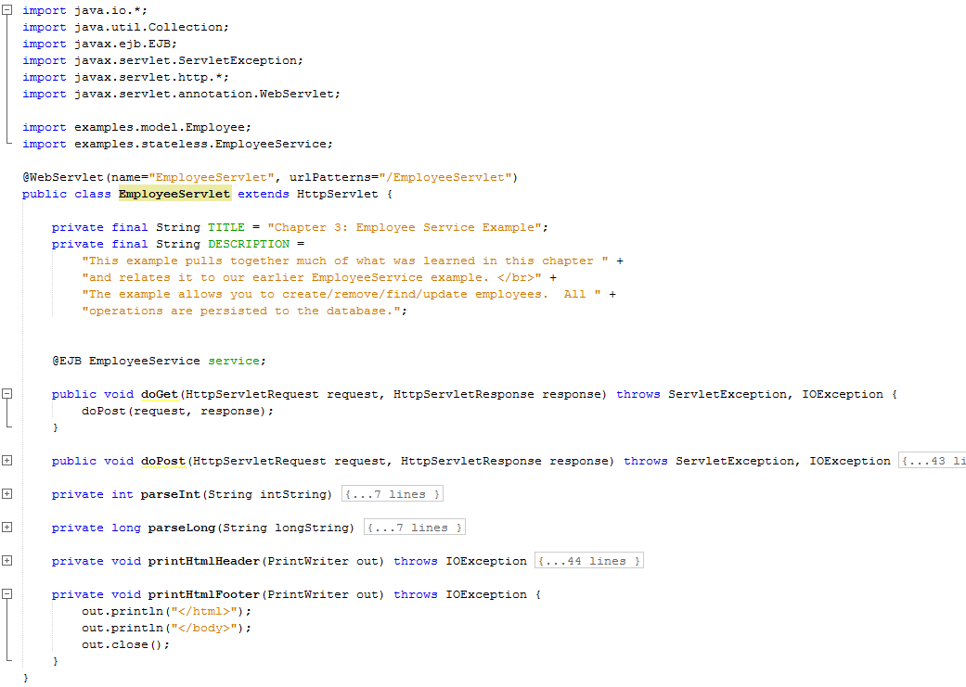
Specification: JSR-000220 Enterprise JavaBeans v.3.x Java Persistence API

Slide 39
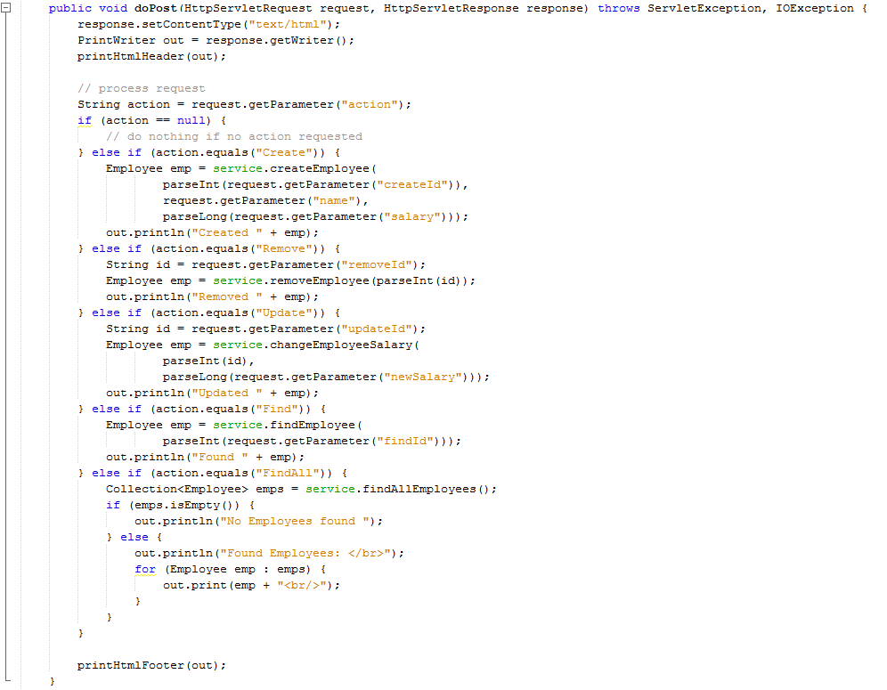
Specification: JSR-000220 Enterprise JavaBeans v.3.x Java Persistence API

Slide 40
Specification: JSR-000220 Enterprise JavaBeans v.3.x Java Persistence API

Slide 41
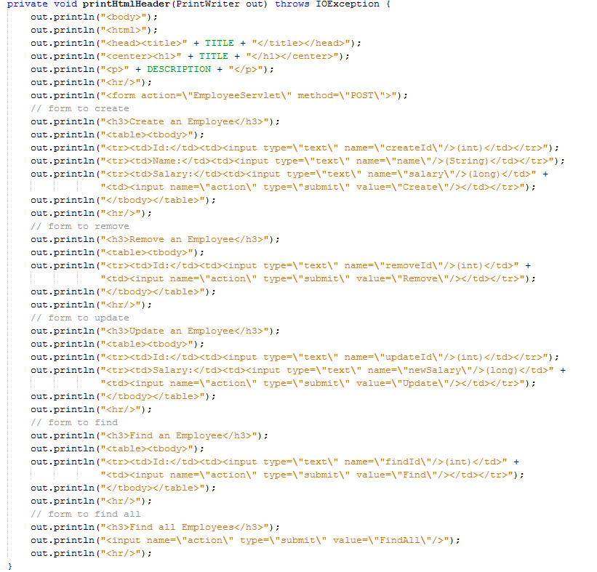
Specification: JSR-000220 Enterprise JavaBeans v.3.x Java Persistence API

Slide 42
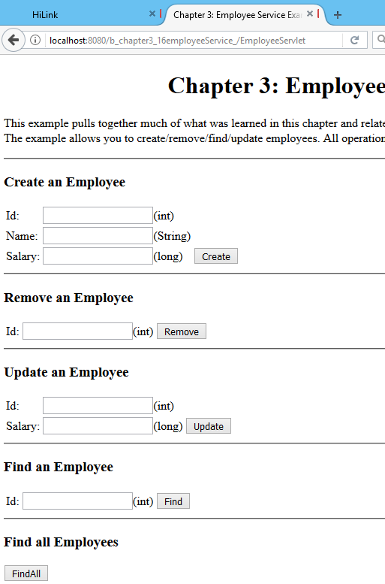
Specification: JSR-000220 Enterprise JavaBeans v.3.x Java Persistence API

Slide 43
Specification: JSR-000220 Enterprise JavaBeans v.3.x Java Persistence API

Slide 44
Specification: JSR-000220 Enterprise JavaBeans v.3.x Java Persistence API

Slide 45
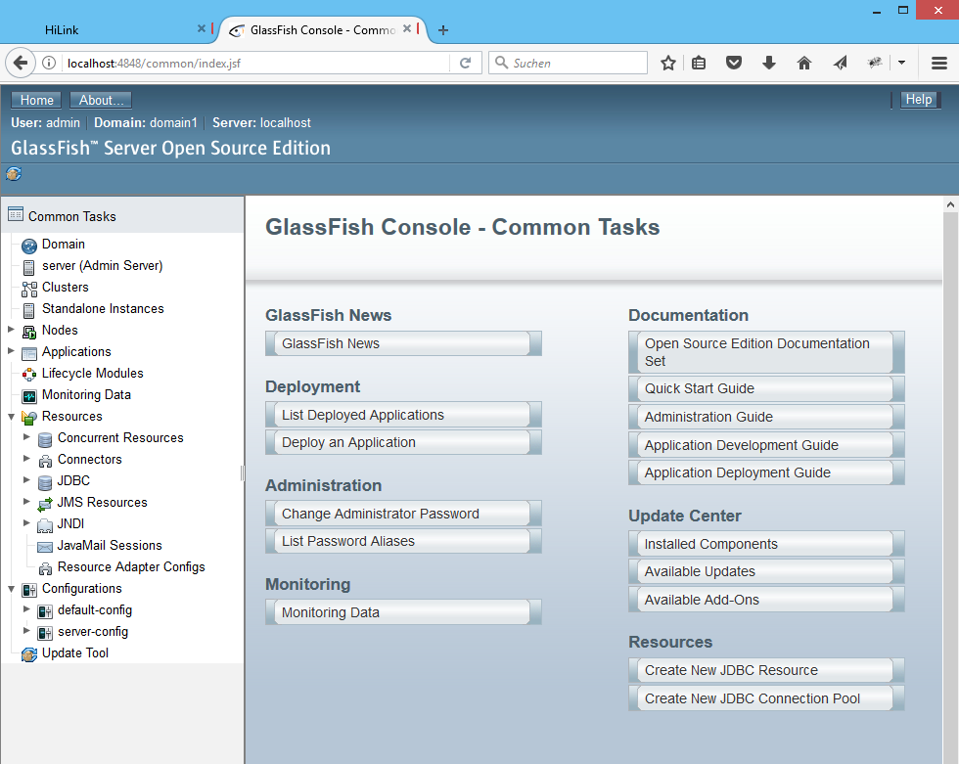
Specification: JSR-000220 Enterprise JavaBeans v.3.x Java Persistence API

Slide 46
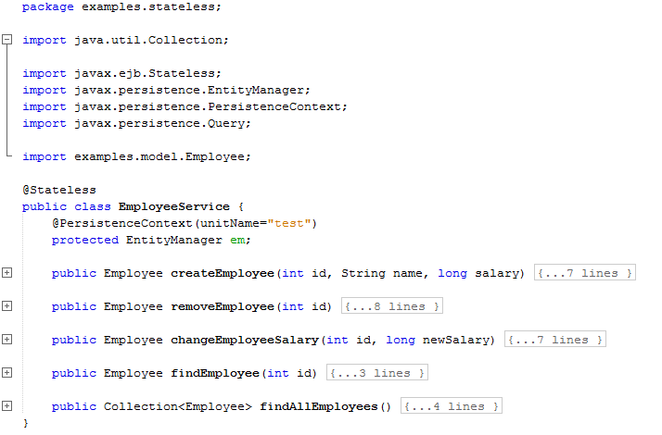
Specification: JSR-000220 Enterprise JavaBeans v.3.x Java Persistence API
exercise

Slide 47
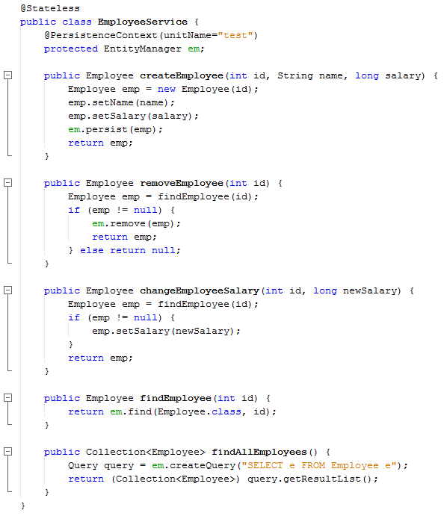

Slide 48
Specification: JSR-000220 Enterprise JavaBeans v.3.x Java Persistence API

