Slide 1

JPA many2one Relation

Slide 2

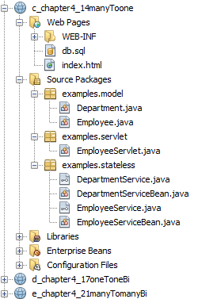
Specification: JSR-000220 Enterprise JavaBeans v.3.x Java Persistence API
JPA many2one Relation

Slide 3
Specification: JSR-000220 Enterprise JavaBeans v.3.x Java Persistence API

Slide 4
Specification: JSR-000220 Enterprise JavaBeans v.3.x Java Persistence API

Slide 5
Specification: JSR-000220 Enterprise JavaBeans v.3.x Java Persistence API

Slide 6
Specification: JSR-000220 Enterprise JavaBeans v.3.x Java Persistence API

Slide 7
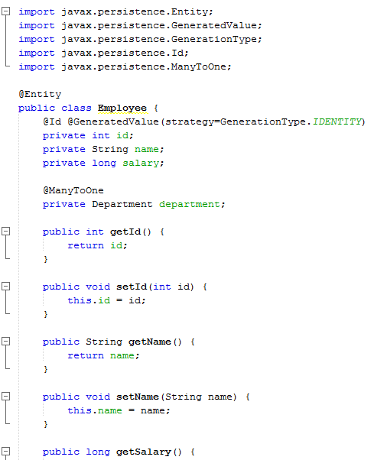
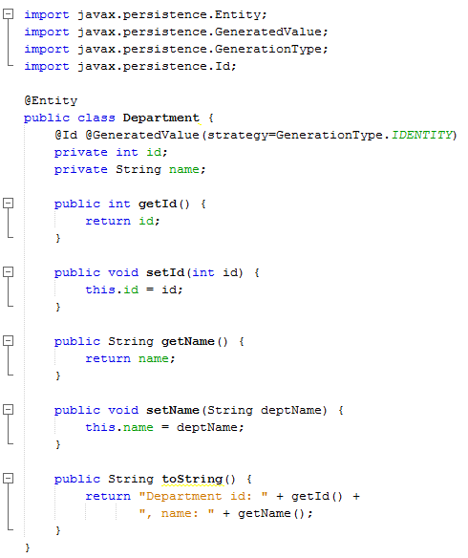
Specification: JSR-000220 Enterprise JavaBeans v.3.x Java Persistence API
It relies on an auto-incremented database column and
lets the database generate a new value with each insert operation

Slide 8
Specification: JSR-000220 Enterprise JavaBeans v.3.x Java Persistence API
It relies on an auto-incremented database column and
lets the database generate a new value with each insert operation
It relies on an auto-incremented database column and
lets the database generate a new value with each insert operation

Slide 9
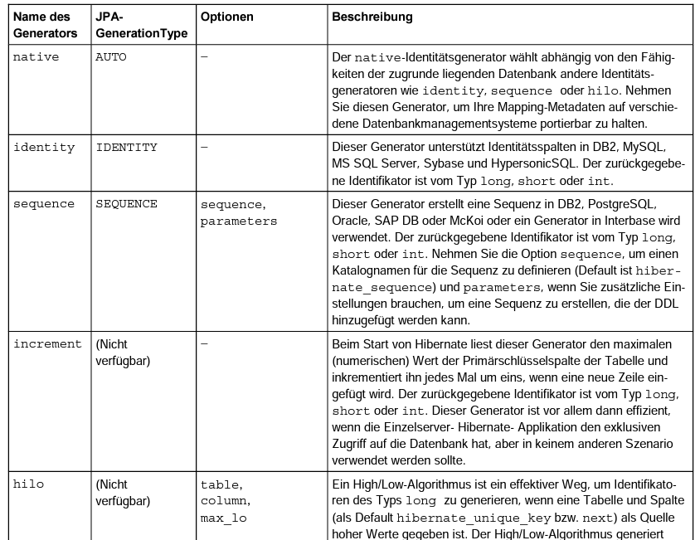
Specification: JSR-000220 Enterprise JavaBeans v.3.x Java Persistence API
It relies on an auto-incremented database column and
lets the database generate a new value with each insert operation
It relies on an auto-incremented database column and
lets the database generate a new value with each insert operation

Slide 10
Specification: JSR-000220 Enterprise JavaBeans v.3.x Java Persistence API
It relies on an auto-incremented database column and
lets the database generate a new value with each insert operation
It relies on an auto-incremented database column and
lets the database generate a new value with each insert operation

Slide 11
Specification: JSR-000220 Enterprise JavaBeans v.3.x Java Persistence API
It relies on an auto-incremented database column and
lets the database generate a new value with each insert operation
It relies on an auto-incremented database column and
lets the database generate a new value with each insert operation

Slide 12
Specification: JSR-000220 Enterprise JavaBeans v.3.x Java Persistence API
It relies on an auto-incremented database column and
lets the database generate a new value with each insert operation
many to one
unidirektional
many to one

Slide 13
Specification: JSR-000220 Enterprise JavaBeans v.3.x Java Persistence API
It relies on an auto-incremented database column and
lets the database generate a new value with each insert operation
many to one
unidirektional
many to one
more than one employee works in the same department,

Slide 14
Specification: JSR-000220 Enterprise JavaBeans v.3.x Java Persistence API
It relies on an auto-incremented database column and
lets the database generate a new value with each insert operation
many to one
unidirektional
many to one
Employee: many side
more than one employee works in the same department,
Department: one side

Slide 15
Specification: JSR-000220 Enterprise JavaBeans v.3.x Java Persistence API
It relies on an auto-incremented database column and
lets the database generate a new value with each insert operation
many to one
unidirektional
many to one
Employee: many side
more than one employee works in the same department,
Department: one side

Slide 16
Specification: JSR-000220 Enterprise JavaBeans v.3.x Java Persistence API
It relies on an auto-incremented database column and
lets the database generate a new value with each insert operation
many to one
unidirektional
many to one
unidirektional
Employee: many side
the relationship is unidirectional, from Employee to Department,
Department: one side

Slide 17
Specification: JSR-000220 Enterprise JavaBeans v.3.x Java Persistence API
It relies on an auto-incremented database column and
lets the database generate a new value with each insert operation
many to one
unidirektional
many to one
unidirektional
Employee: many side
the relationship is unidirectional, from Employee to Department,
Department: one side

Slide 18
Specification: JSR-000220 Enterprise JavaBeans v.3.x Java Persistence API
It relies on an auto-incremented database column and
lets the database generate a new value with each insert operation
many to one
unidirektional
many to one
unidirektional
Employee: many side
the relationship is unidirectional, from Employee to Department,
Department: one side

Slide 19
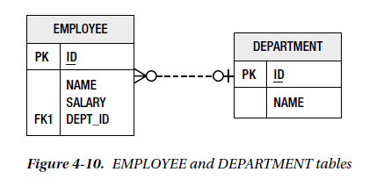
Specification: JSR-000220 Enterprise JavaBeans v.3.x Java Persistence API
Using Join Columns
In the database, a relationship mapping means that one table has a reference to another table.
The database term for a column that refers to a key (usually the primary key) in another table is a foreign key column.

Slide 20
Specification: JSR-000220 Enterprise JavaBeans v.3.x Java Persistence API
Using Join Columns
In the database, a relationship mapping means that one table has a reference to another table.
The database term for a column that refers to a key (usually the primary key) in another table is a foreign key column.

Slide 21
Specification: JSR-000220 Enterprise JavaBeans v.3.x Java Persistence API
Using Join Columns
In the database, a relationship mapping means that one table has a reference to another table.
The database term for a column that refers to a key (usually the primary key) in another table is a foreign key column.

Slide 22
Specification: JSR-000220 Enterprise JavaBeans v.3.x Java Persistence API
Using Join Columns
In the database, a relationship mapping means that one table has a reference to another table.
The database term for a column that refers to a key (usually the primary key) in another table is a foreign key column.

Slide 23
Specification: JSR-000220 Enterprise JavaBeans v.3.x Java Persistence API
Using Join Columns
In the database, a relationship mapping means that one table has a reference to another table.
The database term for a column that refers to a key (usually the primary key) in another table is a foreign key column.

Slide 24
Specification: JSR-000220 Enterprise JavaBeans v.3.x Java Persistence API
Using Join Columns
In the database, a relationship mapping means that one table has a reference to another table.
In JPA, they’re called join columns,
and the @JoinColumn annotation is the primary annotation used to configure these types of columns
DEPT_ID is the join column that associates the Employee and Department entities.

Slide 25
Specification: JSR-000220 Enterprise JavaBeans v.3.x Java Persistence API
Using Join Columns
In the database, a relationship mapping means that one table has a reference to another table.
one of the two sides will have the join column in its table.
That side is called the owning side or the owner of the relationship
DEPT_ID is the join column that associates the Employee and Department entities.

Slide 26
Specification: JSR-000220 Enterprise JavaBeans v.3.x Java Persistence API
Using Join Columns
In the database, a relationship mapping means that one table has a reference to another table.
@Entity
public class Employee {
@Id private long id;
@ManyToOne
@JoinColumn(name="DEPT_ID")
private Department department;
// ...
}
the @JoinColumn ( name="DEPT_ID" ) annotation means that the DEPT_ID
column in the source entity table is the foreign key to the target entity table

Slide 27
Specification: JSR-000220 Enterprise JavaBeans v.3.x Java Persistence API
Using Join Columns
In the database, a relationship mapping means that one table has a reference to another table.
@Entity
public class Employee {
@Id private long id;
@ManyToOne
@JoinColumn(name="DEPT_ID")
private Department department;
// ...
}
the @JoinColumn ( name="DEPT_ID" ) annotation means that the DEPT_ID
column in the source entity table is the foreign key to the target entity table

Slide 28
Specification: JSR-000220 Enterprise JavaBeans v.3.x Java Persistence API
Using Join Columns
In the database, a relationship mapping means that one table has a reference to another table.
@Entity
public class Employee {
@Id private long id;
@ManyToOne
@JoinColumn(name="DEPT_ID")
private Department department;
// ...
}
If no @JoinColumn annotation accompanies the many-to-one mapping,
a default column name will be assumed
the @JoinColumn ( name="DEPT_ID" ) annotation means that the DEPT_ID
column in the source entity table is the foreign key to the target entity table

Slide 29
Specification: JSR-000220 Enterprise JavaBeans v.3.x Java Persistence API
Using Join Columns
@Entity
public class Employee {
@Id private long id;
@ManyToOne
@JoinColumn(name="DEPT_ID")
private Department department;
// ...
}
If no @JoinColumn annotation accompanies the many-to-one mapping,
a default column name will be assumed
it is the name of the relationship attribute in the source entity, which is department in our example,
plus an underscore character (_), plus the name of the primary key column of the targe t entity.

Slide 30
Specification: JSR-000220 Enterprise JavaBeans v.3.x Java Persistence API
Using Join Columns
@Entity
public class Employee {
@Id private long id;
@ManyToOne
@JoinColumn(name="DEPT_ID")
private Department department;
// ...
}
If no @JoinColumn annotation accompanies the many-to-one mapping,
a default column name will be assumed
it is the name of the relationship attribute in the source entity, which is department in our example,
plus an underscore character (_), plus the name of the primary key column of the target entity.

Slide 31
Specification: JSR-000220 Enterprise JavaBeans v.3.x Java Persistence API
Using Join Columns
@Entity
public class Employee {
@Id private long id;
@ManyToOne
@JoinColumn(name="DEPT_ID")
private Department department;
// ...
}
If no @JoinColumn annotation accompanies the many-to-one mapping,
a default column name will be assumed
it is the name of the relationship attribute in the source entity, which is department in our example,
plus an underscore character (_), plus the name of the primary key column of the target entity.

Slide 32
Specification: JSR-000220 Enterprise JavaBeans v.3.x Java Persistence API
Using Join Columns
@Entity
public class Employee {
@Id private long id;
@ManyToOne
@JoinColumn(name="DEPT_ID")
private Department department;
// ...
}
If no @JoinColumn annotation accompanies the many-to-one mapping,
a default column name will be assumed
it is the name of the relationship attribute in the source entity, which is department in our example,
plus an underscore character (_), plus the name of the primary key column of the target entity.

Slide 33
Specification: JSR-000220 Enterprise JavaBeans v.3.x Java Persistence API
Using Join Columns
@Entity
public class Employee {
@Id private long id;
@ManyToOne
@JoinColumn(name="DEPT_ID")
private Department department;
// ...
}
If no @JoinColumn annotation accompanies the many-to-one mapping,
a default column name will be assumed
it is the name of the relationship attribute in the source entity, which is department in our example,
plus an underscore character (_), plus the name of the primary key column of the target entity.

Slide 34
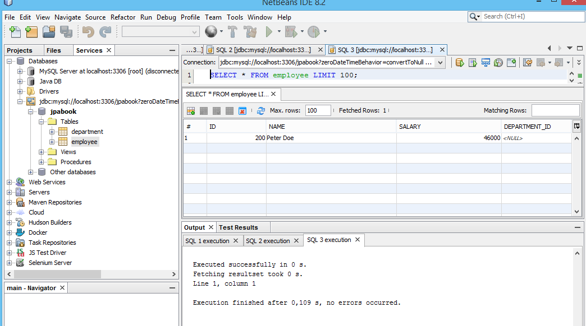
Specification: JSR-000220 Enterprise JavaBeans v.3.x Java Persistence API
Many-to-one mappings are always on the owning side of a relationship
it is the name of the relationship attribute in the source entity, which is department in our example,
plus an underscore character (_), plus the name of the primary key column of the target entity.

Slide 35
Specification: JSR-000220 Enterprise JavaBeans v.3.x Java Persistence API
Many-to-one mappings are always on the owning side of a relationship
it is the name of the relationship attribute in the source entity, which is department in our example,
plus an underscore character (_), plus the name of the primary key column of the target entity.

Slide 36
Specification: JSR-000220 Enterprise JavaBeans v.3.x Java Persistence API
Many-to-one mappings are always on the owning side of a relationship
it is the name of the relationship attribute in the source entity, which is department in our example,
plus an underscore character (_), plus the name of the primary key column of the target entity.

Slide 37
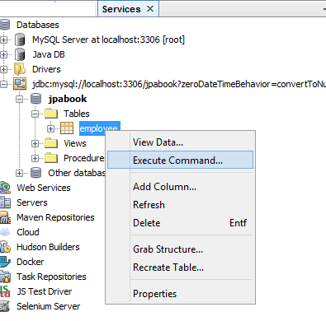
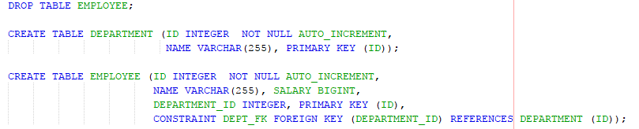
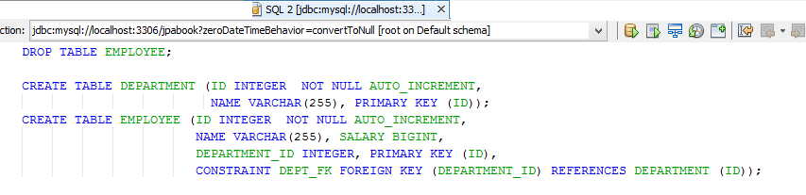
Specification: JSR-000220 Enterprise JavaBeans v.3.x Java Persistence API

Slide 38
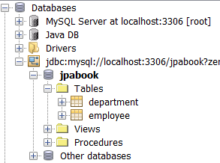
Specification: JSR-000220 Enterprise JavaBeans v.3.x Java Persistence API

Slide 39
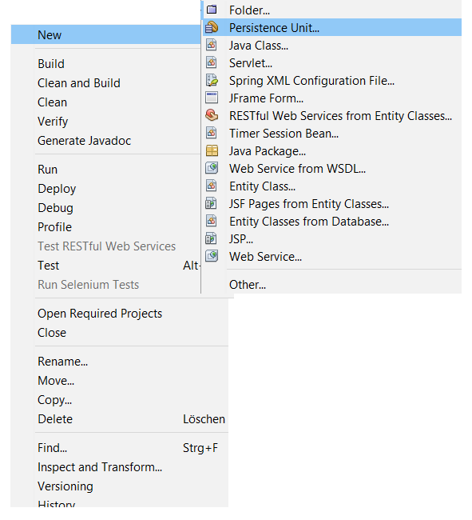
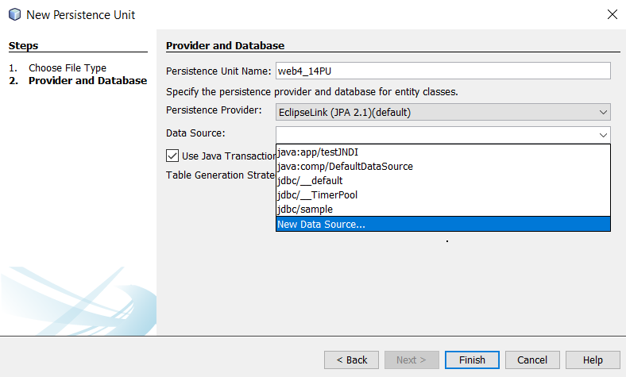
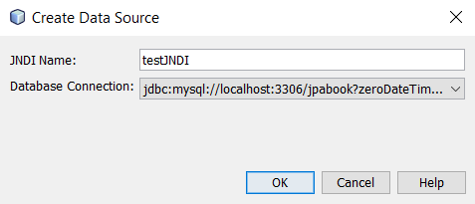
Specification: JSR-000220 Enterprise JavaBeans v.3.x Java Persistence API

Slide 40
Specification: JSR-000220 Enterprise JavaBeans v.3.x Java Persistence API

Slide 41
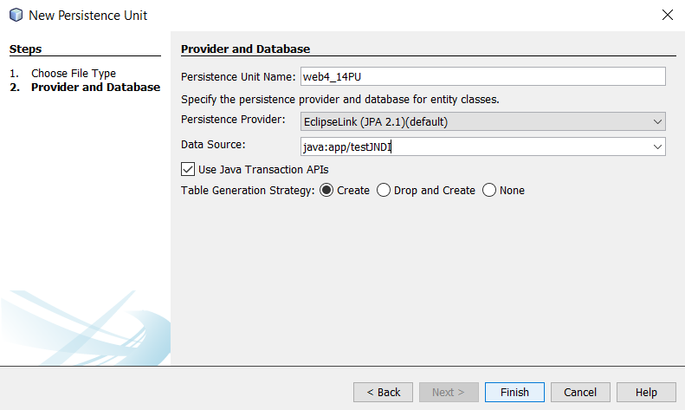
Specification: JSR-000220 Enterprise JavaBeans v.3.x Java Persistence API

Slide 42
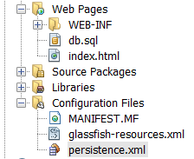
Specification: JSR-000220 Enterprise JavaBeans v.3.x Java Persistence API

Slide 43
Specification: JSR-000220 Enterprise JavaBeans v.3.x Java Persistence API

Slide 44
Specification: JSR-000220 Enterprise JavaBeans v.3.x Java Persistence API

Slide 45
Specification: JSR-000220 Enterprise JavaBeans v.3.x Java Persistence API

Slide 46
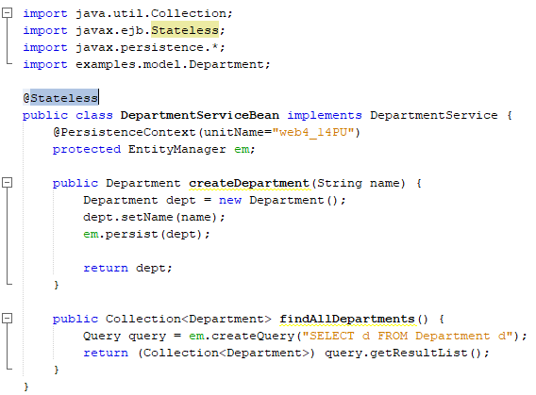
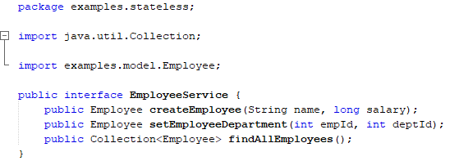
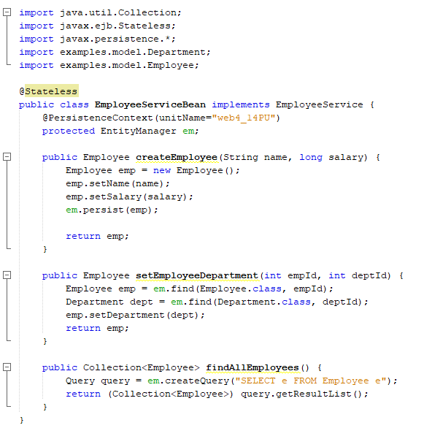
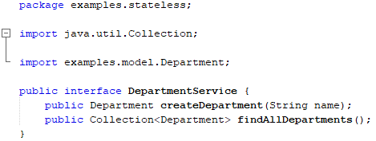
Specification: JSR-000220 Enterprise JavaBeans v.3.x Java Persistence API

Slide 47
Specification: JSR-000220 Enterprise JavaBeans v.3.x Java Persistence API
exercise

Slide 48
Specification: JSR-000220 Enterprise JavaBeans v.3.x Java Persistence API
exercise

Slide 49
Specification: JSR-000220 Enterprise JavaBeans v.3.x Java Persistence API
exercise

Slide 50
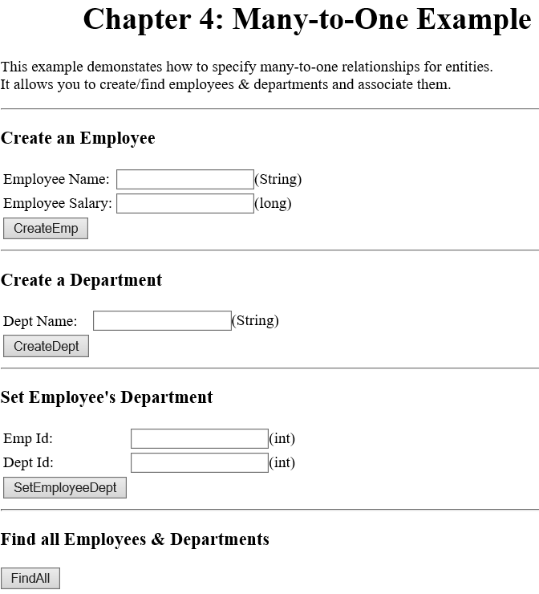
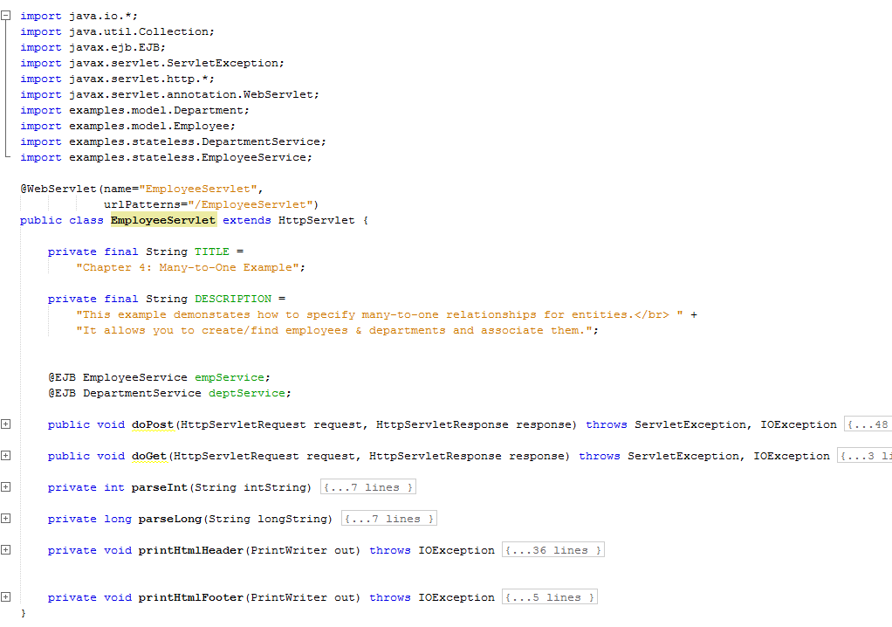
Specification: JSR-000220 Enterprise JavaBeans v.3.x Java Persistence API
exercise

Slide 51
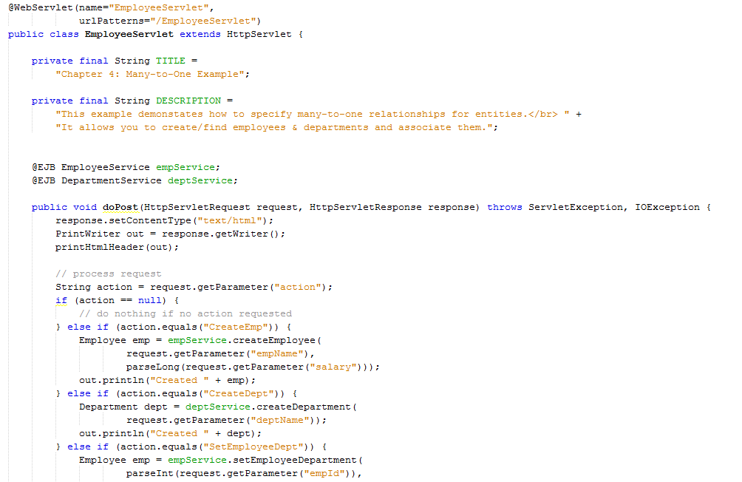
exercise

Slide 52
Specification: JSR-000220 Enterprise JavaBeans v.3.x Java Persistence API

