Slide 1

Abfragen mit
JPA-QL H-QL intro

Slide 2

Specification: JSR-000220 Enterprise JavaBeans v.3.x Java Persistence API
Abfragen mit
JPA-QL H-QL intro

Slide 3

Specification: JSR-000220 Enterprise JavaBeans v.3.x Java Persistence API
Abfragen mit JPAQL , HQL und native SQL

Slide 4
Specification: JSR-000220 Enterprise JavaBeans v.3.x Java Persistence API
Abfragen mit JPAQL , HQL und native SQL

Slide 5
Specification: JSR-000220 Enterprise JavaBeans v.3.x Java Persistence API
Abfragen mit JPAQL , HQL und native SQL

Slide 6
Specification: JSR-000220 Enterprise JavaBeans v.3.x Java Persistence API
Abfragen mit JPAQL , HQL und native SQL

Slide 7
Specification: JSR-000220 Enterprise JavaBeans v.3.x Java Persistence API
Abfragen mit JPAQL , HQL und native SQL

Slide 8
Specification: JSR-000220 Enterprise JavaBeans v.3.x Java Persistence API
Abfragen mit JPAQL , HQL und native SQL

Slide 9
Specification: JSR-000220 Enterprise JavaBeans v.3.x Java Persistence API
Abfragen mit JPAQL , HQL und native SQL

Slide 10
Specification: JSR-000220 Enterprise JavaBeans v.3.x Java Persistence API
Abfragen mit JPAQL , HQL und native SQL

Slide 11
Specification: JSR-000220 Enterprise JavaBeans v.3.x Java Persistence API
Abfragen mit JPAQL , HQL und native SQL

Slide 12
Specification: JSR-000220 Enterprise JavaBeans v.3.x Java Persistence API
Abfragen mit JPAQL , HQL und native SQL

Slide 13
Specification: JSR-000220 Enterprise JavaBeans v.3.x Java Persistence API
Abfragen mit JPAQL , HQL und native SQL

Slide 14

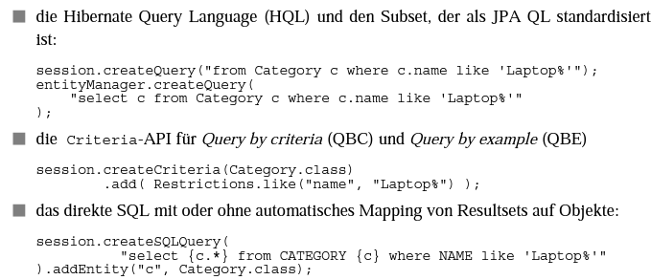
Specification: JSR-000220 Enterprise JavaBeans v.3.x Java Persistence API

Slide 15
Specification: JSR-000220 Enterprise JavaBeans v.3.x Java Persistence API

Slide 16
Specification: JSR-000220 Enterprise JavaBeans v.3.x Java Persistence API

Slide 17
Specification: JSR-000220 Enterprise JavaBeans v.3.x Java Persistence API

Slide 18
Specification: JSR-000220 Enterprise JavaBeans v.3.x Java Persistence API

Slide 19
Specification: JSR-000220 Enterprise JavaBeans v.3.x Java Persistence API

Slide 20
Specification: JSR-000220 Enterprise JavaBeans v.3.x Java Persistence API

Slide 21
Specification: JSR-000220 Enterprise JavaBeans v.3.x Java Persistence API

Slide 22
Specification: JSR-000220 Enterprise JavaBeans v.3.x Java Persistence API

Slide 23
Specification: JSR-000220 Enterprise JavaBeans v.3.x Java Persistence API

Slide 24
Specification: JSR-000220 Enterprise JavaBeans v.3.x Java Persistence API

Slide 25
Specification: JSR-000220 Enterprise JavaBeans v.3.x Java Persistence API

Slide 26
Specification: JSR-000220 Enterprise JavaBeans v.3.x Java Persistence API

Slide 27
Specification: JSR-000220 Enterprise JavaBeans v.3.x Java Persistence API

Slide 28
Specification: JSR-000220 Enterprise JavaBeans v.3.x Java Persistence API

Slide 29
Specification: JSR-000220 Enterprise JavaBeans v.3.x Java Persistence API

Slide 30
Specification: JSR-000220 Enterprise JavaBeans v.3.x Java Persistence API

Slide 31
Specification: JSR-000220 Enterprise JavaBeans v.3.x Java Persistence API

Slide 32
Specification: JSR-000220 Enterprise JavaBeans v.3.x Java Persistence API

Slide 33
Specification: JSR-000220 Enterprise JavaBeans v.3.x Java Persistence API

Slide 34
Specification: JSR-000220 Enterprise JavaBeans v.3.x Java Persistence API

Slide 35
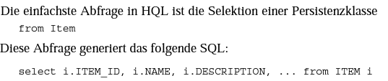
Specification: JSR-000220 Enterprise JavaBeans v.3.x Java Persistence API

Slide 36
Specification: JSR-000220 Enterprise JavaBeans v.3.x Java Persistence API

Slide 37
Specification: JSR-000220 Enterprise JavaBeans v.3.x Java Persistence API

Slide 38
Specification: JSR-000220 Enterprise JavaBeans v.3.x Java Persistence API

Slide 39
Specification: JSR-000220 Enterprise JavaBeans v.3.x Java Persistence API

Slide 40
Specification: JSR-000220 Enterprise JavaBeans v.3.x Java Persistence API

Slide 41
Specification: JSR-000220 Enterprise JavaBeans v.3.x Java Persistence API

Slide 42
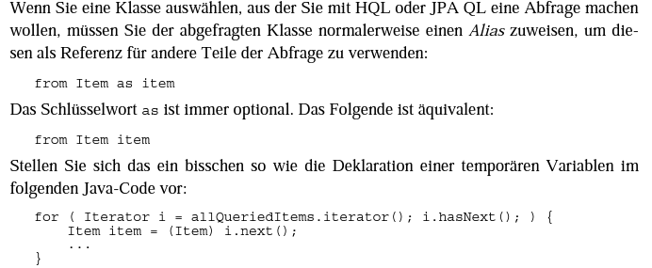
Specification: JSR-000220 Enterprise JavaBeans v.3.x Java Persistence API

Slide 43
Specification: JSR-000220 Enterprise JavaBeans v.3.x Java Persistence API

Slide 44
Specification: JSR-000220 Enterprise JavaBeans v.3.x Java Persistence API

Slide 45
Specification: JSR-000220 Enterprise JavaBeans v.3.x Java Persistence API

Slide 46
Specification: JSR-000220 Enterprise JavaBeans v.3.x Java Persistence API

Slide 47
Specification: JSR-000220 Enterprise JavaBeans v.3.x Java Persistence API

Slide 48
Specification: JSR-000220 Enterprise JavaBeans v.3.x Java Persistence API

Slide 49
Specification: JSR-000220 Enterprise JavaBeans v.3.x Java Persistence API

Slide 50
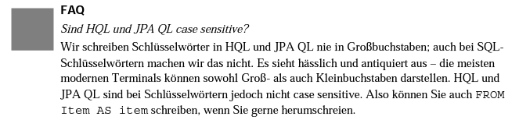
Specification: JSR-000220 Enterprise JavaBeans v.3.x Java Persistence API

Slide 51
Specification: JSR-000220 Enterprise JavaBeans v.3.x Java Persistence API

Slide 52
Specification: JSR-000220 Enterprise JavaBeans v.3.x Java Persistence API

Slide 53
Specification: JSR-000220 Enterprise JavaBeans v.3.x Java Persistence API

Slide 54
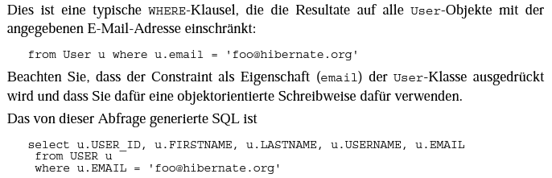
Specification: JSR-000220 Enterprise JavaBeans v.3.x Java Persistence API

Slide 55
Specification: JSR-000220 Enterprise JavaBeans v.3.x Java Persistence API

Slide 56
Specification: JSR-000220 Enterprise JavaBeans v.3.x Java Persistence API

Slide 57
Specification: JSR-000220 Enterprise JavaBeans v.3.x Java Persistence API

Slide 58
Specification: JSR-000220 Enterprise JavaBeans v.3.x Java Persistence API

Slide 59
Specification: JSR-000220 Enterprise JavaBeans v.3.x Java Persistence API

Slide 60
Specification: JSR-000220 Enterprise JavaBeans v.3.x Java Persistence API

Slide 61
Specification: JSR-000220 Enterprise JavaBeans v.3.x Java Persistence API

Slide 62
Specification: JSR-000220 Enterprise JavaBeans v.3.x Java Persistence API

Slide 63
Specification: JSR-000220 Enterprise JavaBeans v.3.x Java Persistence API

Slide 64
Specification: JSR-000220 Enterprise JavaBeans v.3.x Java Persistence API

Slide 65
Specification: JSR-000220 Enterprise JavaBeans v.3.x Java Persistence API

Slide 66

Specification: JSR-000220 Enterprise JavaBeans v.3.x Java Persistence API

Slide 67
Specification: JSR-000220 Enterprise JavaBeans v.3.x Java Persistence API

Slide 68
Specification: JSR-000220 Enterprise JavaBeans v.3.x Java Persistence API

Slide 69
Specification: JSR-000220 Enterprise JavaBeans v.3.x Java Persistence API

Slide 70

Specification: JSR-000220 Enterprise JavaBeans v.3.x Java Persistence API

Slide 71
Specification: JSR-000220 Enterprise JavaBeans v.3.x Java Persistence API

Slide 72
Specification: JSR-000220 Enterprise JavaBeans v.3.x Java Persistence API

Slide 73
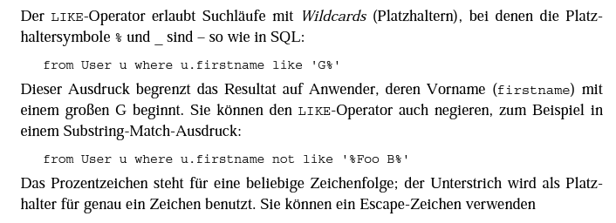
Specification: JSR-000220 Enterprise JavaBeans v.3.x Java Persistence API

Slide 74
Specification: JSR-000220 Enterprise JavaBeans v.3.x Java Persistence API

Slide 75
Specification: JSR-000220 Enterprise JavaBeans v.3.x Java Persistence API

Slide 76
Specification: JSR-000220 Enterprise JavaBeans v.3.x Java Persistence API

Slide 77
Specification: JSR-000220 Enterprise JavaBeans v.3.x Java Persistence API

Slide 78
Specification: JSR-000220 Enterprise JavaBeans v.3.x Java Persistence API

Slide 79
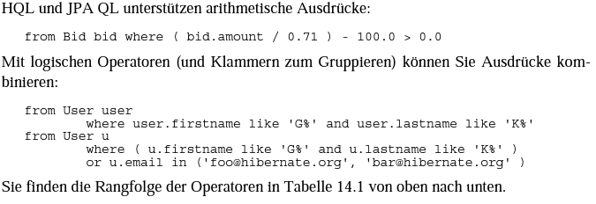
Specification: JSR-000220 Enterprise JavaBeans v.3.x Java Persistence API

Slide 80
Specification: JSR-000220 Enterprise JavaBeans v.3.x Java Persistence API

Slide 81
Specification: JSR-000220 Enterprise JavaBeans v.3.x Java Persistence API

Slide 82
Specification: JSR-000220 Enterprise JavaBeans v.3.x Java Persistence API

Slide 83
Specification: JSR-000220 Enterprise JavaBeans v.3.x Java Persistence API

Slide 84
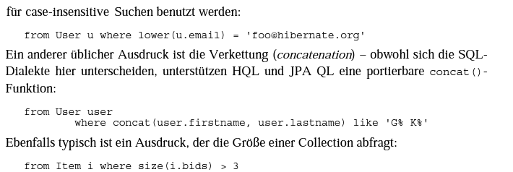
Specification: JSR-000220 Enterprise JavaBeans v.3.x Java Persistence API

Slide 85
Specification: JSR-000220 Enterprise JavaBeans v.3.x Java Persistence API

Slide 86
Specification: JSR-000220 Enterprise JavaBeans v.3.x Java Persistence API

Slide 87
Specification: JSR-000220 Enterprise JavaBeans v.3.x Java Persistence API

Slide 88
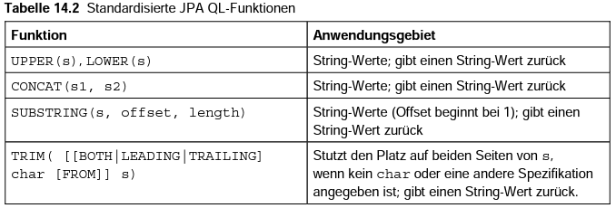
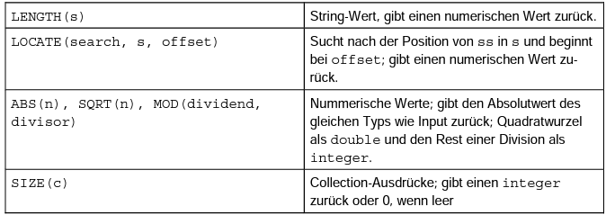
Specification: JSR-000220 Enterprise JavaBeans v.3.x Java Persistence API

Slide 89
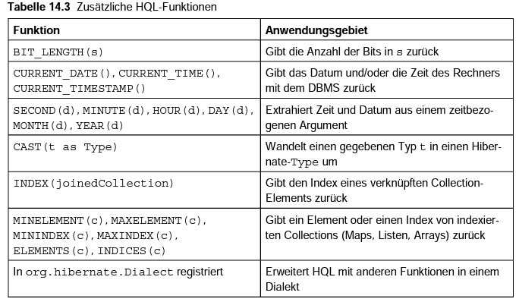
Specification: JSR-000220 Enterprise JavaBeans v.3.x Java Persistence API

Slide 90
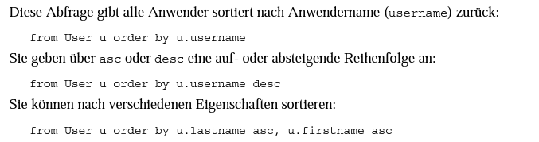
Specification: JSR-000220 Enterprise JavaBeans v.3.x Java Persistence API

Slide 91
Specification: JSR-000220 Enterprise JavaBeans v.3.x Java Persistence API

Slide 92
Specification: JSR-000220 Enterprise JavaBeans v.3.x Java Persistence API

Slide 93
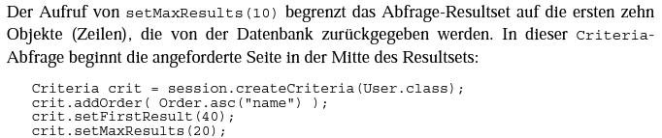
Specification: JSR-000220 Enterprise JavaBeans v.3.x Java Persistence API

Slide 94
Specification: JSR-000220 Enterprise JavaBeans v.3.x Java Persistence API

Slide 95
Specification: JSR-000220 Enterprise JavaBeans v.3.x Java Persistence API

Slide 96
Specification: JSR-000220 Enterprise JavaBeans v.3.x Java Persistence API

Slide 97
Specification: JSR-000220 Enterprise JavaBeans v.3.x Java Persistence API

Slide 98
Specification: JSR-000220 Enterprise JavaBeans v.3.x Java Persistence API

Slide 99
Specification: JSR-000220 Enterprise JavaBeans v.3.x Java Persistence API

Slide 100
Specification: JSR-000220 Enterprise JavaBeans v.3.x Java Persistence API

Slide 101
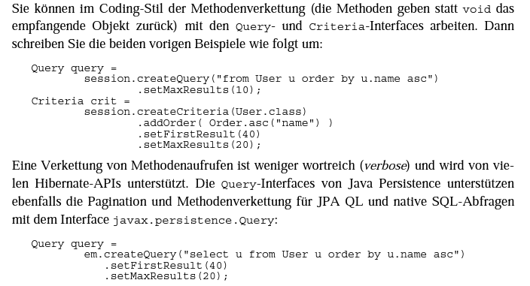
Specification: JSR-000220 Enterprise JavaBeans v.3.x Java Persistence API

Slide 102
Specification: JSR-000220 Enterprise JavaBeans v.3.x Java Persistence API

Slide 103
Specification: JSR-000220 Enterprise JavaBeans v.3.x Java Persistence API

Slide 104
Specification: JSR-000220 Enterprise JavaBeans v.3.x Java Persistence API

Slide 105
Specification: JSR-000220 Enterprise JavaBeans v.3.x Java Persistence API

Slide 106

Specification: JSR-000220 Enterprise JavaBeans v.3.x Java Persistence API

Slide 107
Specification: JSR-000220 Enterprise JavaBeans v.3.x Java Persistence API

Slide 108
Specification: JSR-000220 Enterprise JavaBeans v.3.x Java Persistence API

Slide 109
Specification: JSR-000220 Enterprise JavaBeans v.3.x Java Persistence API

Slide 110
Specification: JSR-000220 Enterprise JavaBeans v.3.x Java Persistence API

Slide 111
Specification: JSR-000220 Enterprise JavaBeans v.3.x Java Persistence API

Slide 112
Specification: JSR-000220 Enterprise JavaBeans v.3.x Java Persistence API

Slide 113
Specification: JSR-000220 Enterprise JavaBeans v.3.x Java Persistence API

Slide 114
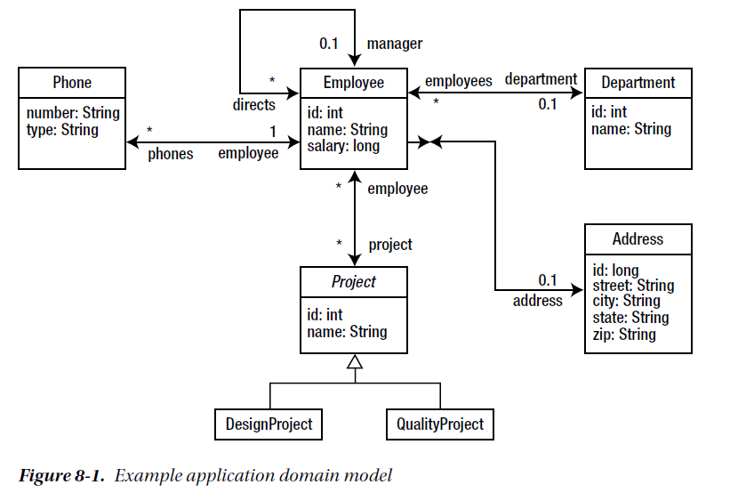

Slide 116
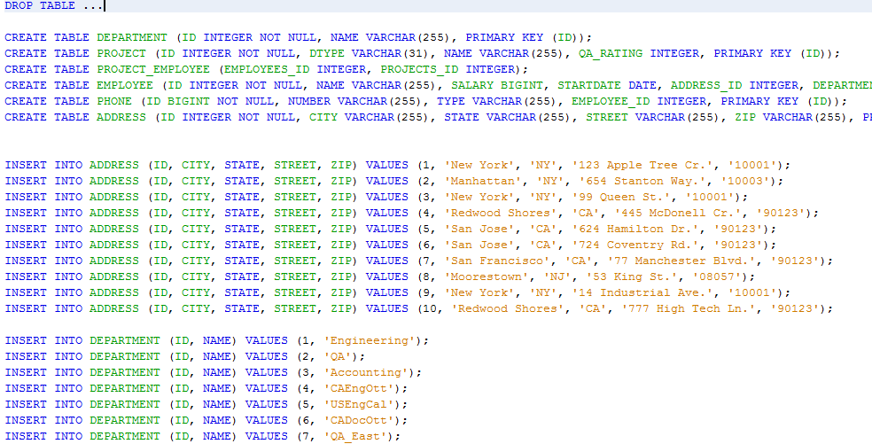

Slide 117
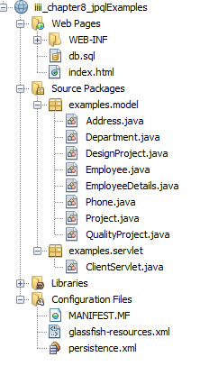
Specification: JSR-000220 Enterprise JavaBeans v.3.x Java Persistence API

Slide 118
Specification: JSR-000220 Enterprise JavaBeans v.3.x Java Persistence API

Slide 119
Specification: JSR-000220 Enterprise JavaBeans v.3.x Java Persistence API

Slide 120
Specification: JSR-000220 Enterprise JavaBeans v.3.x Java Persistence API

Slide 121
Specification: JSR-000220 Enterprise JavaBeans v.3.x Java Persistence API

Slide 122
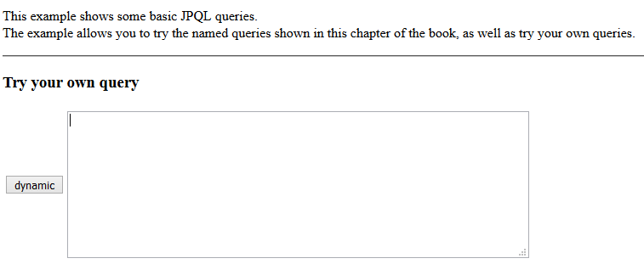
Specification: JSR-000220 Enterprise JavaBeans v.3.x Java Persistence API

Slide 123
Specification: JSR-000220 Enterprise JavaBeans v.3.x Java Persistence API

Slide 124
Specification: JSR-000220 Enterprise JavaBeans v.3.x Java Persistence API

Slide 125
Specification: JSR-000220 Enterprise JavaBeans v.3.x Java Persistence API

Slide 126
Specification: JSR-000220 Enterprise JavaBeans v.3.x Java Persistence API

Slide 127
Specification: JSR-000220 Enterprise JavaBeans v.3.x Java Persistence API
projekt realisieren, …
projekt realisieren, …

Slide 128
Specification: JSR-000220 Enterprise JavaBeans v.3.x Java Persistence API
projekt realisieren, …
projekt realisieren, …

Slide 129
Specification: JSR-000220 Enterprise JavaBeans v.3.x Java Persistence API
projekt realisieren, …
projekt realisieren, …

Slide 130
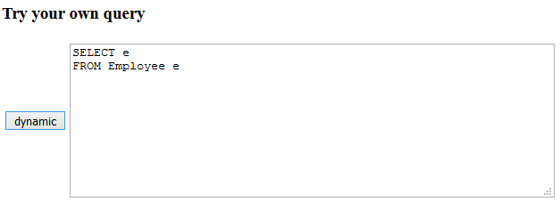
Specification: JSR-000220 Enterprise JavaBeans v.3.x Java Persistence API
query returns all the
departments in the company

Slide 131
Specification: JSR-000220 Enterprise JavaBeans v.3.x Java Persistence API
query returns all the
departments in the company

Slide 132
Specification: JSR-000220 Enterprise JavaBeans v.3.x Java Persistence API
query returns all the
departments in the company

Slide 133
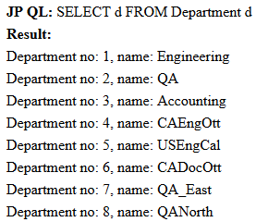
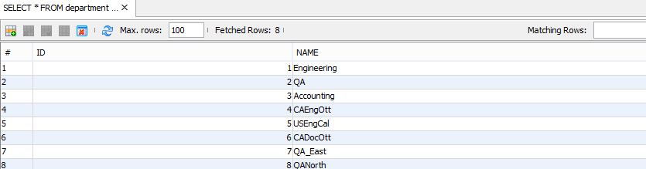
Specification: JSR-000220 Enterprise JavaBeans v.3.x Java Persistence API
query returns all the
departments in the company
Servlet response
Datenbank Kontrolle

Slide 134
Specification: JSR-000220 Enterprise JavaBeans v.3.x Java Persistence API
query returns all the
departments in the company
Servlet response
Datenbank Kontrolle

Slide 135
Specification: JSR-000220 Enterprise JavaBeans v.3.x Java Persistence API
query returns all the
departments in the company
Servlet response
Datenbank Kontrolle

Slide 136
Specification: JSR-000220 Enterprise JavaBeans v.3.x Java Persistence API
query returns the names for all employees

Slide 137
Specification: JSR-000220 Enterprise JavaBeans v.3.x Java Persistence API
query returns the names for all employees

Slide 138
Specification: JSR-000220 Enterprise JavaBeans v.3.x Java Persistence API
query returns the names for all employees

Slide 139
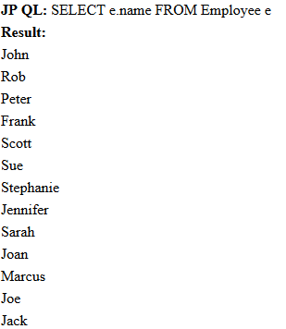
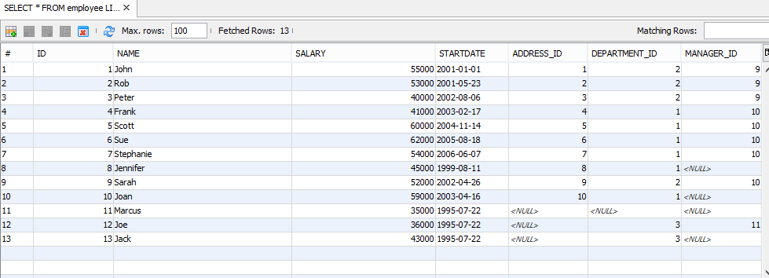
Specification: JSR-000220 Enterprise JavaBeans v.3.x Java Persistence API
query returns the names for all employees

Slide 140

Specification: JSR-000220 Enterprise JavaBeans v.3.x Java Persistence API
x
?
?
?

Slide 141
Specification: JSR-000220 Enterprise JavaBeans v.3.x Java Persistence API
x
?
?
?

Slide 142
Specification: JSR-000220 Enterprise JavaBeans v.3.x Java Persistence API
x
?
?
?

Slide 143
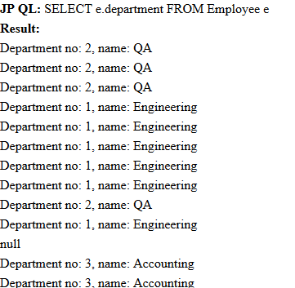
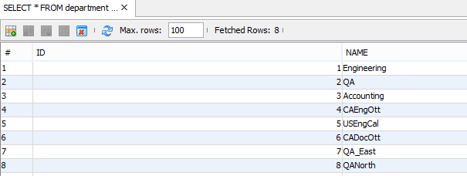
Specification: JSR-000220 Enterprise JavaBeans v.3.x Java Persistence API
x

Slide 144
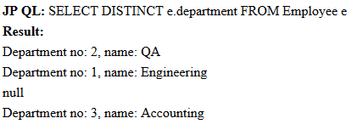
Specification: JSR-000220 Enterprise JavaBeans v.3.x Java Persistence API
x

Slide 145
Specification: JSR-000220 Enterprise JavaBeans v.3.x Java Persistence API
x
To remove the duplicates, the DISTINCT operator must be used:

Slide 146
Specification: JSR-000220 Enterprise JavaBeans v.3.x Java Persistence API
x
To remove the duplicates, the DISTINCT operator must be used:

Slide 147
Specification: JSR-000220 Enterprise JavaBeans v.3.x Java Persistence API
query that returns only the name and salary of an employee

Slide 148
Specification: JSR-000220 Enterprise JavaBeans v.3.x Java Persistence API
query that returns only the name and salary of an employee

Slide 149

Specification: JSR-000220 Enterprise JavaBeans v.3.x Java Persistence API
query that returns only the name and salary of an employee

Slide 150
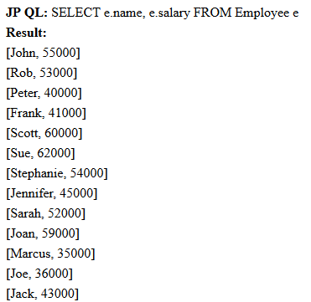
Specification: JSR-000220 Enterprise JavaBeans v.3.x Java Persistence API
query that returns only the name and salary of an employee

Slide 151
Specification: JSR-000220 Enterprise JavaBeans v.3.x Java Persistence API
Any employee making $40,000 to $45,000 inclusively
is included in the results

Slide 152
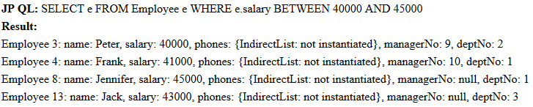

Specification: JSR-000220 Enterprise JavaBeans v.3.x Java Persistence API
Any employee making $40,000 to $45,000 inclusively
is included in the results

Slide 153

Specification: JSR-000220 Enterprise JavaBeans v.3.x Java Persistence API
Any employee making $40,000 to $45,000 inclusively
is included in the results
This is identical

Slide 154
Specification: JSR-000220 Enterprise JavaBeans v.3.x Java Persistence API
The wildcard characters used by the pattern string are
the underscore ( _ ) for single character wildcards and
the percent sign (%) for multicharacter wildcards.

Slide 155
Specification: JSR-000220 Enterprise JavaBeans v.3.x Java Persistence API
The wildcard characters used by the pattern string are
the underscore ( _ ) for single character wildcards and
the percent sign (%) for multicharacter wildcards.

Slide 156
Specification: JSR-000220 Enterprise JavaBeans v.3.x Java Persistence API
We need department names …
“CAEngOtt” or “USEngCal”, but not “CADocOtt

Slide 157


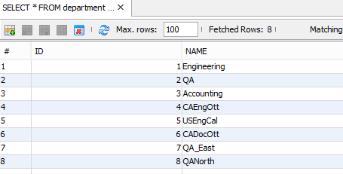
Specification: JSR-000220 Enterprise JavaBeans v.3.x Java Persistence API
We need department names …
“CAEngOtt” or “USEngCal”, but not “CADocOtt

Slide 158
Specification: JSR-000220 Enterprise JavaBeans v.3.x Java Persistence API
subqueries
query returns the employee with the highest salary from among
all employees.

Slide 159
Specification: JSR-000220 Enterprise JavaBeans v.3.x Java Persistence API
subqueries
query returns the employee with the highest salary from among
all employees.

Slide 160

Specification: JSR-000220 Enterprise JavaBeans v.3.x Java Persistence API
subqueries
query returns the employee with the highest salary from among
all employees.
A subquery consisting of an aggregate query (later more) is used to return the
maximum salary value, and then this result is used as the key to filter the employee list by salary.

Slide 161
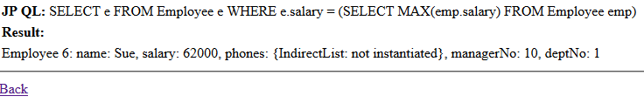
Specification: JSR-000220 Enterprise JavaBeans v.3.x Java Persistence API
subqueries
query returns the employee with the highest salary from among
all employees.
A subquery consisting of an aggregate query (later more) is used to return the
maximum salary value, and then this result is used as the key to filter the employee list by salary.

Slide 162
Specification: JSR-000220 Enterprise JavaBeans v.3.x Java Persistence API
subqueries
query returns the employee with the highest salary from among
all employees.

Slide 163
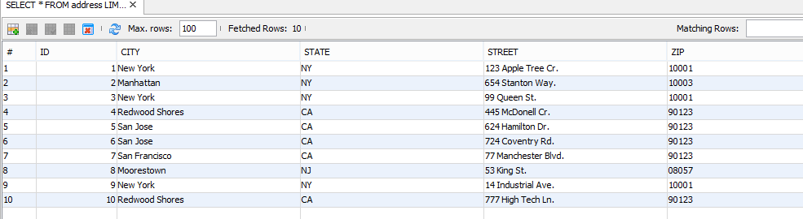
Specification: JSR-000220 Enterprise JavaBeans v.3.x Java Persistence API
IN expresssions
query demonstrates the literal notation by selecting
all the employees who live in New York or California

Slide 164

Specification: JSR-000220 Enterprise JavaBeans v.3.x Java Persistence API
IN expresssions
query demonstrates the literal notation by selecting
all the employees who live in New York or California

Slide 165
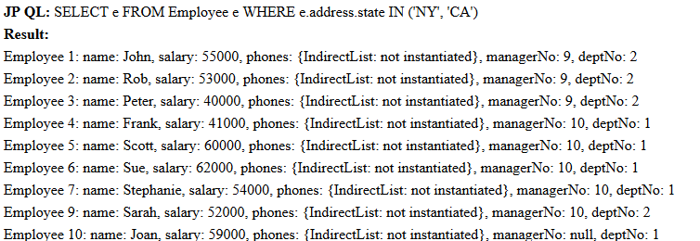
Specification: JSR-000220 Enterprise JavaBeans v.3.x Java Persistence API
IN expresssions
query demonstrates the literal notation by selecting
all the employees who live in New York or California

Slide 166
Specification: JSR-000220 Enterprise JavaBeans v.3.x Java Persistence API
IN expresssions
returns all the
Phone entities representing phone numbers other than for the office or home:

Slide 167
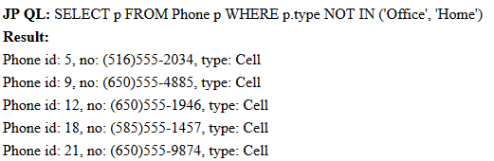

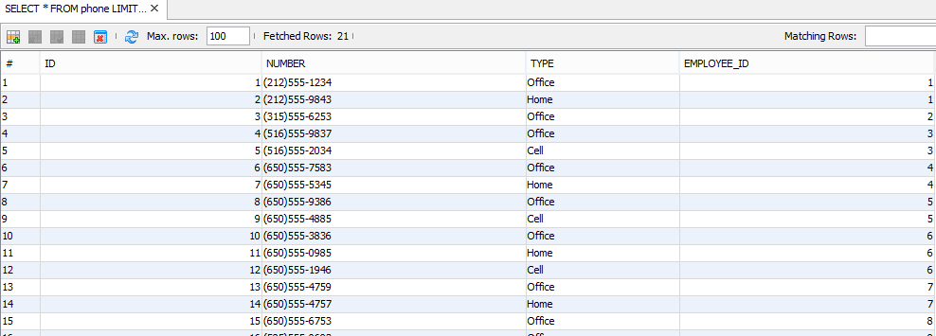
Specification: JSR-000220 Enterprise JavaBeans v.3.x Java Persistence API
IN expresssions
returns all the
Phone entities representing phone numbers other than for the office or home:
)

Slide 168
Specification: JSR-000220 Enterprise JavaBeans v.3.x Java Persistence API
Function expressions

Slide 169
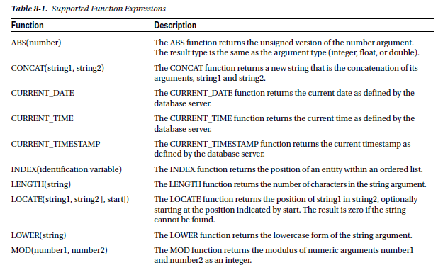
Specification: JSR-000220 Enterprise JavaBeans v.3.x Java Persistence API
Function expressions

Slide 170
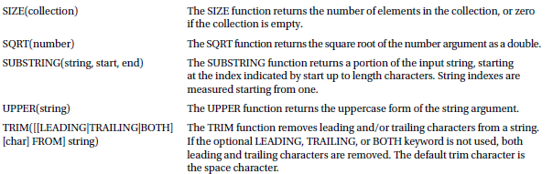
Specification: JSR-000220 Enterprise JavaBeans v.3.x Java Persistence API
Function expressions

Slide 171
Specification: JSR-000220 Enterprise JavaBeans v.3.x Java Persistence API
Function expressions
following query that returns all departments with only two employees

Slide 172


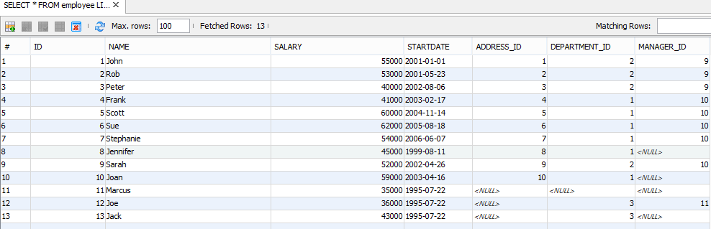
Specification: JSR-000220 Enterprise JavaBeans v.3.x Java Persistence API
Function expressions
following query that returns all departments with only two employees

Slide 173

Specification: JSR-000220 Enterprise JavaBeans v.3.x Java Persistence API
Function expressions
The equivalent form of the previous example using a subquery is as follows:

Slide 174
Specification: JSR-000220 Enterprise JavaBeans v.3.x Java Persistence API
Aggregate Queries
AVG is an aggregate function that takes a numeric
state field path expression as an argument and calculates the average over the group.
query returns the average salary of all employees in the company

Slide 175
Specification: JSR-000220 Enterprise JavaBeans v.3.x Java Persistence API
Aggregate Queries
AVG is an aggregate function that takes a numeric
state field path expression as an argument and calculates the average over the group.
query returns the average salary of all employees in the company

Slide 176
Specification: JSR-000220 Enterprise JavaBeans v.3.x Java Persistence API
Aggregate Queries
query returns the average salary of all employees in the company

Slide 177

Specification: JSR-000220 Enterprise JavaBeans v.3.x Java Persistence API
Aggregate Queries
query returns the average salary of all employees in the company

Slide 178
Specification: JSR-000220 Enterprise JavaBeans v.3.x Java Persistence API
Aggregate Queries
query returns the average salary of all employees in the company

Slide 179
Specification: JSR-000220 Enterprise JavaBeans v.3.x Java Persistence API
JP QL supports queries that draw on multiple entities and the
relationships between them.

Slide 180

Specification: JSR-000220 Enterprise JavaBeans v.3.x Java Persistence API
JP QL supports queries that draw on multiple entities and the
relationships between them.
Inner joins between two entities can be specified in one of the ways that were listed
This query uses the JOIN operator to join the Employee entity to the Phone entity across the phones relationship
By joining the two entities together, this query returns all the Phone entity instances associated with employees in the company

Slide 181
Specification: JSR-000220 Enterprise JavaBeans v.3.x Java Persistence API
JP QL supports queries that draw on multiple entities and the
relationships between them.
Inner joins between two entities can be specified in one of the ways that were listed
This query uses the JOIN operator to join the Employee entity to the Phone entity across the phones relationship
By joining the two entities together, this query returns all the Phone entity instances associated with employees in the company

Slide 182
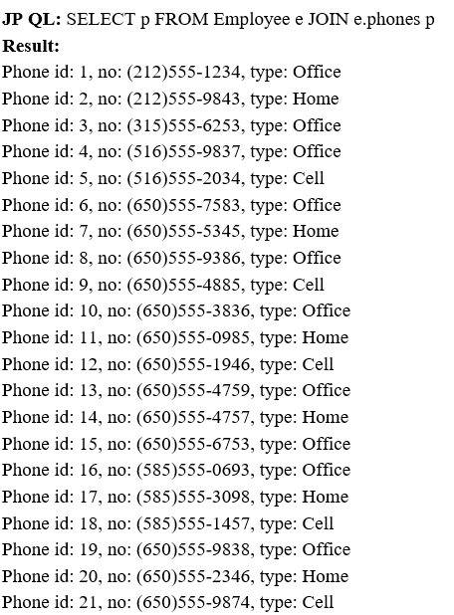
Specification: JSR-000220 Enterprise JavaBeans v.3.x Java Persistence API
JP QL supports queries that draw on multiple entities and the
relationships between them.
Inner joins between two entities can be specified in one of the ways that were listed
This query uses the JOIN operator to join the Employee entity to the Phone entity across the phones relationship
By joining the two entities together, this query returns all the Phone entity instances associated with employees in the company

Slide 183
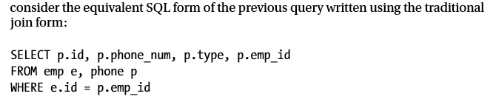
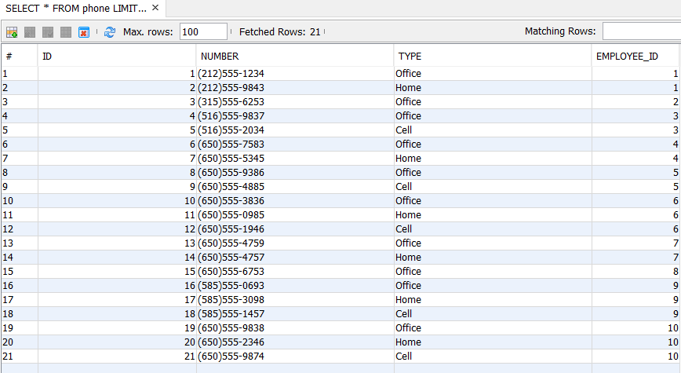
Specification: JSR-000220 Enterprise JavaBeans v.3.x Java Persistence API
JP QL supports queries that draw on multiple entities and the
relationships between them.
Inner joins between two entities can be specified in one of the ways that were listed

Slide 184
Specification: JSR-000220 Enterprise JavaBeans v.3.x Java Persistence API
JP QL supports queries that draw on multiple entities and the
relationships between them.
Inner joins between two entities can be specified in one of the ways that were listed

Slide 185
Specification: JSR-000220 Enterprise JavaBeans v.3.x Java Persistence API
instead of returning Phone entity instances, phone numbers can be
returned instead.

Slide 186
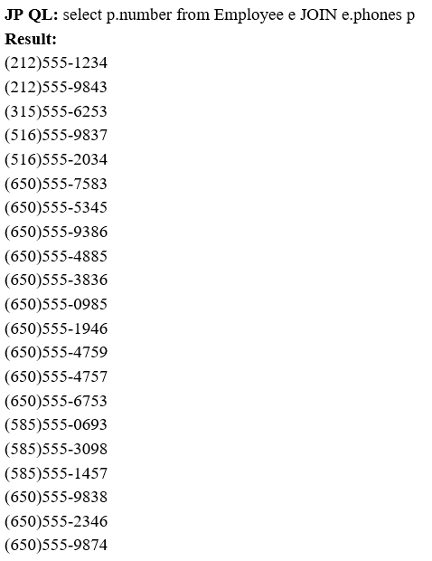

Specification: JSR-000220 Enterprise JavaBeans v.3.x Java Persistence API
instead of returning Phone entity instances, phone numbers can be
returned instead.

Slide 187
Specification: JSR-000220 Enterprise JavaBeans v.3.x Java Persistence API
instead of returning Phone entity instances, phone numbers can be
returned instead.

Slide 188
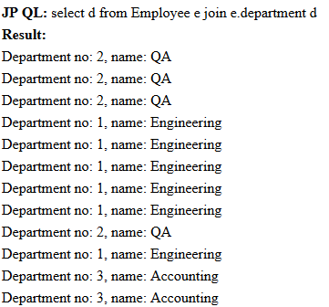


Specification: JSR-000220 Enterprise JavaBeans v.3.x Java Persistence API
This query defines a join from Employee to Department across
the department relationship
This is semantically equivalent to using a path expression in
the SELECT clause to obtain the department for the employee

Slide 189
Specification: JSR-000220 Enterprise JavaBeans v.3.x Java Persistence API
This query defines a join from Employee to Department across
the department relationship
This is semantically equivalent to using a path expression in
the SELECT clause to obtain the department for the employee

Slide 190
Specification: JSR-000220 Enterprise JavaBeans v.3.x Java Persistence API
This query defines a join from Employee to Department across
the department relationship
This is semantically equivalent to using a path expression in
the SELECT clause to obtain the department for the employee

Slide 191
Specification: JSR-000220 Enterprise JavaBeans v.3.x Java Persistence API
This query defines a join from Employee to Department across
the department relationship
This is semantically equivalent to using a path expression in
the SELECT clause to obtain the department for the employee

Slide 192
Specification: JSR-000220 Enterprise JavaBeans v.3.x Java Persistence API
This query defines a join from Employee to Department across
the department relationship
This is semantically equivalent to using a path expression in
the SELECT clause to obtain the department for the employee

Slide 193

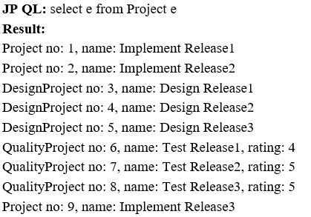

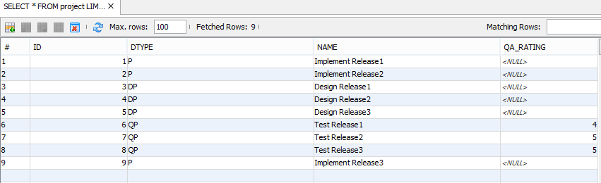
Specification: JSR-000220 Enterprise JavaBeans v.3.x Java Persistence API
following example that returns the distinct departments based in
California that are participating in the “Implement Release1” project

Slide 194
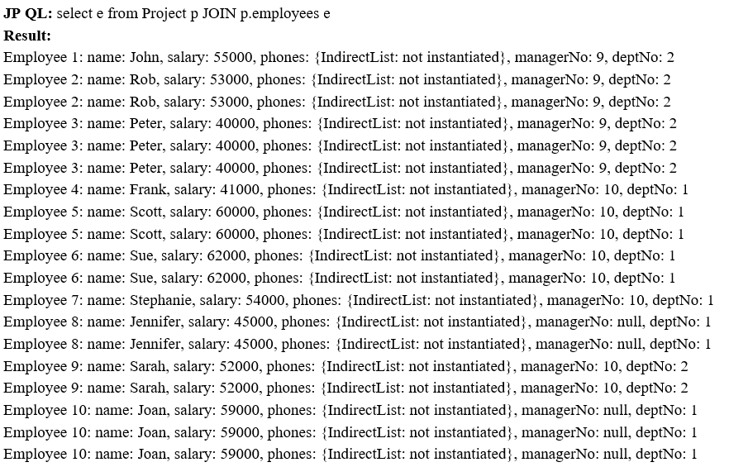

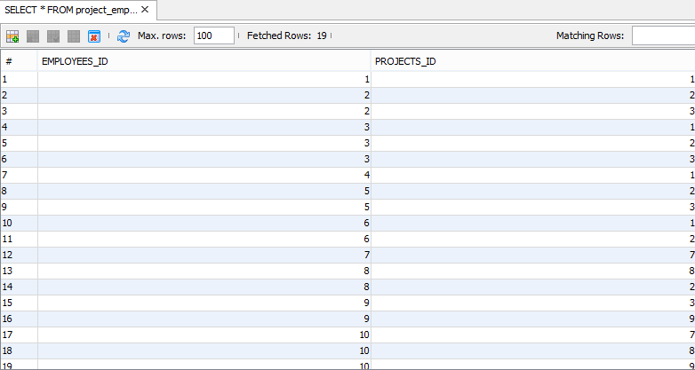
Specification: JSR-000220 Enterprise JavaBeans v.3.x Java Persistence API
following example that returns the distinct departments based in
California that are participating in the “Implement Release1” project

Slide 195

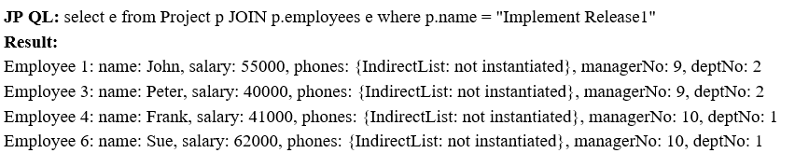
Specification: JSR-000220 Enterprise JavaBeans v.3.x Java Persistence API
following example that returns the distinct departments based in
California that are participating in the “Implement Release1” project

Slide 196
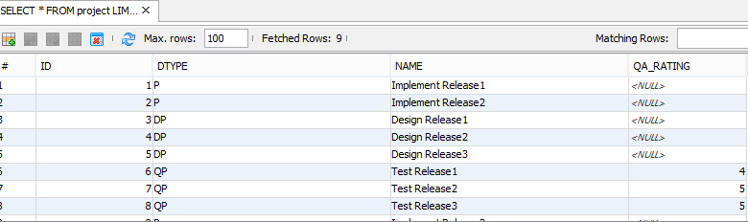
Specification: JSR-000220 Enterprise JavaBeans v.3.x Java Persistence API

Slide 197
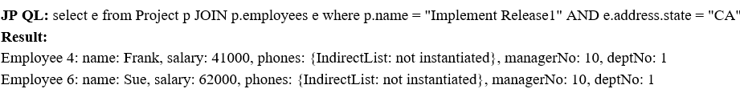
Specification: JSR-000220 Enterprise JavaBeans v.3.x Java Persistence API
following example that returns the distinct departments based in
California that are participating in the “Implement Release1” project

Slide 198
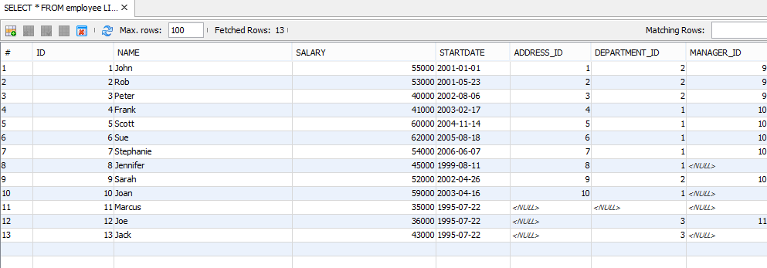

Specification: JSR-000220 Enterprise JavaBeans v.3.x Java Persistence API

Slide 199
Specification: JSR-000220 Enterprise JavaBeans v.3.x Java Persistence API

