Slide 1

Abfragen mit
JPA-QL H-QL 2nd

Slide 2

Specification: JSR-000220 Enterprise JavaBeans v.3.x Java Persistence API
Abfragen mit
JPA-QL H-QL 2nd

Slide 3

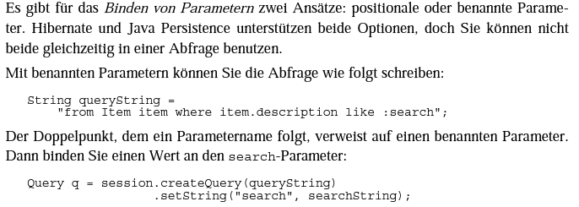
Specification: JSR-000220 Enterprise JavaBeans v.3.x Java Persistence API

Slide 4
Specification: JSR-000220 Enterprise JavaBeans v.3.x Java Persistence API

Slide 5
Specification: JSR-000220 Enterprise JavaBeans v.3.x Java Persistence API

Slide 6
Specification: JSR-000220 Enterprise JavaBeans v.3.x Java Persistence API

Slide 7
Specification: JSR-000220 Enterprise JavaBeans v.3.x Java Persistence API

Slide 8
Specification: JSR-000220 Enterprise JavaBeans v.3.x Java Persistence API

Slide 9
Specification: JSR-000220 Enterprise JavaBeans v.3.x Java Persistence API

Slide 10
Specification: JSR-000220 Enterprise JavaBeans v.3.x Java Persistence API

Slide 11
Specification: JSR-000220 Enterprise JavaBeans v.3.x Java Persistence API

Slide 12
Specification: JSR-000220 Enterprise JavaBeans v.3.x Java Persistence API

Slide 13
Specification: JSR-000220 Enterprise JavaBeans v.3.x Java Persistence API

Slide 14
Specification: JSR-000220 Enterprise JavaBeans v.3.x Java Persistence API

Slide 15
Specification: JSR-000220 Enterprise JavaBeans v.3.x Java Persistence API
1

Slide 16
Specification: JSR-000220 Enterprise JavaBeans v.3.x Java Persistence API
1

Slide 17
Specification: JSR-000220 Enterprise JavaBeans v.3.x Java Persistence API
1
2

Slide 18
Specification: JSR-000220 Enterprise JavaBeans v.3.x Java Persistence API
1
2

Slide 19
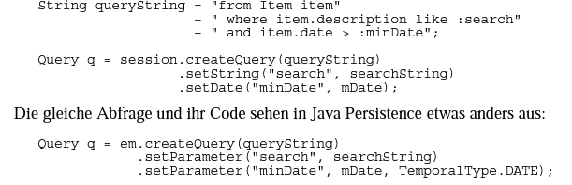
Specification: JSR-000220 Enterprise JavaBeans v.3.x Java Persistence API

Slide 20
Specification: JSR-000220 Enterprise JavaBeans v.3.x Java Persistence API
1

Slide 21
Specification: JSR-000220 Enterprise JavaBeans v.3.x Java Persistence API
1

Slide 22
Specification: JSR-000220 Enterprise JavaBeans v.3.x Java Persistence API
1
2

Slide 23
Specification: JSR-000220 Enterprise JavaBeans v.3.x Java Persistence API
1
2

Slide 24
Specification: JSR-000220 Enterprise JavaBeans v.3.x Java Persistence API

Slide 25
Specification: JSR-000220 Enterprise JavaBeans v.3.x Java Persistence API

Slide 26
Specification: JSR-000220 Enterprise JavaBeans v.3.x Java Persistence API

Slide 27
Specification: JSR-000220 Enterprise JavaBeans v.3.x Java Persistence API

Slide 28
Specification: JSR-000220 Enterprise JavaBeans v.3.x Java Persistence API

Slide 29
Specification: JSR-000220 Enterprise JavaBeans v.3.x Java Persistence API

Slide 30
Specification: JSR-000220 Enterprise JavaBeans v.3.x Java Persistence API

Slide 31
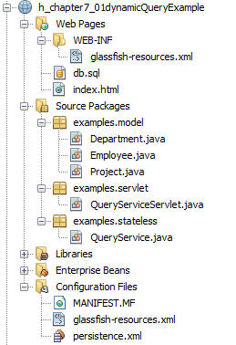
Specification: JSR-000220 Enterprise JavaBeans v.3.x Java Persistence API

Slide 32
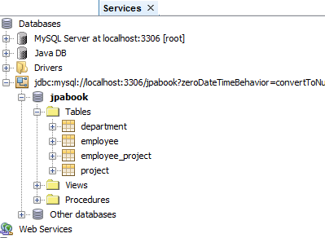
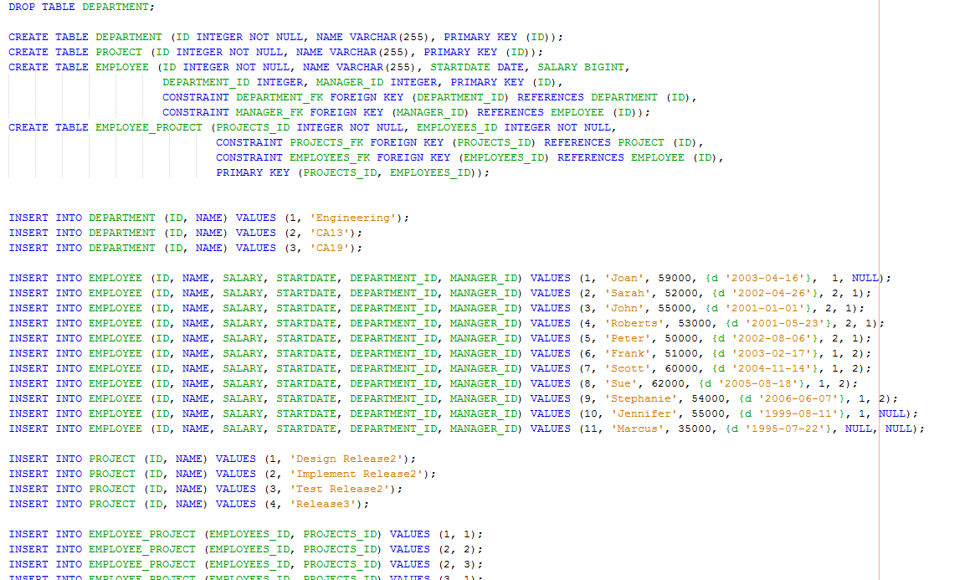
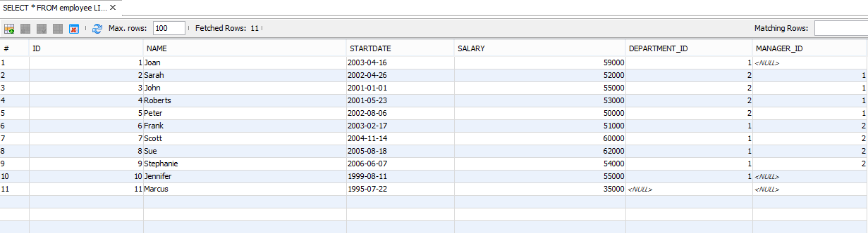
Specification: JSR-000220 Enterprise JavaBeans v.3.x Java Persistence API

Slide 33
Specification: JSR-000220 Enterprise JavaBeans v.3.x Java Persistence API

Slide 34
Specification: JSR-000220 Enterprise JavaBeans v.3.x Java Persistence API

Slide 35
Specification: JSR-000220 Enterprise JavaBeans v.3.x Java Persistence API
exercise

Slide 36
Specification: JSR-000220 Enterprise JavaBeans v.3.x Java Persistence API
exercise

Slide 37
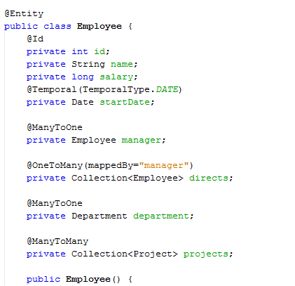
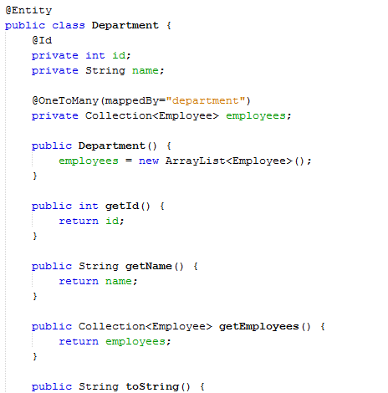
Specification: JSR-000220 Enterprise JavaBeans v.3.x Java Persistence API

Slide 38
Specification: JSR-000220 Enterprise JavaBeans v.3.x Java Persistence API

Slide 39
Specification: JSR-000220 Enterprise JavaBeans v.3.x Java Persistence API

Slide 40
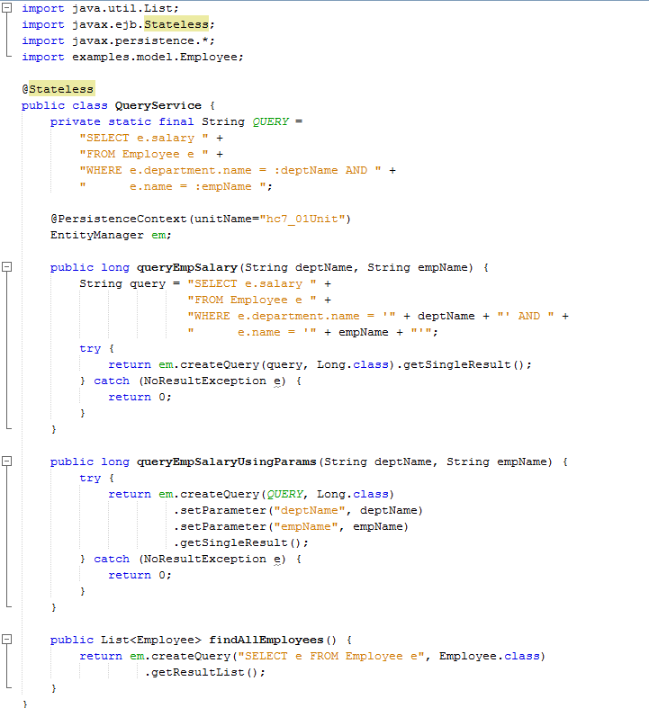

Slide 42


Slide 49
Specification: JSR-000220 Enterprise JavaBeans v.3.x Java Persistence API

Slide 50
Specification: JSR-000220 Enterprise JavaBeans v.3.x Java Persistence API

Slide 51
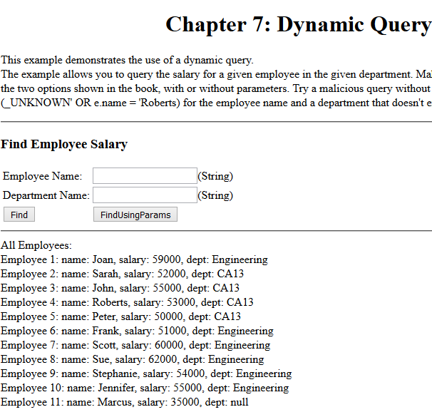
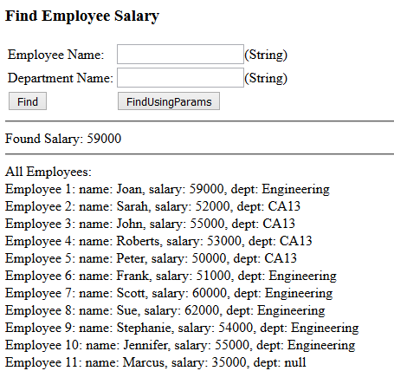

Specification: JSR-000220 Enterprise JavaBeans v.3.x Java Persistence API

Slide 52
Specification: JSR-000220 Enterprise JavaBeans v.3.x Java Persistence API

Slide 53
Specification: JSR-000220 Enterprise JavaBeans v.3.x Java Persistence API
exercise

Slide 54
Specification: JSR-000220 Enterprise JavaBeans v.3.x Java Persistence API
exercise

Slide 55
Specification: JSR-000220 Enterprise JavaBeans v.3.x Java Persistence API
exercise

Slide 56
exercise

