Slide 1

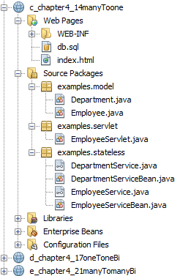
Specification: JSR-000220 Enterprise JavaBeans v.3.x Java Persistence API

Slide 2
Specification: JSR-000220 Enterprise JavaBeans v.3.x Java Persistence API
Theorie
Praxis

Slide 3
Specification: JSR-000220 Enterprise JavaBeans v.3.x Java Persistence API

Slide 4
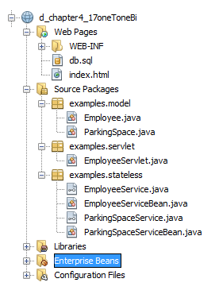
Specification: JSR-000220 Enterprise JavaBeans v.3.x Java Persistence API
one2one relationships
bidirektional
a realistic example of a one-to-one association, however, would be an employee who has a parking space.
Assuming that every employee got assigned his or her own parking space

Slide 5
Specification: JSR-000220 Enterprise JavaBeans v.3.x Java Persistence API
one2one relationships
bidirektional
a realistic example of a one-to-one association, however, would be an employee who has a parking space.
Assuming that every employee got assigned his or her own parking space

Slide 6
Specification: JSR-000220 Enterprise JavaBeans v.3.x Java Persistence API
one2one relationships
bidirektional
a realistic example of a one-to-one association, however, would be an employee who has a parking space.
Assuming that every employee got assigned his or her own parking space

Slide 7
Specification: JSR-000220 Enterprise JavaBeans v.3.x Java Persistence API
one2one relationships
bidirektional
a realistic example of a one-to-one association, however, would be an employee who has a parking space.
Assuming that every employee got assigned his or her own parking space

Slide 8
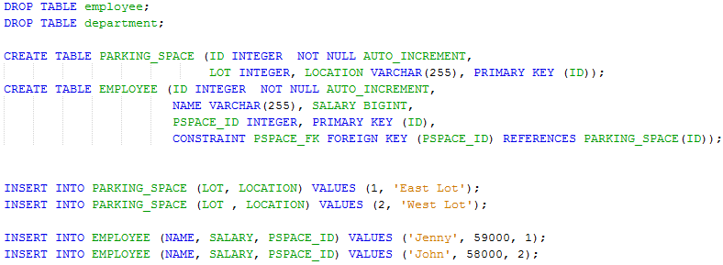
Specification: JSR-000220 Enterprise JavaBeans v.3.x Java Persistence API
one2one relationships
bidirektional

Slide 9
Specification: JSR-000220 Enterprise JavaBeans v.3.x Java Persistence API
one2one relationships
bidirektional

Slide 10
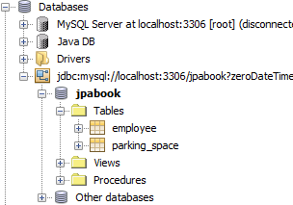
Specification: JSR-000220 Enterprise JavaBeans v.3.x Java Persistence API
one2one relationships
bidirektional

Slide 11
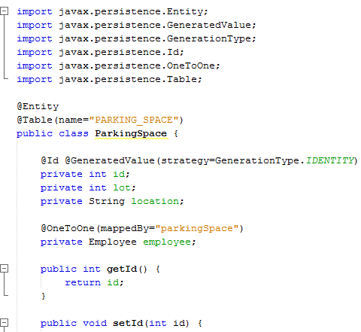
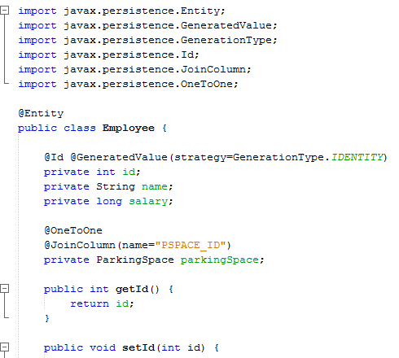
Specification: JSR-000220 Enterprise JavaBeans v.3.x Java Persistence API
one2one relationships
bidirektional

Slide 12
Specification: JSR-000220 Enterprise JavaBeans v.3.x Java Persistence API
one2one relationships
bidirektional
bidirektional

Slide 13
Specification: JSR-000220 Enterprise JavaBeans v.3.x Java Persistence API
one2one relationships
bidirektional
bidirektional

Slide 14
Specification: JSR-000220 Enterprise JavaBeans v.3.x Java Persistence API
one2one relationships
bidirektional

Slide 15
Specification: JSR-000220 Enterprise JavaBeans v.3.x Java Persistence API
one2one relationships
bidirektional

Slide 16
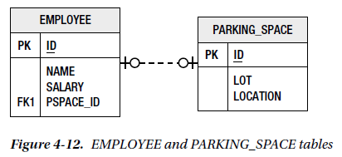
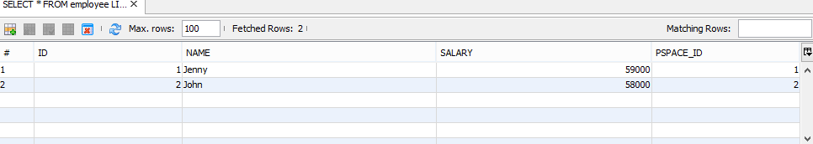
Specification: JSR-000220 Enterprise JavaBeans v.3.x Java Persistence API
one2one relationships
bidirektional
one-to-one mappings are almost the same as many-to-one mappings
except that
only one instance of the source entity can refer to the same target entity instance.

Slide 17
Specification: JSR-000220 Enterprise JavaBeans v.3.x Java Persistence API
one2one relationships
bidirektional
one-to-one mappings are almost the same as many-to-one mappings
except that
only one instance of the source entity can refer to the same target entity instance.

Slide 18
Specification: JSR-000220 Enterprise JavaBeans v.3.x Java Persistence API
one2one relationships
bidirektional
one-to-one mappings are almost the same as many-to-one mappings
except that
only one instance of the source entity can refer to the same target entity instance.

Slide 19
Specification: JSR-000220 Enterprise JavaBeans v.3.x Java Persistence API
one2one relationships
bidirektional
one-to-one mappings are almost the same as many-to-one mappings
except that
only one instance of the source entity can refer to the same target entity instance.

Slide 20
Specification: JSR-000220 Enterprise JavaBeans v.3.x Java Persistence API
one2one relationships
bidirektional
one-to-one mappings are almost the same as many-to-one mappings
except that
only one instance of the source entity can refer to the same target entity instance.

Slide 21
Specification: JSR-000220 Enterprise JavaBeans v.3.x Java Persistence API

Slide 22
Specification: JSR-000220 Enterprise JavaBeans v.3.x Java Persistence API

Slide 23
Specification: JSR-000220 Enterprise JavaBeans v.3.x Java Persistence API

Slide 24
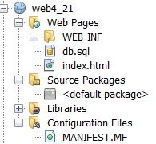
Specification: JSR-000220 Enterprise JavaBeans v.3.x Java Persistence API

Slide 25
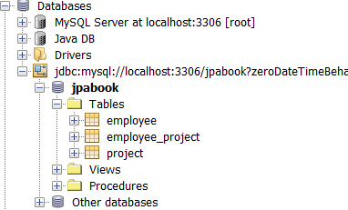
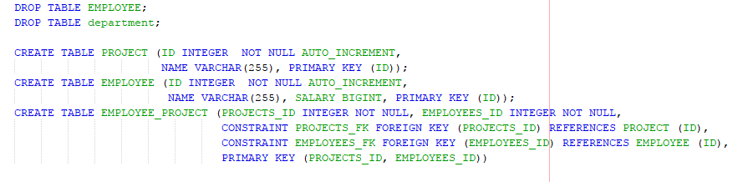
Specification: JSR-000220 Enterprise JavaBeans v.3.x Java Persistence API

Slide 26
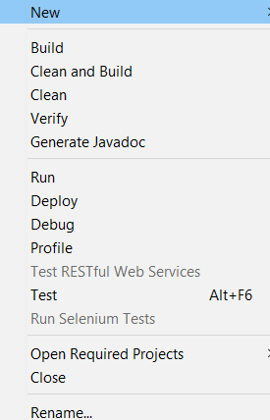
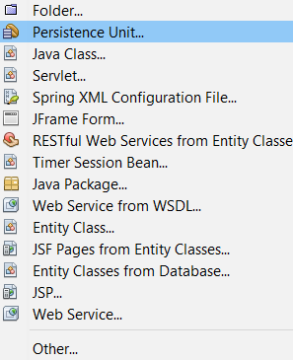
Specification: JSR-000220 Enterprise JavaBeans v.3.x Java Persistence API

Slide 27
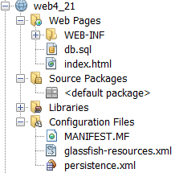
Specification: JSR-000220 Enterprise JavaBeans v.3.x Java Persistence API

Slide 28
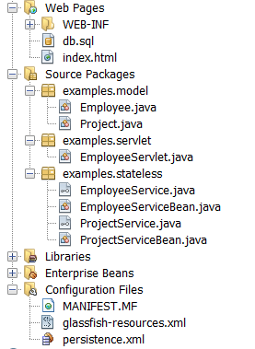
Specification: JSR-000220 Enterprise JavaBeans v.3.x Java Persistence API

Slide 29
Specification: JSR-000220 Enterprise JavaBeans v.3.x Java Persistence API

Slide 30
Specification: JSR-000220 Enterprise JavaBeans v.3.x Java Persistence API

Slide 31
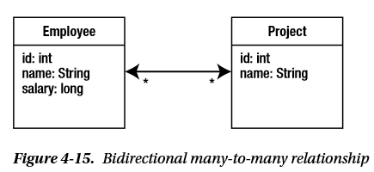
Specification: JSR-000220 Enterprise JavaBeans v.3.x Java Persistence API
Each employee can work on multiple projects, and
…. and each project can be worked on by multiple employees.

Slide 32
Specification: JSR-000220 Enterprise JavaBeans v.3.x Java Persistence API
Each employee can work on multiple projects, and
…. and each project can be worked on by multiple employees.
…. and each project can be worked on by multiple employees.

Slide 33
Specification: JSR-000220 Enterprise JavaBeans v.3.x Java Persistence API
Each employee can work on multiple projects, and
…. and each project can be worked on by multiple employees.
…. and each project can be worked on by multiple employees.

Slide 34
Specification: JSR-000220 Enterprise JavaBeans v.3.x Java Persistence API
Each employee can work on multiple projects, and
…. and each project can be worked on by multiple employees.
…. and each project can be worked on by multiple employees.

Slide 35
Specification: JSR-000220 Enterprise JavaBeans v.3.x Java Persistence API
Each employee can work on multiple projects, and
…. and each project can be worked on by multiple employees.
…. and each project can be worked on by multiple employees.

Slide 36
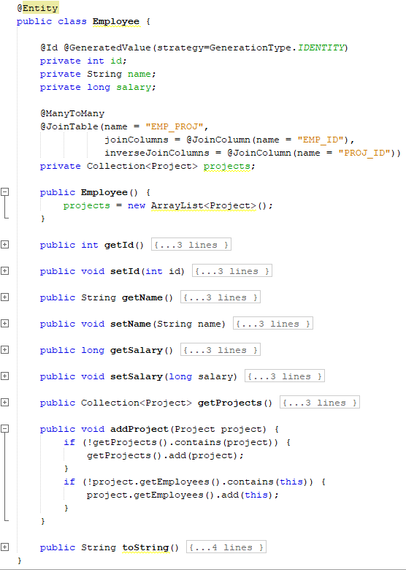
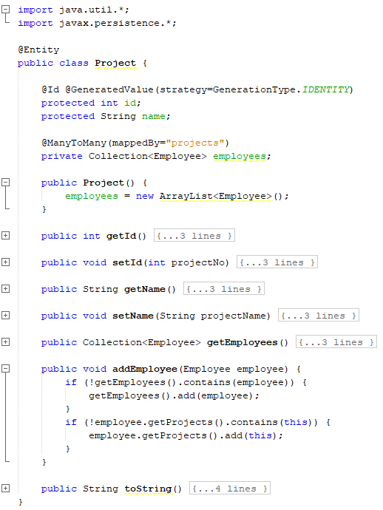

Slide 38
A many-to-many mapping is expressed on both the source and target
entities as a @ManyToMany annotation on the collection attributes

Slide 39
A many-to-many mapping is expressed on both the source and target
entities as a @ManyToMany annotation on the collection attributes

Slide 40
A many-to-many mapping is expressed on both the source and target
entities as a @ManyToMany annotation on the collection attributes

Slide 41
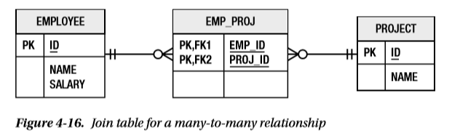
Specification: JSR-000220 Enterprise JavaBeans v.3.x Java Persistence API
Because the multiplicity of both sides of a many-to-many relationship is plural,
neither of the two entity tables can store an unlimited set of foreign key values in a single entity row.
We must use a third table to associate the two entity type
This association table is called a join table, and
each many-to-many relationship must have one

Slide 42
Specification: JSR-000220 Enterprise JavaBeans v.3.x Java Persistence API
Because the multiplicity of both sides of a many-to-many relationship is plural,
neither of the two entity tables can store an unlimited set of foreign key values in a single entity row.
We must use a third table to associate the two entity type
This association table is called a join table, and
each many-to-many relationship must have one

Slide 43
Specification: JSR-000220 Enterprise JavaBeans v.3.x Java Persistence API
Because the multiplicity of both sides of a many-to-many relationship is plural,
neither of the two entity tables can store an unlimited set of foreign key values in a single entity row.
We must use a third table to associate the two entity type
This association table is called a join table, and
each many-to-many relationship must have one

Slide 44
Specification: JSR-000220 Enterprise JavaBeans v.3.x Java Persistence API
Because the multiplicity of both sides of a many-to-many relationship is plural,
neither of the two entity tables can store an unlimited set of foreign key values in a single entity row.
We must use a third table to associate the two entity type
This association table is called a join table, and
each many-to-many relationship must have one

Slide 45
Specification: JSR-000220 Enterprise JavaBeans v.3.x Java Persistence API
Because the multiplicity of both sides of a many-to-many relationship is plural,
neither of the two entity tables can store an unlimited set of foreign key values in a single entity row.
We must use a third table to associate the two entity type
This association table is called a join table, and
each many-to-many relationship must have one

Slide 46
Specification: JSR-000220 Enterprise JavaBeans v.3.x Java Persistence API
A join table consists simply of two foreign key or join columns to
refer to each of the two entity types in the relationship.
A collection of entities is then mapped as multiple rows in the table, each of which associates one entity with another.
The set of rows that contain a given entity identifier in the source foreign
key column represents the collection of entities related to that given entity.

Slide 47
Specification: JSR-000220 Enterprise JavaBeans v.3.x Java Persistence API
A join table consists simply of two foreign key or join columns to
refer to each of the two entity types in the relationship.
A collection of entities is then mapped as multiple rows in the table, each of which associates one entity with another.
The set of rows that contain a given entity identifier in the source foreign
key column represents the collection of entities related to that given entity.

Slide 54
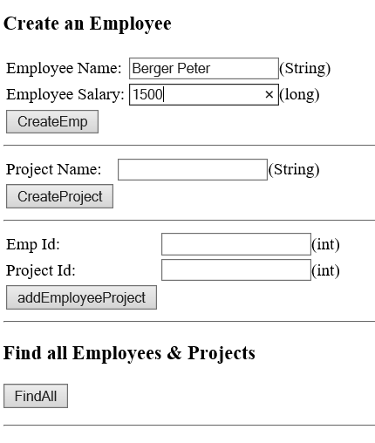
Specification: JSR-000220 Enterprise JavaBeans v.3.x Java Persistence API

Slide 55
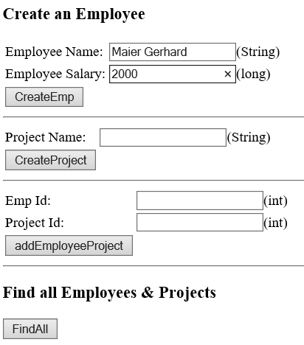

Specification: JSR-000220 Enterprise JavaBeans v.3.x Java Persistence API

Slide 56
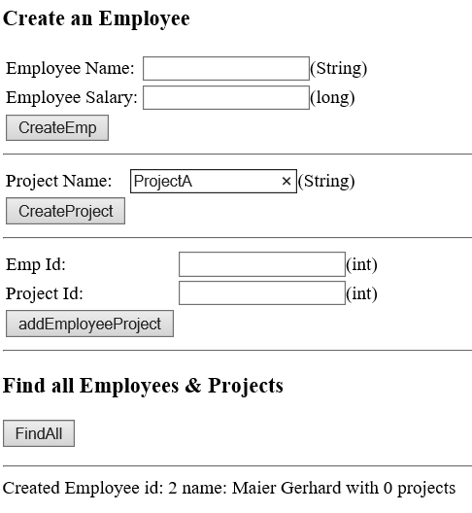
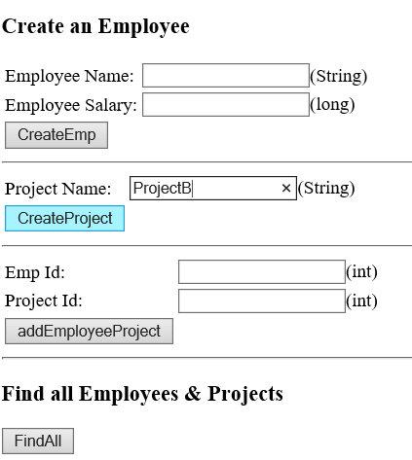
Specification: JSR-000220 Enterprise JavaBeans v.3.x Java Persistence API

Slide 57
Specification: JSR-000220 Enterprise JavaBeans v.3.x Java Persistence API

Slide 58
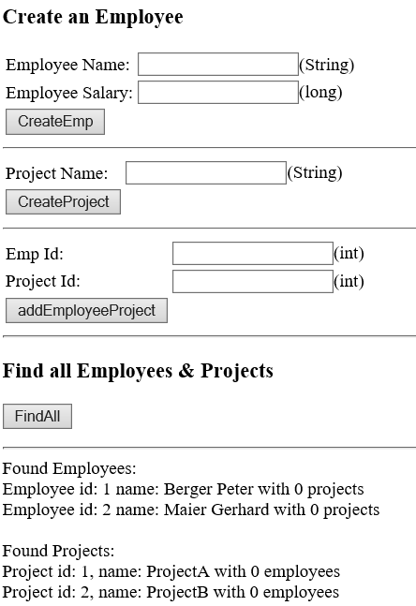
Specification: JSR-000220 Enterprise JavaBeans v.3.x Java Persistence API

Slide 59
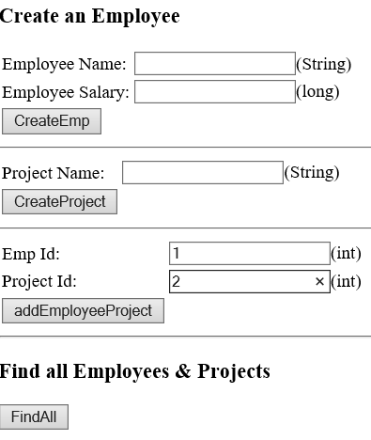
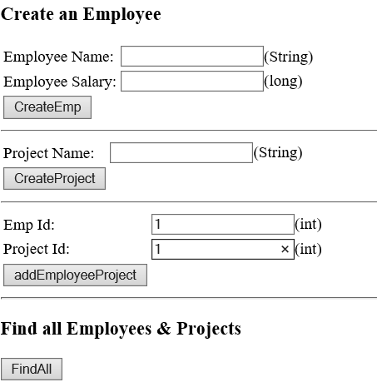
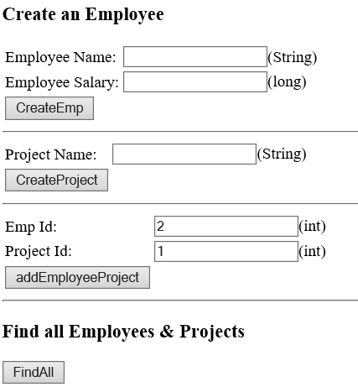

Specification: JSR-000220 Enterprise JavaBeans v.3.x Java Persistence API

Slide 60
Specification: JSR-000220 Enterprise JavaBeans v.3.x Java Persistence API

Slide 61
Specification: JSR-000220 Enterprise JavaBeans v.3.x Java Persistence API

Slide 62
Specification: JSR-000220 Enterprise JavaBeans v.3.x Java Persistence API

Slide 63
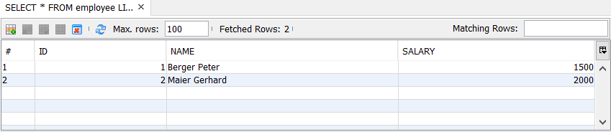
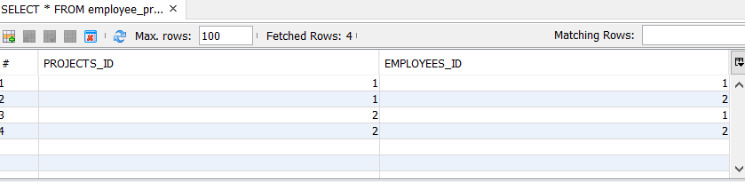
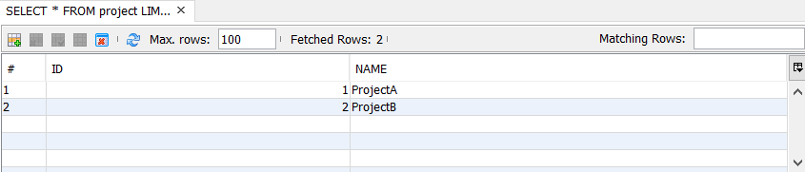
Specification: JSR-000220 Enterprise JavaBeans v.3.x Java Persistence API

Slide 64
Specification: JSR-000220 Enterprise JavaBeans v.3.x Java Persistence API

Slide 65
Specification: JSR-000220 Enterprise JavaBeans v.3.x Java Persistence API

Slide 66
exercise

Slide 67
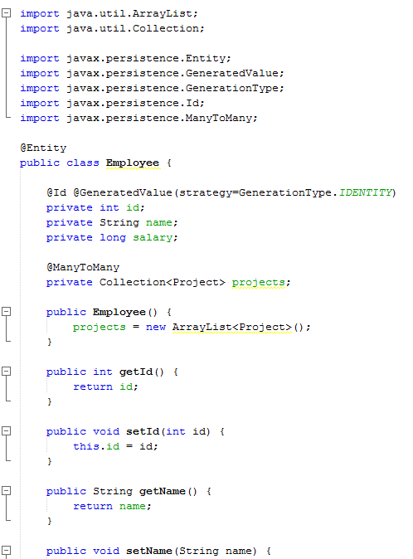
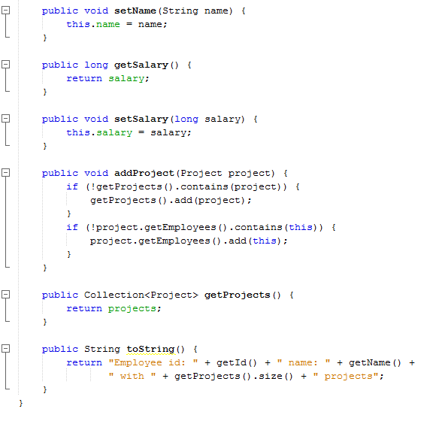
exercise

Slide 68
exercise

Slide 69
Specification: JSR-000220 Enterprise JavaBeans v.3.x Java Persistence API

