Slide 1

JPA many2many mapping

Slide 2

Specification: JSR-000220 Enterprise JavaBeans v.3.x Java Persistence API
JPA many2many mapping

Slide 3
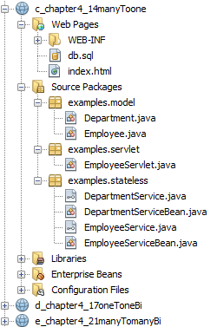
Specification: JSR-000220 Enterprise JavaBeans v.3.x Java Persistence API

Slide 4
Specification: JSR-000220 Enterprise JavaBeans v.3.x Java Persistence API

Slide 5
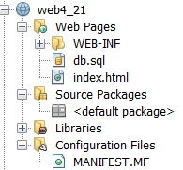
Specification: JSR-000220 Enterprise JavaBeans v.3.x Java Persistence API

Slide 6
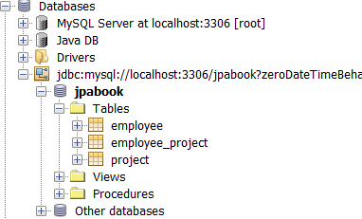
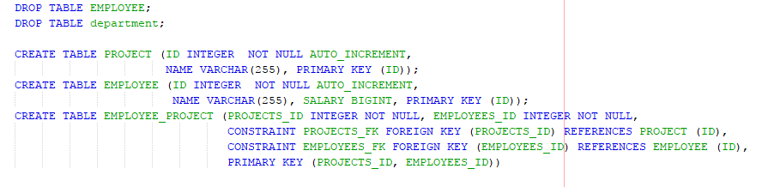
Specification: JSR-000220 Enterprise JavaBeans v.3.x Java Persistence API

Slide 7
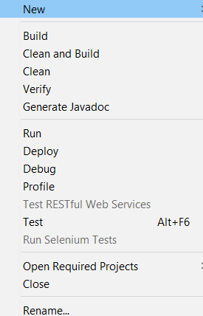
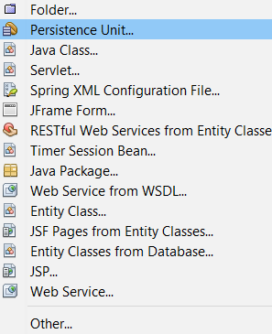
Specification: JSR-000220 Enterprise JavaBeans v.3.x Java Persistence API

Slide 8
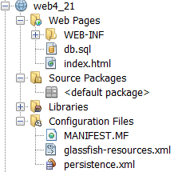
Specification: JSR-000220 Enterprise JavaBeans v.3.x Java Persistence API

Slide 9
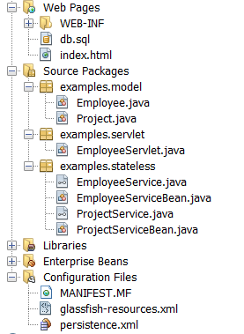
Specification: JSR-000220 Enterprise JavaBeans v.3.x Java Persistence API

Slide 10
Specification: JSR-000220 Enterprise JavaBeans v.3.x Java Persistence API

Slide 11
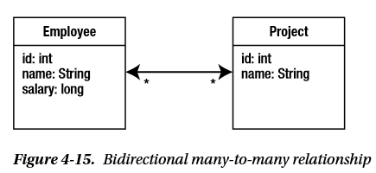
Specification: JSR-000220 Enterprise JavaBeans v.3.x Java Persistence API
Each employee can work on multiple projects, and
…. and each project can be worked on by multiple employees.

Slide 12
Specification: JSR-000220 Enterprise JavaBeans v.3.x Java Persistence API
Each employee can work on multiple projects, and
…. and each project can be worked on by multiple employees.
…. and each project can be worked on by multiple employees.

Slide 13
Specification: JSR-000220 Enterprise JavaBeans v.3.x Java Persistence API
Each employee can work on multiple projects, and
…. and each project can be worked on by multiple employees.
…. and each project can be worked on by multiple employees.

Slide 14
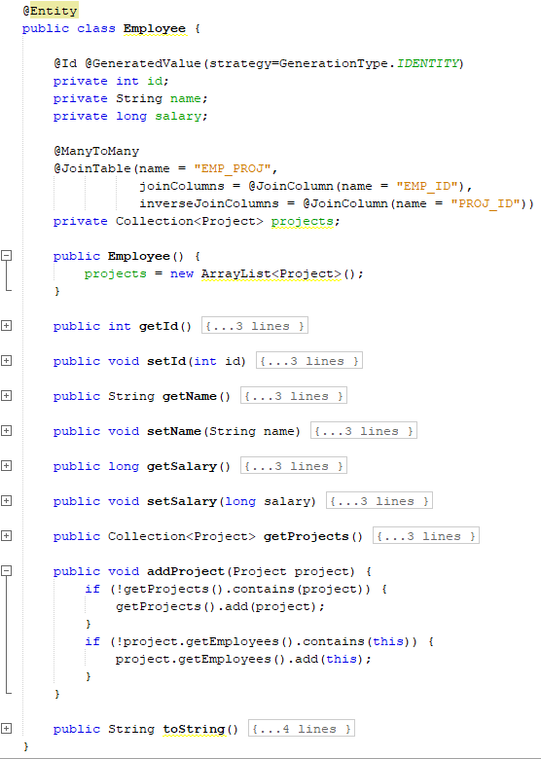
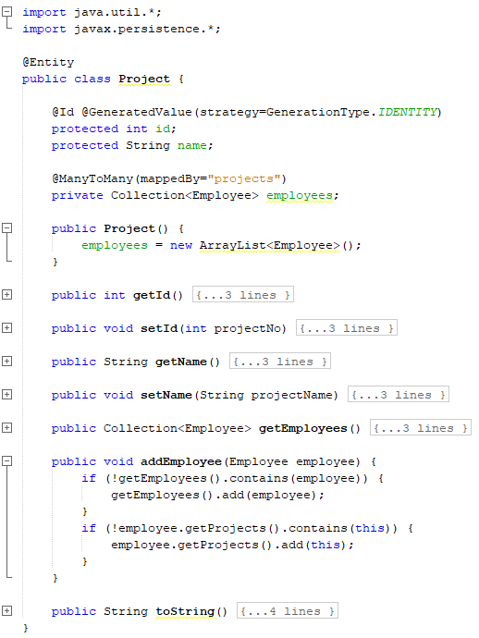

Slide 16
A many-to-many mapping is expressed on both the source and target
entities as a @ManyToMany annotation on the collection attributes

Slide 17
A many-to-many mapping is expressed on both the source and target
entities as a @ManyToMany annotation on the collection attributes

Slide 18
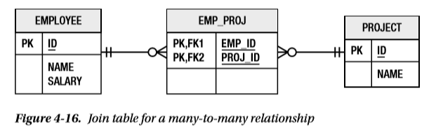
Specification: JSR-000220 Enterprise JavaBeans v.3.x Java Persistence API
Because the multiplicity of both sides of a many-to-many relationship is plural,
neither of the two entity tables can store an unlimited set of foreign key values in a single entity row.
We must use a third table to associate the two entity type
This association table is called a join table, and
each many-to-many relationship must have one

Slide 19
Specification: JSR-000220 Enterprise JavaBeans v.3.x Java Persistence API
Because the multiplicity of both sides of a many-to-many relationship is plural,
neither of the two entity tables can store an unlimited set of foreign key values in a single entity row.
We must use a third table to associate the two entity type
This association table is called a join table, and
each many-to-many relationship must have one

Slide 20
Specification: JSR-000220 Enterprise JavaBeans v.3.x Java Persistence API
Because the multiplicity of both sides of a many-to-many relationship is plural,
neither of the two entity tables can store an unlimited set of foreign key values in a single entity row.
We must use a third table to associate the two entity type
This association table is called a join table, and
each many-to-many relationship must have one

Slide 21
Specification: JSR-000220 Enterprise JavaBeans v.3.x Java Persistence API
Because the multiplicity of both sides of a many-to-many relationship is plural,
neither of the two entity tables can store an unlimited set of foreign key values in a single entity row.
We must use a third table to associate the two entity type
This association table is called a join table, and
each many-to-many relationship must have one

Slide 22
Specification: JSR-000220 Enterprise JavaBeans v.3.x Java Persistence API
Because the multiplicity of both sides of a many-to-many relationship is plural,
neither of the two entity tables can store an unlimited set of foreign key values in a single entity row.
We must use a third table to associate the two entity type
This association table is called a join table, and
each many-to-many relationship must have one

Slide 23
Specification: JSR-000220 Enterprise JavaBeans v.3.x Java Persistence API
A join table consists simply of two foreign key or join columns to
refer to each of the two entity types in the relationship.
A collection of entities is then mapped as multiple rows in the table, each of which associates one entity with another.
The set of rows that contain a given entity identifier in the source foreign
key column represents the collection of entities related to that given entity.

Slide 24
Specification: JSR-000220 Enterprise JavaBeans v.3.x Java Persistence API
A join table consists simply of two foreign key or join columns to
refer to each of the two entity types in the relationship.
A collection of entities is then mapped as multiple rows in the table, each of which associates one entity with another.
The set of rows that contain a given entity identifier in the source foreign
key column represents the collection of entities related to that given entity.

Slide 27
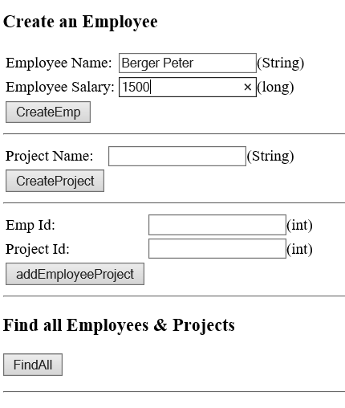
Specification: JSR-000220 Enterprise JavaBeans v.3.x Java Persistence API

Slide 28
Specification: JSR-000220 Enterprise JavaBeans v.3.x Java Persistence API

Slide 29
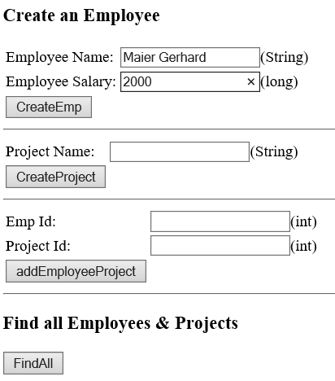
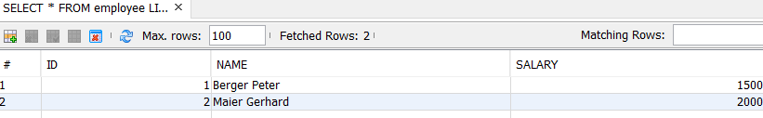
Specification: JSR-000220 Enterprise JavaBeans v.3.x Java Persistence API

Slide 30
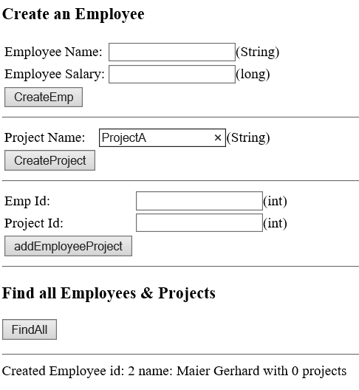
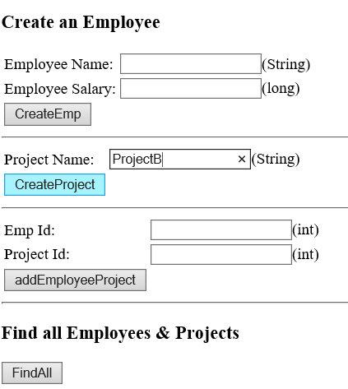
Specification: JSR-000220 Enterprise JavaBeans v.3.x Java Persistence API

Slide 31
Specification: JSR-000220 Enterprise JavaBeans v.3.x Java Persistence API

Slide 32
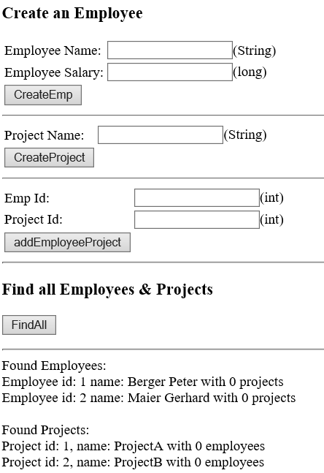
Specification: JSR-000220 Enterprise JavaBeans v.3.x Java Persistence API

Slide 33
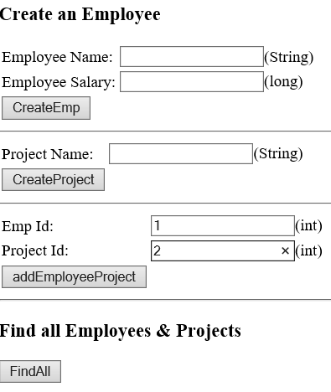
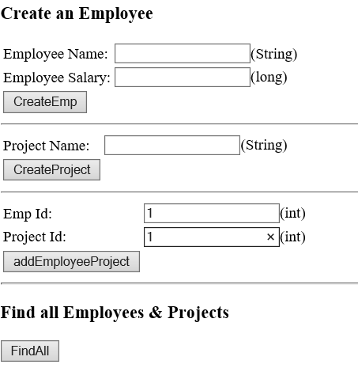
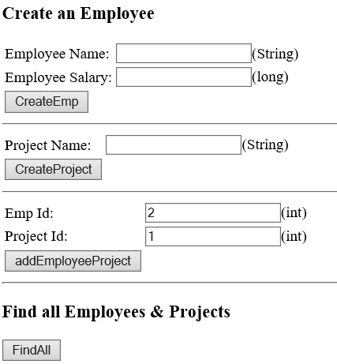

Specification: JSR-000220 Enterprise JavaBeans v.3.x Java Persistence API

Slide 34
Specification: JSR-000220 Enterprise JavaBeans v.3.x Java Persistence API

Slide 35
Specification: JSR-000220 Enterprise JavaBeans v.3.x Java Persistence API

Slide 36
Specification: JSR-000220 Enterprise JavaBeans v.3.x Java Persistence API

Slide 37
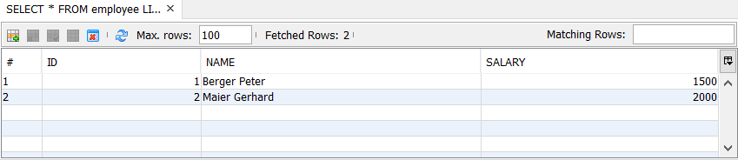
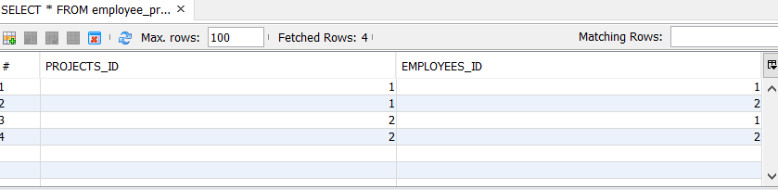
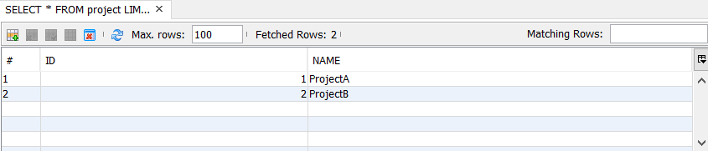
Specification: JSR-000220 Enterprise JavaBeans v.3.x Java Persistence API

Slide 38
exercise

Slide 39
Specification: JSR-000220 Enterprise JavaBeans v.3.x Java Persistence API

Slide 40
Specification: JSR-000220 Enterprise JavaBeans v.3.x Java Persistence API

Slide 41
Specification: JSR-000220 Enterprise JavaBeans v.3.x Java Persistence API

Slide 42
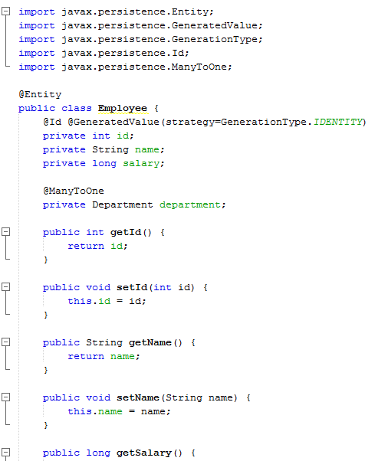
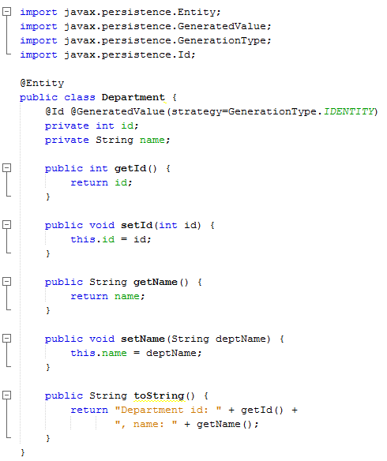
Specification: JSR-000220 Enterprise JavaBeans v.3.x Java Persistence API
It relies on an auto-incremented database column and
lets the database generate a new value with each insert operation

Slide 43
Specification: JSR-000220 Enterprise JavaBeans v.3.x Java Persistence API
It relies on an auto-incremented database column and
lets the database generate a new value with each insert operation
It relies on an auto-incremented database column and
lets the database generate a new value with each insert operation

Slide 44
Specification: JSR-000220 Enterprise JavaBeans v.3.x Java Persistence API
It relies on an auto-incremented database column and
lets the database generate a new value with each insert operation
many to one
unidirektional
many to one

Slide 45
Specification: JSR-000220 Enterprise JavaBeans v.3.x Java Persistence API
It relies on an auto-incremented database column and
lets the database generate a new value with each insert operation
many to one
unidirektional
many to one
more than one employee works in the same department,

Slide 46
Specification: JSR-000220 Enterprise JavaBeans v.3.x Java Persistence API
It relies on an auto-incremented database column and
lets the database generate a new value with each insert operation
many to one
unidirektional
many to one
Employee: many side
more than one employee works in the same department,
Department: one side

Slide 47
Specification: JSR-000220 Enterprise JavaBeans v.3.x Java Persistence API
It relies on an auto-incremented database column and
lets the database generate a new value with each insert operation
many to one
unidirektional
many to one
Employee: many side
more than one employee works in the same department,
Department: one side

Slide 48
Specification: JSR-000220 Enterprise JavaBeans v.3.x Java Persistence API
It relies on an auto-incremented database column and
lets the database generate a new value with each insert operation
many to one
unidirektional
many to one
unidirektional
Employee: many side
the relationship is unidirectional, from Employee to Department,
Department: one side

Slide 49
Specification: JSR-000220 Enterprise JavaBeans v.3.x Java Persistence API
It relies on an auto-incremented database column and
lets the database generate a new value with each insert operation
many to one
unidirektional
many to one
unidirektional
Employee: many side
the relationship is unidirectional, from Employee to Department,
Department: one side

Slide 50
Specification: JSR-000220 Enterprise JavaBeans v.3.x Java Persistence API
It relies on an auto-incremented database column and
lets the database generate a new value with each insert operation
many to one
unidirektional
many to one
unidirektional
Employee: many side
the relationship is unidirectional, from Employee to Department,
Department: one side

Slide 51
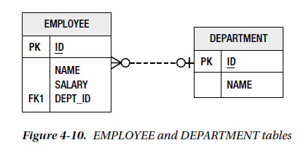
Specification: JSR-000220 Enterprise JavaBeans v.3.x Java Persistence API
Using Join Columns
In the database, a relationship mapping means that one table has a reference to another table.
The database term for a column that refers to a key (usually the primary key) in another table is a foreign key column.

Slide 52
Specification: JSR-000220 Enterprise JavaBeans v.3.x Java Persistence API
Using Join Columns
In the database, a relationship mapping means that one table has a reference to another table.
The database term for a column that refers to a key (usually the primary key) in another table is a foreign key column.

Slide 53
Specification: JSR-000220 Enterprise JavaBeans v.3.x Java Persistence API
Using Join Columns
In the database, a relationship mapping means that one table has a reference to another table.
The database term for a column that refers to a key (usually the primary key) in another table is a foreign key column.

Slide 54
Specification: JSR-000220 Enterprise JavaBeans v.3.x Java Persistence API
Using Join Columns
In the database, a relationship mapping means that one table has a reference to another table.
The database term for a column that refers to a key (usually the primary key) in another table is a foreign key column.

Slide 55
Specification: JSR-000220 Enterprise JavaBeans v.3.x Java Persistence API
Using Join Columns
In the database, a relationship mapping means that one table has a reference to another table.
The database term for a column that refers to a key (usually the primary key) in another table is a foreign key column.

Slide 56
Specification: JSR-000220 Enterprise JavaBeans v.3.x Java Persistence API
Using Join Columns
In the database, a relationship mapping means that one table has a reference to another table.
In JPA, they’re called join columns,
and the @JoinColumn annotation is the primary annotation used to configure these types of columns
DEPT_ID is the join column that associates the Employee and Department entities.

Slide 57
Specification: JSR-000220 Enterprise JavaBeans v.3.x Java Persistence API
Using Join Columns
In the database, a relationship mapping means that one table has a reference to another table.
one of the two sides will have the join column in its table.
That side is called the owning side or the owner of the relationship
DEPT_ID is the join column that associates the Employee and Department entities.

Slide 58
Specification: JSR-000220 Enterprise JavaBeans v.3.x Java Persistence API
Using Join Columns
In the database, a relationship mapping means that one table has a reference to another table.
@Entity
public class Employee {
@Id private long id;
@ManyToOne
@JoinColumn(name="DEPT_ID")
private Department department;
// ...
}
the @JoinColumn ( name="DEPT_ID" ) annotation means that the DEPT_ID
column in the source entity table is the foreign key to the target entity table

Slide 59
Specification: JSR-000220 Enterprise JavaBeans v.3.x Java Persistence API
Using Join Columns
@Entity
public class Employee {
@Id private long id;
@ManyToOne
@JoinColumn(name="DEPT_ID")
private Department department;
// ...
}
If no @JoinColumn annotation accompanies the many-to-one mapping,
a default column name will be assumed
it is the name of the relationship attribute in the source entity, which is department in our example,
plus an underscore character (_), plus the name of the primary key column of the targe t entity.

Slide 60
Specification: JSR-000220 Enterprise JavaBeans v.3.x Java Persistence API
Using Join Columns
@Entity
public class Employee {
@Id private long id;
@ManyToOne
@JoinColumn(name="DEPT_ID")
private Department department;
// ...
}
If no @JoinColumn annotation accompanies the many-to-one mapping,
a default column name will be assumed
it is the name of the relationship attribute in the source entity, which is department in our example,
plus an underscore character (_), plus the name of the primary key column of the target entity.

Slide 61
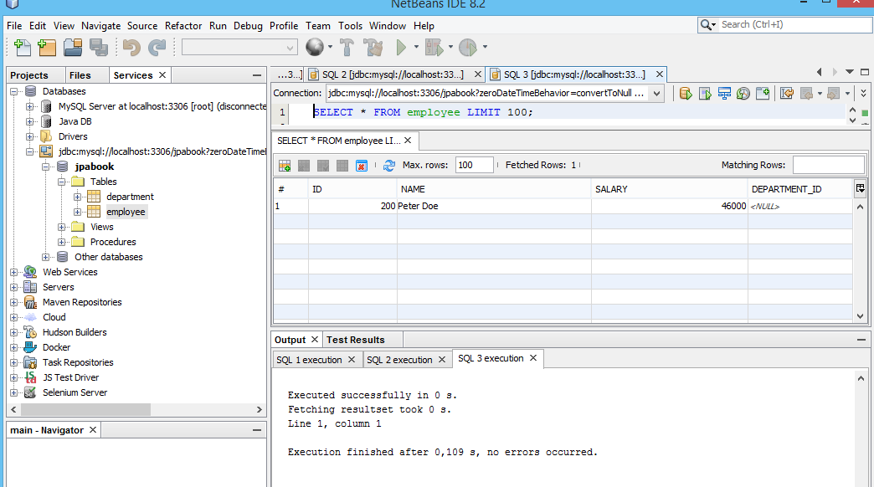
Specification: JSR-000220 Enterprise JavaBeans v.3.x Java Persistence API
Many-to-one mappings are always on the owning side of a relationship
it is the name of the relationship attribute in the source entity, which is department in our example,
plus an underscore character (_), plus the name of the primary key column of the target entity.

Slide 62
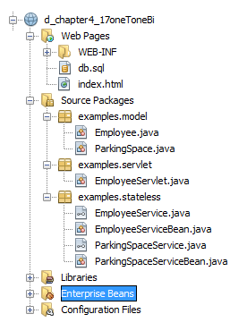
Specification: JSR-000220 Enterprise JavaBeans v.3.x Java Persistence API
one2one relationships
bidirektional
a realistic example of a one-to-one association, however, would be an employee who has a parking space.
Assuming that every employee got assigned his or her own parking space

Slide 63
Specification: JSR-000220 Enterprise JavaBeans v.3.x Java Persistence API
one2one relationships
bidirektional
a realistic example of a one-to-one association, however, would be an employee who has a parking space.
Assuming that every employee got assigned his or her own parking space

Slide 64
Specification: JSR-000220 Enterprise JavaBeans v.3.x Java Persistence API
one2one relationships
bidirektional
a realistic example of a one-to-one association, however, would be an employee who has a parking space.
Assuming that every employee got assigned his or her own parking space

Slide 65
Specification: JSR-000220 Enterprise JavaBeans v.3.x Java Persistence API
one2one relationships
bidirektional
a realistic example of a one-to-one association, however, would be an employee who has a parking space.
Assuming that every employee got assigned his or her own parking space

Slide 66
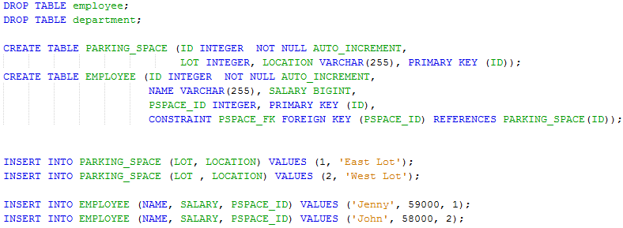
Specification: JSR-000220 Enterprise JavaBeans v.3.x Java Persistence API
one2one relationships
bidirektional

Slide 67
Specification: JSR-000220 Enterprise JavaBeans v.3.x Java Persistence API
one2one relationships
bidirektional

Slide 68
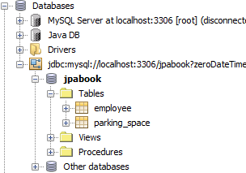
Specification: JSR-000220 Enterprise JavaBeans v.3.x Java Persistence API
one2one relationships
bidirektional

Slide 69
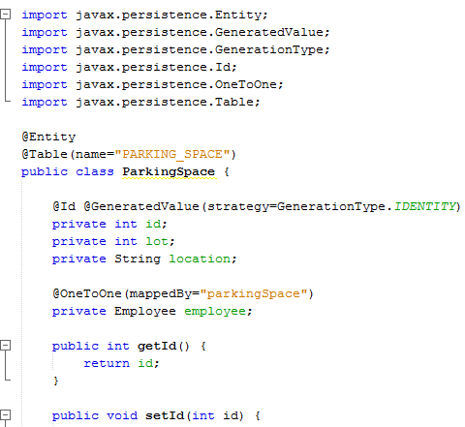
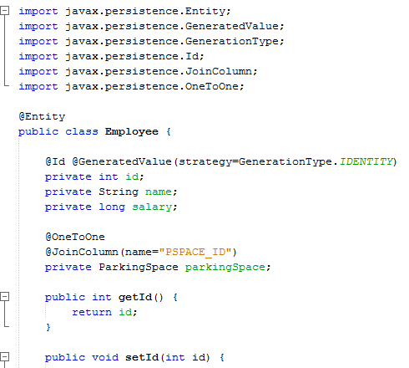
Specification: JSR-000220 Enterprise JavaBeans v.3.x Java Persistence API
one2one relationships
bidirektional

Slide 70
Specification: JSR-000220 Enterprise JavaBeans v.3.x Java Persistence API
one2one relationships
bidirektional
bidirektional

Slide 71
Specification: JSR-000220 Enterprise JavaBeans v.3.x Java Persistence API
one2one relationships
bidirektional
bidirektional

Slide 72
Specification: JSR-000220 Enterprise JavaBeans v.3.x Java Persistence API
one2one relationships
bidirektional

Slide 73
Specification: JSR-000220 Enterprise JavaBeans v.3.x Java Persistence API
one2one relationships
bidirektional

Slide 74
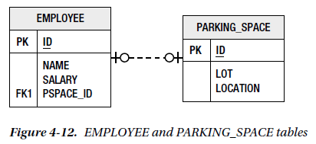
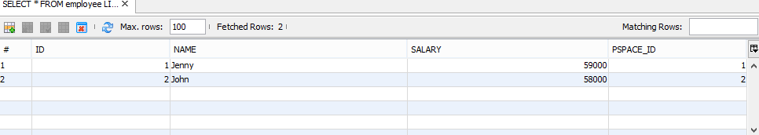
Specification: JSR-000220 Enterprise JavaBeans v.3.x Java Persistence API
one2one relationships
bidirektional
one-to-one mappings are almost the same as many-to-one mappings
except that
only one instance of the source entity can refer to the same target entity instance.

Slide 75
Specification: JSR-000220 Enterprise JavaBeans v.3.x Java Persistence API
one2one relationships
bidirektional
one-to-one mappings are almost the same as many-to-one mappings
except that
only one instance of the source entity can refer to the same target entity instance.

Slide 76
Specification: JSR-000220 Enterprise JavaBeans v.3.x Java Persistence API
one2one relationships
bidirektional
one-to-one mappings are almost the same as many-to-one mappings
except that
only one instance of the source entity can refer to the same target entity instance.

Slide 77
Specification: JSR-000220 Enterprise JavaBeans v.3.x Java Persistence API

Slide 78
Specification: JSR-000220 Enterprise JavaBeans v.3.x Java Persistence API

