Slide 1

JPAQL HQL
NamedQuery

Slide 2

Specification: JSR-000220 Enterprise JavaBeans v.3.x Java Persistence API
JPAQL HQL
NamedQuery

Slide 3
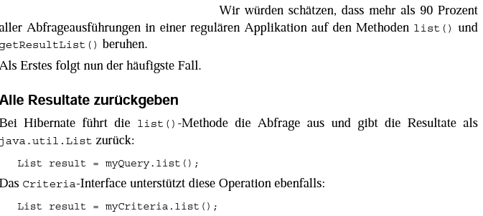
Specification: JSR-000220 Enterprise JavaBeans v.3.x Java Persistence API

Slide 4
Specification: JSR-000220 Enterprise JavaBeans v.3.x Java Persistence API

Slide 5
Specification: JSR-000220 Enterprise JavaBeans v.3.x Java Persistence API

Slide 6
Specification: JSR-000220 Enterprise JavaBeans v.3.x Java Persistence API

Slide 7
Specification: JSR-000220 Enterprise JavaBeans v.3.x Java Persistence API

Slide 8
Specification: JSR-000220 Enterprise JavaBeans v.3.x Java Persistence API

Slide 9
Specification: JSR-000220 Enterprise JavaBeans v.3.x Java Persistence API

Slide 10
Specification: JSR-000220 Enterprise JavaBeans v.3.x Java Persistence API

Slide 11
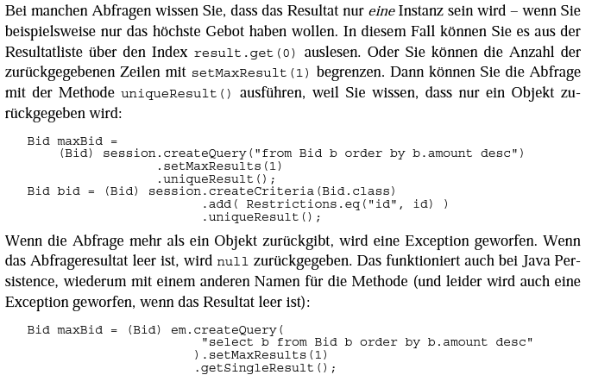
Specification: JSR-000220 Enterprise JavaBeans v.3.x Java Persistence API

Slide 12
Specification: JSR-000220 Enterprise JavaBeans v.3.x Java Persistence API

Slide 13
Specification: JSR-000220 Enterprise JavaBeans v.3.x Java Persistence API

Slide 14
Specification: JSR-000220 Enterprise JavaBeans v.3.x Java Persistence API
Hibernate
JPA

Slide 15
Specification: JSR-000220 Enterprise JavaBeans v.3.x Java Persistence API
Hibernate
JPA

Slide 16
Specification: JSR-000220 Enterprise JavaBeans v.3.x Java Persistence API
Hibernate
JPA

Slide 17
Specification: JSR-000220 Enterprise JavaBeans v.3.x Java Persistence API
Hibernate
JPA

Slide 18
Specification: JSR-000220 Enterprise JavaBeans v.3.x Java Persistence API
Hibernate
JPA

Slide 19
Specification: JSR-000220 Enterprise JavaBeans v.3.x Java Persistence API

Slide 20
Specification: JSR-000220 Enterprise JavaBeans v.3.x Java Persistence API

Slide 21
Specification: JSR-000220 Enterprise JavaBeans v.3.x Java Persistence API

Slide 22
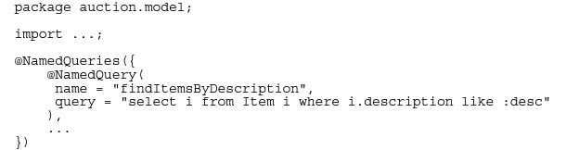

Specification: JSR-000220 Enterprise JavaBeans v.3.x Java Persistence API

Slide 23
Specification: JSR-000220 Enterprise JavaBeans v.3.x Java Persistence API

Slide 24
Specification: JSR-000220 Enterprise JavaBeans v.3.x Java Persistence API

Slide 25
Specification: JSR-000220 Enterprise JavaBeans v.3.x Java Persistence API

Slide 26
Specification: JSR-000220 Enterprise JavaBeans v.3.x Java Persistence API

Slide 27
Specification: JSR-000220 Enterprise JavaBeans v.3.x Java Persistence API

Slide 28
Specification: JSR-000220 Enterprise JavaBeans v.3.x Java Persistence API

Slide 29
Specification: JSR-000220 Enterprise JavaBeans v.3.x Java Persistence API

Slide 30
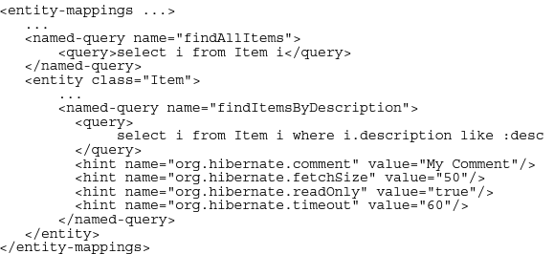
Specification: JSR-000220 Enterprise JavaBeans v.3.x Java Persistence API

Slide 31
Specification: JSR-000220 Enterprise JavaBeans v.3.x Java Persistence API

Slide 32
Specification: JSR-000220 Enterprise JavaBeans v.3.x Java Persistence API

Slide 33
Specification: JSR-000220 Enterprise JavaBeans v.3.x Java Persistence API
Hibernate
JPA

Slide 34
Specification: JSR-000220 Enterprise JavaBeans v.3.x Java Persistence API
Hibernate
JPA

Slide 35
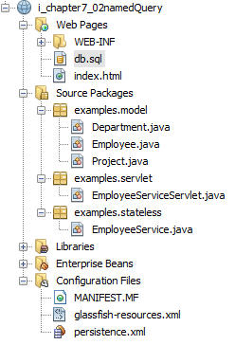
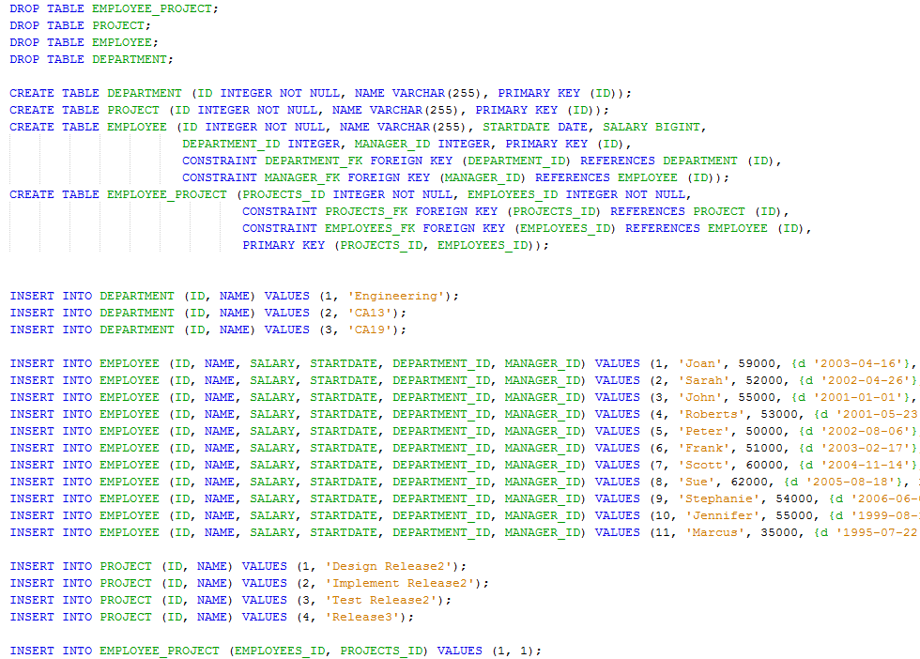
Specification: JSR-000220 Enterprise JavaBeans v.3.x Java Persistence API

Slide 36
Specification: JSR-000220 Enterprise JavaBeans v.3.x Java Persistence API

Slide 37
Specification: JSR-000220 Enterprise JavaBeans v.3.x Java Persistence API

Slide 38
Specification: JSR-000220 Enterprise JavaBeans v.3.x Java Persistence API

Slide 39
Specification: JSR-000220 Enterprise JavaBeans v.3.x Java Persistence API

Slide 40
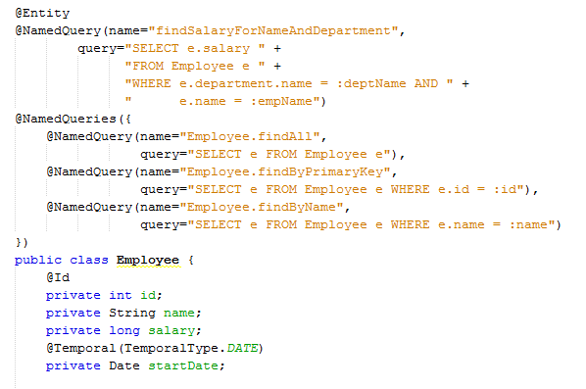
Specification: JSR-000220 Enterprise JavaBeans v.3.x Java Persistence API

Slide 41
Specification: JSR-000220 Enterprise JavaBeans v.3.x Java Persistence API

Slide 42
Specification: JSR-000220 Enterprise JavaBeans v.3.x Java Persistence API

Slide 43
Specification: JSR-000220 Enterprise JavaBeans v.3.x Java Persistence API

Slide 44
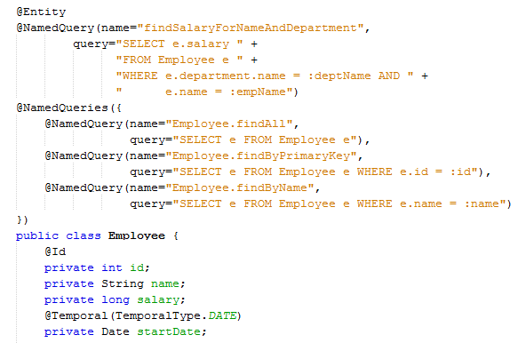
Specification: JSR-000220 Enterprise JavaBeans v.3.x Java Persistence API

Slide 45
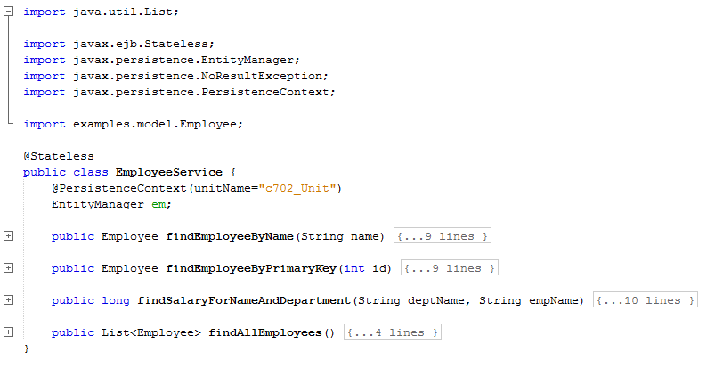
Specification: JSR-000220 Enterprise JavaBeans v.3.x Java Persistence API

Slide 46
Specification: JSR-000220 Enterprise JavaBeans v.3.x Java Persistence API

Slide 47
Specification: JSR-000220 Enterprise JavaBeans v.3.x Java Persistence API

Slide 48
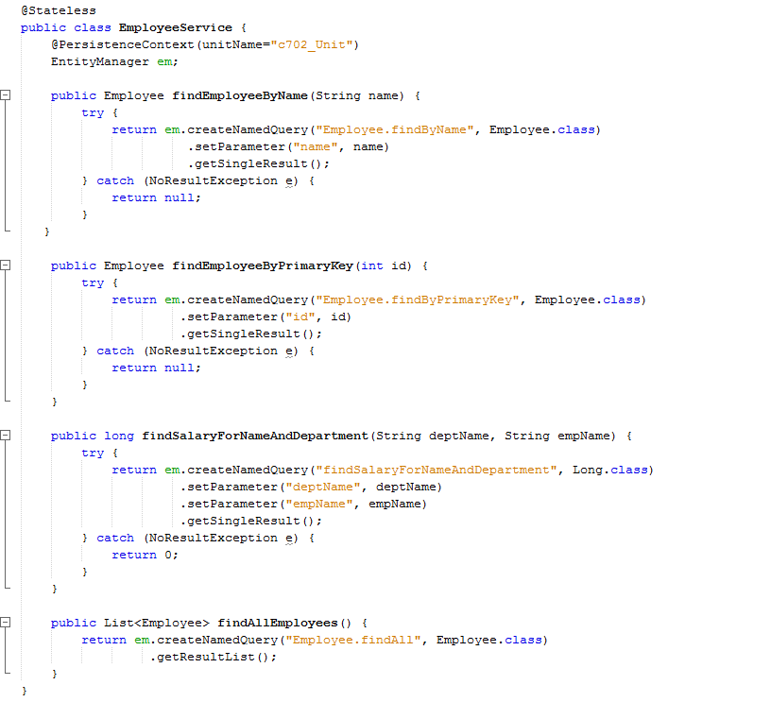
Specification: JSR-000220 Enterprise JavaBeans v.3.x Java Persistence API

Slide 49
Specification: JSR-000220 Enterprise JavaBeans v.3.x Java Persistence API

Slide 50
Specification: JSR-000220 Enterprise JavaBeans v.3.x Java Persistence API

Slide 51
Specification: JSR-000220 Enterprise JavaBeans v.3.x Java Persistence API

Slide 52
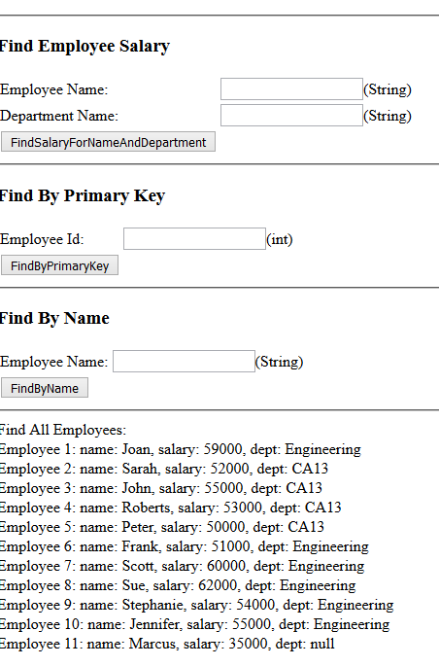
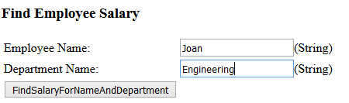
Specification: JSR-000220 Enterprise JavaBeans v.3.x Java Persistence API

Slide 53
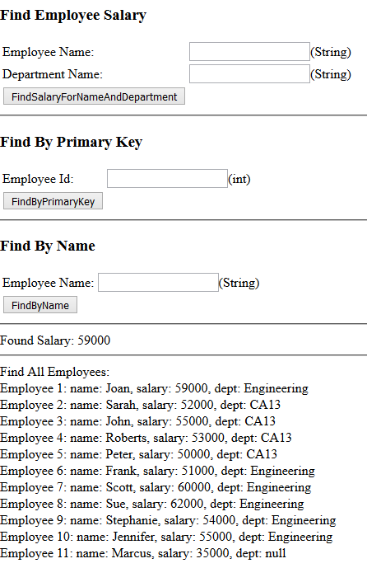
Specification: JSR-000220 Enterprise JavaBeans v.3.x Java Persistence API

Slide 54
Specification: JSR-000220 Enterprise JavaBeans v.3.x Java Persistence API
exercise

Slide 55
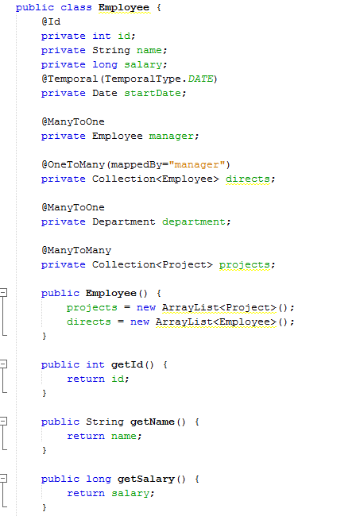
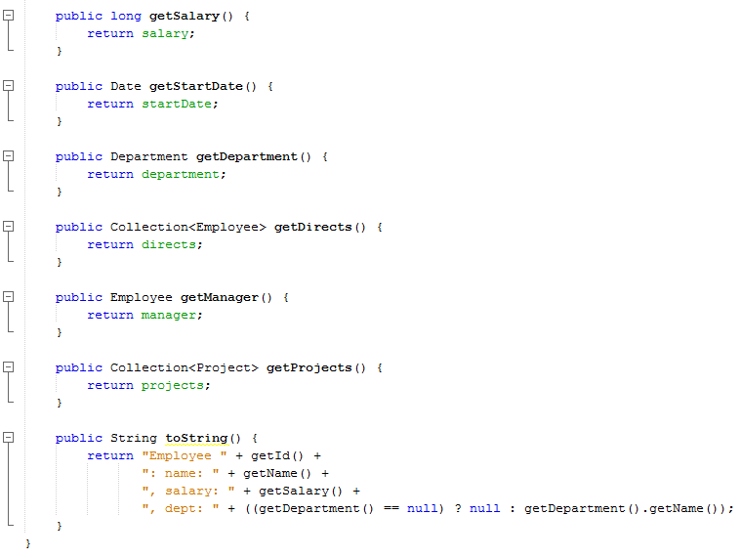
exercise

Slide 56
exercise

