Slide 1

JPAQL HQL
DynamicNamedQuery

Slide 2

Specification: JSR-000220 Enterprise JavaBeans v.3.x Java Persistence API
JPAQL HQL
DynamicNamedQuery

Slide 3
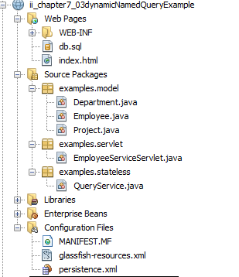
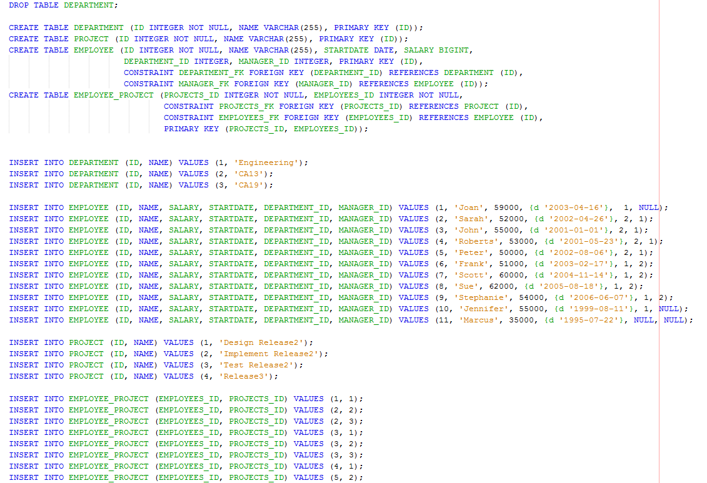
Specification: JSR-000220 Enterprise JavaBeans v.3.x Java Persistence API

Slide 4
Specification: JSR-000220 Enterprise JavaBeans v.3.x Java Persistence API

Slide 5
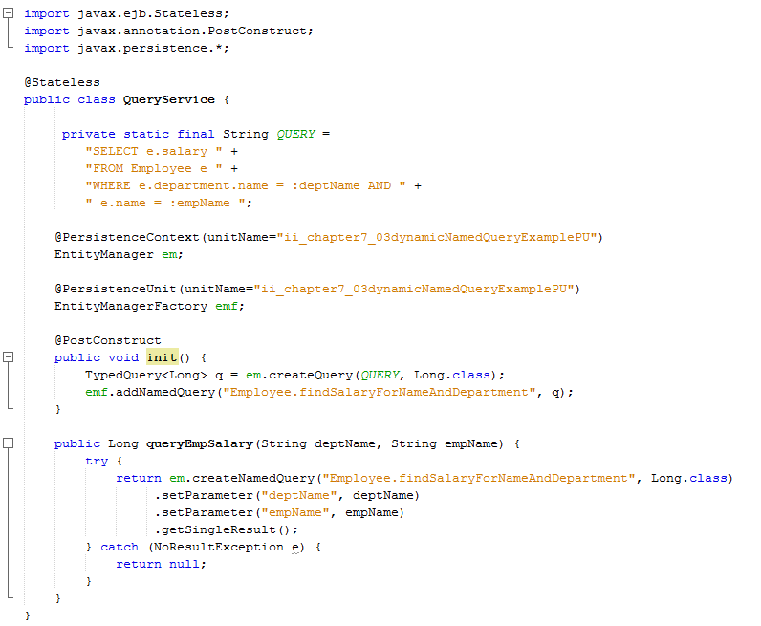

Slide 16
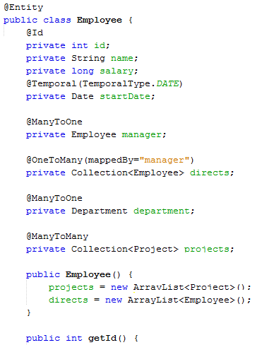

Slide 20
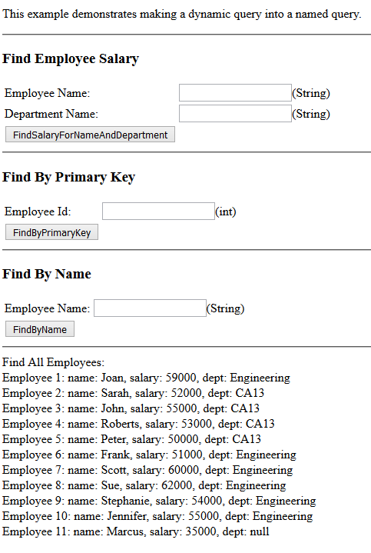
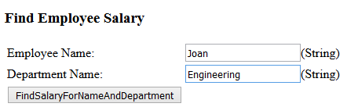
Specification: JSR-000220 Enterprise JavaBeans v.3.x Java Persistence API
Servlet

Slide 21
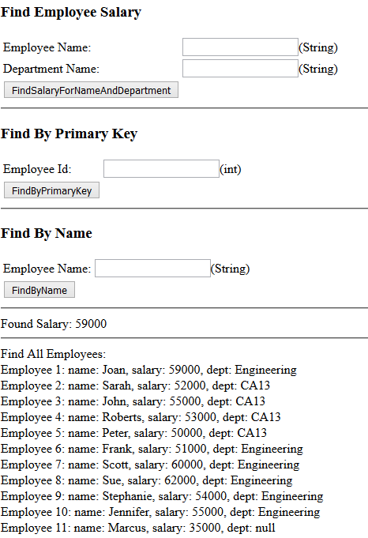
Specification: JSR-000220 Enterprise JavaBeans v.3.x Java Persistence API
Servlet

Slide 22
Specification: JSR-000220 Enterprise JavaBeans v.3.x Java Persistence API
exercise

Slide 23
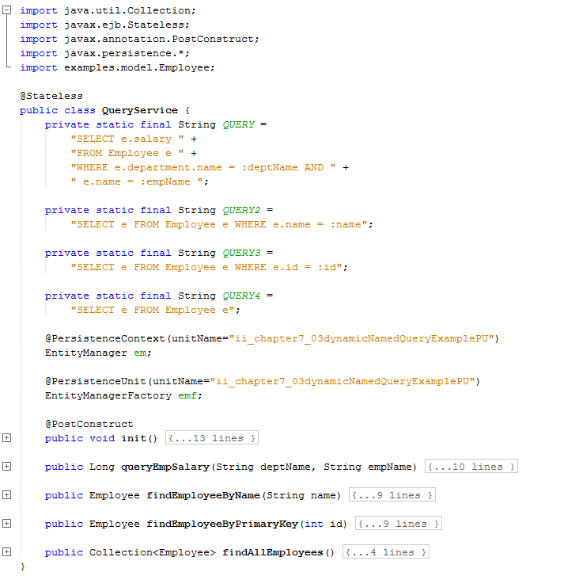
exercise.txt

Slide 24
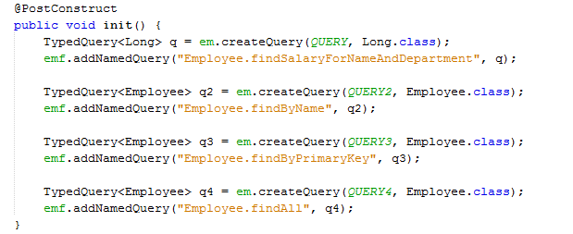
exercise

Slide 25
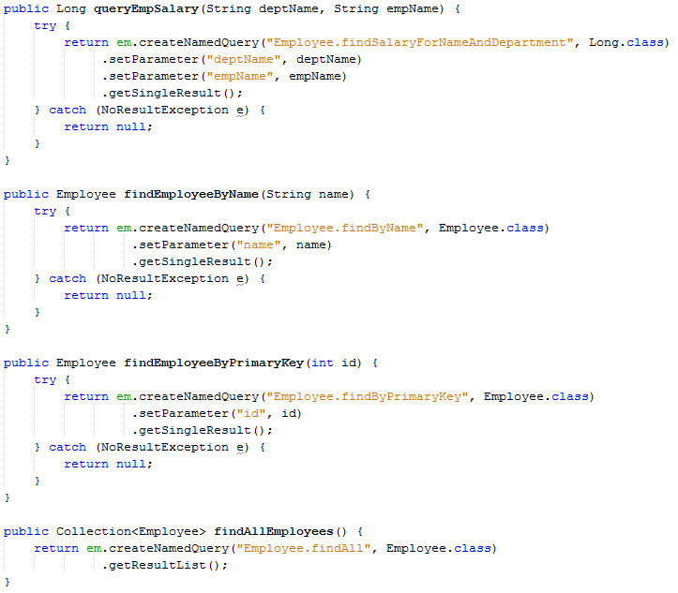
exercise

