Slide 1

queries
Bulk Update and Delete

Slide 2

Specification: JSR-000220 Enterprise JavaBeans v.3.x Java Persistence API
queries
Bulk Update and Delete

Slide 3
Specification: JSR-000220 Enterprise JavaBeans v.3.x Java Persistence API
queries
Bulk Update and Delete

Slide 4
Specification: JSR-000220 Enterprise JavaBeans v.3.x Java Persistence API
queries
Bulk Update and Delete

Slide 5
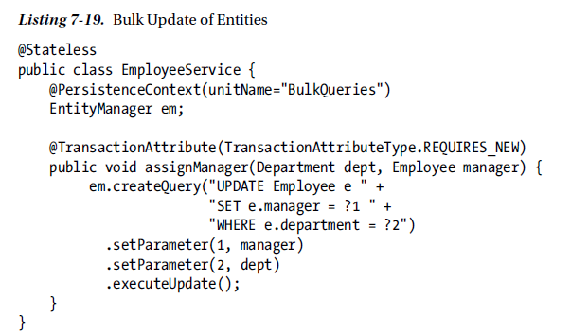
Specification: JSR-000220 Enterprise JavaBeans v.3.x Java Persistence API
queries
Bulk Update and Delete

Slide 6
Specification: JSR-000220 Enterprise JavaBeans v.3.x Java Persistence API
queries
Bulk Update and Delete

Slide 7
Specification: JSR-000220 Enterprise JavaBeans v.3.x Java Persistence API
queries
Bulk Update and Delete

Slide 8
Specification: JSR-000220 Enterprise JavaBeans v.3.x Java Persistence API
queries
Bulk Update and Delete

Slide 9
Specification: JSR-000220 Enterprise JavaBeans v.3.x Java Persistence API
queries
Bulk Update and Delete

Slide 10
Specification: JSR-000220 Enterprise JavaBeans v.3.x Java Persistence API
queries
Bulk Update and Delete

Slide 11
Specification: JSR-000220 Enterprise JavaBeans v.3.x Java Persistence API
queries
Bulk Update and Delete

Slide 12
Specification: JSR-000220 Enterprise JavaBeans v.3.x Java Persistence API
queries
Bulk Update and Delete

Slide 13
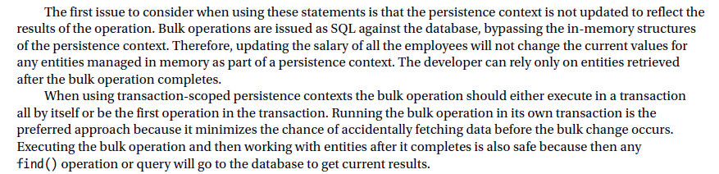
Specification: JSR-000220 Enterprise JavaBeans v.3.x Java Persistence API

Slide 14
Specification: JSR-000220 Enterprise JavaBeans v.3.x Java Persistence API

Slide 15
Specification: JSR-000220 Enterprise JavaBeans v.3.x Java Persistence API

Slide 16
Specification: JSR-000220 Enterprise JavaBeans v.3.x Java Persistence API

Slide 17
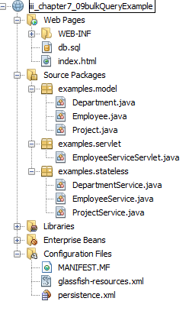
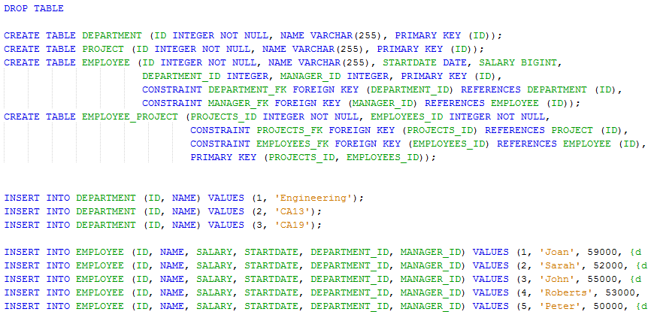
Specification: JSR-000220 Enterprise JavaBeans v.3.x Java Persistence API

Slide 18
Specification: JSR-000220 Enterprise JavaBeans v.3.x Java Persistence API

Slide 19
Specification: JSR-000220 Enterprise JavaBeans v.3.x Java Persistence API
exercise

Slide 20
Specification: JSR-000220 Enterprise JavaBeans v.3.x Java Persistence API
exercise

Slide 21
Specification: JSR-000220 Enterprise JavaBeans v.3.x Java Persistence API
exercise

Slide 22
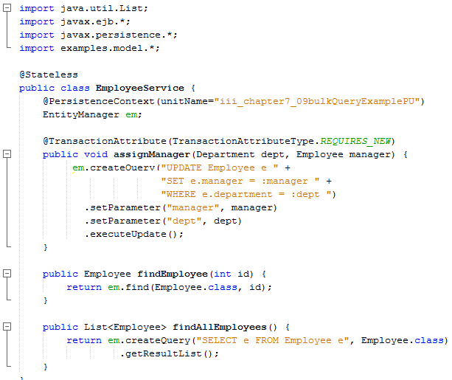
Specification: JSR-000220 Enterprise JavaBeans v.3.x Java Persistence API
exercise

Slide 23
Specification: JSR-000220 Enterprise JavaBeans v.3.x Java Persistence API
exercise

Slide 24
Specification: JSR-000220 Enterprise JavaBeans v.3.x Java Persistence API
exercise

Slide 25
Specification: JSR-000220 Enterprise JavaBeans v.3.x Java Persistence API
exercise

Slide 26
Specification: JSR-000220 Enterprise JavaBeans v.3.x Java Persistence API
exercise

Slide 27
Specification: JSR-000220 Enterprise JavaBeans v.3.x Java Persistence API
exercise

Slide 28
Specification: JSR-000220 Enterprise JavaBeans v.3.x Java Persistence API
exercise

Slide 29
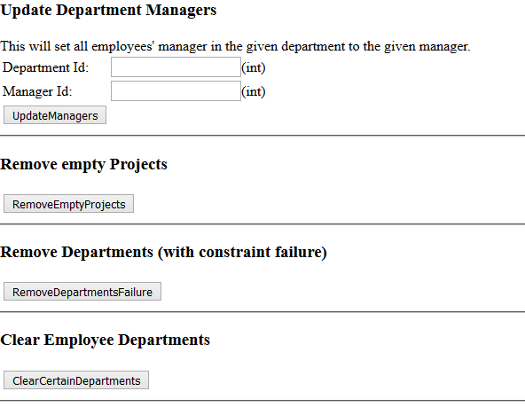
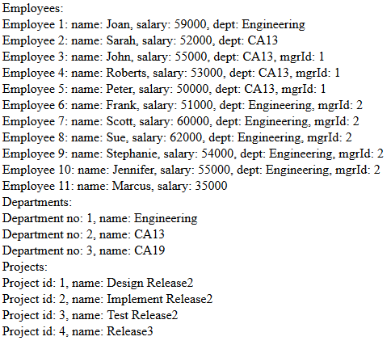
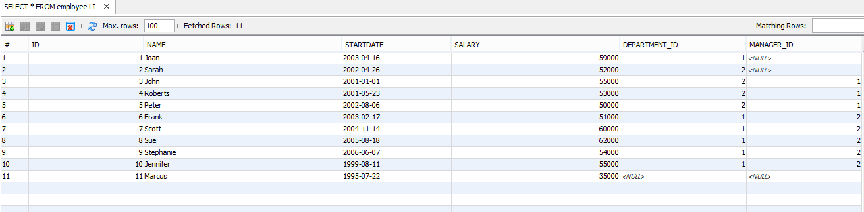

Slide 30
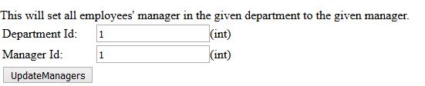

Slide 31
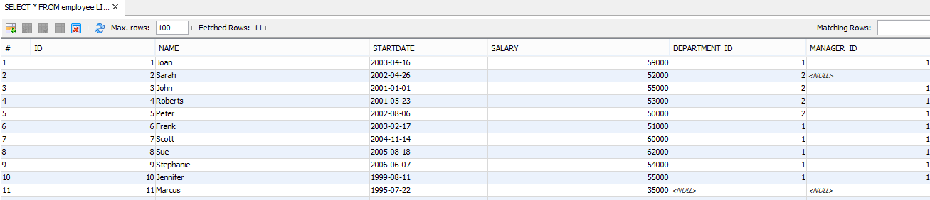

Slide 32
exercise

