Slide 1

entityLifecycle
removing cascade

Slide 2

Specification: JSR-000220 Enterprise JavaBeans v.3.x Java Persistence API
entityLifecycle
removing cascade

Slide 3
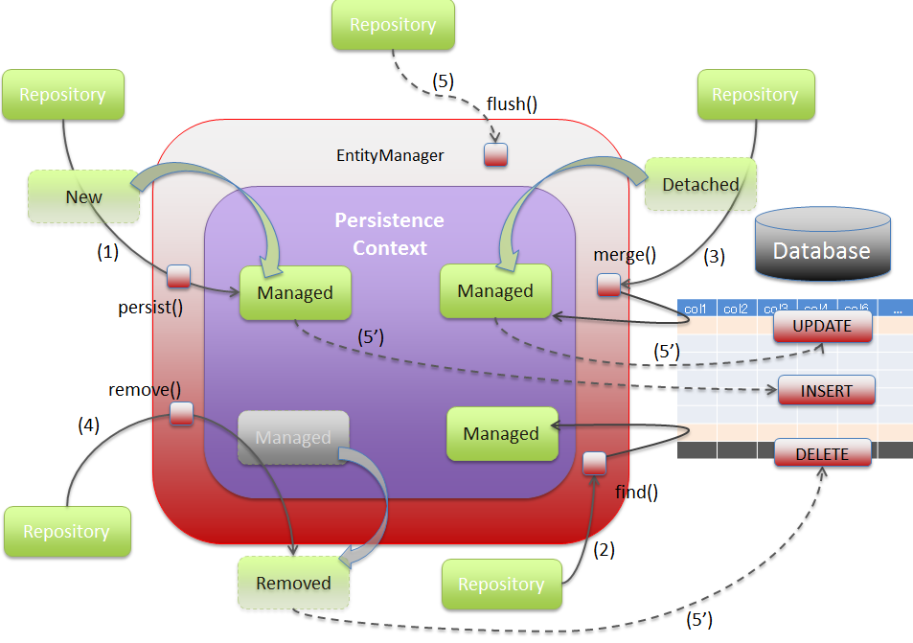
Specification: JSR-000220 Enterprise JavaBeans v.3.x Java Persistence API

Slide 4
Specification: JSR-000220 Enterprise JavaBeans v.3.x Java Persistence API

Slide 5
Specification: JSR-000220 Enterprise JavaBeans v.3.x Java Persistence API

Slide 6
Specification: JSR-000220 Enterprise JavaBeans v.3.x Java Persistence API

Slide 7
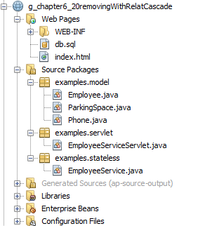
Specification: JSR-000220 Enterprise JavaBeans v.3.x Java Persistence API

Slide 8
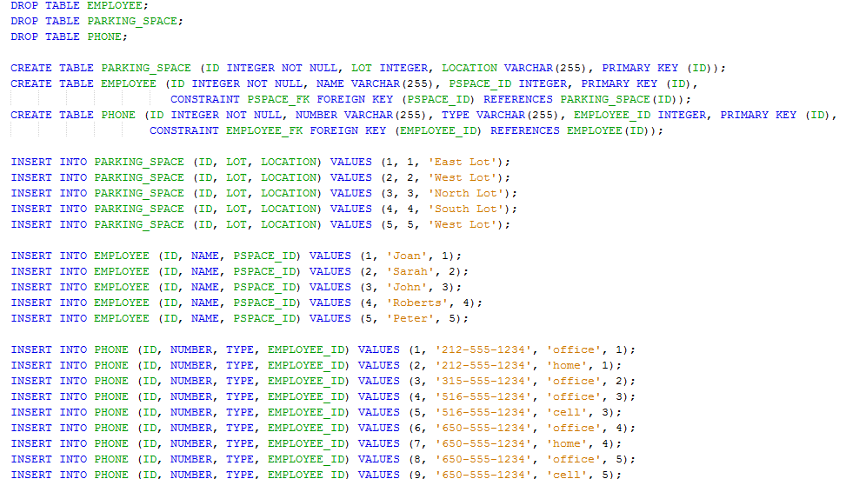
Specification: JSR-000220 Enterprise JavaBeans v.3.x Java Persistence API

Slide 9

Specification: JSR-000220 Enterprise JavaBeans v.3.x Java Persistence API

Slide 10
Specification: JSR-000220 Enterprise JavaBeans v.3.x Java Persistence API

Slide 11
Specification: JSR-000220 Enterprise JavaBeans v.3.x Java Persistence API

Slide 12
Specification: JSR-000220 Enterprise JavaBeans v.3.x Java Persistence API

Slide 13
Specification: JSR-000220 Enterprise JavaBeans v.3.x Java Persistence API

Slide 14
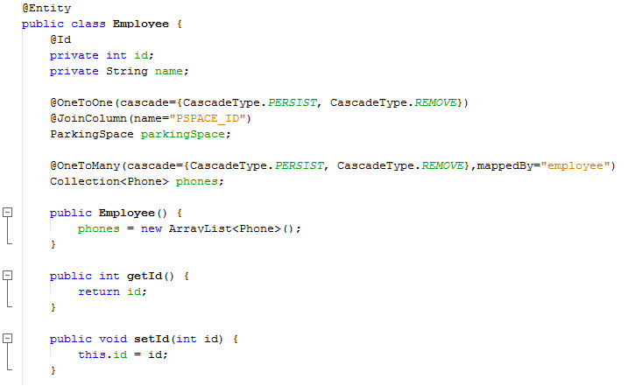
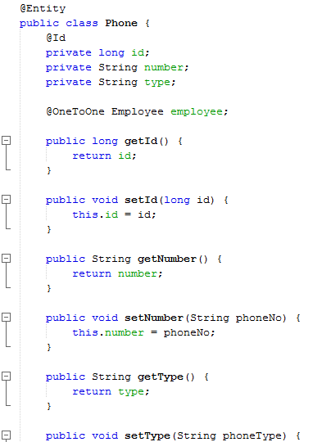
Specification: JSR-000220 Enterprise JavaBeans v.3.x Java Persistence API

Slide 15
Specification: JSR-000220 Enterprise JavaBeans v.3.x Java Persistence API

Slide 16
Specification: JSR-000220 Enterprise JavaBeans v.3.x Java Persistence API

Slide 17
Specification: JSR-000220 Enterprise JavaBeans v.3.x Java Persistence API

Slide 18
Specification: JSR-000220 Enterprise JavaBeans v.3.x Java Persistence API

Slide 19
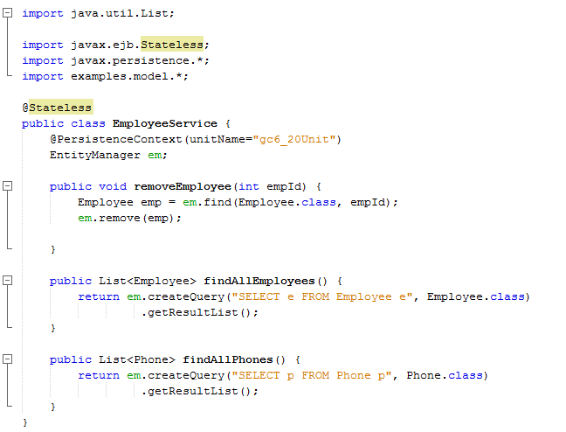
Specification: JSR-000220 Enterprise JavaBeans v.3.x Java Persistence API

Slide 20
Specification: JSR-000220 Enterprise JavaBeans v.3.x Java Persistence API

Slide 21
Specification: JSR-000220 Enterprise JavaBeans v.3.x Java Persistence API

Slide 22
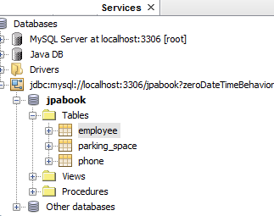
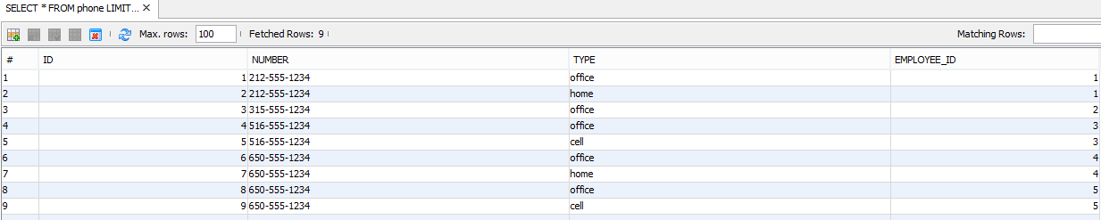
Specification: JSR-000220 Enterprise JavaBeans v.3.x Java Persistence API

Slide 23
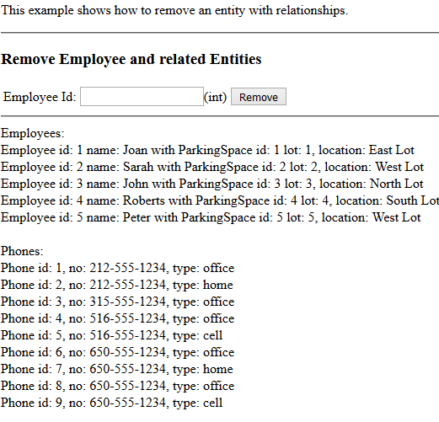
Specification: JSR-000220 Enterprise JavaBeans v.3.x Java Persistence API

Slide 24

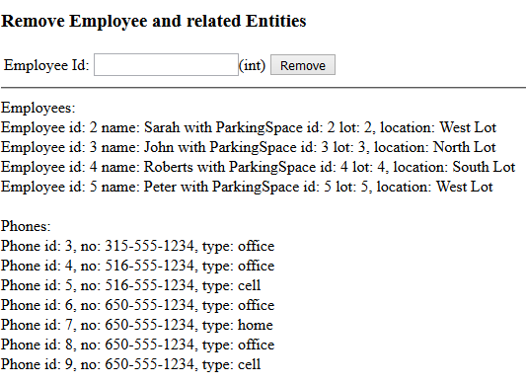
Specification: JSR-000220 Enterprise JavaBeans v.3.x Java Persistence API

Slide 25
Specification: JSR-000220 Enterprise JavaBeans v.3.x Java Persistence API

Slide 26
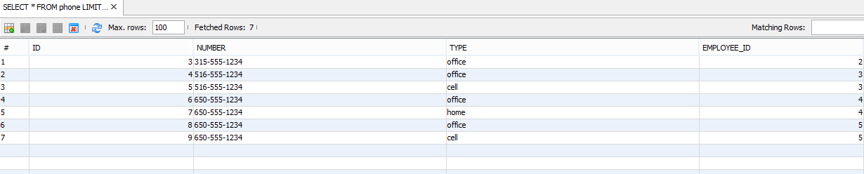
Specification: JSR-000220 Enterprise JavaBeans v.3.x Java Persistence API

Slide 27
Specification: JSR-000220 Enterprise JavaBeans v.3.x Java Persistence API

Slide 28
Specification: JSR-000220 Enterprise JavaBeans v.3.x Java Persistence API
exercise

Slide 29
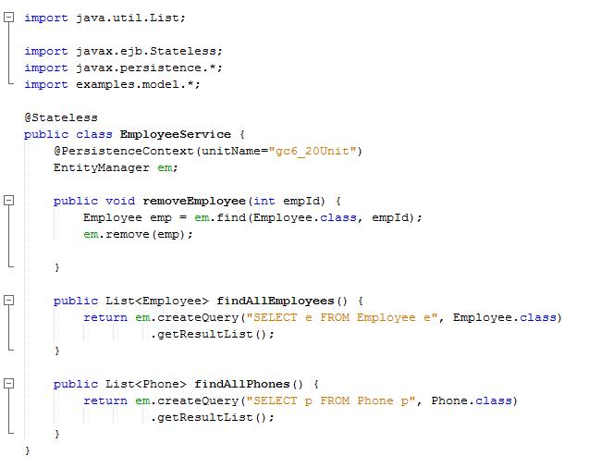
exercise

