Slide 1

jPersistenceAPI
id class

Slide 2

Specification: JSR-000220 Enterprise JavaBeans v.3.x Java Persistence API
jPersistenceAPI
id class

Slide 3
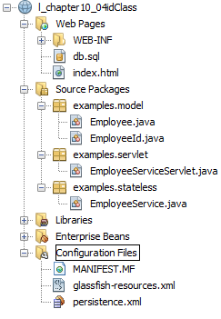
Specification: JSR-000220 Enterprise JavaBeans v.3.x Java Persistence API

Slide 4
Specification: JSR-000220 Enterprise JavaBeans v.3.x Java Persistence API

Slide 5
Specification: JSR-000220 Enterprise JavaBeans v.3.x Java Persistence API
exercise

Slide 6
Specification: JSR-000220 Enterprise JavaBeans v.3.x Java Persistence API
exercise

Slide 7
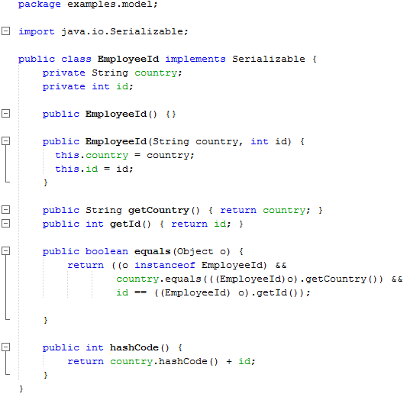
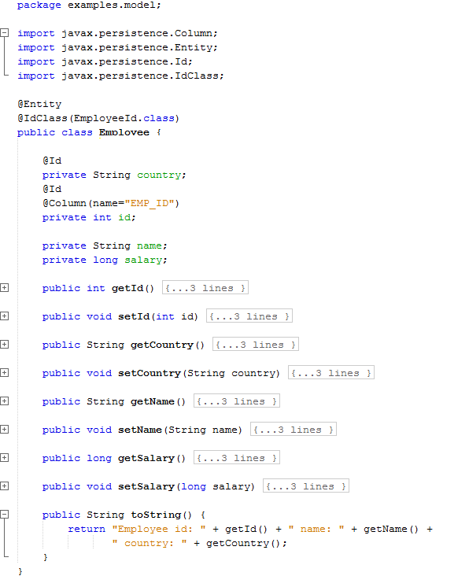

Slide 8


Slide 13
