Slide 1

JPA
single table inheritance

Slide 2

Specification: JSR-000220 Enterprise JavaBeans v.3.x Java Persistence API
JPA
single table inheritance

Slide 3
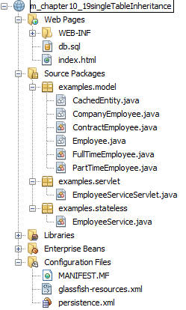
Specification: JSR-000220 Enterprise JavaBeans v.3.x Java Persistence API

Slide 4
Specification: JSR-000220 Enterprise JavaBeans v.3.x Java Persistence API

Slide 5
Specification: JSR-000220 Enterprise JavaBeans v.3.x Java Persistence API

Slide 6
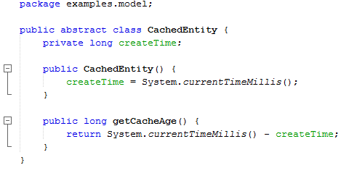
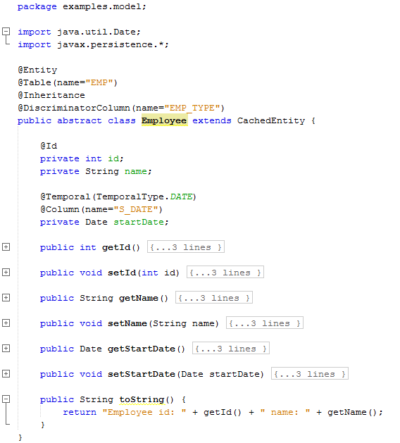
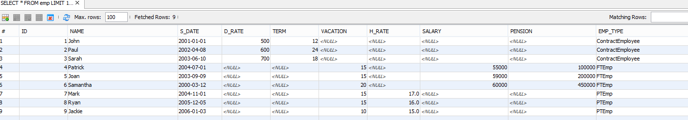

Slide 8
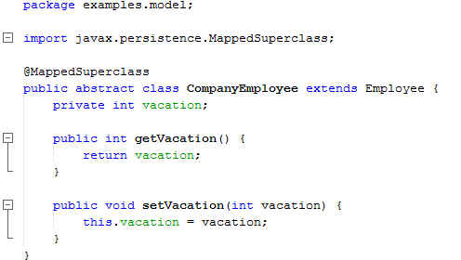
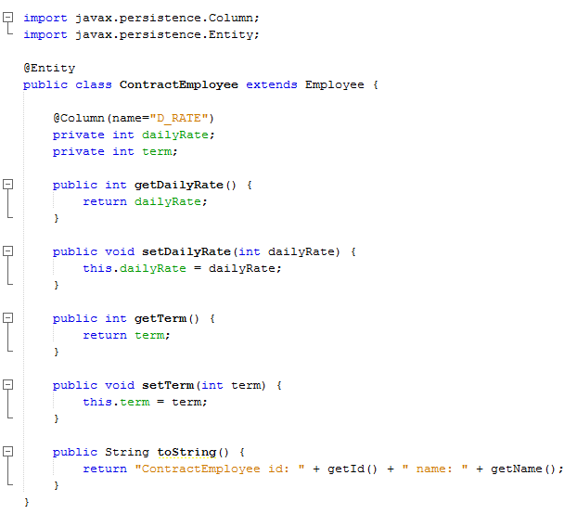

Slide 12
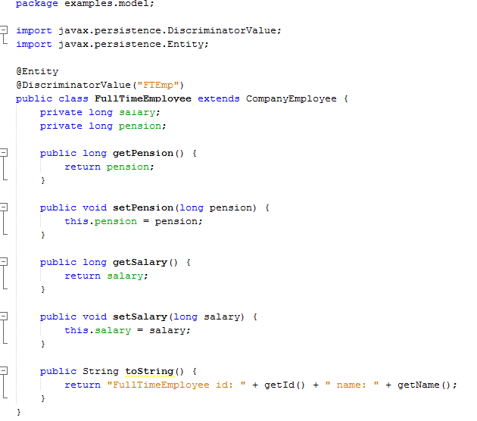

Slide 13
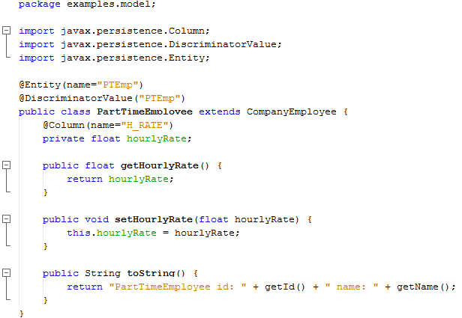

Slide 14
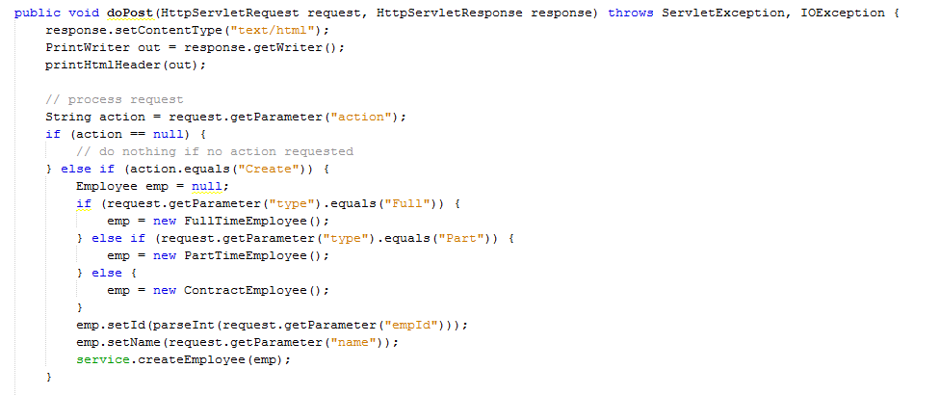
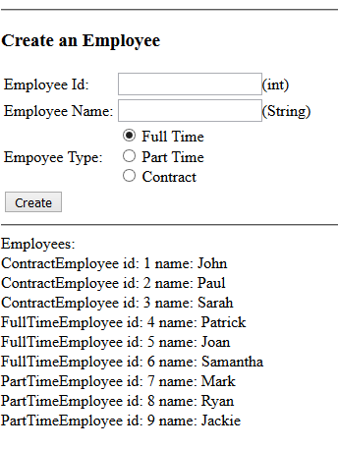
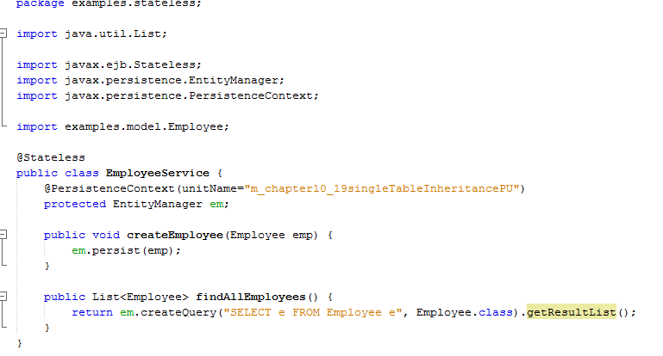

Slide 15
exercise

