Slide 1

jPersistenceAPI
Criteria API

Slide 2

Specification: JSR-000220 Enterprise JavaBeans v.3.x Java Persistence API
jPersistenceAPI
Criteria API

Slide 3

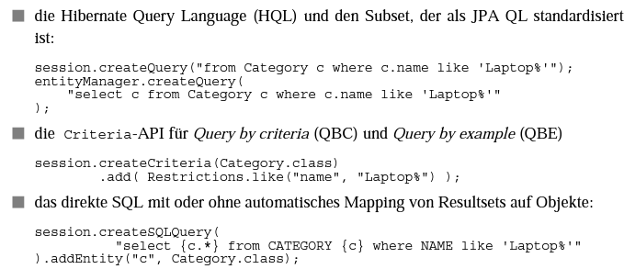
Specification: JSR-000220 Enterprise JavaBeans v.3.x Java Persistence API

Slide 4
Specification: JSR-000220 Enterprise JavaBeans v.3.x Java Persistence API

Slide 5
Specification: JSR-000220 Enterprise JavaBeans v.3.x Java Persistence API

Slide 6
Specification: JSR-000220 Enterprise JavaBeans v.3.x Java Persistence API

Slide 7
Specification: JSR-000220 Enterprise JavaBeans v.3.x Java Persistence API

Slide 8
Specification: JSR-000220 Enterprise JavaBeans v.3.x Java Persistence API

Slide 9
Specification: JSR-000220 Enterprise JavaBeans v.3.x Java Persistence API

Slide 10
Specification: JSR-000220 Enterprise JavaBeans v.3.x Java Persistence API

Slide 11
Specification: JSR-000220 Enterprise JavaBeans v.3.x Java Persistence API

Slide 12
Specification: JSR-000220 Enterprise JavaBeans v.3.x Java Persistence API

Slide 13
Specification: JSR-000220 Enterprise JavaBeans v.3.x Java Persistence API

Slide 14
Specification: JSR-000220 Enterprise JavaBeans v.3.x Java Persistence API

Slide 15
Specification: JSR-000220 Enterprise JavaBeans v.3.x Java Persistence API

Slide 16
Specification: JSR-000220 Enterprise JavaBeans v.3.x Java Persistence API

Slide 17
Specification: JSR-000220 Enterprise JavaBeans v.3.x Java Persistence API

Slide 18
Specification: JSR-000220 Enterprise JavaBeans v.3.x Java Persistence API

Slide 19
Specification: JSR-000220 Enterprise JavaBeans v.3.x Java Persistence API

Slide 20
Specification: JSR-000220 Enterprise JavaBeans v.3.x Java Persistence API

Slide 21
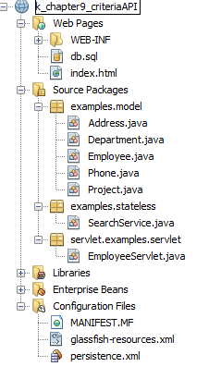
Specification: JSR-000220 Enterprise JavaBeans v.3.x Java Persistence API

Slide 22
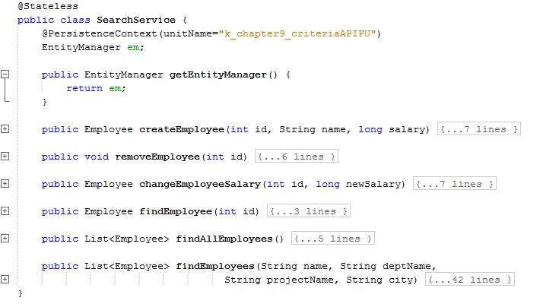
Specification: JSR-000220 Enterprise JavaBeans v.3.x Java Persistence API

Slide 23
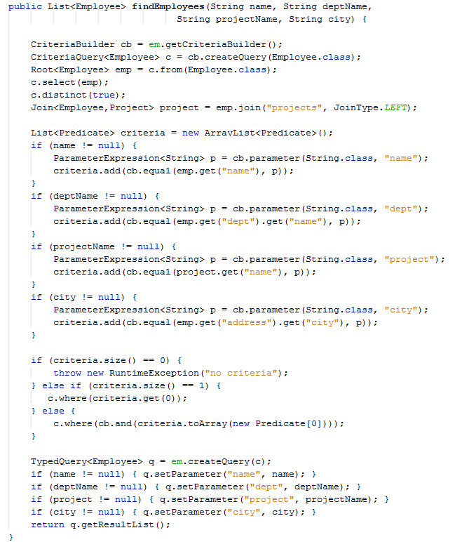

Slide 44
Specification: JSR-000220 Enterprise JavaBeans v.3.x Java Persistence API

Slide 45
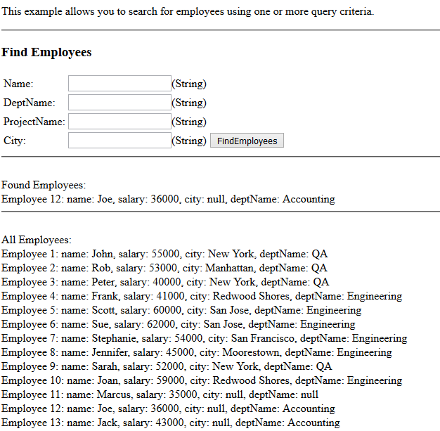

Slide 46
Specification: JSR-000220 Enterprise JavaBeans v.3.x Java Persistence API
exercise

Slide 47
Specification: JSR-000220 Enterprise JavaBeans v.3.x Java Persistence API

