Slide 1

Hibernate JPA

Slide 2

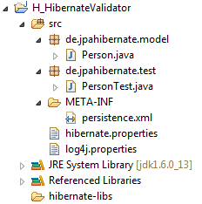
Hibernate Validator classes
builtIn classes
builtIn classes
custom classes
custom classes
using Hibernate Validator

Slide 3
Hibernate Validator classes
builtIn classes
custom classes
using Hibernate Validator

Slide 4
Hibernate Validator classes
builtIn classes
custom classes
using Hibernate Validator

Slide 5
Hibernate Validator classes
builtIn classes
custom classes
using Hibernate Validator

Slide 6
Hibernate Validator classes
builtIn classes
custom classes
using Hibernate Validator

Slide 7
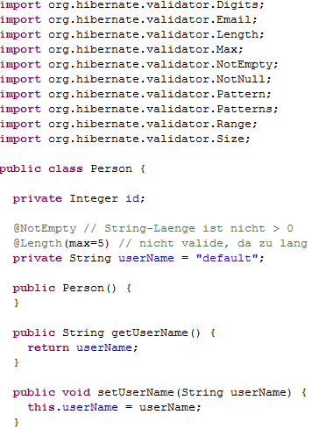
using Hibernate Validator

Slide 8
using Hibernate Validator

Slide 9
using Hibernate Validator

Slide 10
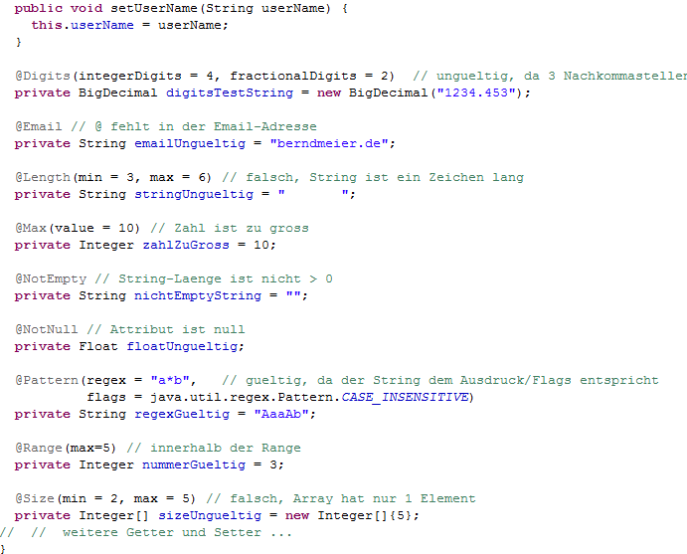
using Hibernate Validator

Slide 11
using Hibernate Validator

Slide 12
using Hibernate Validator

Slide 13
using Hibernate Validator

Slide 14
using Hibernate Validator

Slide 15
using Hibernate Validator

Slide 16
using Hibernate Validator

Slide 17
using Hibernate Validator

Slide 18
using Hibernate Validator

Slide 19
using Hibernate Validator

Slide 20
using Hibernate Validator

Slide 21
using Hibernate Validator

Slide 22
using Hibernate Validator

Slide 23
using Hibernate Validator

Slide 24
using Hibernate Validator

Slide 25
using Hibernate Validator

Slide 26
using Hibernate Validator

Slide 27
using Hibernate Validator

Slide 28
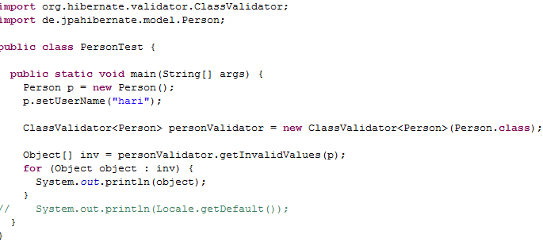
using Hibernate Validator

Slide 29
using Hibernate Validator

Slide 30
using Hibernate Validator

Slide 31
using Hibernate Validator

Slide 32
using Hibernate Validator

Slide 33
using Hibernate Validator

Slide 34
using Hibernate Validator

Slide 35
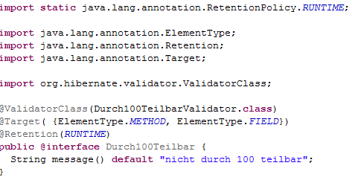
using Hibernate Validator

Slide 36
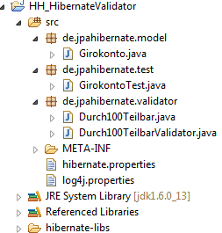
using Hibernate Validator

Slide 37
using Hibernate Validator

Slide 38
using Hibernate Validator

Slide 39
using Hibernate Validator

Slide 40
using Hibernate Validator

Slide 41
using Hibernate Validator

Slide 42
using Hibernate Validator

Slide 43
using Hibernate Validator

Slide 44
using Hibernate Validator

Slide 45
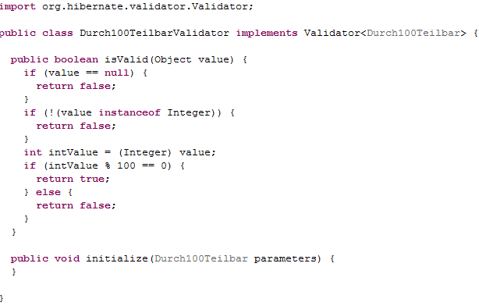
using Hibernate Validator

Slide 46
using Hibernate Validator

Slide 47
using Hibernate Validator

Slide 48
using Hibernate Validator

Slide 49
using Hibernate Validator

Slide 50
using Hibernate Validator

Slide 51
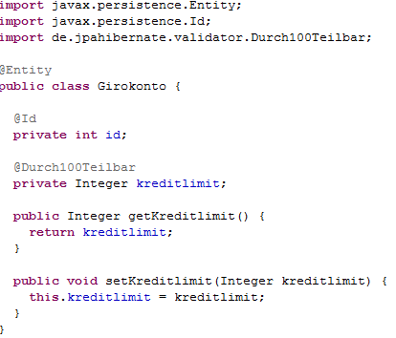
using Hibernate Validator

Slide 52
using Hibernate Validator

Slide 53
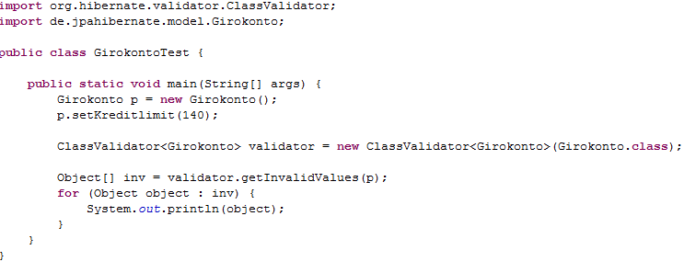
using Hibernate Validator

Slide 54
using Hibernate Validator

Slide 55
using Hibernate Validator

Slide 56
using Hibernate Validator

Slide 57
using Hibernate Validator

