Slide 1
Lasso & Ridge
Regression

Slide 2
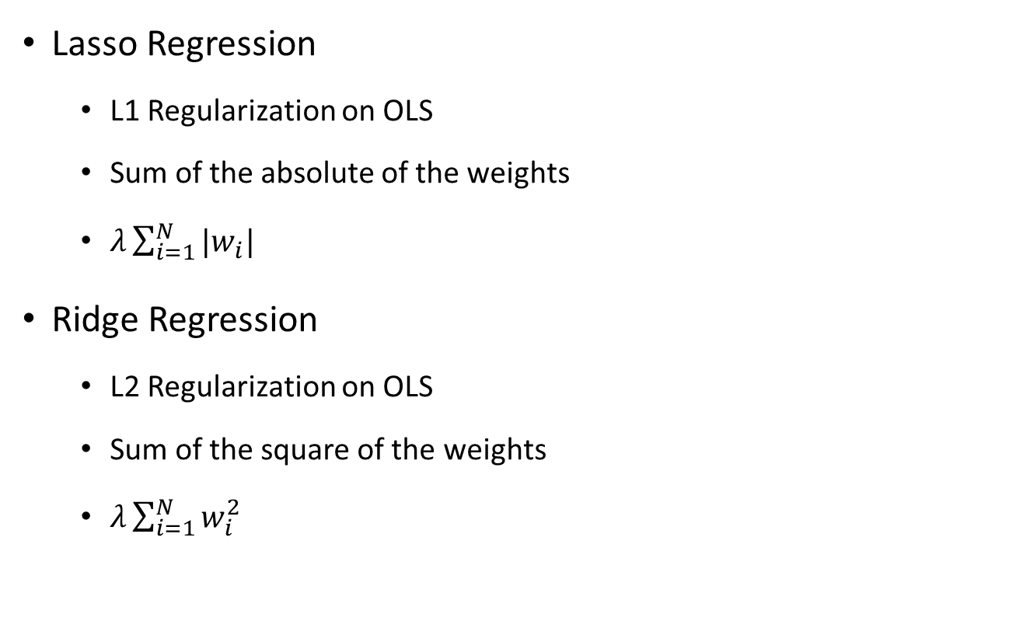
Definition
Lasso Regression
L1 Regularization on OLS
Sum of the absolute of the weights
$λ\sum_{i=1}^{N}{{|w}_{i}| }$
Ridge Regression
L2 Regularization on OLS
Sum of the square of the weights
$λ\sum_{i=1}^{N}{w_{i}^{2} }$
Notes:
Both Lasso and Ridge is a type of linear regression that includes regularization term to prevent coefficients from overfitting
The difference between Lasso and Ridge lies in their method of regularization

Slide 3
Implementation
Preprocessing
Normalization
Features Addition
Features Removal
Training
Model per Store
K-Fold Cross Validation
Prediction
Predict per store
Predict only open stores (sales prediction for closed store will be set to 0)
Denormalize prediction result

Slide 4
Result & Conclusion
DATA | LASSO |  | RIDGE
 | Private | Public | Private | Public
20 features No normalization No cross validation Global Model | 0.24082 | 0.22302 | 0.21149 | 0.20215
20 features Normalization No cross validation Model Per Store | 0.23920 | 0.23479 | 0.17369 | 0.15602
26 features Normalization 5 Fold Validation Model Per Store | 0.25260 | 0.25426 | 0.16308 | 0.14370

