Slide 1
CZ4041 Project
Members:
Peter
Zillion Govin
Stefan Artaputra Indriawan
Benedita Tanabi
Dataset:
Rossman Store Sales

Slide 2
Preprocessing
Done in Python, with pandas and NumPy
Initially, merge train.csv and store.csv on column Store (Store ID)
DayOfWeek (1-7) is transformed into one-hot vector, i.e., Mon, Tue, Wed, etc.
StateHoliday, StoreType, and Assortment are also transformed into one-hot vector respectively
Do not discard when Open is False, i.e., keep the data even when the store is closed on that day.

Slide 3
Preprocessing (Cont’d)
CompetitionOpenSinceMonth and CompetitionOpenSinceYear are transformed into HasCompetition (T/F) which depends on Date column in train.csv
Promo2SinceWeek, Promo2SinceYear, and PromoInterval are also transformed into IsDoingPromo2 (T/F)
If HasCompetition is False, CompetitionDistance is the maximum value in train dataset

Slide 4
LSTM per store
Each store has its own predictive model

Slide 5
LSTM per store
Dependencies: CUDA 8.0, cuDNN v5.1, Caffe, pandas, numpy
Preprocessing:
Split the data by stores
Sort each by Date in ascending manner
Drop Customers column
Normalize Sales by stores NOT globally
Drop StoreType, Assortment, HasCompetition, and CompetitionDistance since each store is trained separately
Take last 50 days data for validation

Slide 6
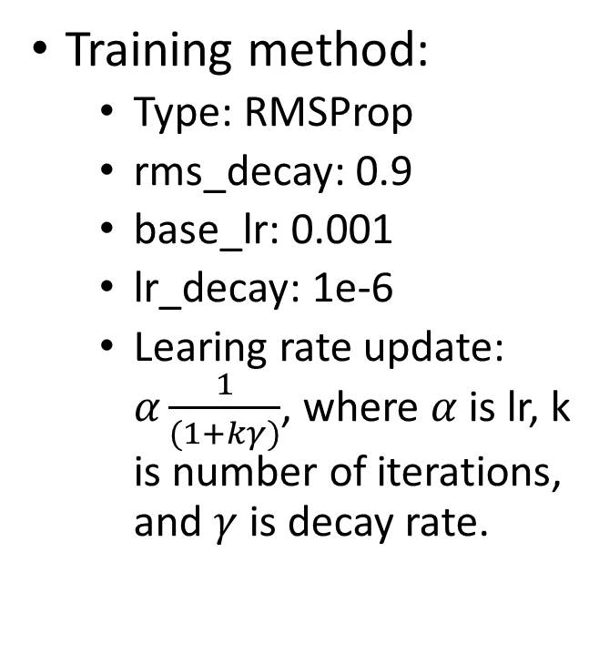
LSTM per store (Cont’d)
Architecture:
Input layer: 15 features
LSTM: 50 hidden units
Fully connected layers: 50 units
Output layer
Training method:
Type: RMSProp
rms_decay: 0.9
base_lr: 0.001
lr_decay: 1e-6
Learing rate update: $α\frac{1}{(1+kγ)}$, where $α$ is lr, k is number of iterations, and $γ$ is decay rate.

Slide 7
LSTM per store (Cont’d)
Number of epochs: 200
Validate every: 4 epochs
Hardware: GTX 850m
Duration: 4 hours
Result
Private score: 0.15578
Public score: 0.15904

Slide 8
Neural Network
with 2 hidden layers

Slide 9
Neural Network
Dependencies: CUDA 8.0, cuDNN v5.1, Caffe, pandas, numpy
Preprocessing:
Shuffle the data (order is not important)
Take 100k samples for validation
Add 6 new features, SalesAvg, SalesMax, SalesMean, CustomersAvg, CustomersMax, CustomersMean for each store respectively, and normalize these features
Normalize Sales globally
Drop Customers column

Slide 10
Neural Network (Cont’d)
Architecture:
Embedding layers for StoreID, DayOfWeek, Day, Month, Year, StoreType, Assortment
1st hidden layer (128 units)
2nd hidden layer (64 units)
Output layer
Training method:
Type: Nesterov
Momentum: 0.9
base_lr: 0.01
lr_decay: 1e-6

Slide 11
Neural Network (Cont’d)
Batch size: 5000
Number of epochs: 25
Validate at every epoch
Hardware: GTX 850m
Duration < 1 hour
Result
Private score: 0.20356
Public score: 0.20298

Slide 12
Lasso & Ridge
Regression

Slide 13
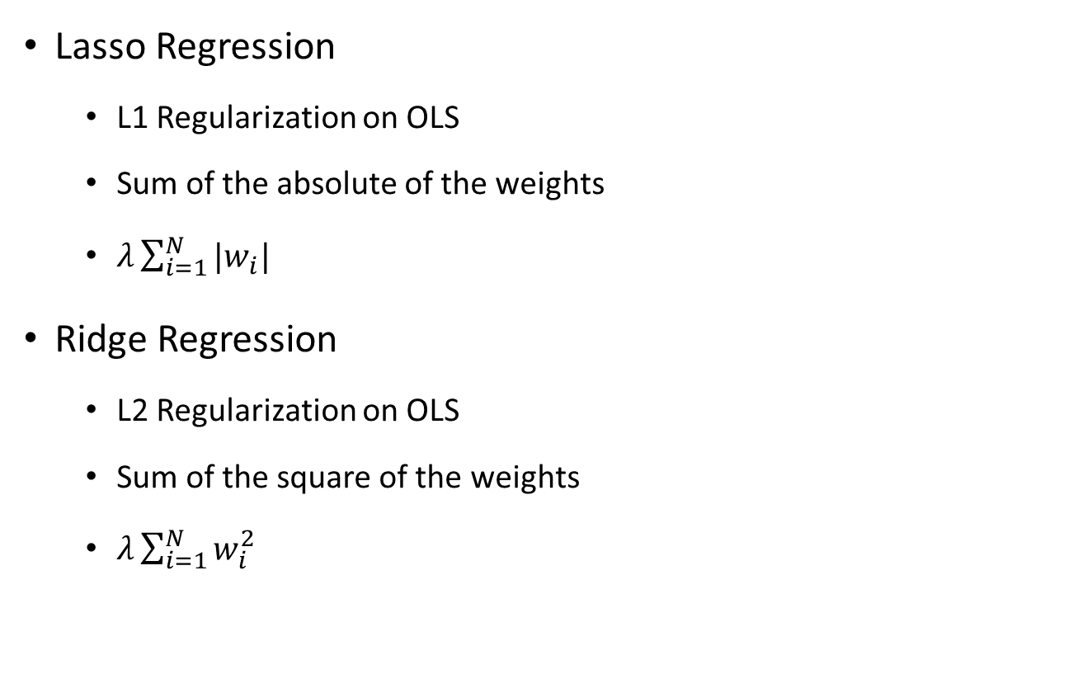
Definition
Lasso Regression
L1 Regularization on OLS
Sum of the absolute of the weights
$λ\sum_{i=1}^{N}{{|w}_{i}| }$
Ridge Regression
L2 Regularization on OLS
Sum of the square of the weights
$λ\sum_{i=1}^{N}{w_{i}^{2} }$
Notes:
Both Lasso and Ridge is a type of linear regression that includes regularization term to prevent coefficients from overfitting
The difference between Lasso and Ridge lies in their method of regularization

Slide 14
Implementation
Preprocessing
Normalization
Features Addition
Features Removal
Training
Model per Store
K-Fold Cross Validation
Prediction
Predict per store
Predict only open stores (sales prediction for closed store will be set to 0)
Denormalize prediction result

Slide 15
Result & Conclusion
DATA | LASSO |  | RIDGE
 | Private | Public | Private | Public
20 features No normalization No cross validation Global Model | 0.24082 | 0.22302 | 0.21149 | 0.20215
20 features Normalization No cross validation Model Per Store | 0.23920 | 0.23479 | 0.17369 | 0.15602
28 features Normalization 5 Fold Validation Model Per Store | 0.25260 | 0.25426 | 0.16308 | 0.14370

Slide 16
Random Forest

Slide 17
What is Random Forest?
Random forest is an algorithm that operate by constructing a multitude of decision trees at training time and outputting the prediction of the individual trees.
Library: Scikit-learn RandomForestRegressor
Dependency: numpy, pandas

Slide 18
Preprocessing
Implemented one-hot encoding for DayOfWeek, State Holiday, Assortment, and Store Type
Number of Features: 26
Each feature from each store was normalized using its corresponding standard deviation and mean

Slide 19
Training
Training and Validation Ratio:
First Trial: 80:20
Second Trial: 50:50
Each store was trained, validated, and predicted independently from each other
Number of Trees: 30 (100)
Maximum Features: 0.7

Slide 20
Result
Training vs Validation ratio 80:20
Private Score: 0.15815
Public Score: 0.14731
Training vs Validation ratio 50:50
Private Score: 0.15703
Public Score: 0.14604

Slide 21
Conclusion
LSTM per store and NN are not performing well.
Unable to increase the number of hidden units in LSTM or hidden layer due to hardware limitation

