Slide 1
CZ4041 Project
Members:
Peter
Zillion Govin
Stefan Artaputra Indriawan
Benedita Tanabi
Dataset:
Rossman Store Sales

Slide 2
Preprocessing
Done in Python, with pandas and NumPy
Initially, merge train.csv and store.csv on column Store (Store ID)
DayOfWeek (1-7) is transformed into one-hot vector, i.e., Mon, Tue, Wed, etc.
StateHoliday, StoreType, and Assortment are also transformed into one-hot vector respectively
Do not discard when Open is False, i.e., keep the data even when the store is closed on that day.

Slide 3
Preprocessing (Cont’d)
CompetitionOpenSinceMonth and CompetitionOpenSinceYear are transformed into HasCompetition (T/F) which depends on Date column in train.csv
Promo2SinceWeek, Promo2SinceYear, and PromoInterval are also transformed into IsDoingPromo2 (T/F)
If HasCompetition is False, CompetitionDistance is the maximum value in train dataset

Slide 4
Our Model: LSTM per store
Dependencies: CUDA 8.0, cuDNN v5.1, Caffe, pandas, numpy
Preprocessing:
Split the data by stores
Sort each by Date in ascending manner
Drop Customers column
Normalize Sales by stores NOT globally
Drop StoreType, Assortment, HasCompetition, and CompetitionDistance since each store is trained separately
Take last 50 days data for validation

Slide 5
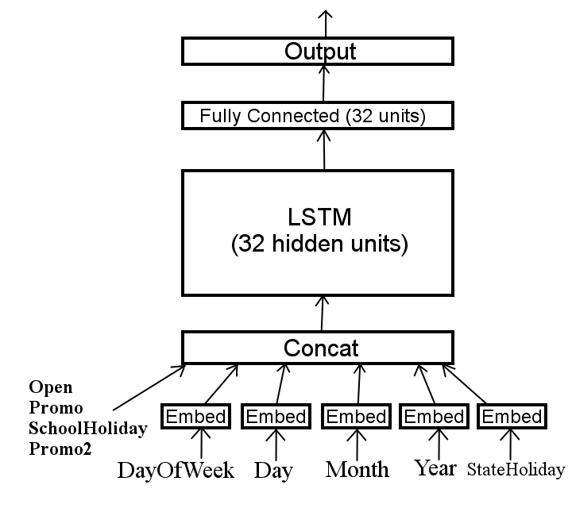
Our Model: LSTM per store (Cont’d)
Architecture:
Training method:
RMSProp
rms_decay: 0.9
base_lr: 0.001
lr_policy: “inv”
lr_decay: 1e-6

Slide 6
Our Model: LSTM per store (Cont’d)
Result:

