Slide 1
CZ4041 Project
Members:
Peter
Zillion Govin
Stefan Artaputra Indriawan
Benedita Tanabi
Dataset:
Rossman Store Sales

Slide 2
Preprocessing
Done in Python, with pandas and NumPy
Initially, merge train.csv and store.csv on column Store (Store ID)
DayOfWeek (1-7) is transformed into one-hot vector, i.e., Mon, Tue, Wed, etc.
StateHoliday, StoreType, and Assortment are also transformed into one-hot vector respectively
Do not discard when Open is False, i.e., keep the data even when the store is closed on that day.

Slide 3
Preprocessing (Cont’d)
CompetitionOpenSinceMonth and CompetitionOpenSinceYear are transformed into HasCompetition (T/F) which depends on Date column in train.csv
Promo2SinceWeek, Promo2SinceYear, and PromoInterval are also transformed into IsDoingPromo2 (T/F)
If HasCompetition is False, CompetitionDistance is the maximum value in train dataset

Slide 4
Our Model: LSTM per store
Dependencies: CUDA 8.0, cuDNN v5.1, Caffe, pandas, numpy
Preprocessing:
Split the data by stores
Sort each by Date in ascending manner
Drop Customers column
Normalize Sales by stores NOT globally
Drop StoreType, Assortment, HasCompetition, and CompetitionDistance since each store is trained separately
Take last 50 days data for validation

Slide 5
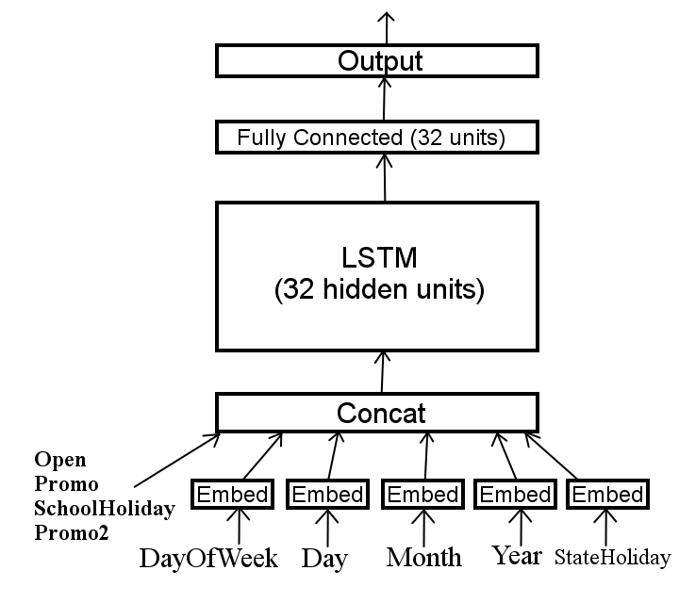
Our Model: LSTM per store (Cont’d)
Architecture:
Training method:
RMSProp
rms_decay: 0.9
base_lr: 0.001
lr_policy: “inv”
lr_decay: 1e-6

Slide 6
Our Model: LSTM per store (Cont’d)
Result:

Slide 7
Lasso & Ridge
Regression

Slide 8
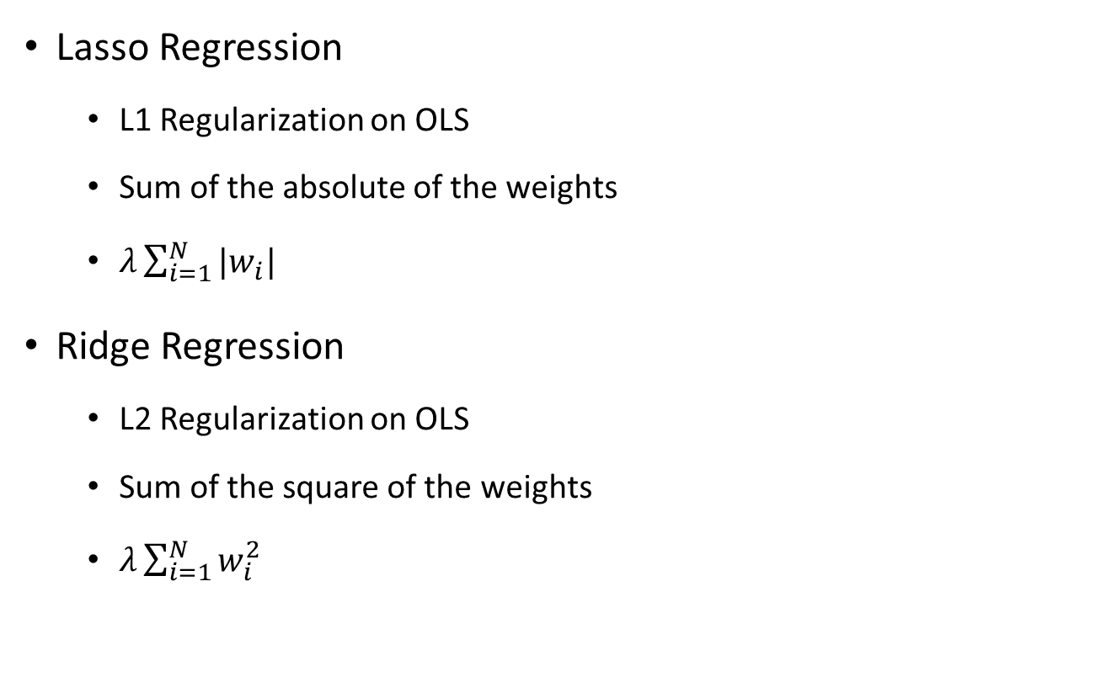
Definition
Lasso Regression
L1 Regularization on OLS
Sum of the absolute of the weights
$λ\sum_{i=1}^{N}{{|w}_{i}| }$
Ridge Regression
L2 Regularization on OLS
Sum of the square of the weights
$λ\sum_{i=1}^{N}{w_{i}^{2} }$
Notes:
Both Lasso and Ridge is a type of linear regression that includes regularization term to prevent coefficients from overfitting
The difference between Lasso and Ridge lies in their method of regularization

Slide 9
Implementation
Preprocessing
Normalization
Features Addition
Features Removal
Training
Model per Store
K-Fold Cross Validation
Prediction
Predict per store
Predict only open stores (sales prediction for closed store will be set to 0)
Denormalize prediction result

Slide 10
Result & Conclusion
DATA | LASSO |  | RIDGE
 | Private | Public | Private | Public
20 features No normalization No cross validation Global Model | 0.24082 | 0.22302 | 0.21149 | 0.20215
20 features Normalization No cross validation Model Per Store | 0.23920 | 0.23479 | 0.17369 | 0.15602
28 features Normalization 5 Fold Validation Model Per Store | 0.25260 | 0.25426 | 0.16308 | 0.14370

