Slide 1
FitLife
Team Squad:
Benjamin Agueros, Bo Fu, Ben Milligan, Ryland Beaver, Yufan Xu

Slide 2
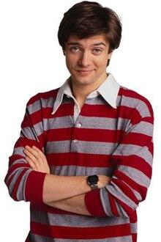
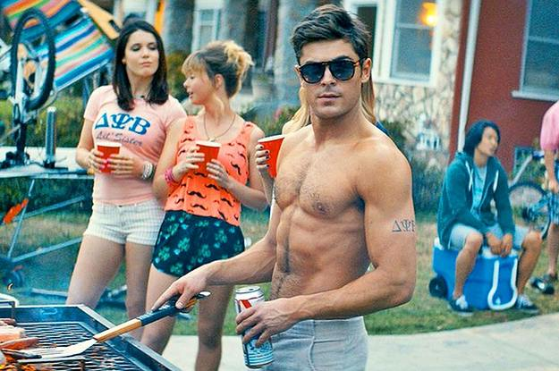
Scenario 1
Topher
Wants to maintainz the gainz
Hates using paper
Works out multiple time a day
Wishes there was a better way

Slide 3
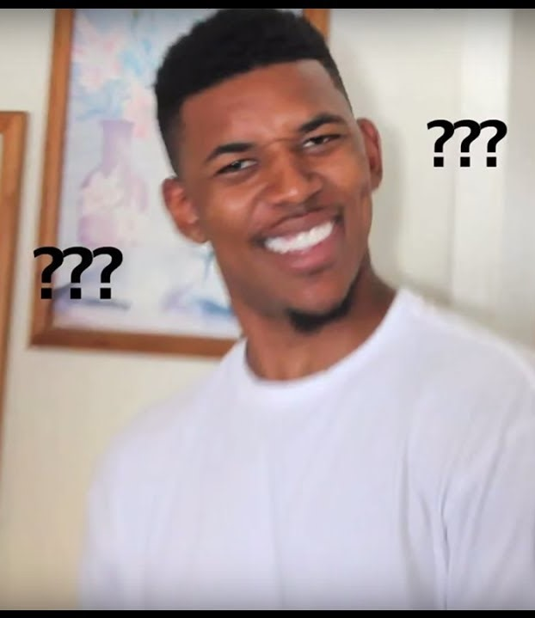
Topher’s Requirements
Add Workouts
Specify the type
Record weight
See his progress
Simple
Easy
Basic
Simple
Not Redundant

Slide 4
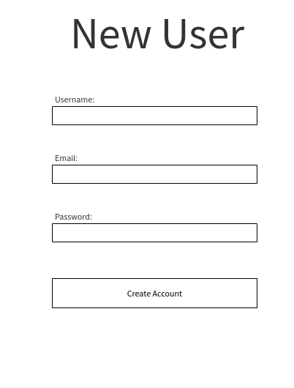
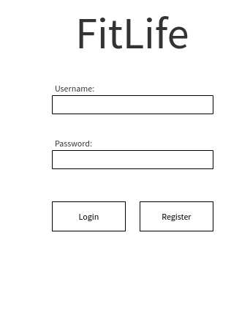
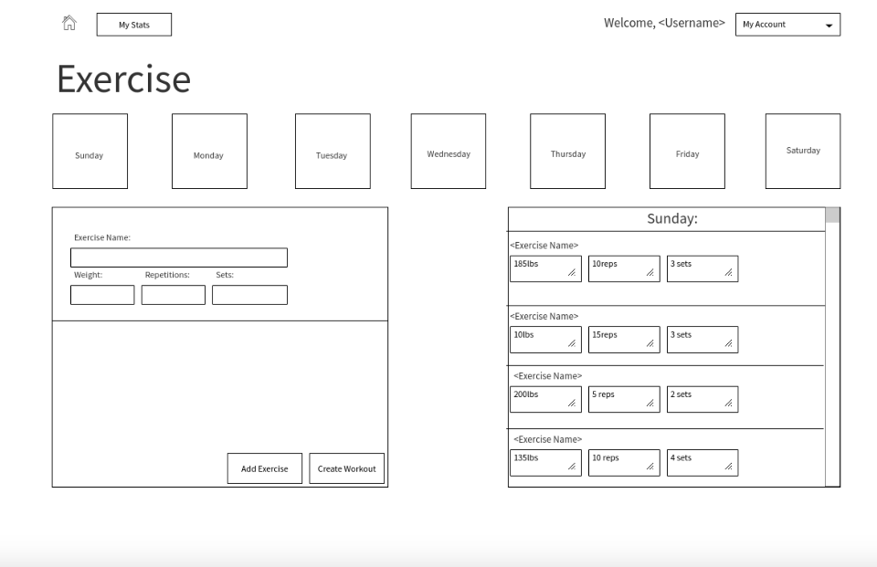
Inspired by the humble Topher

Slide 5
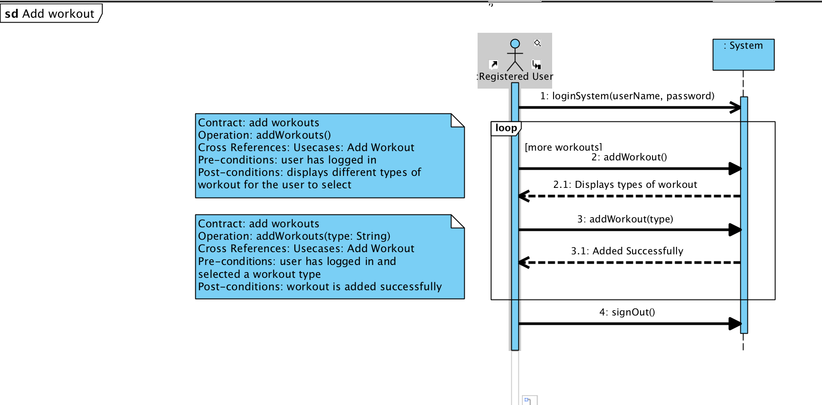
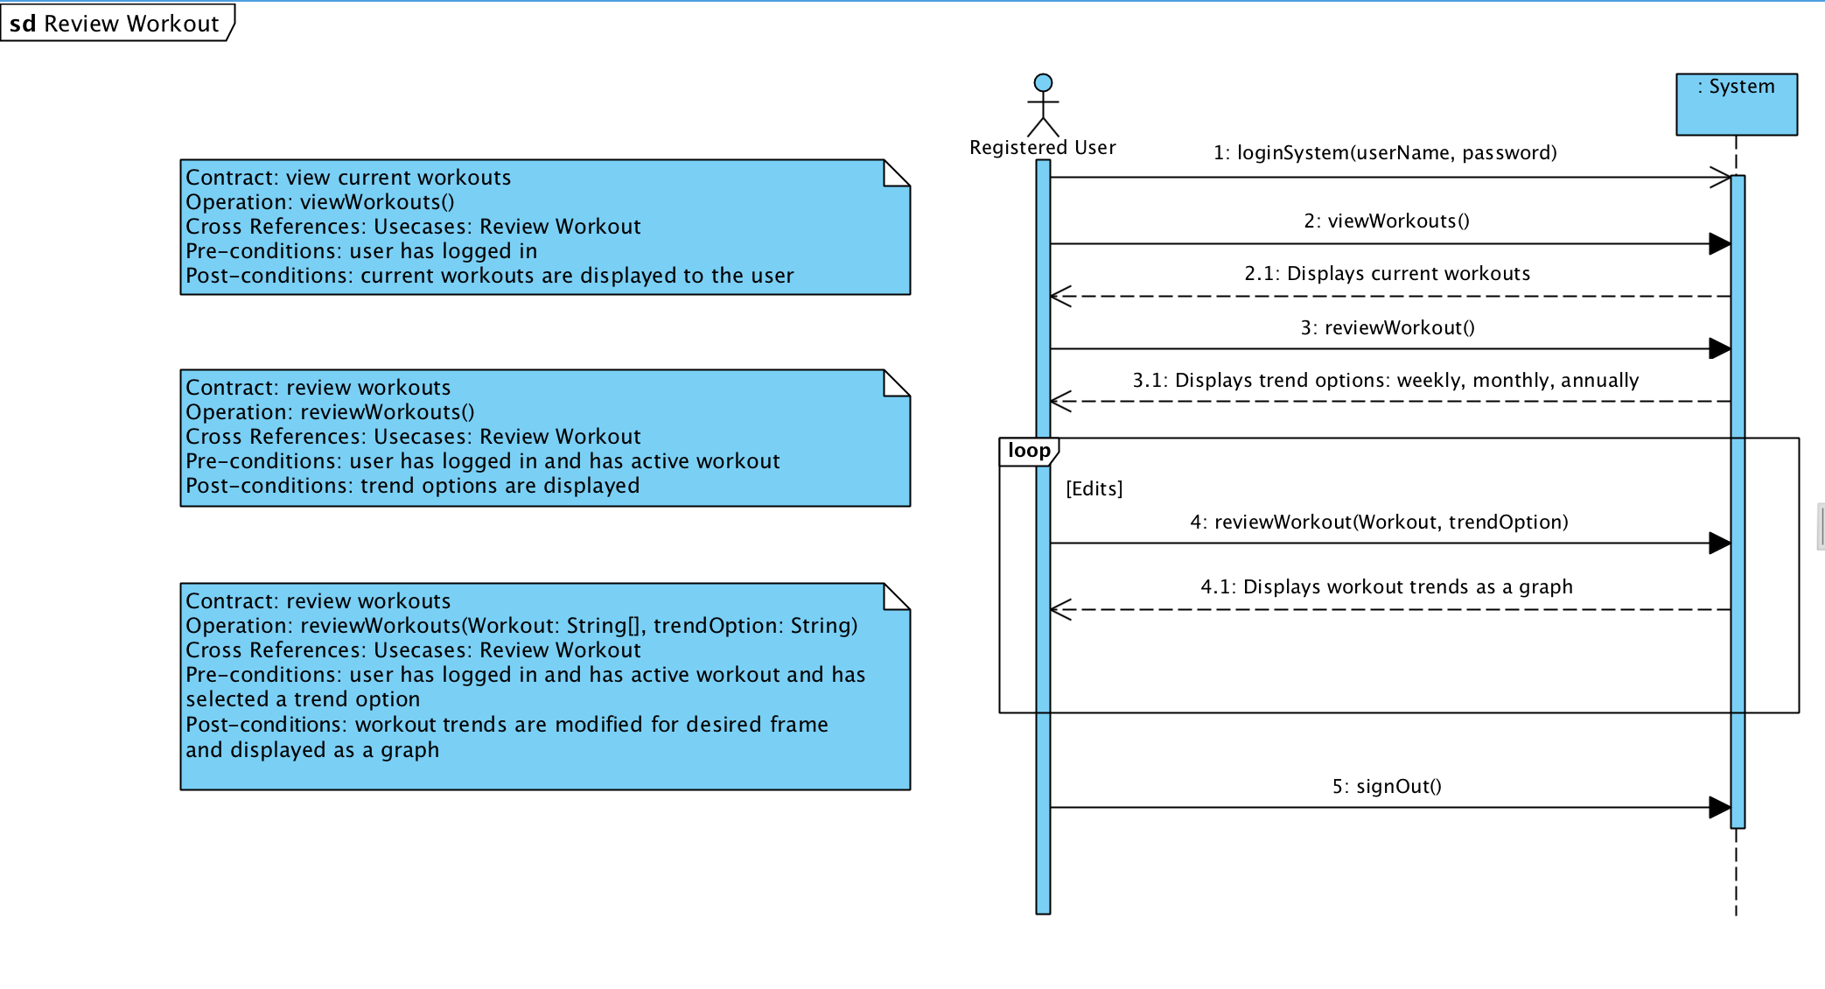
Closer Look
Review Workout
Add Workout

Slide 6
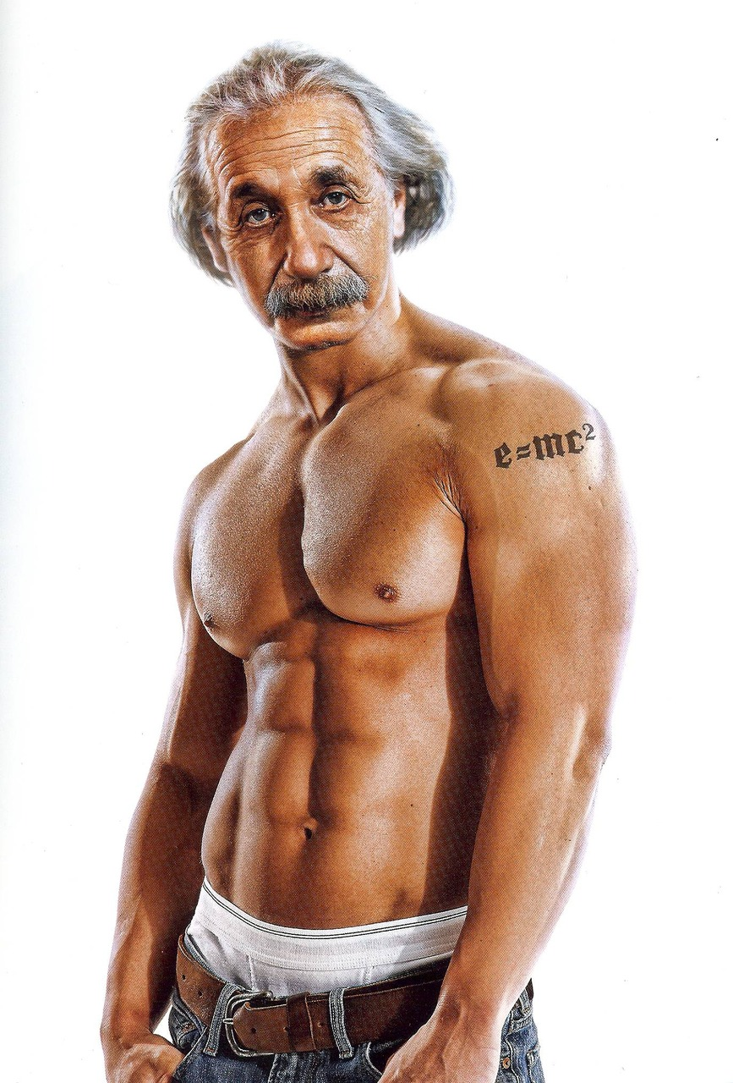
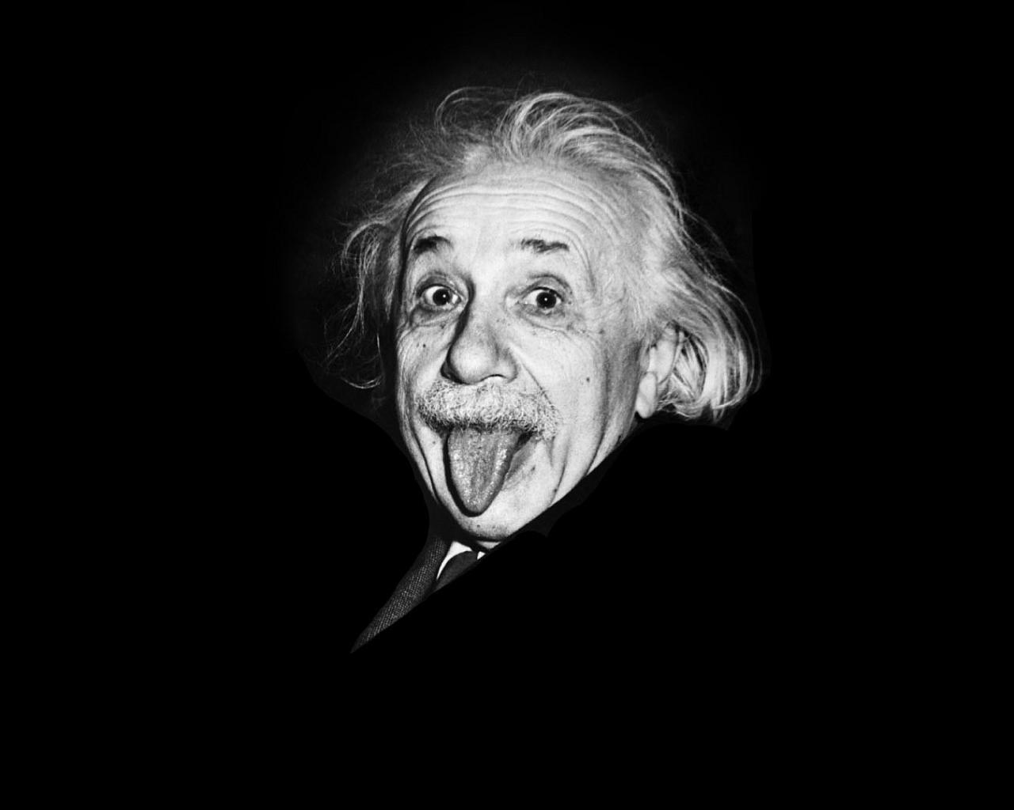
Scenario 2
Albert
Semi-Professional LARPer
Steady diet of Monster and Dominos
Wants to improve his diet
Wishes there was a better way

Slide 7
Albert’s Requirements
Log Meals
Plan Meals
Easily add previous meal
See progress

Slide 8
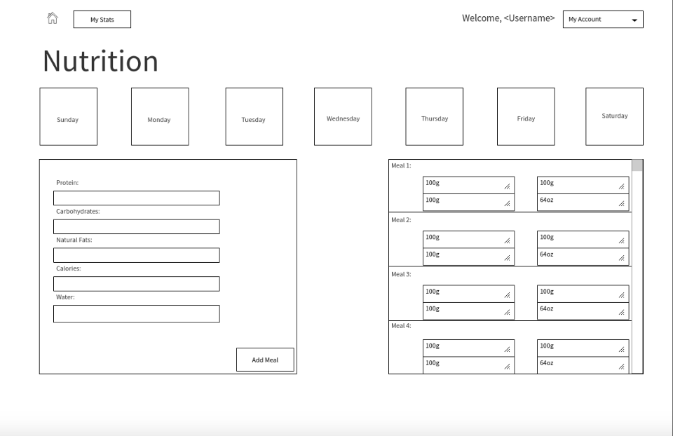
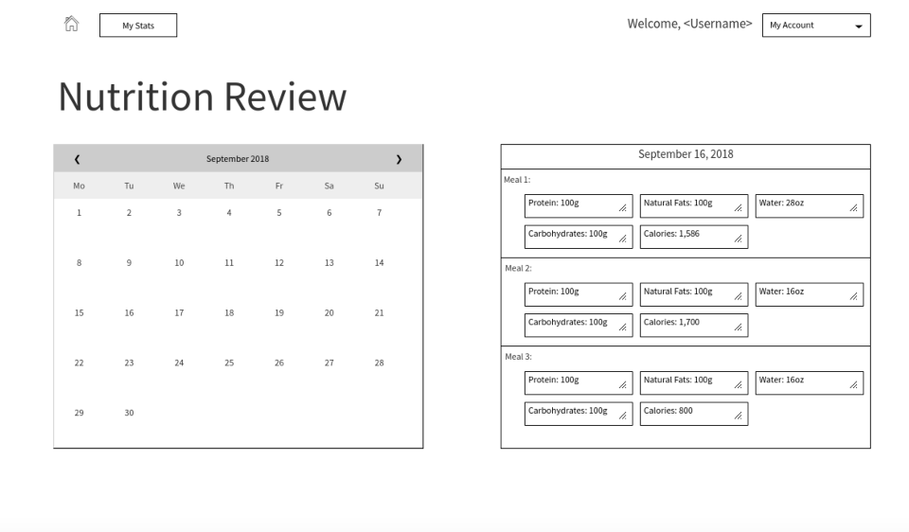
Concept

Slide 9
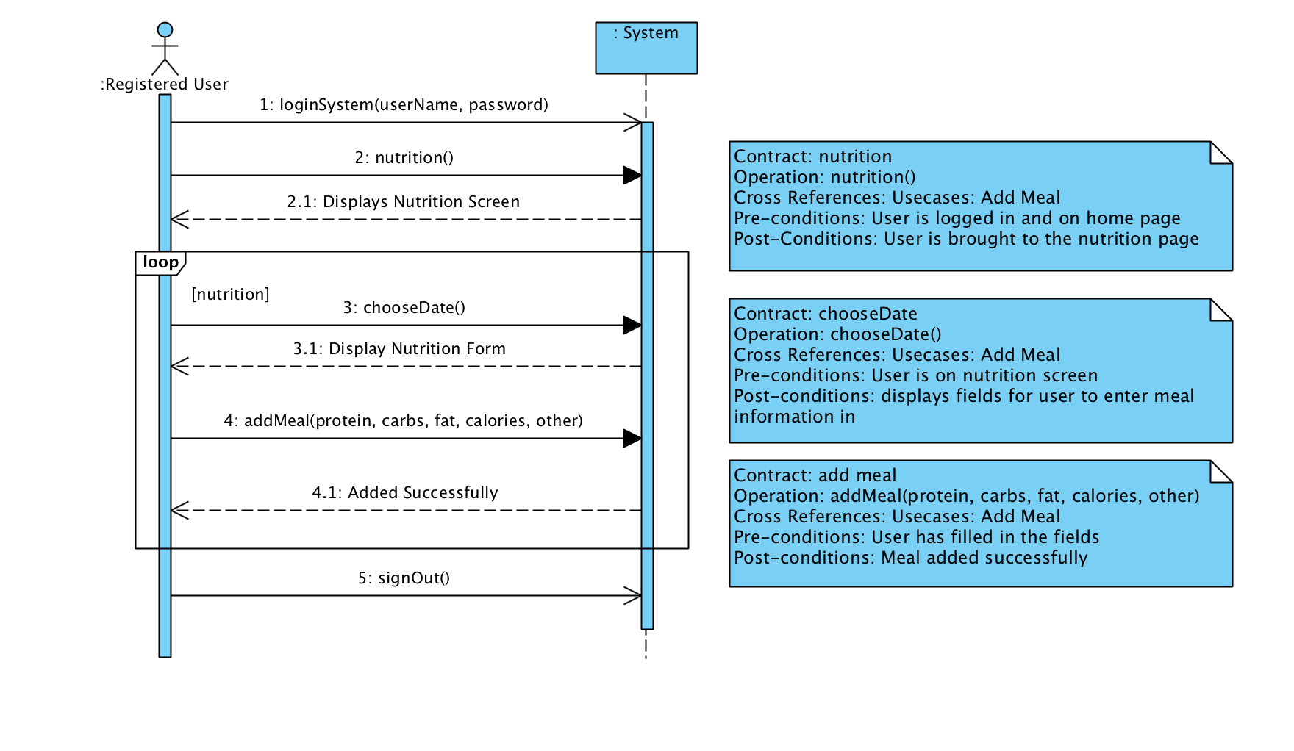
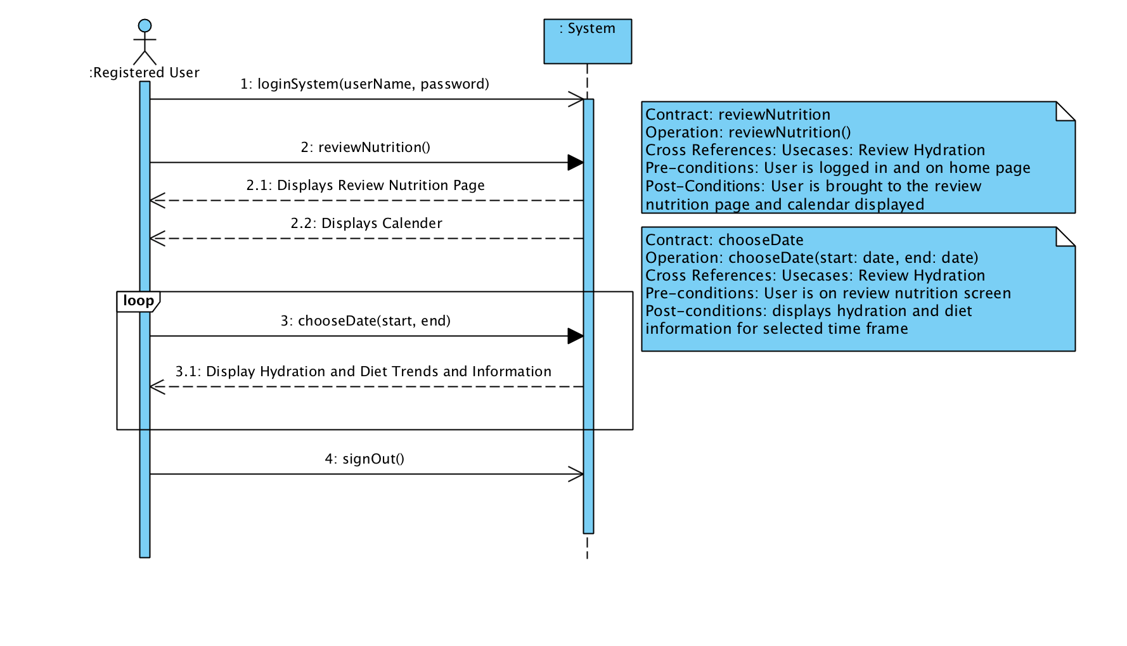
Under the Microscope
Add Meal
Review Nutrition

Slide 10
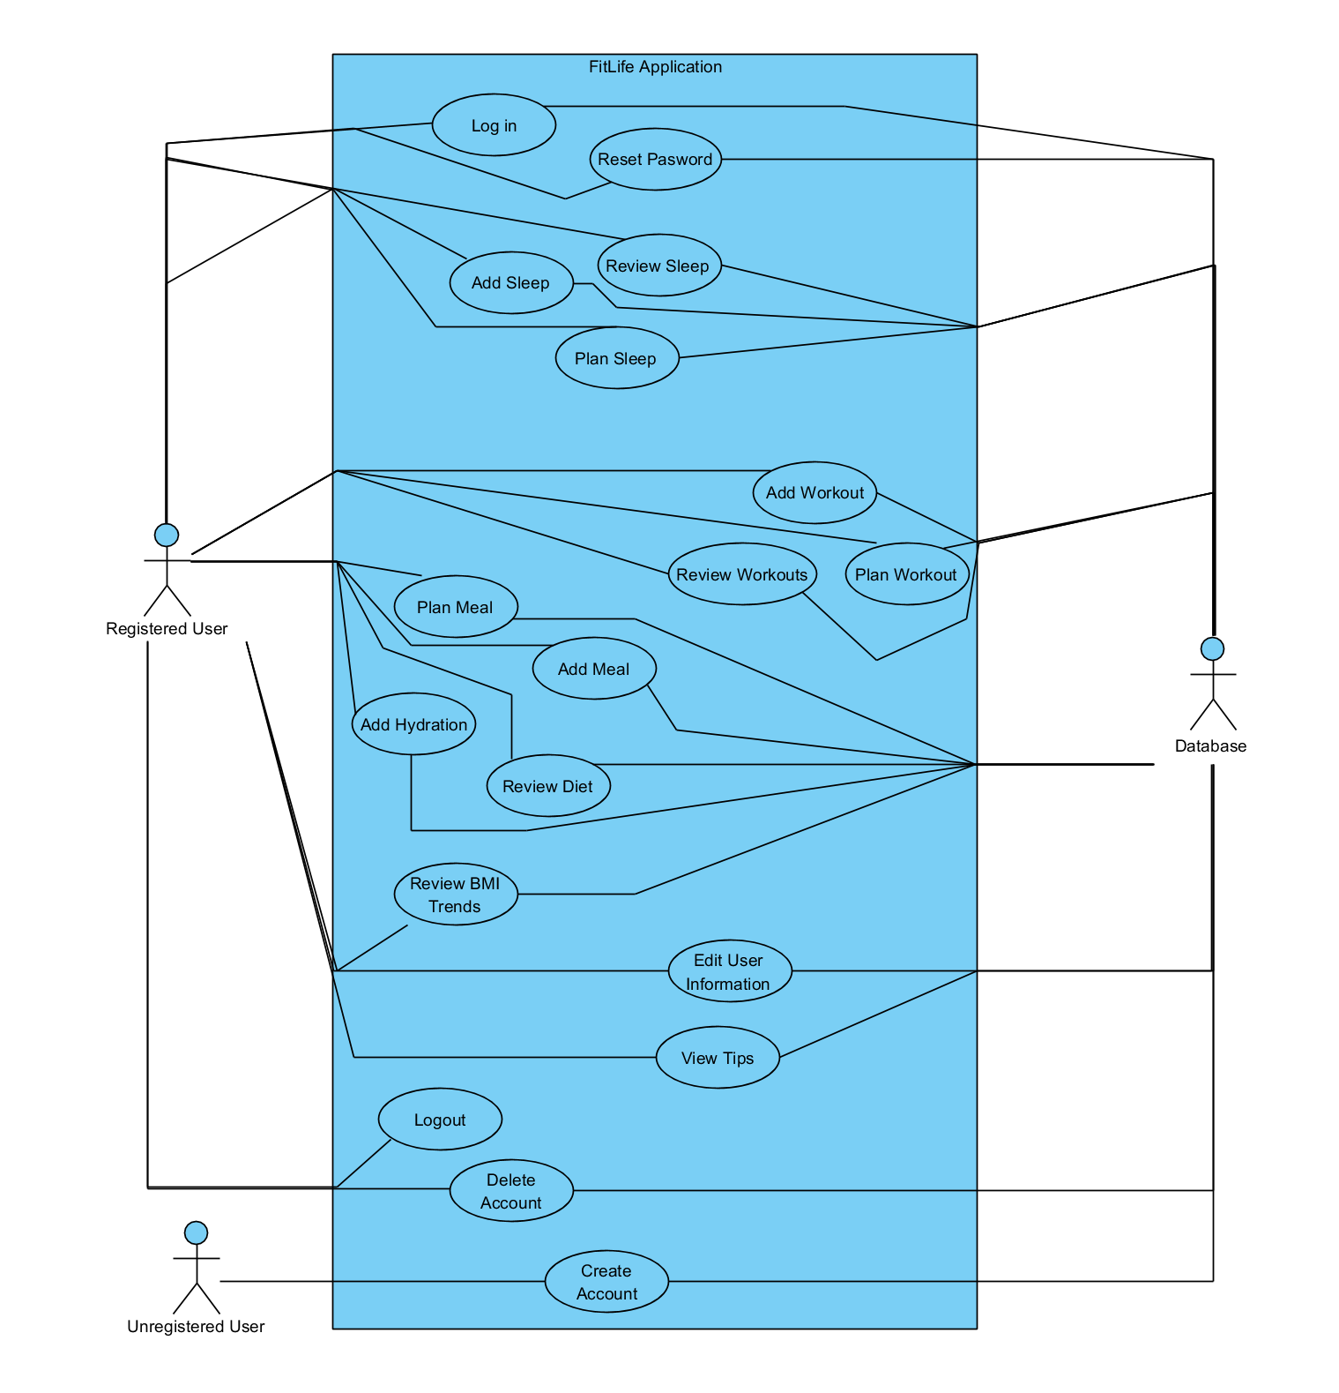
Different Uses

Slide 11
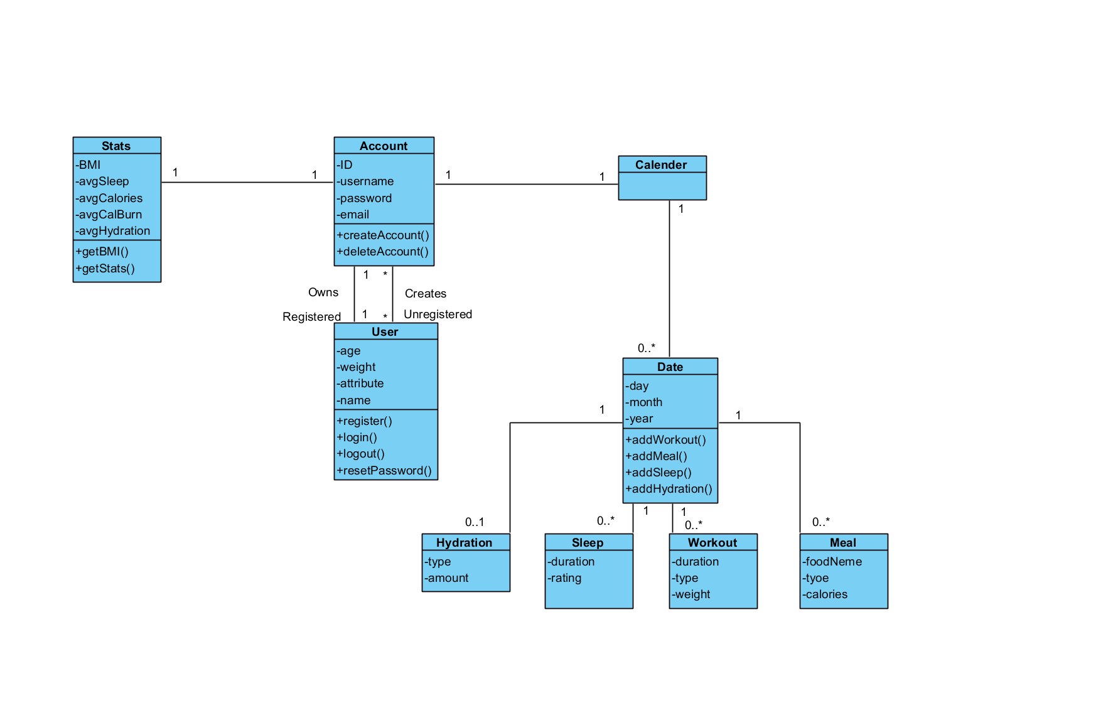
The Blueprint

Slide 12
Stay Updated
FitLife App
https://fitlifeapp.github.io/

Slide 13
Thank You

