Slide 1

Jboss fuse:
QE way to full automatisation,
part 1: “results to database”
Stefan Veres, Lukas Vydra
Jboss Fuse, Red Hat
June 6th, 2017

Slide 2
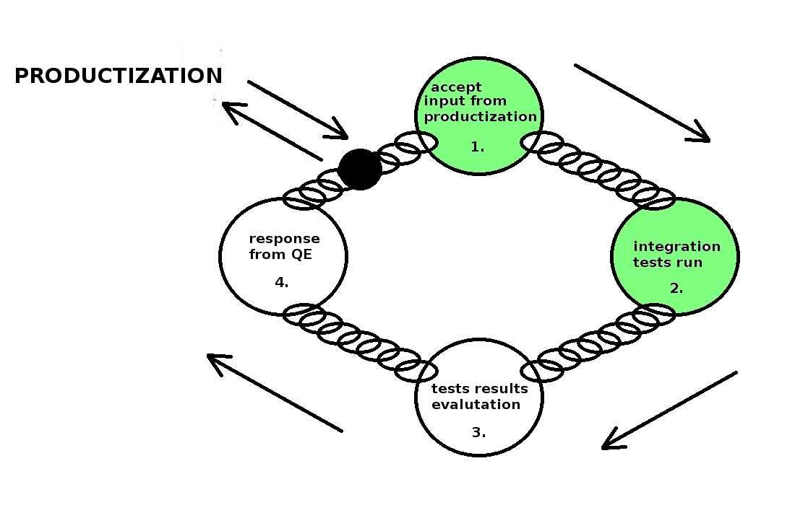
QE testing cycle

Slide 3
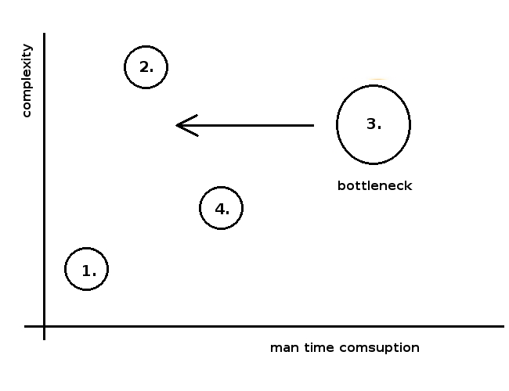
testing cycle

Slide 4
3. results evaluation: Need for change
Need for automation, requirements:
  Test results info must be in easy accessible form.
  All additional knowledge (needed for evaluation), must be in easy accessible form.
proposal: Relational database

Slide 5
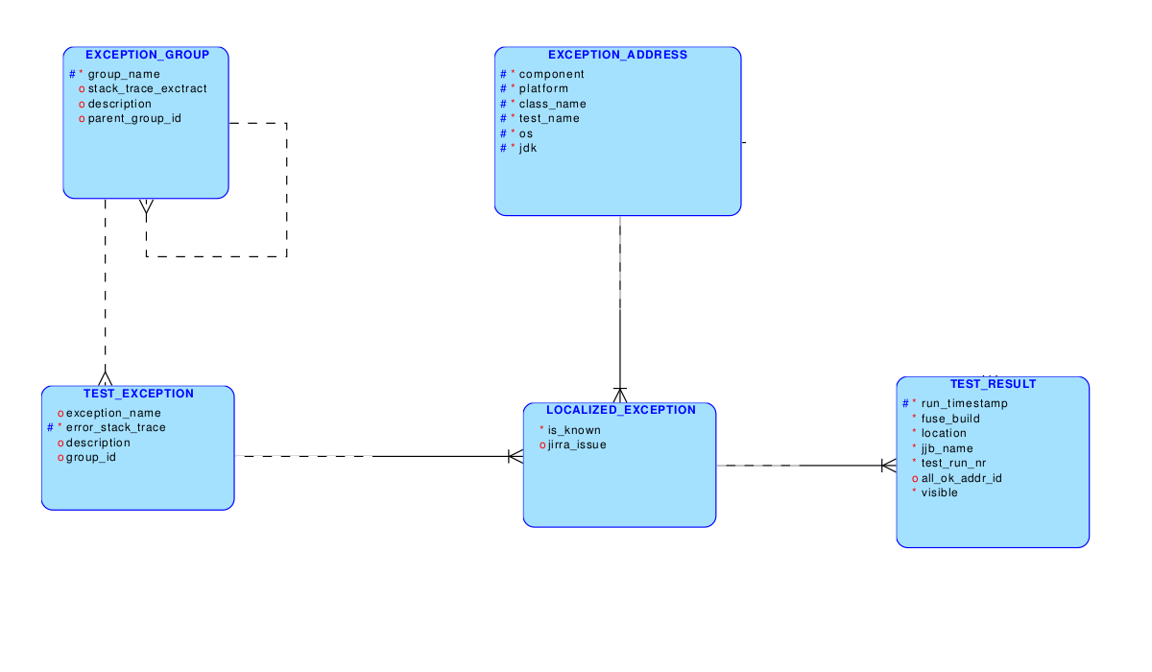
Solution proposal: MYSQL DB.

Slide 6
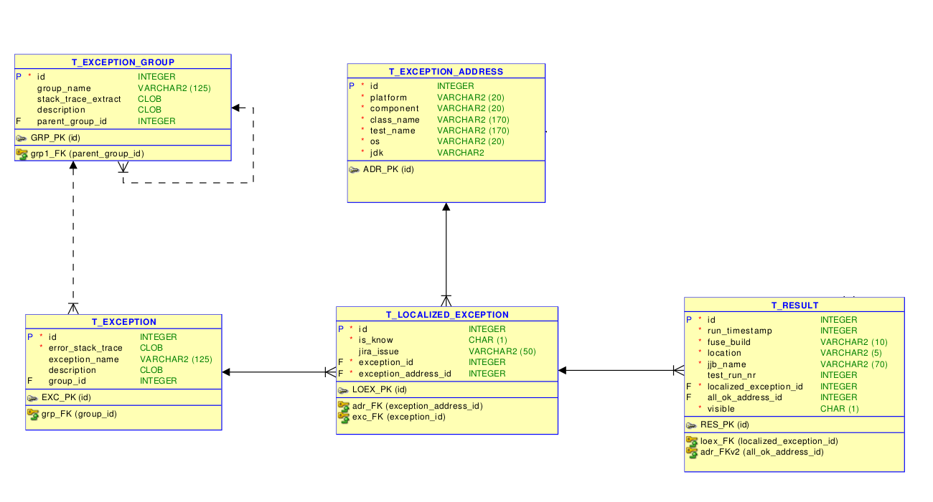
Solution proposal: MYSQL DB.

Slide 7
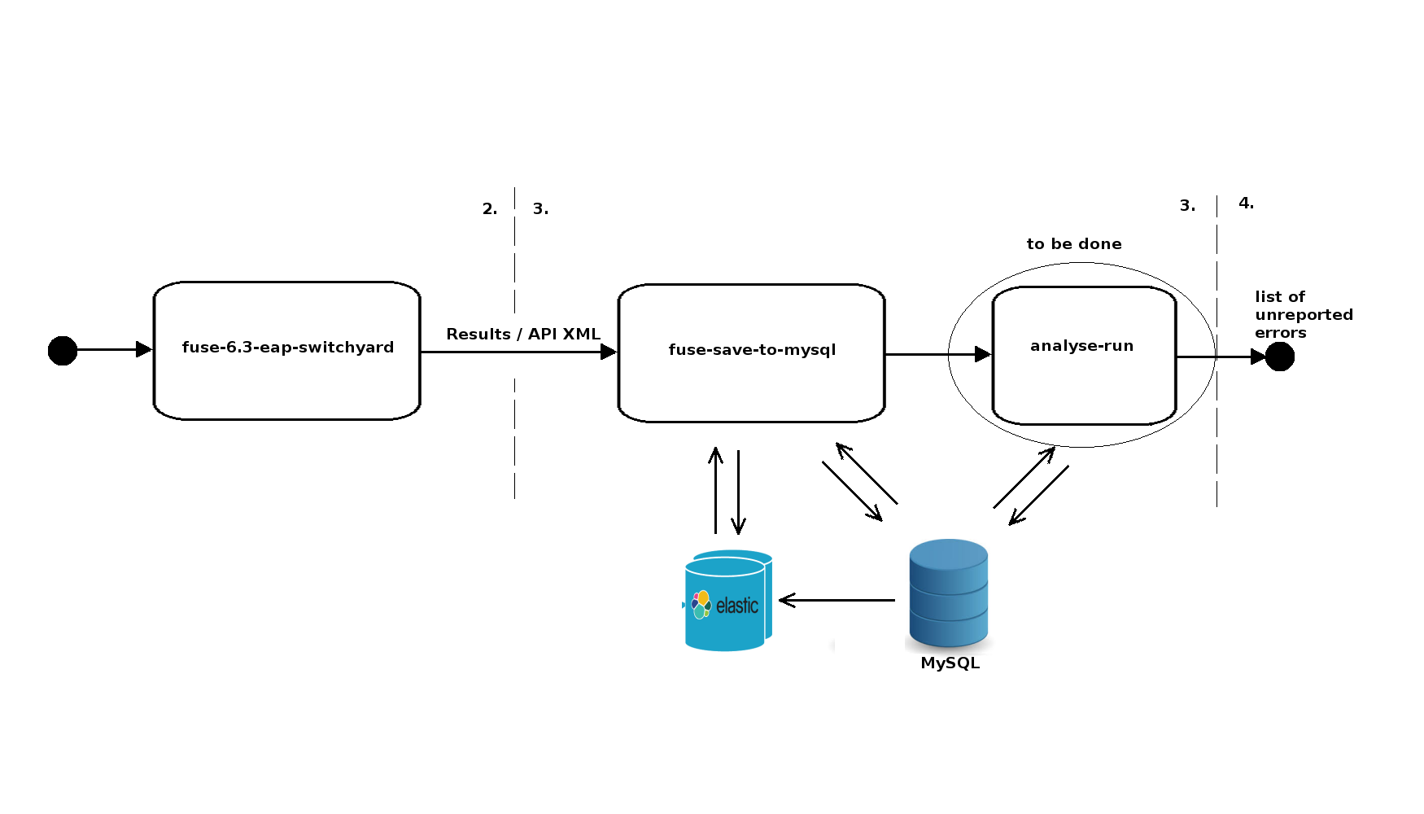
How does it work?, part1 : jenkins pipeline

Slide 8
How does it work?, part2 : manual loading database with exception info
  After create Jira issue manually update table
  t_localized_exception (is_known and jira_issue).
  Use some automation to spread known exceptions (after each test run “analyse-run”) example:
  UPDATE t_localized_exception
  SET is_know=true, jira_issue=kn.jira_issue
  WHERE id IN
  (SELECT id FROM t_localized_exception WHERE exception_address_id = kn.adr_id AND exception_id IN (SELECT ex.id FROM t_exception ex WHERE ex.group_id IN (SELECT group_id FROM t_exception WHERE id = kn.id)));

Slide 9
How does it work?, part3 : really problematic results
  Via SQL query (“analyse-run”):
  SELECT * FROM t_result
  WHERE fuse_build like '630269'
  AND
  localized_exception_id IN
  (SELECT id from t_localized_exception WHERE is_known IS NOT true);

Slide 10
Solution proposal: MYSQL DB.
Problems:
  Identification of error via error_stack_trace, too slow
  if exact method (Leveshtein method)
  Elastic search.

Slide 11
Elasticsearch
Problem definition
  Match long string by given meassure o similarity
  Group them and make this way error classes

Slide 12
Elasticsearch
Reasons for choosing elasticsearch
  built on top of Lucene, which is a full-featured information retrieval library, so it provides the most powerful full-text search capabilities of any open source product
  effective at quickly and dynamically searching through large amounts of data

Slide 13
Elasticsearch
Some implementation details... meybe technical details about ES

Slide 14
To be done: project future possibilities
  Evaluation of fuse server log.
    Step to automatic results evaluation
  Test statistics
    Decrease number or running test. (Run just with maximal information value)
  ...

Slide 15

Punch it, Mr. Frodo!

