Slide 1

Jboss fuse:
QE way to full automatisation,
part 1: “master ring found”
Stefan Veres, Lukas Vydra
Jboss Fuse, Red Hat
June 6th, 2017

Slide 2
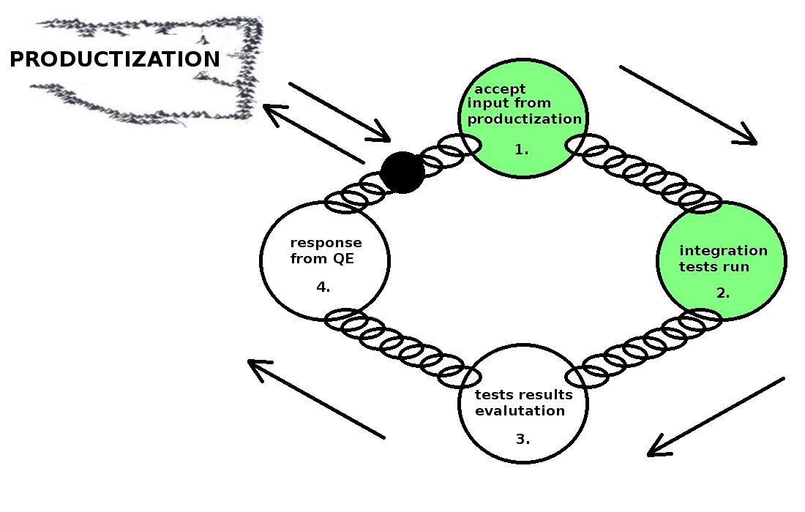
QE testing cycle chain

Slide 3
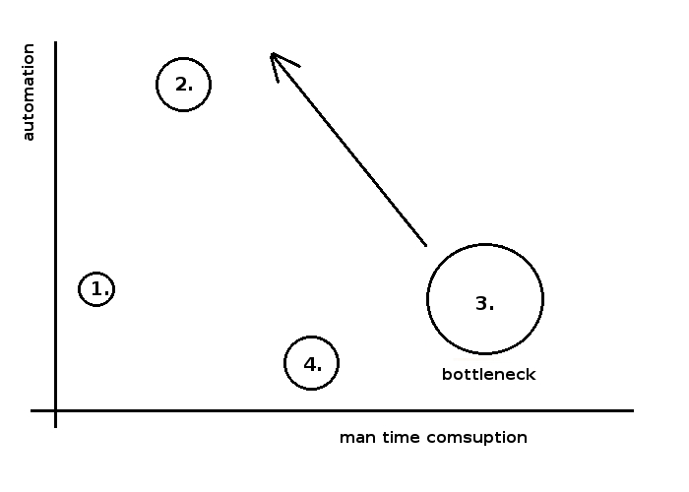
testing cycle

Slide 4
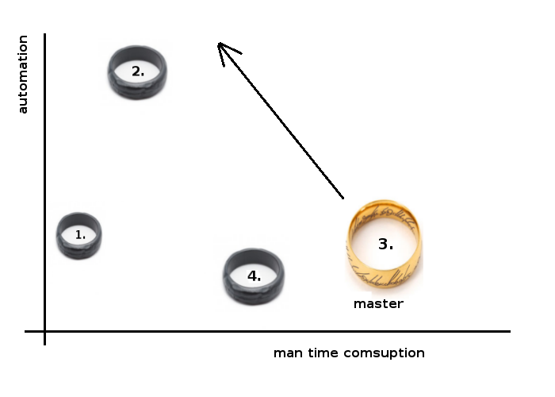
testing cycle

Slide 5
3. results evaluation: Need for change
Need for automation, requirements:
  Test results info must be in easy accessible form.
  All additional knowledge (needed for evaluation), must be in easy accessible form.
proposal: Relational database

Slide 6
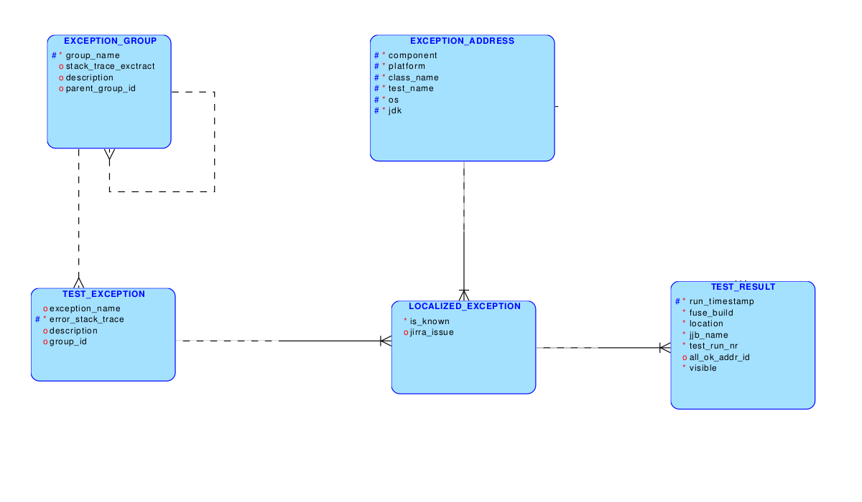
Solution proposal: MYSQL DB.

Slide 7
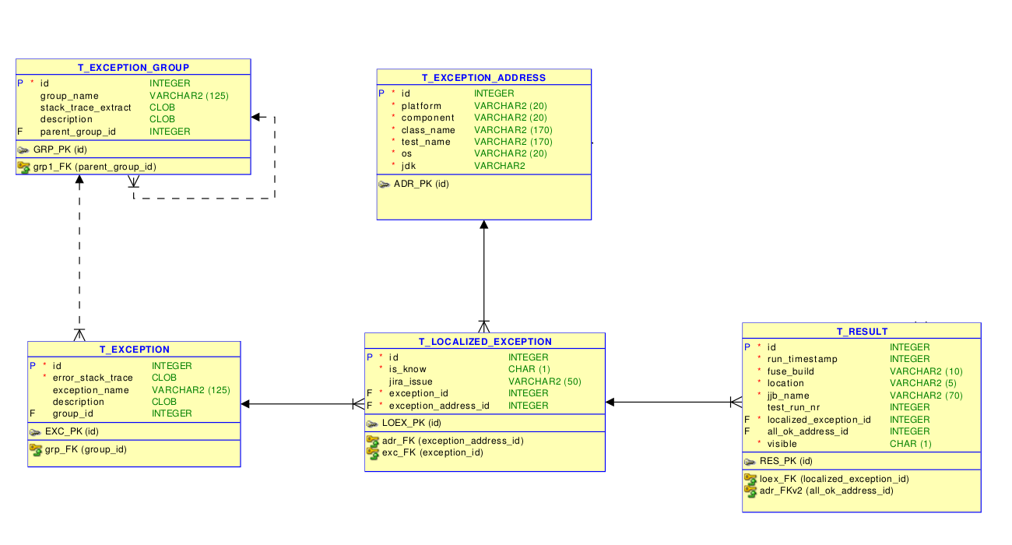
Solution proposal: MYSQL DB.

Slide 8
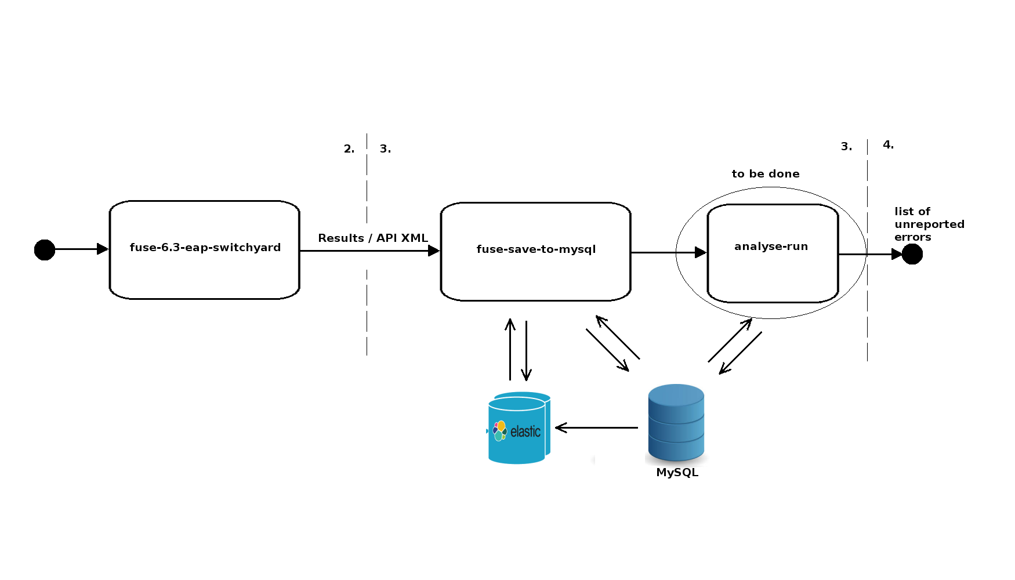
How does it work?, part1 : jenkins pipeline

Slide 9
How does it work?, part2 : manual loading database with exception info
  After create Jira issue manually update table
  t_localized_exception (is_known and jira_issue).
  Use some automation to spread known exceptions (after each test run “analyse-run”) example:
  UPDATE t_localized_exception
  SET is_know=true, jira_issue=kn.jira_issue
  WHERE id IN
  (SELECT id FROM t_localized_exception WHERE exception_address_id = kn.adr_id AND exception_id IN (SELECT ex.id FROM t_exception ex WHERE ex.group_id IN (SELECT group_id FROM t_exception WHERE id = kn.id)));

Slide 10
How does it work?, part3 : really problematic results
  Via SQL query (“analyse-run”):
  SELECT * FROM t_result
  WHERE fuse_build like '630269'
  AND
  localized_exception_id IN
  (SELECT id from t_localized_exception WHERE is_known IS NOT true);

Slide 11
Solution proposal: MYSQL DB.
Problems:
  Identification of error via error_stack_trace, too slow
  if exact method (Leveshtein method)
  Elastic search.

Slide 12

Elasticsearch
Lukasova cast s Elasticsearchom.

Slide 13
To be done: project future possibilities
  Evaluation of fuse server log.
    Step to automatic results evaluation
  Test statistics
    Decrease number or running test. (Run just with maximal information value)
  ...

Slide 14

Punch it, Mr. Frodo!

