Slide 1
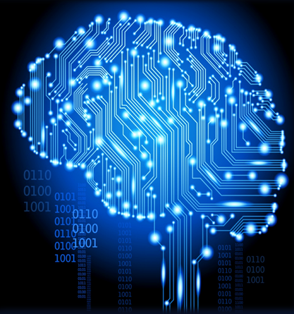
Dragon Ball Z character generation with Generative Adverserial Networks
Authors: Stefan Radonjić &Marko Jurić

Slide 2
Presentation Overview
Discriminative VS. Generative Models
Generative Adverserial Networks (GANs)
Deep Convolution Generative Adverserial Networks ( DCGANS )
Project Overview
Results
Problem with GANs
Possible Improvements
References

Slide 3
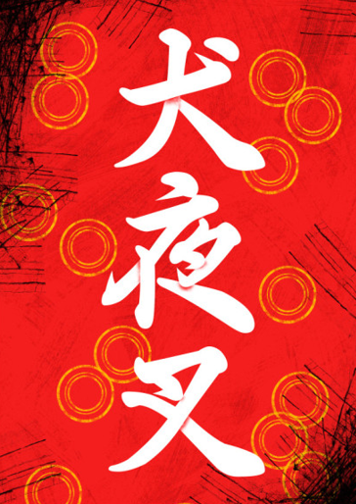
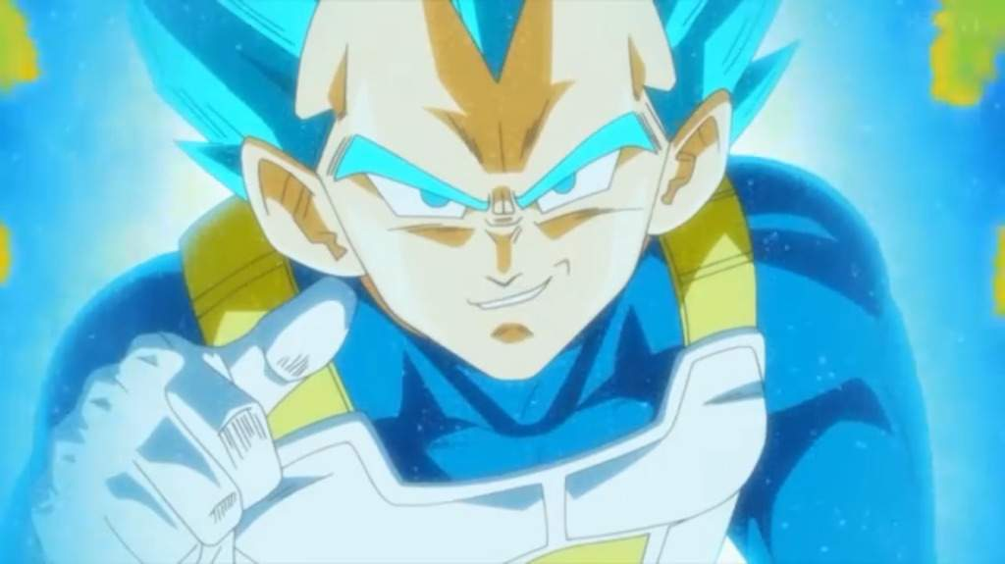
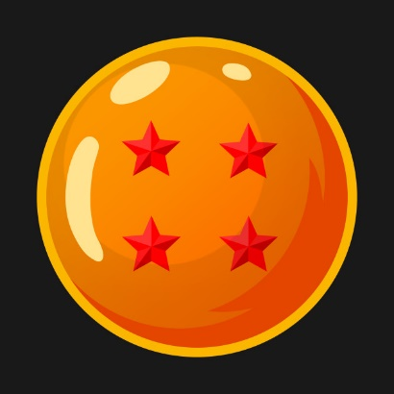
Discriminative VS. Generative Models
Discriminative models try to estimate a function called Posterior Probability - p(y|x)
In other words, Discriminative models are trying to classify features of input data ( x ) as one of predefined categories ( y ).
They ask the questions like:
What language is this?
Which character is this?
What kind of object is this?

Slide 4
Discriminative VS. Generative Models
Generative models try to estimate a function called Joint Probability – p(y,x).
Generative models are trying to figure out what is the probability that the features ( x ) belong to the given category ( y ).
Conclusion: Generative models are trying to predict the features of a given label, while Discriminative models are trying to predict the label of the given input data features.

Slide 5
Generative Adverserial Networks ( GANs ) - Introduction
GANs represent a class of Unsupervised Machine Learning algorithms which can be characterized as two neural networks competing against each other.
GANs were introduced in 2014 by a Google research scientiest Ian J. Goodfellow
This new generation of Neural Nets are being used to :
produce samples of photorealistic images for the purpose of industrial design, shoes, bags, etc.
Reconstruct 3D models of objects from images
They were reported to be used by Facebook, and many other applications

Slide 6
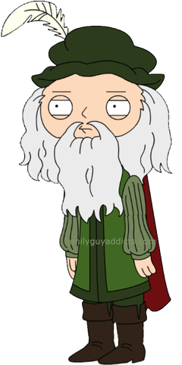
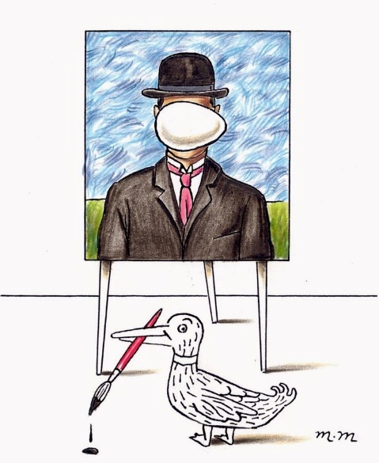
Generative Adverserial Networks ( GANs ) - Analogy
Hmm … I wonder…
One way to think about GANs is by thinking of one network as an art forger, and the other as an art expert. Art forger, in GAN literature known as Generator, is trying to forge pictures that resemble the originals. Art expert, in GAN literature known as Discriminator, recives both the forged, and the original paintings and tries to discriminate which one is fake and which one is real.

Slide 7

Generative Adverserial Networks ( GANs ) – Formal Aproach
We can consider Generator network as function G which performs the mapping from latent space, to the space of the data ( e.g images ) .
Formal expression - $G:G\left(z\right)→R^{|x|}$, where $z∈ R^{|z|}$ is a sample from latent space, $x∈ R^{\left|x\right|}$ is an image and |.| denotes the number of dimensions
Similarly, Discriminator networks can be characterized as function that maps from image data to probability of that image coming from real data distribution, or generator data distribution
Formal expression - $D:D\left(x\right)→\left(0,1\right)$ , where $x∈ R^{\left|x\right|}$ is an image, either from real data distribution, or generator data distribution

Slide 8
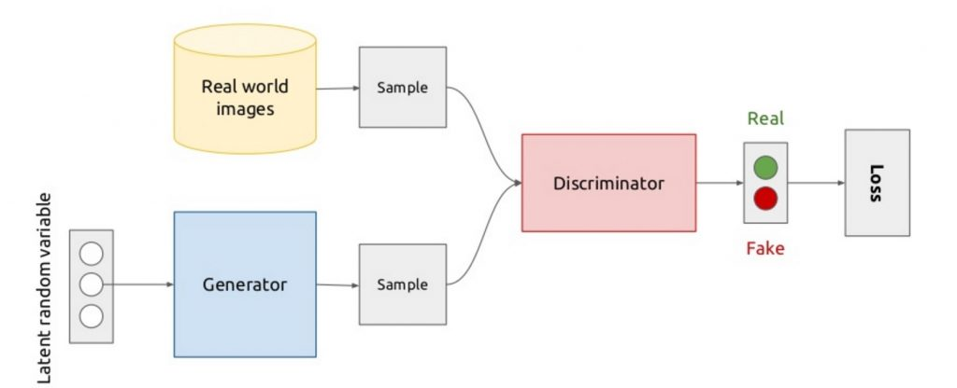
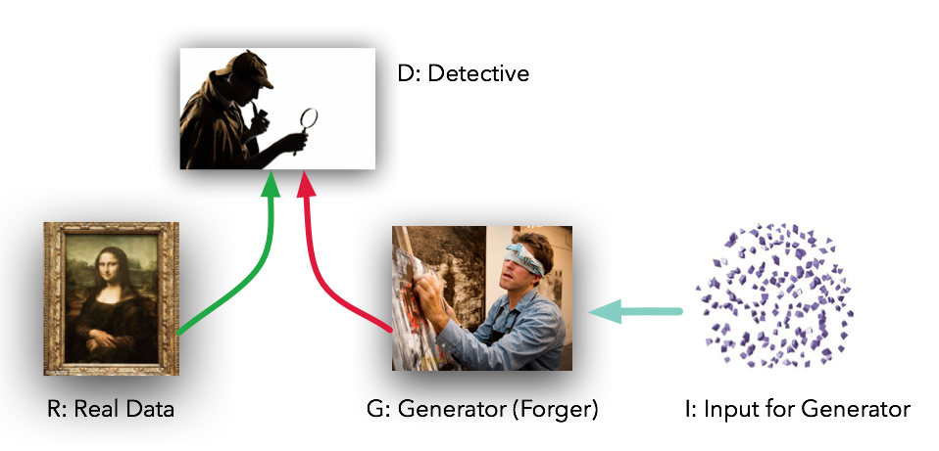
Generative Adverserial Networks - Visualization

Slide 9

Generative Adverserial Networks ( GANs ) – Training
Both Generator, and Discriminator network have their own Cost Functions, where each of those cost function depends on both, Generator parameters ($θ^{(G)}$), and Discriminator parameters ($θ^{(D)}) −$ $J\left(θ^{\left(G\right)},θ^{\left(D\right)}\right).$
Discriminator aims to minimize $J^{(D)}\left(θ^{\left(G\right)},θ^{\left(D\right)}\right)$ by controlling only his parameters - $θ^{(D)}$, while the Generator aims to minimize $J^{(G)}\left(θ^{\left(G\right)},θ^{\left(D\right)}\right)$by controlling only his parameters - $θ^{\left(G\right)}$.
Since $J\left(θ^{\left(G\right)},θ^{\left(D\right)}\right)$ depends on both, Generator, and Discriminator parameters, where each of them has control over their parameters and their parameters only, this scenario ( training ) can more easily be characterized as a game then as a optimization problem.

Slide 10

Generative Adverserial Networks ( GANs ) – Training
Since we are characterizing the competition between Generator and Discriminator as a game and not as a optimization problem, the solution to this game is not a (local) minimum but a Nash Equalibrium.
Nash Equalibrium in GANs : scenario in which Discriminator network searches for ( local ) minimum inside it’s optimization space ( $J^{(D)}$) by controlling $θ^{(D)}$, while Generator network searches for ( local ) minimum inside it’s optimization space ( $J^{(G)}$) by controlling $θ^{(G)}$. Result of training process is tuple ( $θ^{(D)}$, $θ^{(G)}$ ) where both D & G succeeded in reaching (local) minimum inside their optimization space.

Slide 11
Generative Adverserial Networks ( GANs ) – Training
Formally, training process of GANs is characterized as “minimax” game.
In Game Theory, minimax represents a decision rule in which players of the game are aiming to minimize the possible loss for the worst case scenario ( e.g maximum loss ) .
The name “minimax” comes from the idea of one minimizing its loss after his opponent tries to maximize it.
“minimax” can result in Nash equailibrium.

Slide 12

Generative Adverserial Networks ( GANs ) – Training
Discriminator Cost Function : $J^{(D)}=−\frac{1}{2}∗E_{x\sim p_{data}}\log\left(D\left(x\right)\right)−\frac{1}{2}∗E_{z\sim p_{g}}\log\left(1−D\left(G\left(z\right)\right)\right)$
By using minimax formulation we can represent Generator’s Cost Function as follows:
$J^{(G)}$= $−{ J}^{\left(D\right)}$

Slide 13

Generative Adverserial Networks ( GANs ) – Training
Since Generator performs poorly at the start of the game ( training procedure ), there is a high chance that we will have a small gradient flow through at the beginning of the training where we are suppose to learn the most – This problem is referred to as Saturating Gradient Problem.
In practice it is much better to use a slightly different formulation where Generator is now trying to maximize the probability of the Discriminator being mistaken.
Generator Cost Function used in practice:
$J^{(G)}=−\frac{1}{2}∗E_{z\sim p_{g}}\log\left(D\left(G\left(z\right)\right)\right)$

Slide 14

Generative Adverserial Networks ( GANs ) – Training
Training both Discriminator and Generator, is based on simultaneous parameter update using Stochastic Gradient Descent ( SGD ) optimization algorithm.
The idea is to sample two mini-batches in each step, where one mini-batch is consisted of data from original data distribution and other mini-batch is consisted of data from distribution we are trying to model ( generators distribution ) – also known as prior. After that, we are simultaneously taking a step in direction of gradient descent – Discriminator wants to update its parameters in order to minimize $J^{(D)}$ , and Generator wants to update its parameters in order to maximize $J^{(G)}$.
In the original paper by Ian J. Goodfellow, one player ( Discriminator ) is being trainer in $K$ steps, while the other player ( Generator ) is being trained in only one. By the end of 2016. it has been confirmed through many experiments that simultaneously training both players gives much better results.

Slide 15
Deep Convolutional Generative Adverserial Network - Introduction
Supervised learning with Convolution Neural Networks ( CNN ) has seen huge adoption in Computer Vision applications ever since Alex Krizhevsky won the ImageNet competition back in 2012. Comparatively, unsupervised learning with Convolution Neural Networks has received much less attention.
With the introduction of Deep Convolutional Generative Adverserial Networks, or DCGANs for short, Alec Radford & Luke Metz made a great contribution and a strong candidate for unsupervised learning with Convolution Neural Networks.

Slide 16
Deep Convolutional Generative Adverserial Network - Contribution
There are many ways in which DCGANs made contribution to the field of unsupervised learning. So, what did Alec Radford & Luke Metz do in order to create this unique class of architectures which they call Deep Convolutional GANs :
They replaced any spatial pooling functions with strided convolution, allowing the network to learn its own spatial downsampling, or in case of Generator network, its own spatial upsampling.
They’ve used batch normalization in both Generator and Discriminator. Batch normalization helped at with training problems that occurred due to poor initialization, and it also helped gradient flow in deeper models.
They replaced Tanh function with ReLU, except at the last layer. The reason why they did this is because they actually observed that using bounded activation function allows model to learn more quickly to saturate and cover the color space of the training distribution.
Lastly, they replaced maxout activation in Discriminator with LeakyReLU.

Slide 17
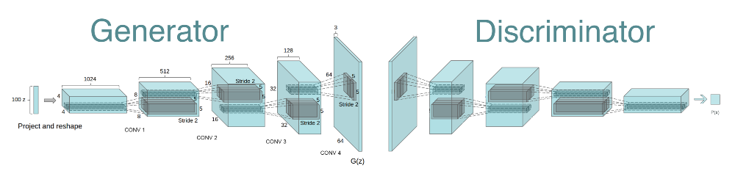
Deep Convolutional Generative Adverserial Network - Vizualization

Slide 18
Project Overview - Idea
We both are fans of Dragon Ball Z/Super series, and we’ve gotten inspired by the fact that the series might soon end due to lack of materials for it.
In order to prevent that, we present a Deep Convolution Generative Adverserial Netowork , able to generate new Dragon Ball characters based on the old ones.
Who knows, maybe next we will make a network which generates a script for the same characters we generated using this network.

Slide 19
Project Overview – Code Structure
dcgan.py – Architecture of the network.
project.py – Training procedure.
augmentation.py – Transformations used for data augmentation.
Repository link : https://github.com/StefanCepa/generating-dbs-characters

Slide 20
Results
We’ve made two experiments :
Training DCGAN while using SELU activation function – reason behind this experiment is that, in the “High-Resolution Deep Convolution Generative Adverserial Network” paper, it has been proven that SELU greatly improves convergence speed on DCGAN structure
Training DCGAN while using ReLU activation function – this experiment is based on the initial implementation of DCGAN, done by Alec Radford & Luke Metz in their “Unsupervised Representation Learning with Deep Convolutional Generative Adversarial Networks” paper

Slide 21
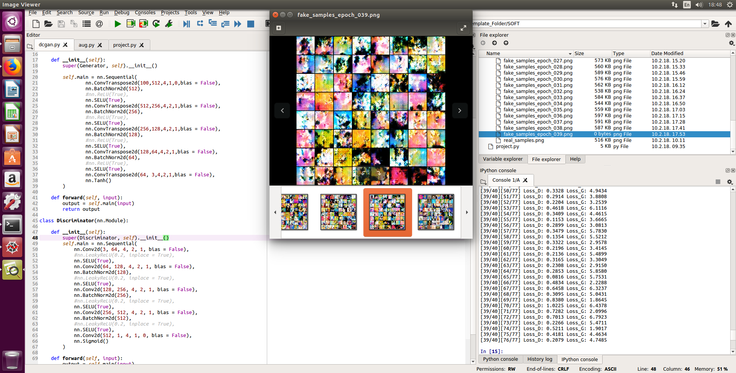
Results
Experiment ( A )

Slide 22
Results
Experiment ( A ) : for some reason results were not so satisfying as paper promised, of course we know that we are the ones who messed things up, and we will surely spend more time on this experiment to try and correct it.
Experiment ( B ) :

Slide 23
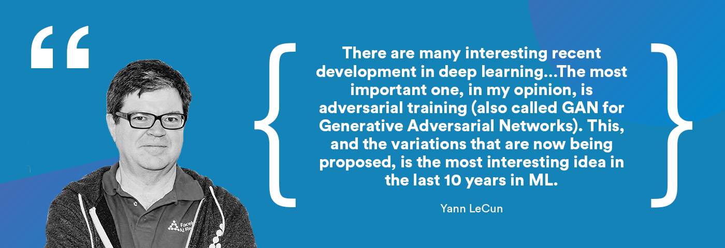
Problems with GANs
Generative Adverserial Networks are brand new generation of Neural Networks, and even though that they have made a great contribution in the field of unsupervised and semi-supervised learning, they are still a very active area of research .

Slide 24
Problems with GANs
Few main drawbacks introduced by Generative Adverserial Networks are:
Training a GAN requires finding a Nash equilibrium of a game. Sometimes gradient descent does this, sometimes it doesn’t. We don’t really have a good equilibrium finding algorithm yet, so GAN training is unstable compared to VAE or PixelRNN training.
It’s hard to learn to generate discrete data, like text.
Compared to Boltzmann machines, it’s hard to do things like guess the value of one pixel given another pixel. GANs are really trained to do just one thing, which is generate all the pixels in one shot.

Slide 25
Possible Improvements
Dataset
Increased data quality – we need images that have better quality, and same semantic interpretation.
Increased data quantity – we need more images . One possible solution to this was data augmentation, but even with it, our dataset is still small to train DCGAN.
Training
As mentioned before, we still do not have a good algorithm to find Nash equilibrium of the game. Improving the training stability of Generative Adverserial Networks is still an active area of research.
Architecture
Replaced ReLU with SELU.

Slide 26
References
GANs, original paper by Ian J. Goodfellow: https://arxiv.org/abs/1406.2661
DCGAN , paper by Alec Radford & Luke Metz: https://arxiv.org/abs/1511.06434
HDCGAN, paper by Joachim D. Curto, Irene C. Zarza, Fernando De La Torre, Irwin King, and Michael R. Lyu: https://arxiv.org/pdf/1711.06491
GANs: Overview, paper by Antonia Creswell, Tom White, Vincent Dumoulin, Kai Arulkumaran, Biswa Sengupta and Anil A Bharath : https://arxiv.org/pdf/1710.07035
Siraj Reval YouTube channel : https://www.youtube.com/channel/UCWN3xxRkmTPmbKwht9FuE5A

