Slide 1

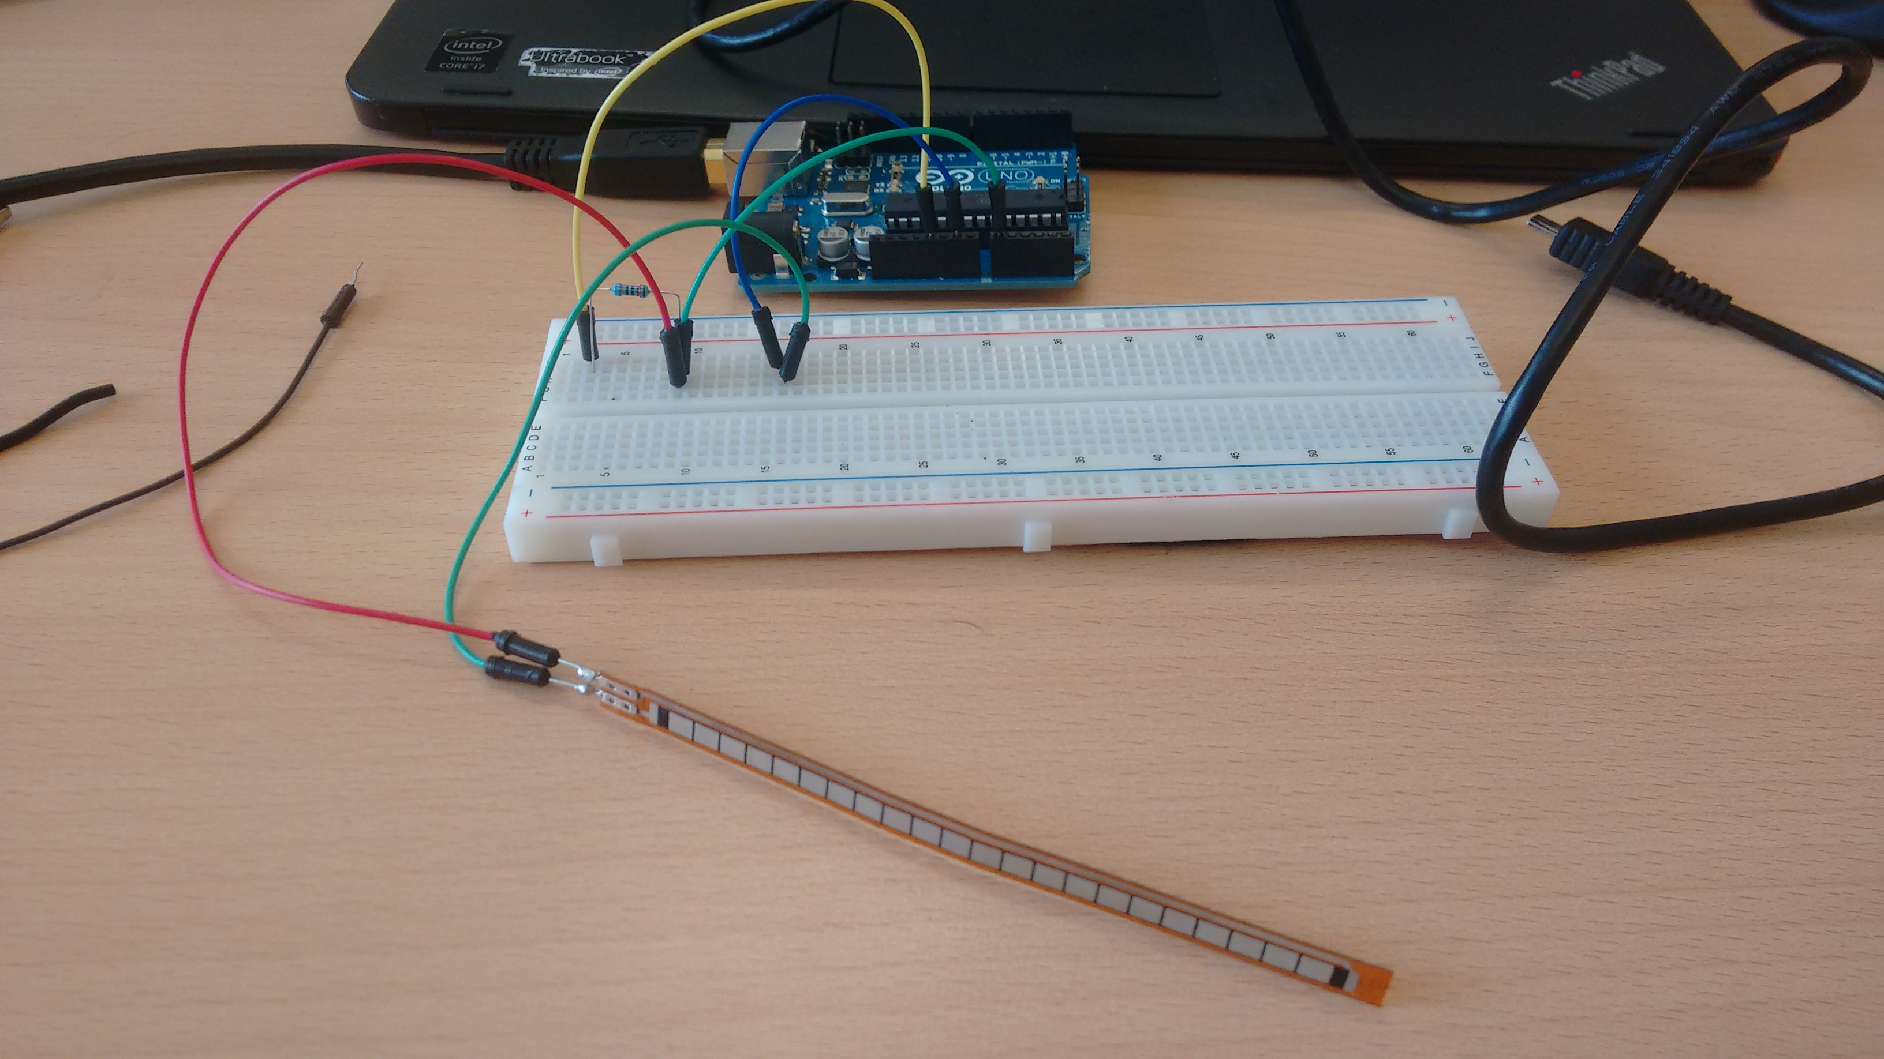
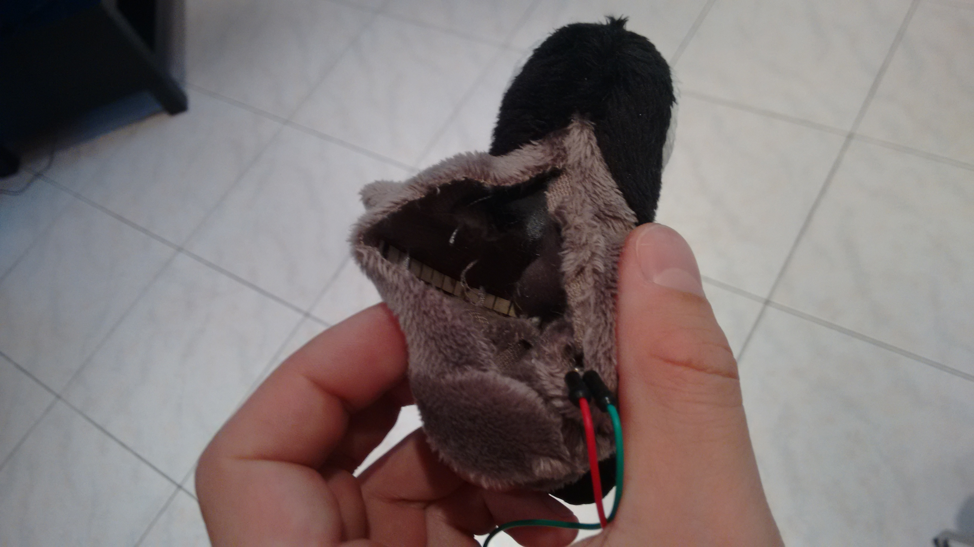

Hardware: Input device
Integrating Flex Sensor into Penguin Plush Toy

Slide 2
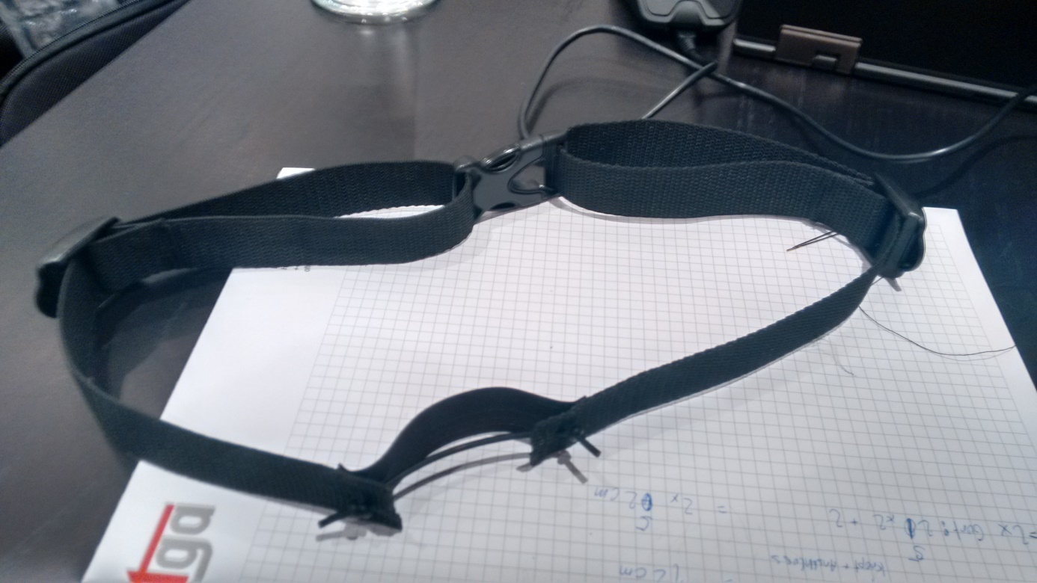
Hardware: Breathing-Sensor
Using Stretch Sensor for Breath Recognition

