Slide 1

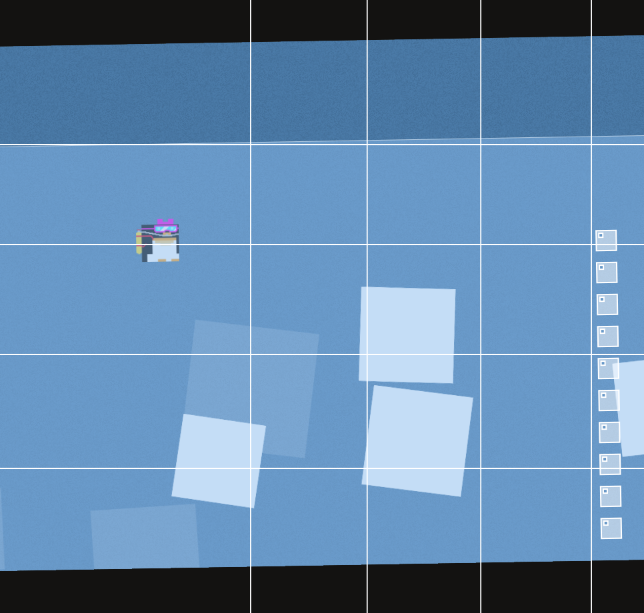

Q-Learning
Q-Table is a JavaScript Object
State is key-type, i.e. Int or String
Challenge: Encode game state as <32bit Integer

Slide 2

Q-Learning
Discretize Space in front of the penguin in n (<32) sample points
Encode obstacle or ¬obstacle bitwise
0001 0011 0000 0000

Slide 3

Q-Learning
Append n bits: Discretized penguin position
e.g. Penguin 10 (= 0000 1010) Units from top
0001 0011 0000 0000 0000 1010

Slide 4
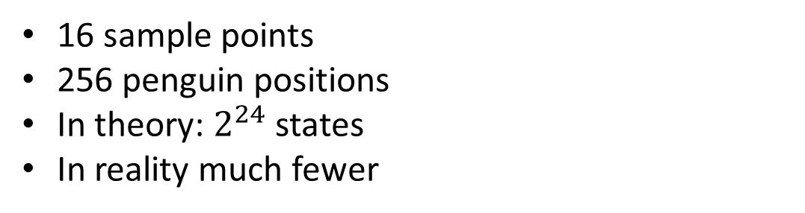
Q-Learning
16 sample points
256 penguin positions
In theory: $2^{24}$ states
In reality much fewer

