Slide 1


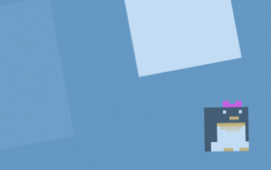


Flappy Penguin
HCI Final Project
Gernot Brunner - Stefan Cimander - Martin Hartmond - Thomas Weber

Slide 2



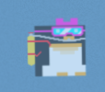
Game Concept
Don’t crash with an Ice Block!

Slide 3
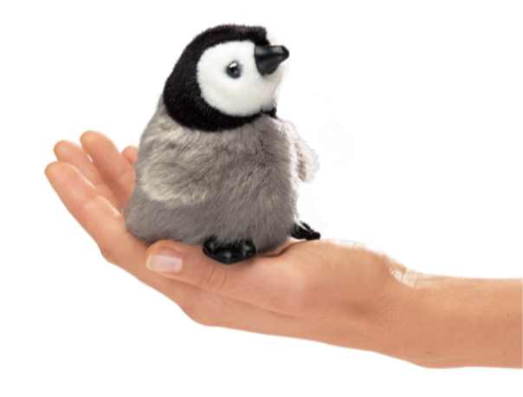
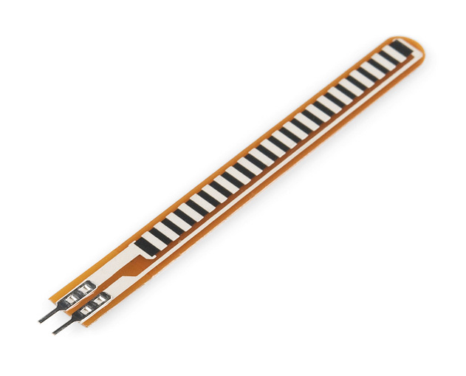
Physical Computing
Integrating Stretch Sensor into Penguin Plush Toy

Slide 4
Bio Signals

Slide 5





Software Stack
Backend
Frontend
Synchronous Rendering Pipeline
Detected User Actions
Asynchronous Callbacks
Sensor Input
Enemy AI
Q-Learning

Slide 6
Reinforcement Learning

Slide 7
Outlook

