Slide 1
Bacteria that grows 60 percent better on Space than on Earth

Slide 2
International Space Station
•Artificial satellite
•Research
•1998 – 2024 (maybe)
•~50 times Everest

Slide 3
Most Previous works
•Escherichia coli 1997 and 2002
•Pseudomanas aeruginosa 2011 2013
•Antibiotic resistance production

Slide 4
Project MERCCURI
•Microbial Ecology Research Combining Citizen
and University Researchers on the ISS
•2012 - 2014 ( successfully launched April 18, 2014 )
•Nationwide
•Science Cheerleader
•Contest
•ISS

Slide 5
Results
•Nothing
•Bacillus safensis
•Genome sequence
•No time for long-term addaption

Slide 6
References
•PeerJ. (2016, March 22). Single bacteria type grows 60 percent better on the International Space Station than on Earth. ScienceDaily. Retrieved March 28, 2016 from www.sciencedaily.com/releases/2016/03/160322100716.htm

Slide 7
The End
Slides by Stefan Cobeli

Slide 8
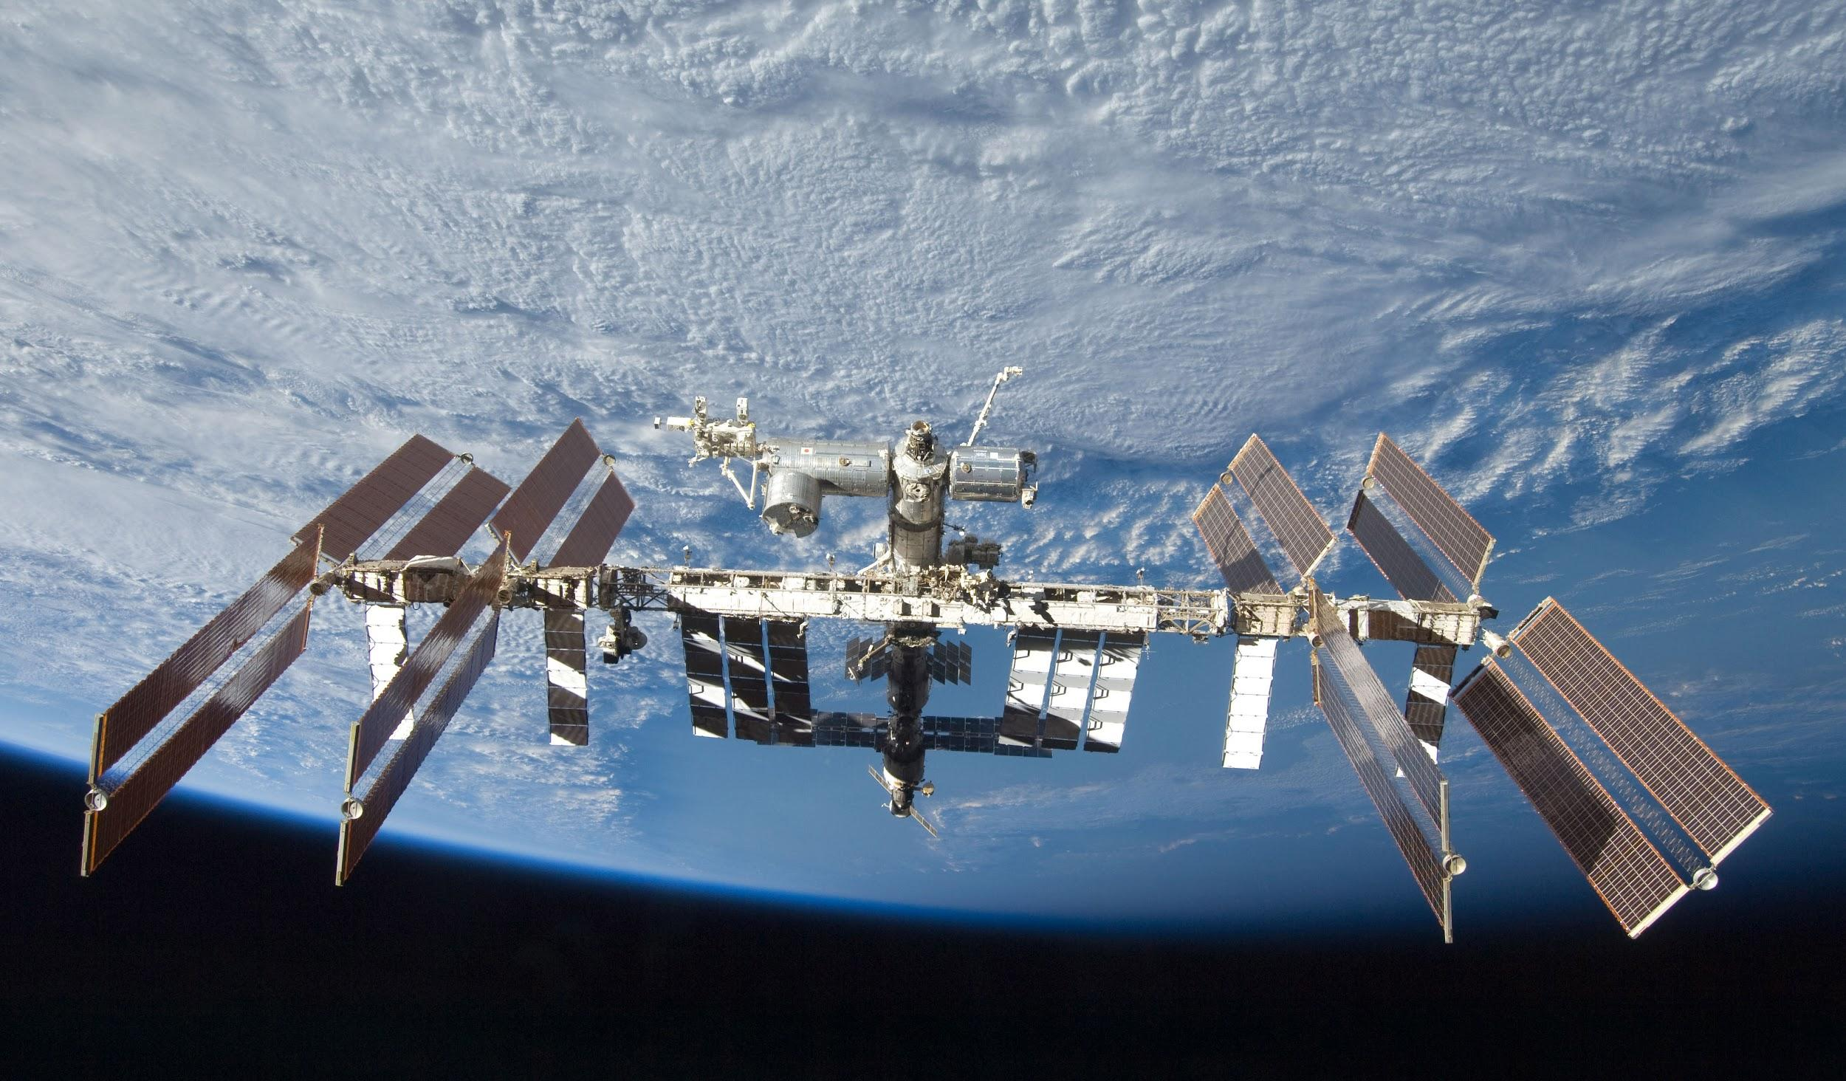

Slide 9


Slide 10
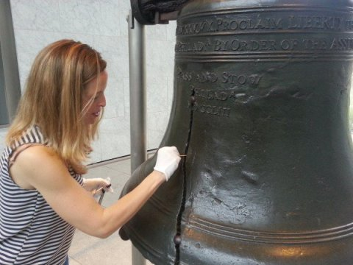

Slide 11
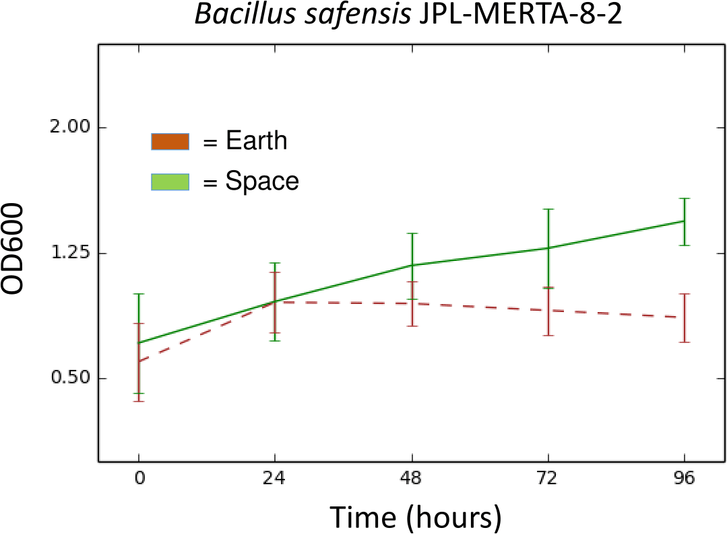

Slide 12
