Slide 1
CONFERENCE MANAGEMENT SYSTEM
TEAM
COMMODORE 64

Slide 2
CONTENT:
Team members
App introduction
Used technologies
Functional requirements
Diagrams
- Use case
- Class
UI
Timeline
Links

Slide 3
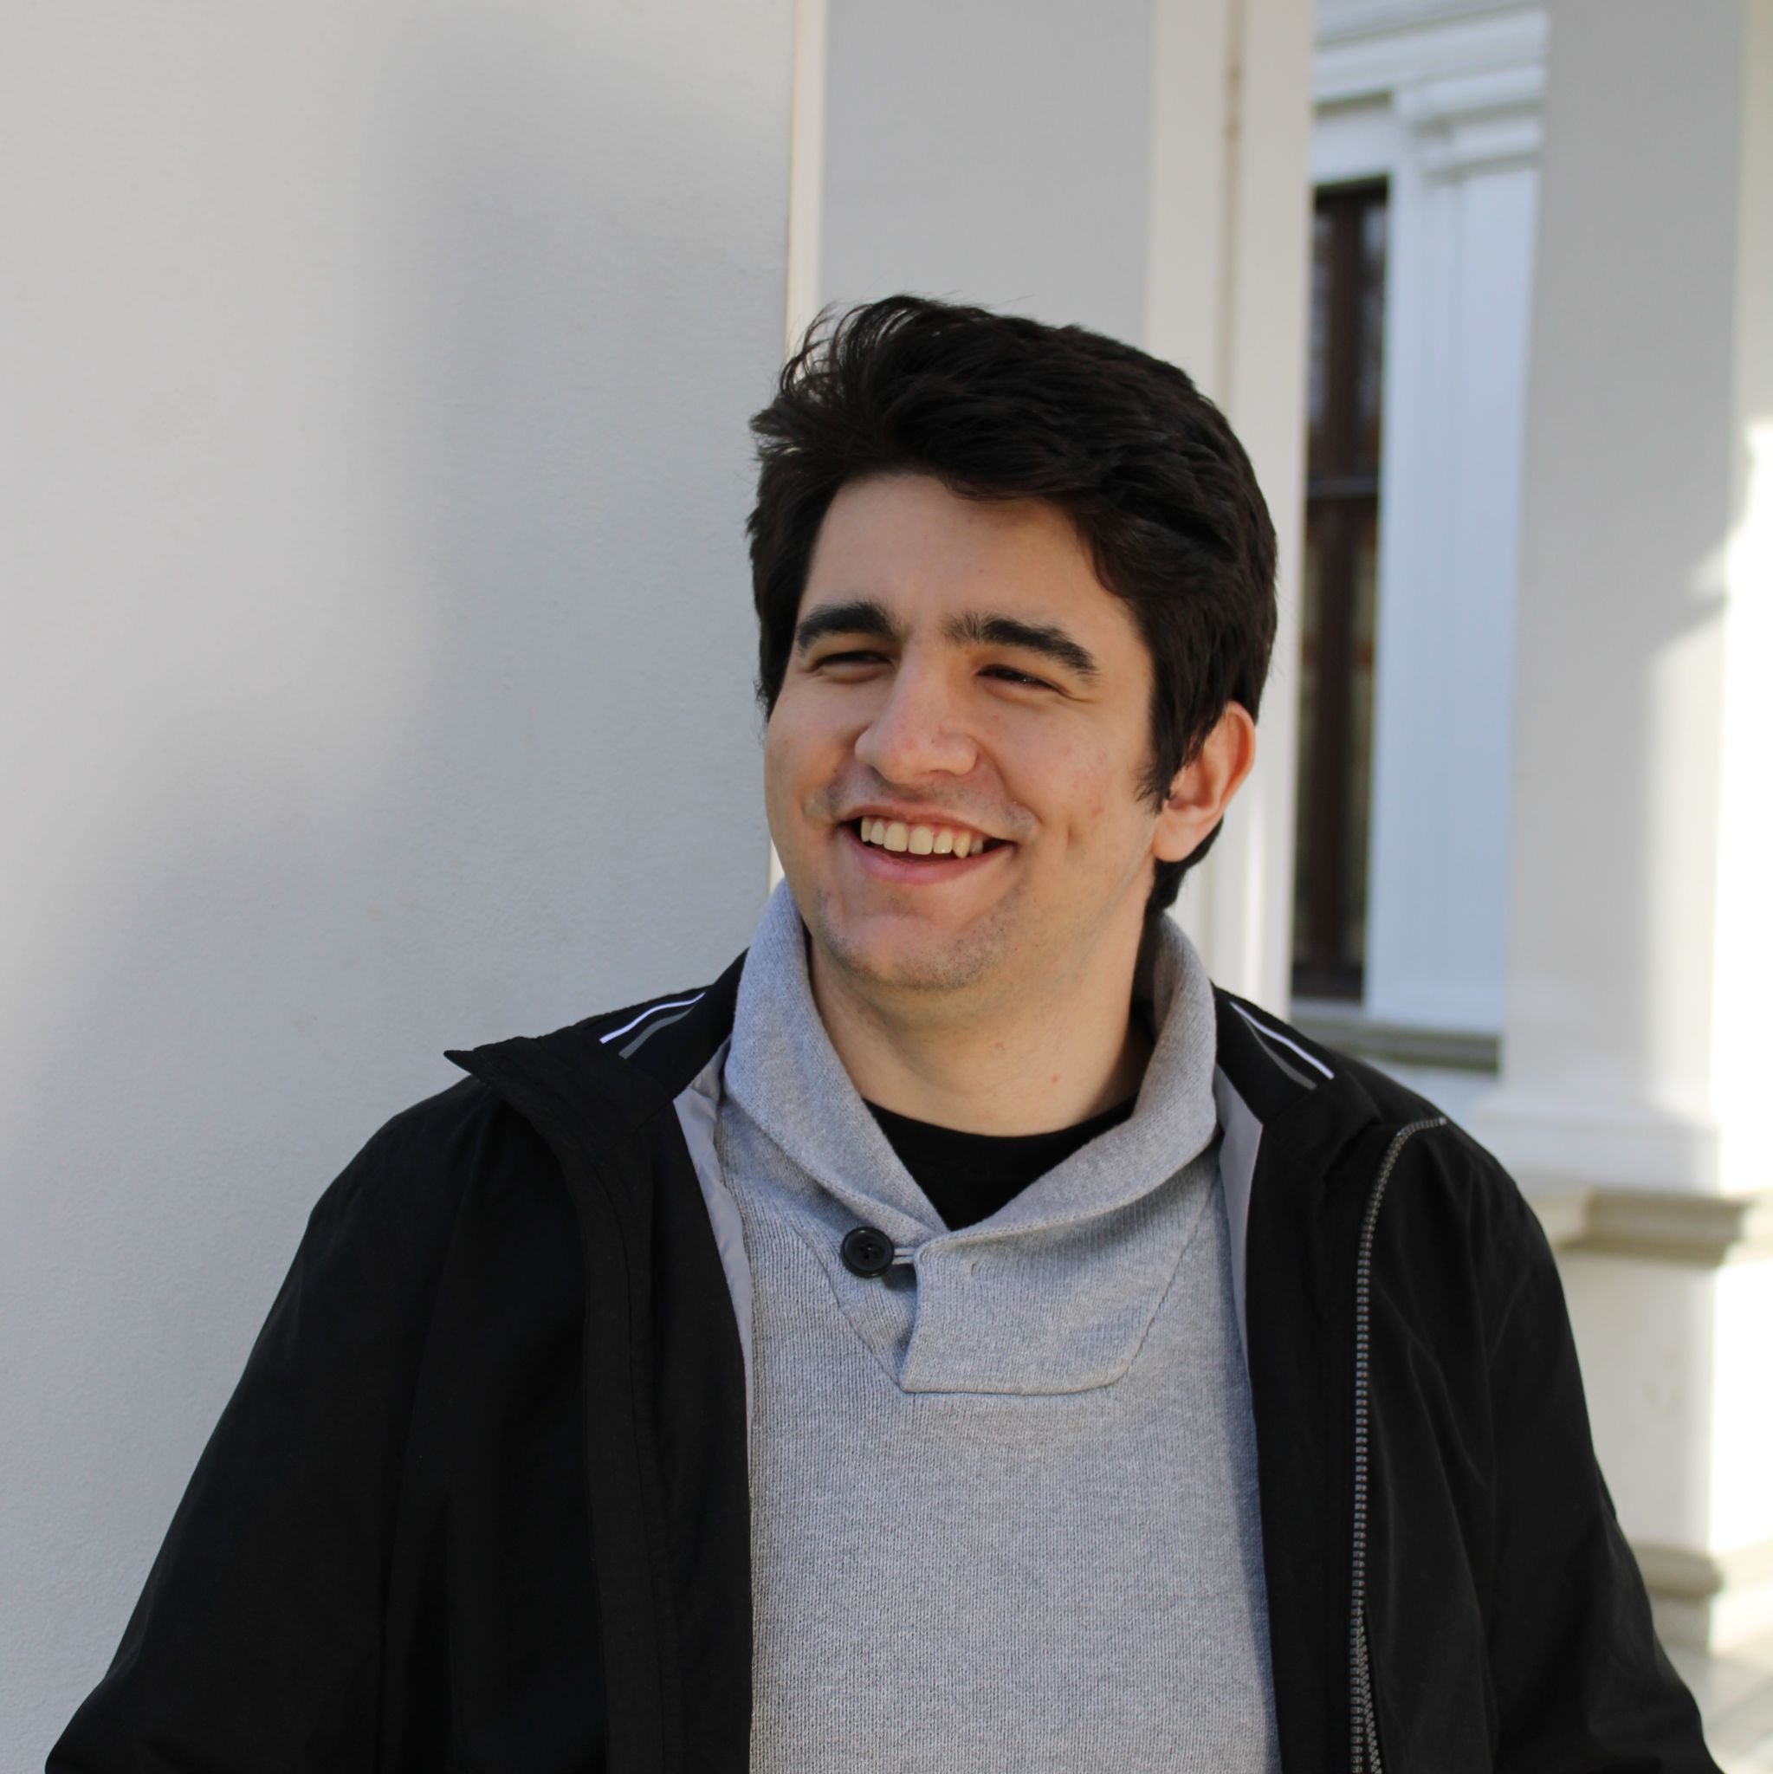



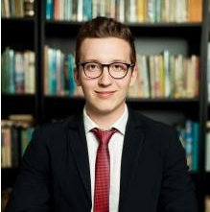
TEAM MEMBERS
MUNTEAN ANDREI-OVIDIU
MIRON MIHNEA
MIHALACHE ȘTEFAN
MOȘ DANIELE
MINA PATRICIU
Team Leader
Front-End Architect
Solution Architect
Back-end Integration Specialist
Front-end Developer

Slide 4
INTRODUCTION:
The Conference Management App aims to facilitate the whole process of organizing scientific conferences by automating the connections between the conference participants and by offering an easy to use and intuitive online platform

Slide 5


USED TECHNOLOGIES
Front-end: React.js
Back-end: Java Spring Boot
Database: JPA Hibernate
Security: JWT

Slide 6
FUNCTIONAL REQUIREMENTS:
User
Author
PC member
Steering Committee
Users can register on the website for a conference as a listener after paying the registration fee
Any user can register as an author, providing the name, affiliation, email
The author has to submit the paper for phase 1 (if the deadline if not reached yet)
After evaluation receive the results for the paper
During phase 2 PC members bid papers until the bid deadline is reached
In the case of Chair/Co-chair it will show accepted but not assigned papers and assign it to at least 2 different reviewers
When the bid deadline is reached the PC members select papers from the list of papers assigned to review and set their accepted/rejected evaluation qualifier
Steering Committee can see existing conferences and create conferences
Steering Committee can add PC members

Slide 7
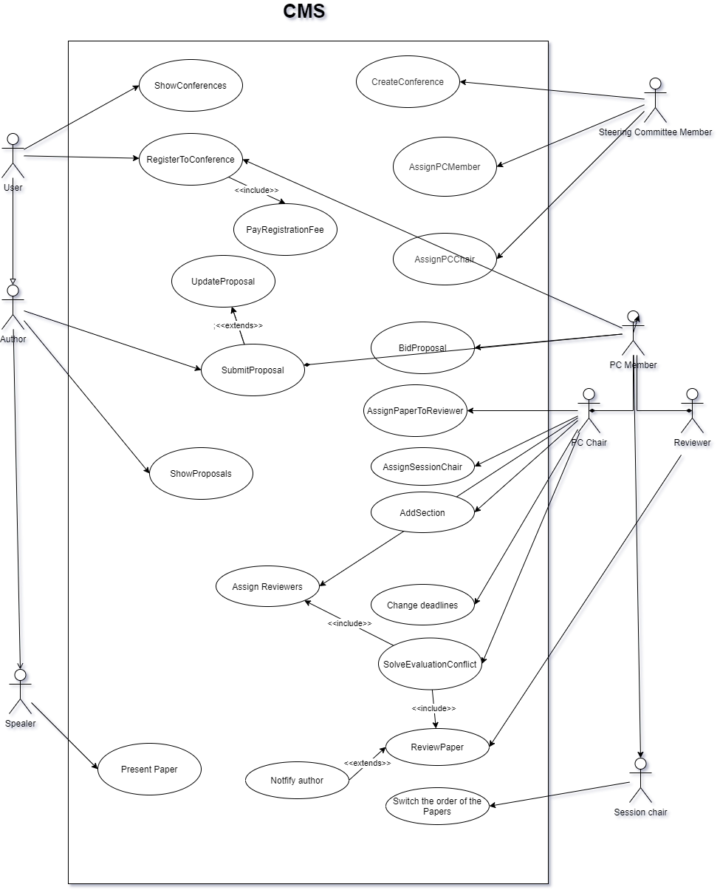
USE CASES
User:
Action:
-User register
Precondition:
-User is not already logged in
-User data is valid
Postcondition:
-User is registered
Steering committee:
Action:
-Create conference
Precondition:
-User logged in as Steering Committee Member
Postcondition:
-Conference saved

Slide 8
USE CASES
Author:
Action:
-Submit proposal
Precondition:
-User is logged in
Postcondition:
-Proposal is saved
PC Member/Reviewer:
Action:
-Evaluate papers
Precondition:
-Reviewer logged in the application
Postcondition:
-Reviewer submits his evaluation

Slide 9
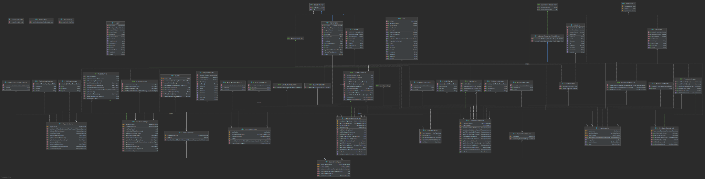
CLASS DIAGRAM

Slide 10
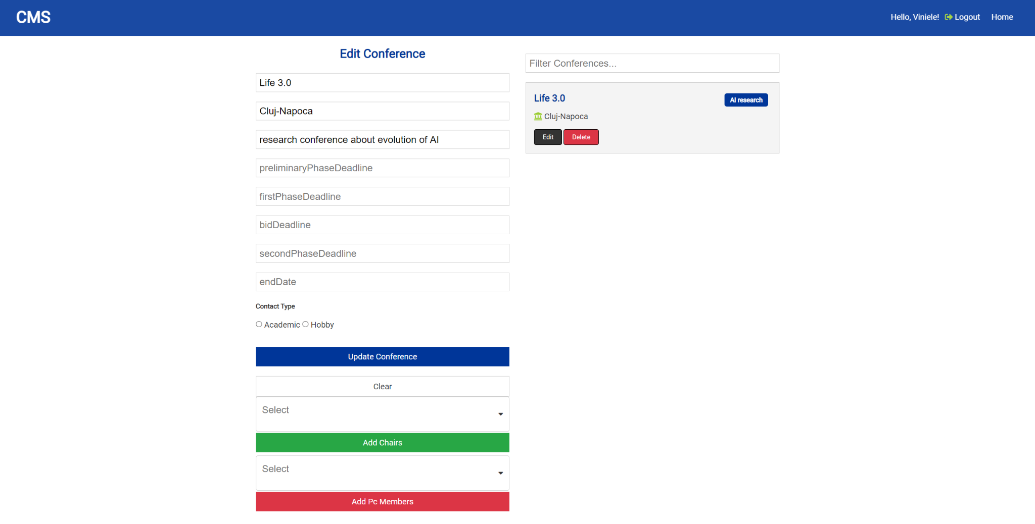
UI
We use intuitive and minimalistic UI to make sure that the user has an amazing experience on our platform

Slide 11
PROJECT TIMELINE
Week 7
Account creation
Upload proposals
Create conferences
Upload informations
Week 11
Generating list of papers
Assigning session chairs
Week 3
Diagrams
1
3
5
2
4
6
Week 5
More diagrams
Backend for entities
Week 9
PC looking over proposals
PC review papers
Week 13
Finishing touches on phase 2 & 3
Testing

Slide 12


THANK YOU FOR YOUR ATTENTION
Find the project here

