Slide 1
Final project
Stefan Georgescu
31 iulie 2024

Slide 2
Introduction
The purpose of this project is to use my SQL knowledge gained during the Software Testing course and apply it in practice.
Tested application: company
Tools used: MySQL Workbench
Database description: This database is designed to efficiently manage the administrative aspects of a company. It facilitates the storage, access, and management of data related to employees, departments, training sessions, vehicles, and telephones. The main goal is to streamline the administration of human resources, equipment, and training tracking.
You can find the GitHub repository of this project here.

Slide 3
CHAPTER 1: THEORY
1. Shortly explain what are business requirements, their purpose and who creates them
Business requirements represent a set of needs or conditions that an organization has to meet its objectives and improve its processes. They are fundamental for developing effective solutions and for carrying out projects in a way that adds value to the company. They are created by stakeholders (managers, end users), the business analyst, and the project team.
2. Explain the difference between test condition and test case
A test condition defines what is being tested and refers to any aspect of a system that can be verified or tested, such as a specific requirement or functionality. Specifically, it is a criterion that must be met for a test case to be considered passed or validated. A test case defines how the testing is performed (steps taken and/or code executed).
3. List and briefly explain the stages of the testing process.
Test Planning: Defining the Testing Strategy and Objectives. This involves setting the testing goals, identifying necessary resources, and determining success criteria. The testing strategy is developed to ensure comprehensive coverage of requirements and potential risks.
Requirements Analysis: Identifying the requirements to be tested. In this phase, the testing team examines the requirements documentation to understand which functionalities need validation. This includes identifying both functional and non-functional requirements that will guide the testing process.
Test Design: Creating test cases and test scripts. Based on the analyzed requirements, detailed test cases are developed that describe input conditions, testing actions, and expected results. Test scripts are created for test automation, if required.
Test Execution: Running test cases and collecting results. Tests are executed according to the plan, and results are recorded and compared with expected outcomes to identify discrepancies.
Testing Closure: Evaluation of testing and final reporting. Once tests are completed and critical defects have been addressed, a final evaluation of the testing process is conducted. A final test report is prepared summarizing the activities conducted.

Slide 4
CHAPTER 1: THEORY
4. Explain the difference between retesting and regression testing
Retesting checks whether a repaired defect has been resolved, while regression testing checks whether recent changes have not introduced new defects into the system.
5. Explain the difference between functional testing and non-functional testing.
Functional testing verifies whether the system meets specific requirements and functions correctly, while non-functional testing evaluates aspects such as performance, security, and reliability of the system.
6. Explain the difference between blackbox testing and whitebox testing.
Blackbox testing verifies the functionality of the software without knowing the internal structure of the code, while whitebox testing tests the internal structure and logic of the source code.
7. List the testing techniques and group them by category.
Blackbox Testing: Equivalence Partitioning, Boundary Value Analysis, Decision Table Testing, State Transition Testing
Whitebox Testing: Statement Coverage, Decision Coverage
Experience-Based: Exploratory Testing
8. Explain the difference between verification and validation.
Verification ensures that the software product is built correctly according to specifications and requirements (an internal process), while validation ensures that the built product meets the needs and expectations of the end user (an external process).

Slide 5
CHAPTER 1: THEORY
9. Explain the difference between positive testing and negative testing and provide an example of each. Positive testing verifies that the system works as expected with valid and correct data. An example is entering a correct username and password to verify successful authentication.
Negative testing tests the system with invalid or incorrect data to check how it handles errors. An example is entering an incorrect username and password to verify the error message during authentication.
10. Enumerate and briefly explain the levels of testing
Unit Testing: Testing the smallest units of code, such as functions or methods, to verify their individual correctness.
Integration Testing: Testing the combination of multiple units to verify their interactions and identify integration issues.
System Testing: Testing the entire integrated system to ensure it meets the specified requirements and functions correctly as a whole.
Acceptance Testing: Validating the system by users or clients to ensure it meets their needs and requirements before the final release.

Slide 6
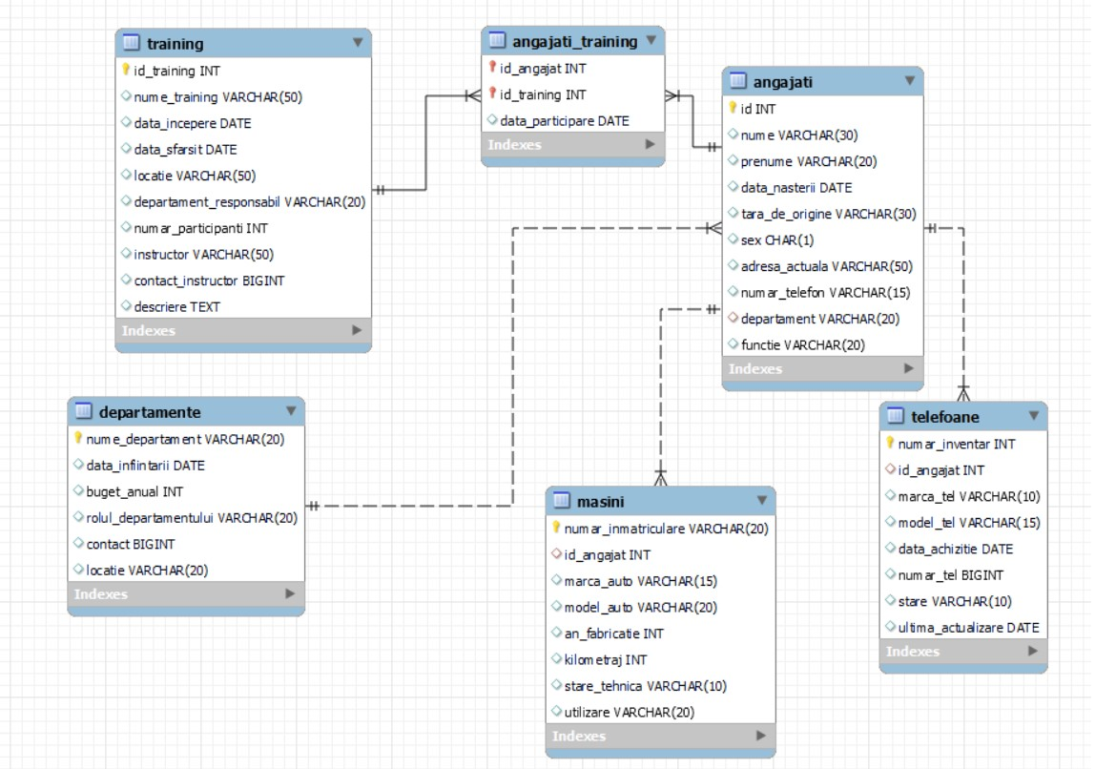
CHAPTER 2: PRACTICAL Database schema

Slide 7
Database schema
The tables are connected as follows:
The "departamente" table is connected to the "angajati" table through a one-to-many relationship implemented by using "departamente.nume_departament" as the primary key and "angajati.departament" as the foreign key.
The "angajati" table is connected to the "masini" table through a one-to-many relationship implemented by using "angajati.id" as the primary key and "masini.id_angajat" as the foreign key.
The "angajati" table is connected to the "telefoane" table through a one-to-many relationship implemented by using "angajati.id" as the primary key and "telefoane.id_angajat" as the foreign key.
The "angajati" table is connected to the "angajati_training" table through a one-to-many relationship implemented by using "angajati.id" as the primary key and "angajati_training.id_angajat" as the foreign key.
The "training" table is connected to the "angajati_training" table through a one-to-many relationship implemented by using "training.id_training" as the primary key and "angajati_training.id_training" as the foreign key.

Slide 8
CREATE statements
CREATE TABLE MASINI (
numar_inmatriculare varchar(40) primary key,
id_angajat int,
marca_auto varchar (15),
model_auto varchar (20),
an_fabricatie int,
kilometraj int,
stare_tehnica varchar (10),
utilizare varchar (20),
FOREIGN KEY (id_angajat) REFERENCES ANGAJATI(id)
);
CREATE TABLE DEPARTAMENTE (
nume_departament varchar (20) primary key,
data_infiintarii date,
buget_anual int,
functie varchar (20),
contact bigint,
locatie varchar (20)
);
CREATE TABLE ANGAJATI(
id int primary key auto_increment,
nume varchar(30),
prenume varchar(20),
data_nasterii date,
tara_de_origine varchar (30),
oras_de_origine varchar (30),
sex char (1),
adresa_actuala varchar (50),
numar_telefon varchar(15),
departament varchar (20),
functie varchar (20),
FOREIGN KEY (departament) REFERENCES DEPARTAMENTE(nume_departament)
);
CREATE TABLE TELEFOANE (
numar_inventar int primary key,
id_angajat int,
marca_tel varchar (10),
model_tel varchar (15),
data_achizitie date,
numar_tel bigint,
stare varchar (10),
data_ultima_actualizare_software date,
FOREIGN KEY (id_angajat) REFERENCES ANGAJATI(id)
);
CREATE TABLE TRAINING (
id_training INT PRIMARY KEY AUTO_INCREMENT,
nume_training VARCHAR(50),
data_incepere DATE,
data_sfarsit DATE,
locatie VARCHAR(50),
departament_responsabil VARCHAR(20),
numar_participanti INT,
instructor VARCHAR(50),
contact_instructor BIGINT,
descriere TEXT
);
CREATE TABLE ANGAJATI_TRAINING (
id_angajat INT,
id_training INT,
data_participare DATE,
PRIMARY KEY (id_angajat, id_training),
FOREIGN KEY (id_angajat) REFERENCES ANGAJATI(id),
FOREIGN KEY (id_training) REFERENCES TRAINING(id_training)
);

Slide 9
INSERT instructions
-- Example for Angajati
INSERT INTO ANGAJATI (name, surname, date_of_birth, country_of_origin, city_of_origin, gender, current_address, phone_number, department, position) VALUES
('John', 'Doe', '1985-05-15', 'USA', 'New York', 'M', '123 Main St', 1234567890, 'IT', 'Developer'),
('Jane', 'Smith', '1990-06-20', 'Canada', 'Toronto', 'F', '456 Elm St', 2345678901, 'HR', 'Manager');
-- Example for Departamente
INSERT INTO DEPARTAMENTE (department_name, foundation_date, annual_budget, responsibility, contact, location) VALUES
('IT', '2005-06-15', 500000, 'Technical Support', 1234567890, 'Bucharest'),
('HR', '2010-03-10', 300000, 'Human Resources', 2345678901, 'Cluj-Napoca');
-- Example for Training
INSERT INTO TRAINING (training_name, start_date, end_date, location, responsible_department, number_of_participants, instructor, instructor_contact, description) VALUES
('Java Programming Course', '2024-07-01', '2024-07-05', 'Room 101', 'IT', 20, 'Ion Popescu', 1234567890, 'Intensive Java programming course.'),
('Management Training', '2024-08-10', '2024-08-12', 'Conference Hall', 'HR', 15, 'Maria Ionescu', 2345678901, 'Management skills development training.');
-- Example for Angajati_Training
INSERT INTO ANGAJATI_TRAINING (id_angajat, id_training, participation_date) VALUES
(1, 1, '2024-07-01'),
(2, 2, '2024-08-10');
-- Example for Masini
INSERT INTO MASINI (registration_number, id_angajat, car_make, car_model, year_of_manufacture, mileage, technical_condition, usage) VALUES
('B-123-XYZ', 1, 'Dacia', 'Duster', 2018, 50000, 'Good', 'Service'),
('CJ-456-ABC', 2, 'Volkswagen', 'Golf', 2017, 60000, 'Good', 'Personal');
-- Example for Telefoane
INSERT INTO TELEFOANE (inventory_number, id_angajat, phone_brand, phone_model, acquisition_date, phone_number, condition, last_update_date) VALUES
(1001, 1, 'Apple', 'iPhone 12', '2021-01-15', 1234567890, 'Good', '2023-01-15'),
(1002, 2, 'Samsung', 'Galaxy S21', '2021-02-10', 2345678901, 'Good', '2023-02-10');

Slide 10
ALTER TABLE instructions
After creating the tables, it was necessary to modify some of the table columns to better accommodate the data.
--Allocate more space for license plate numbers (in case longer numbers appear)
ALTER TABLE MASINI
MODIFY COLUMN numar_inmatriculare VARCHAR(20);
--Clarify what a column means by changing its name
ALTER TABLE DEPARTAMENTE
RENAME COLUMN functie TO rolul_departamentului;
--The column oras_de_origine is not necessary
ALTER TABLE ANGAJATI
DROP COLUMN oras_de_origine;
--Shorten the name of a column
ALTER TABLE TELEFOANE
RENAME COLUMN data_ultima_actualizare_software TO ultima_actualizare;

Slide 11
Queries
In the next section, several SELECT queries were performed on the database to ensure that the correct data was retrieved.
-- I search for employees from Romania or Bulgaria
SELECT nume, prenume, departament
FROM ANGAJATI
WHERE tara_de_origine = 'România' OR tara_de_origine = 'Bulgaria’;
-- Look up the average budget
SELECT AVG(buget_anual) AS buget_mediu
FROM DEPARTAMENTE;
-- Look up the minimum budget
SELECT MIN(buget_anual) AS buget_minim
FROM DEPARTAMENTE;
-- Search for female employees in the HR department
SELECT nume, prenume, functie
FROM ANGAJATI
WHERE departament = 'HR' AND sex = 'F’;
-- Count how many employees are in Marketing
SELECT COUNT(*) AS numar_angajati
FROM ANGAJATI
WHERE departament = 'Marketing’;
-- Search departments with at least 5 employees
SELECT departament, COUNT(*) AS numar_angajati
FROM ANGAJATI
GROUP BY departament
HAVING COUNT(*) > 5;
-- Look for the Apple phones
SELECT *
FROM telefoane
WHERE marca_tel = 'Apple';
-- We want to see what departments have employees
SELECT DISTINCT(departament) FROM ANGAJATI;
-- Searching for men who work in IT
SELECT prenume, nume, departament
FROM angajati
WHERE sex = 'M' AND departament = 'IT’;
-- Count how many phones of each brand we have. We want to see which are the most common (more than 2 phones).
SELECT COUNT(numar_inventar), marca_tel
FROM telefoane
GROUP BY marca_tel
HAVING numar > 2;
--Search for employees with newer cars (after 2019)
SELECT id, prenume, nume, functie, sex
FROM angajati
WHERE id IN (
SELECT id_angajat
FROM masini
WHERE an_fabricatie > 2019
);

Slide 12
-- We want to see the new cars or those made by Dacia.
SELECT numar_inmatriculare, an_fabricatie, marca_auto, id_angajat
FROM masini
WHERE stare_tehnica = 'Noua' OR marca_auto = 'Dacia’;
-- We want to see non-HR trainings with more than 20 participants.
SELECT id_training, nume_training, locatie, numar_participanti
FROM training
WHERE NOT(departament_responsabil = 'HR' OR numar_participanti <= 20);
-- We want to see every phone whose name starts with “p” or begins with a letter, continues with “Phone“, then continues with any string.
SELECT numar_inventar, marca_tel, model_tel, id_angajat
FROM telefoane
WHERE model_tel LIKE('P%') OR model_tel LIKE('_Phone%');
-- We want to see where each employee works
SELECT angajati.id, angajati.nume, angajati.prenume, angajati.departament, departamente.locatie
FROM angajati INNER JOIN departamente
ON angajati.departament = departamente.nume_departament;
-- We want to see which trainings each employee is enrolled in
SELECT angajati.id, angajati.nume, angajati.prenume, angajati_training.id_training, training.nume_training
FROM angajati LEFT JOIN angajati_training
ON angajati.id = angajati_training.id_angajat
INNER JOIN training
ON angajati_training.id_training = training.id_training;

Slide 13
UPDATE instructions
To simulate changes made to the data in the database, two update statements were created.
-- A phone has been broken
UPDATE telefoane
SET stare = 'Defect'
WHERE marca_tel IN ('Huawei', 'Samsung’);
-- A car is no longer considered new
UPDATE masini
SET kilometraj = kilometraj + 10000, stare_tehnica = 'Buna'
WHERE numar_inmatriculare = 'IS-101-GHI';

Slide 14
DELETE instructions
Deleting records can be straightforward in some cases. In others, it may be necessary to delete from multiple tables.
-- We are closing the branch in the United Kingdom.
DELETE
FROM masini
WHERE id_angajat IN (
SELECT id
FROM angajati
WHERE tara_de_origine = 'Regatul Unit');
DELETE
FROM telefoane
WHERE id_angajat IN (
SELECT id
FROM angajati
WHERE tara_de_origine = 'Regatul Unit’);
DELETE FROM angajati
WHERE tara_de_origine = 'Regatul Unit';
-- The employee no longer has trainings.
DELETE FROM angajati_training
WHERE id_angajat = 6;

Slide 15
Conclusion
The aim of this project was to design and manage a database to streamline the administration of human resources, equipment, and departments. By organizing critical information into interconnected tables, we created a system that ensures efficient data management and reporting, thereby enhancing overall productivity.
Thank you for taking the time to read this presentation. Your interest and attention are greatly appreciated.

