Slide 1

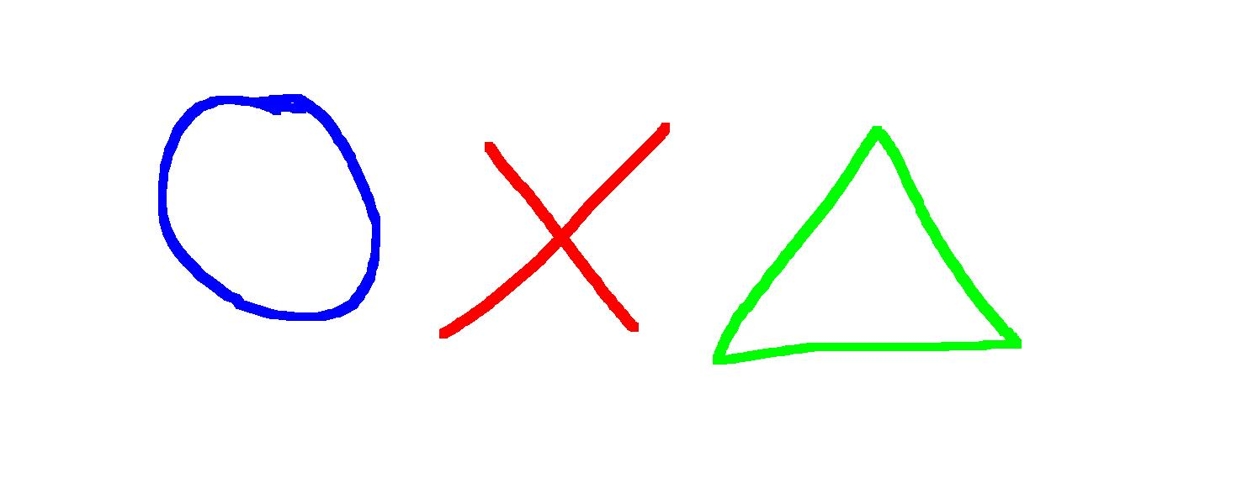
Alumax-index
Characters
objects
exit

Slide 2

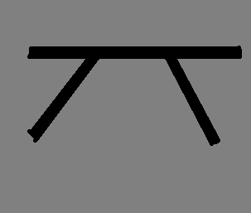
Alumax- Characters
O
E
F
W
?
%
?,?
X
S
N
P
I
B
C
V
U
H
J
T
Gigga
G
Terra
G
K
R
Y
D
L
$
A
M
Z
Q
@
back
exit

Slide 3









Alumax-objects
Gigga
port
NWH
Switch/
Gate
back
exit

Slide 4
O
Basic weakest character in the game.
Toughness: weak
Survival: 
back
exit

Slide 5

X
Strong fighting character.
Kills: O, ◻,, K,B,R,E,M, ,C,J,Y,Z,W,N,V,T,D,Q,?,U,L,I,%,$
Weakness: A,H
Toughness: high
Survival: X
back
exit

Slide 6
Strongest all round killing character.
Kills: O, , K,A,H,B,R,E,M, ,C,J,Y,Z,W,N,V,T,D,Q,?,U,L,I,%,$
Weakness: X
Toughness: very high
Survival: 
back
exit

Slide 7
Used for tunneling.
Toughness: weak
Survival: 
back
exit

Slide 8

K
Used for tunneling through diamond.
Toughness: weak
Survival: X
back
exit

Slide 9
A
Specialized killing character.
Kills: X,H,R,M, ,J,Y,Z,W,N,V,T,D,Q,?,U,I,$
Weakness: 
Toughness: very high
Survival: X
back
exit

Slide 10

E
Specialized killing character.
Kills: O,◻,K,S,H,R,B,M,F, ,C,J,Y,Z,W,N,Y,Z,W,N,V,T,D,Q,?,U,L,I,%,$
Weakness: X
Toughness: high
Survival 
back
exit

Slide 11
S
Stuns charters.
Weakness: H,E,F
Toughness: high
Special: stuns (O,◻,,X,K,A,R,B,M,O,Y,Z,N,V,T, ,D,U,P,L,I,%,$) for 1 move
* Characters cannot use their functions, i.e. Cast, when stunned.
Survival: X
back
exit

Slide 12

B
Infiltrates boxes of 4.
Toughness: weak
Special: Can get into a box of 4 and remove 1 character of the oppositions choice.
Survival: X
back
exit

Slide 13

H
Hybrid killer/ tunner.
Kills: X,S,F, ,V,U
Weakness: ,E,A
Toughness: Medium
Survival: X
back
exit

Slide 14
R
Can shoot other characters.
Toughness: Weak
Special: can shoot all characters except “Y” up to 5 ◻`s away.
* Takes 1 move to shoot.
* Takes 1 shot to kill each box.
Survival: 
back
exit

Slide 15

M
Blows up surrounding area.
Toughness: Weak
Special: detonates to blow up 9 adjacent ◻`s (single use).
* Takes 1 move to detonate.
Survival: X
back
exit

Slide 16
F
Can charm other charters.
Weakness: H,E
Toughness: high
Special: stuns (O,◻,,X,K,A,R,B,M,O,Y,Z,N,V,T,D,U,P,S,L,I,%,$) to make them into yours.
Survival: X
back
exit

Slide 17
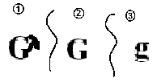
Giant, Toughest character in the game.
Kills: All
Toughness: extremely high (X3)
Weakness: R
Special: takes up 4 spaces, can get through anything and turns it into yellow. Takes 3 hits to kill.
Survival: X
back
exit

Slide 18
C
Hybrid- catapult/ Killer.
Kills: O, ◻ ,K,M,B, ,J,Y,Z,W,N,V,T,D,Q,?,U,L,I,%,$
Toughness: medium
Special: Catapults boulders 5 ◻ `s away, can pault over anything. Boulders kill on impacted. (only horizontal).
* Cannot fire into double boxing
* If fired into a ◻ with a diagonal barrier, it always lands on the side closest to the C
* Cannot fire into a box containing a G
Survival: X
back
exit

Slide 19
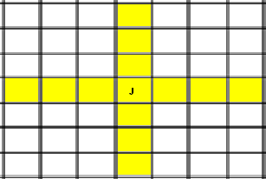
J
Blows up a row and a column.
Toughness: weak
Special: blows up the row and a column that the “J” is in. (single use).
* Takes 1 move to detonate.
Survival: X
back
exit

Slide 20
Y
Protects from arrows, boulders and bombs.
Toughness: weak
Special: blocks arrows, boulders and bombs. Can destroy boulders and bombs by moving thought the same ◻ as it. Standing beneath boulders stops them getting into that box.
Survival: 
back
exit

Slide 21
Z
One off use, stuns all charters.
Toughness: weak
Special: Stuns all charters except W. If the enemy has no W they are not out. If they have a W then they must move it. If they are unable to move there W they are out. (single use).
* Takes 1 move to detonate.
* Freezes enemy nuclear war heads.
* Dose not stop nuclear war head from going off.
* Freezes enemy sniper towers.
Survival: X
back
exit

Slide 22
W
Heals and curs stuns.
Toughness: weak
Special: heals `s from 5 ◻`s away or curs stuns from 5 ◻`s away.
* Takes 1 move to cast.
* Is resistant to stuns, including Z.
* Must be in yellow to heal or cure stun.
* Can not heal or cure stun a charter in the same ◻ as it.
Survival: X
back
exit

Slide 23
N
Catapults nuclear bombs.
Toughness: weak
Special: Same as “C” but fires nuclear bombs. they do not necessarily explode on impact.
Survival: X
back
exit

Slide 24
V
Stealthy assassinating character.
Toughness: weak
Kills: all
Special: Can move diagonally to kill anything, not killed it's self, Only diagonal moves kill. Normally it is killed. Can not move into Rock/ diamond. If V moves diagonally into , looses 1 hit, V dies.
Survival: X
back
exit

Slide 25

T
Twin character.
Toughness: weak
Special: T only works wit 2 or more. Dose not get used up, 1 move to detonate per T. dose not blow up square with T in.
Multiple T `s can blow at once, if a square is formed, then the middle is also completely detonated.
(click “Next page” to continue)
Survival: X
back
Next page
exit

Slide 26
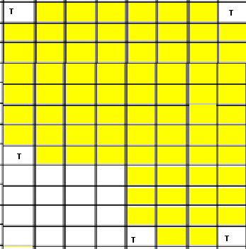
T
(6 moves)
* Blocked by concrete.
Survival: X
back
Previous page
exit

Slide 27

D
Makes diamond.
Toughness: weak
Special: leaves a trial of diamond in a box as it moves out of it. Dose not turn the box it is in into diamond.
* Teleports and angers can't be turned into diamond.
Survival: X
back
exit

Slide 28

Q
Spawns q `s.
Toughness: weak
Special: Spawns 4 q `s, 1 on each side that is yellow. 4 moves to spawn. If 1 side is not yellow, no q will be there, but it will still take 4 moves.
* If in a Giiga Port Q will still take only 4 moves, but will spawn 8 q`s
* In gigga/ Teleports Q will spawn q`s on both sides of the teleport for no extra moves
Survival: X
back
exit

Slide 29
?
????????
Toughness: weak
Special: ? starts off completely useless, but can use 1 move to turn into any character, taking up 4 or less spaces, (not gaga or terror G)
* Irreversible change.
Survival: X
back
exit

Slide 30
P
One-off killing character.
Toughness: weak
Special: can kill any character, but is killed itself.
* Takes 1 hit off a .
* Destroys all characters in a ◻.
Survival: X
back
exit

Slide 31
U
stealther.
Toughness: weak
Special: Can enter “stealth” mode
* Takes 1 move to enter “stealth” mode.
* “Stealth” mode enables it to get through medium (even steel) with out leaving yellow. When it comes back into yellow, it exits “stealth” mode automatically.
* When it comes out of “stealth” mode it can kill any character without dieing like a “V”.
* Can not travel diagonally l like a “V”.
* Normally if it hits another character, U dies.
* If it moves out of “stealth” mode onto a , looses 1 hit and U dies.
* 1 move to climb barrier/ gate.
Survival: X
back
exit

Slide 32


Gigga G
* Gigga G takes up 4 ◻`s
* Gigga G has 5 hits.
* When Gigga G moves it leaves 4 ◻`s of yellow behind.
Small G can not attack small G e.t.c.
gigga G can destroy its own G with no loss of hits.
* When 2 G `s fight the 1 with the last hits dies. The 1 with the most hits looses the amount of hits that the other G has.
(click “Next page” to continue)
Survival: X
back
Next page
exit

Slide 33
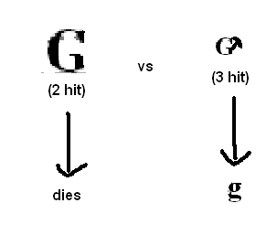
Gigga G
E.g.:
* The square the Gigga G is in counts as 1 square, not 4, therefore explosions which act upon multiple squares that the G is in will knok a maximum of 1 hit off the G.
Survival: X
back
Previous page
exit

Slide 34

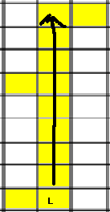
L
Takes all remaining moves to go a line of yellow.
Toughness: weak
Special: When L reaches a plane where there is a straight line of yellow (vertical or horizontal). It may travel as far as it wants up it, by the reminder of moves. (like an anger).
Survival: 
back
exit

Slide 35
Is a moveable block of concrete.
Toughness: very high
Weakness:
Special: is a block of concrete that can move only through yellow. Can not get into a ◻ with another character in it, niter can character. Can not be shot/ boulders. Blocks explosions. Can move into an adjacent block of concrete, leaving behind it's own block of concrete.
* If enters mud rub out symbol and leave behind concrete.
* Cannot do angers or teleports
Survival: X
back
exit

Slide 36
%
Grants a group of charter speed.
Toughness: Weak
Special: All characters that move at the same time as %, including % move 2 ◻ `s with 1 move.
* Can move round angles
Survival: 
back
exit

Slide 37

I
Leaves a trail of mud.
Toughness: weak
* Same rules apply as with as “D”.
* Cannot get trough rock.
Survival: X
back
exit

Slide 38

/W hybrid
W starts with 0 extra lives and can have a maximum of 4.
Has the same killing capabilities as a G. will loose 1 life when attacked by a x. normal g killing rules will apply when killing G’s.
Cannot get through rock/ diamond, etc. or into a box with you own characters.
can cast a life drain off any G from up to 5 spaces away. This will transfer I hit from the G to the W, until the W is fully healed. Can transfer hits from W to your own G but not the opponents G.
W v W: W cannot transfer hits between any other W’s. cannot get into box with other W’s. Can be healed by small w.
Survival X
back
exit

Slide 39

Terra G
* Takes up 16 ◻ `s
* Terra G has 10 hits.
* Normal G rules apply.
Survival X
back
exit

Slide 40
$
$ casts an AOE stun
Toughness: weak
Special: Must cast on a character, not an empty ◻, stuns a 5x5 area of oppositions, characters except W. stunned for 1 move
* Takes 1 go to stun.
Survival X
back
exit

Slide 41
@
Survival X
back
exit

Slide 42
?, ?
Survival X
back
exit

Slide 43
Boulder
Falls down always thought yellow. Crushes all characters in it's path.
* Can turn itself if it hits a diagonal barrier.
* Boulder takes up ½ a square, nothing else can fit in the square that the boulder is in.
back
exit

Slide 44
Bomb
Falls like a “boulder”, but for every ◻ of yellow it falls trough it can travel trough rock.
back
exit

Slide 45
Diamond bomb
Some as “bomb”, but can get thought rock and diamond.
back
exit

Slide 46
Nuclear bomb
Same as a “boulder” but detonates like a “M” when it hits something, e.g.: rock, diamond, barrier.
* Blows up when it hits a .
* Blows up when it hits a .
* When it hits a it knocks off 2 hits, 1 for the impact, 1 for the explosion.
back
exit

Slide 47
Concrete bomb
Some as “bomb”, but can get thought rock and diamond and concrete.
back
exit

Slide 48
J bomb
Same as ‘Nuclear bomb’, but blows up like a ‘J’
back
exit

Slide 49

Time bomb
Time bomb detonates a 7x7 area, including off the edge. 1 move to set off. Time bomb will count down at the end of the player who set it offs, go. Starts to count down the first player change after the bomb is set off. When the number would reach -1 the bomb detonates. Can be pushed like a bolder.
back
exit

Slide 50
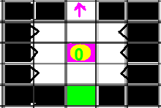
Nuclear war head (NWH)
Can be controlled by any player and destroys 7X7 area when activated (level 5).
* To raze a level a character must occupy each switch 1 round.
* If another player captures it, the number must decrees to 0 before increasing.
* steel indestructible center decrees 1 level per detonation.
* Completely destroys `s, but not off the page.
* Turns screen color negative for 5 turns.
back
exit

Slide 51
Nuclear war head (NWH)
* Can Be Targeted on another page on a multiple page level
back
exit

Slide 52

Concrete wall
* Can not be blown up.
* Blocks paths that have been blown up, e.g. J, Nuclear war head.
* Can not be catapulted over.
* Can be broken down by `s
back
exit

Slide 53

Arrow
A player can enter the arrow from any 3 sides is not the head. Can only exit from head.
* Boulders and arrows (R) follow the same rules.
* Arrows can have as many heads as you want.
back
exit

Slide 54
Sniper tower
Similar to a “Nuclear war head”
* Similar to a “Nuclear war head” but only takes out 1 character.
* Must occupy 1 charter to operate, max holds 2 characters.
* Indestructible
* Takes 1 go to arm, then can fire, so can use every other go.
* Fires an arrow, so is blockable with a ‘Y’ in the square.
* Has 3 stages – green, orange, red
* At the start of the go, if there is a character in it, changes colure, it can fire when green
* Z stops it going up, but not fireing
* Sniper tower must have an ‘R’ in it to shoot or go up
back
exit

Slide 55

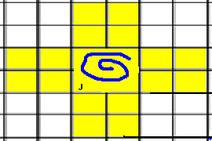
Gigga port
* Same as teleport but takes up 4 ◻`s.
* Indestructible.
* Can move and Gigga G.
* Can not move terror G.
* No teleports can be trued into diamond
* J explosion in the port dose 2 lines on each Gigga port.
back
Next page
exit

Slide 56
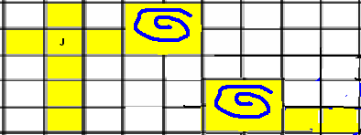
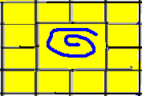
Gigga port
* Gigga port always teleports “J” explosions, boulder, bombs and arrows.
* M `s and Nuclear war head explosions port.
* M in port.
* Gigga port counts as 1 square, only 1 bomb/ boulder can fit in a Gigga port at 1 time, no other character will fit in it at this time
back
Previous page
exit

Slide 57

Mud
* When a character enters mud it becomes stuck in the mud. Including G`s, U`s, bombs and arrows etc. and cannot move out until mud is destroyed
* Can still cast shoot
* When a ◻ of mud is destroyed each adjacent ◻ also blows up – chain effect.
E.g.:
* They all blow up
back
exit

Slide 58

Switch/ Gate
A gate can be opened by a switch that has the same number. Always opens from side without blocks. 1 move to open or close, adjacent to switch. Dose not kill or blocked by characters when opening. 2 gates can be any length as long as they are the same
* Gates cannot be destroyed by `s
back
exit

