Slide 1
Return-oriented Programming
Explanation, prevention and detection of attacks
Stefan Haslhofer

Slide 2


What is return oriented programming (ROP)?
Attack on a system
Uses buffer overflow
to change return address

Slide 3
Buffer overflow
Program only has limited space
Memory space = buffer
e.g. used for storing variables
What happens if program occupies more than it should?
Buffer 1
Buffer 2
O | V | E | R | F | L | O | W | 0 | 0

Slide 4
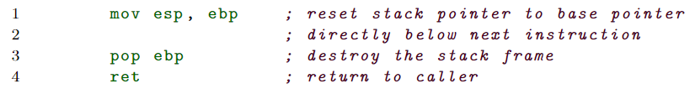
Importance of return
High memory
Return address
EBP (base pointer)
Local variable 1
Local variable 2
.
.
Low memory
next
instruction
reset ESP
ESP

Slide 5
Importance of return
What does it do?
Reset stack pointer (%esp) to base pointer (%ebp)
%eip = instruction pointer = %ebp + 4 = return address
Buffer 1
Buffer 2
O | V | E | R | F | L | O | W | 0 | 1
…
EBP
ESP

Slide 6
Importance of return
Jump to return address (%ebp + 4)
Buffer 1
Buffer 2
O | V | E | R | F | L | O | W | 0 | 0
…
Return address

Slide 7
Importance of return
After jump to return address:
execute instruction referenced by instruction pointer
“W” can be arbitrary
point to harmful program
Buffer 1
Buffer 2
O | V | E | R | F | L | O | W | 0 | 0
…
address of next instruction

Slide 8

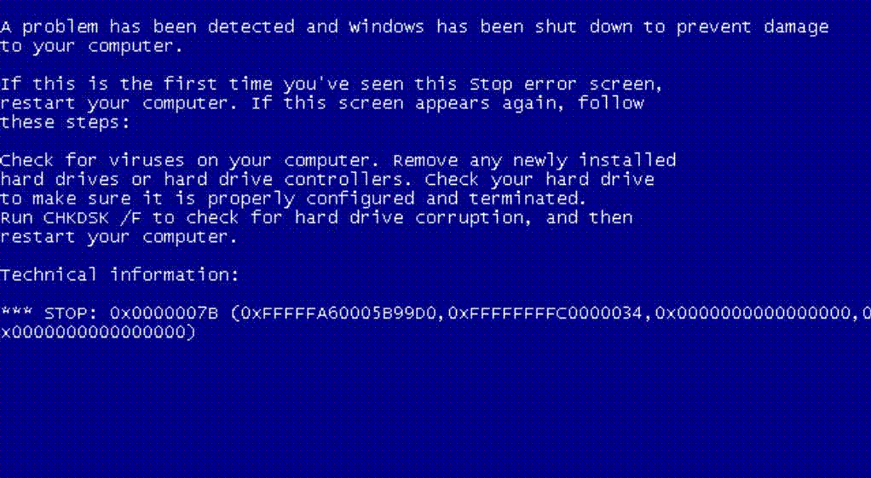
Buffer 1
Buffer 2
O | V | E | R | F | L | O | W | 0 | 0
…
address of next instruction

Slide 9

Let´s start with the fun part – shall we?
Hard to inject own code
But what about code already present?
libC widely used
Arrangement of exploitable code = “gadget”

Slide 10
Return-to-libc attack
Chain instruction gadgets
Gadgets end must end with ret
Havov Shacham: it is possible to build a Turing complete instruction set

Slide 11
Return-to-libc attack - finding GaDgets
Intentionally misinterpret byte sequences
Can be done with words:
“the address”
“the address”
Byte sequence may has “hidden” command?

Slide 12
Return-to-libc attack - finding GaDgets
GALILEO algorithm
Scan libC (sequentially) for ret instructions
If one found:
Go backwards
Already read bytes build suffix
Read bytes already useable?
Carry on until max instruction length

Slide 13
Return-to-libc attack - Vulnerable Code setup

Slide 14
Sources
Icons: https://www.flaticon.com/

