Slide 1
Return-oriented Programming
Explanation, prevention and detection of attacks
Stefan Haslhofer

Slide 2


What is return oriented programming (ROP)?
Attack on a system
Uses buffer overflow
to change return address

Slide 3
Buffer overflow
Program only has limited space
Memory space = buffer
e.g. used for storing variables
What happens if program occupies more than it should?
Buffer 1
Buffer 2
O | V | E | R | F | L | O | W | 0 | 0

Slide 4
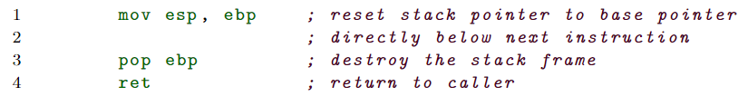
Importance of return
High memory
Return address
EBP (base pointer)
Local variable 1
Local variable 2
.
.
Low memory
next
instruction
reset ESP
ESP

Slide 5
Importance of return
What does it do?
Reset stack pointer (%esp) to base pointer (%ebp)
%eip = instruction pointer = %ebp + 4 = return address
Buffer 1
Buffer 2
O | V | E | R | F | L | O | W | 0 | 1
…
EBP
ESP

Slide 6
Importance of return
Jump to return address (%ebp + 4)
Buffer 1
Buffer 2
O | V | E | R | F | L | O | W | 0 | 0
…
Return address

Slide 7
Importance of return
After jump to return address:
Execute instruction referenced by instruction pointer
“W” can be arbitrary
Point to harmful program
Buffer 1
Buffer 2
O | V | E | R | F | L | O | W | 0 | 0
…
address of next instruction

Slide 8

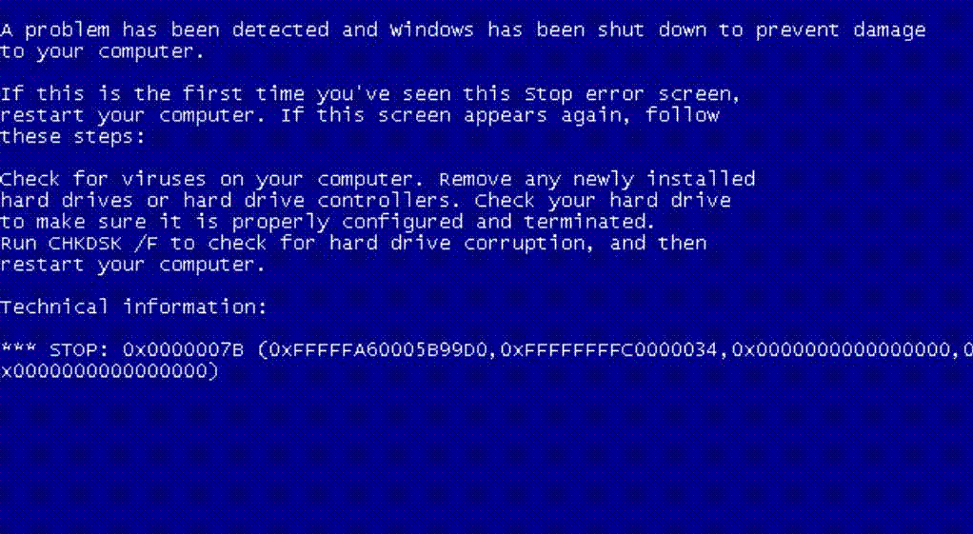
Buffer 1
Buffer 2
O | V | E | R | F | L | O | W | 0 | 0
…
address of next instruction

Slide 9
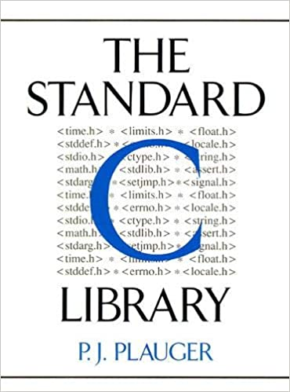
Return-to-libc attack
Hard to inject own code
But what about code already present?
libC widely used
Arrangement of exploitable code = “gadget”

Slide 10
Return-to-libc attack
Chain instruction gadgets
Gadgets end must end with ret
Havov Shacham: it is possible to build a Turing complete instruction set

Slide 11
Return-to-libc attack - finding GaDgets
Intentionally misinterpret byte sequences
Can be done with words:
“the address”
“the address”
Byte sequence may has “hidden” command?

Slide 12
Return-to-libc attack - finding GaDgets
GALILEO algorithm
Scan libC (sequentially) for ret instructions
If one found:
Go backwards
Already read bytes build suffix
Read bytes already useable?
Carry on until max instruction length
If “a; b; ret;” usable → “b; ret;” is too

Slide 13
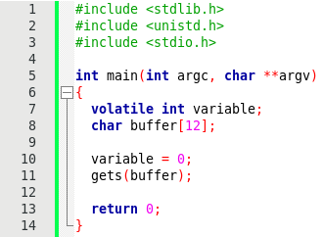
Let´s have some fun

Slide 14
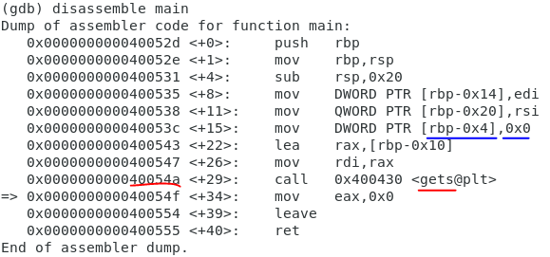
BUFFER OVERFLOW

Slide 15
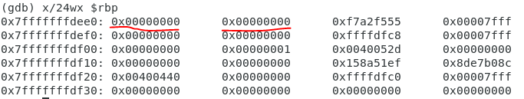
BUFFER OVERFLOW
Input: HELLO

Slide 16
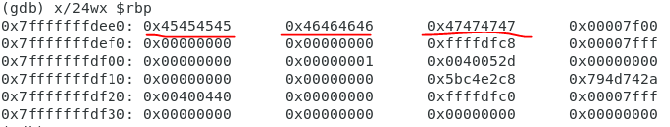
BUFFER OVERFLOW
Input: AAAABBBBCCCCDDDDEEEEFFFFGGGG

Slide 17

WHAT happened?
Buffer had space for 12 bytes
AAAABBBBCCCCDDDDEEEEFFFFGGGG → “AAAABBBBCCCC” in buffer → “EEEEFFFFGGGG” had written over return address
What happened with “DDDD”?
We successfully changed the variable!

Slide 18
RETURN-TO-libc
EEEEFFFFGGGG was written over return address
What if we Input AAAABBBBCCCCDDDD<address of libc-function>?
Gain control over execution flow
Even start a shell with system()

Slide 19

Prevent buffer overflow – secure code
Languages like java perform boundary checks
When me must use C or C++:
Don´t use unsafe functions
Instead of strcpy -> strcpy_s

Slide 20
Prevent buffer overflow – code analysis
Automated analysis
IDE highlighting
Disassemble binary code (static)
Dynamic approach:
Algorithms try to attack themselves
At run-time

Slide 21
Prevent ROP – w xor x
Early defense
Memory cell either writable (W) or executable (X)
Attacker cannot use is own code
What about present code?

Slide 22

Prevent ROP – Address space layout Rand.
ASLR randomizes base addresses of:
Stack
Heap
External libraries
ROP needs location of instructions
→ at random position
→ exploit has to be adapted every time

Slide 23
Prevent ROP – Address space layout Rand.
Brute force to find instructions
Gives valuable time
Different granularity
Library-level
Function-level
Usage of compiler possible

Slide 24

DETECT ROP – Return frequency
ROP attack = large number of small gadgets
End with return
Two metrics:
Length of suspicious snippets
Quantity of returns
DROP algorithm
Every return = candidate
Exceeding threshold leads to alarm

Slide 25
DETECT ROP – CHANGE in control flow
Expected order of execution
Deviation = manipulation
Check branches:
cond./uncond. Jumps
Returns
Function calls

Slide 26
DETECT ROP – CHANGE in control flow
Static approach
Model in graph (CFG)
Hols possible paths (and memory destinations)
Static source code/binary analysis
If branch is not in graph → control-flow integrity error
What about destination computations at runtime?

Slide 27
DETECT ROP – CHANGE in control flow
Dynamic approach
Define a set of valid targets
Can be very slow → not practical
Or insert bit pattern
Resembles ID
Equivalence classes
Incoming edges from same sources → destinations are seen as equal
Source wants to jump to another destination
… and checks for bit patterns

Slide 28
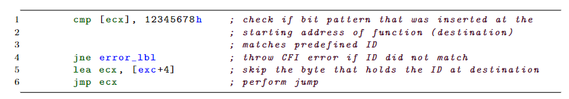
DETECT ROP – CHANGE in control flow
Any libC function not used in the program is not in the graph and therefore not a valid target
Code added by algorithm:

Slide 29
STAY safe!

Slide 30
Sources
AbadiMartín, BudiuMihai, ErlingssonÚlfar, and LigattiJay. Control-flow integrity principles, implementations, and applications. Publisher: ACM PUB27 New York, NY, USA.
Ping Chen, Hai Xiao, Xiaobin Shen, Xinchun Yin, Bing Mao, and Li Xie. Drop: Detecting return-oriented programming malicious code. In Proceedings of the 5th International Conference on Information Systems Security, ICISS ’09, page 163–177, Berlin, Heidelberg, 2009. Springer- Verlag.
Desheng Fu and Feiyue Shi. Buffer overflow exploit and defensive techniques. In 2012 Fourth In- ternational Conference on Multimedia Information Networking and Security, pages 87–90, 2012.
Marco Prandini and Marco Ramilli. Return-oriented programming. IEEE Security Privacy, 10(6):84–87, 2012.

Slide 31
Sources
Hovav Shacham. The geometry of innocent flesh on the bone: Return-into-libc without function calls (on the x86). CCS ’07, page 552–561, New York, NY, USA, 2007. Association for Computing Machinery.
Hovav Shacham, Matthew Page, Ben Pfaff, Eu-Jin Goh, Nagendra Modadugu, and Dan Boneh. On the effectiveness of address-space randomization. In Proceedings of the 11th ACM Conference on Computer and Communications Security, CCS ’04, page 298–307, New York, NY, USA, 2004. Association for Computing Machinery.
Pax Team. Pax address space layout randomization (aslr). https://pax.grsecurity.net/ docs/aslr.txt, 2003. [Online; accessed 15-May-2022].
Jingyuan Wang, Peidai Xie, Yongjun Wang, and Zelin Rong. A survey of return-oriented pro- gramming attack, defense and its benign use. In 2018 13th Asia Joint Conference on Information Security (AsiaJCIS), pages 83–88, 2018.

Slide 32
Sources
Icons: https://www.flaticon.com/

