Slide 1
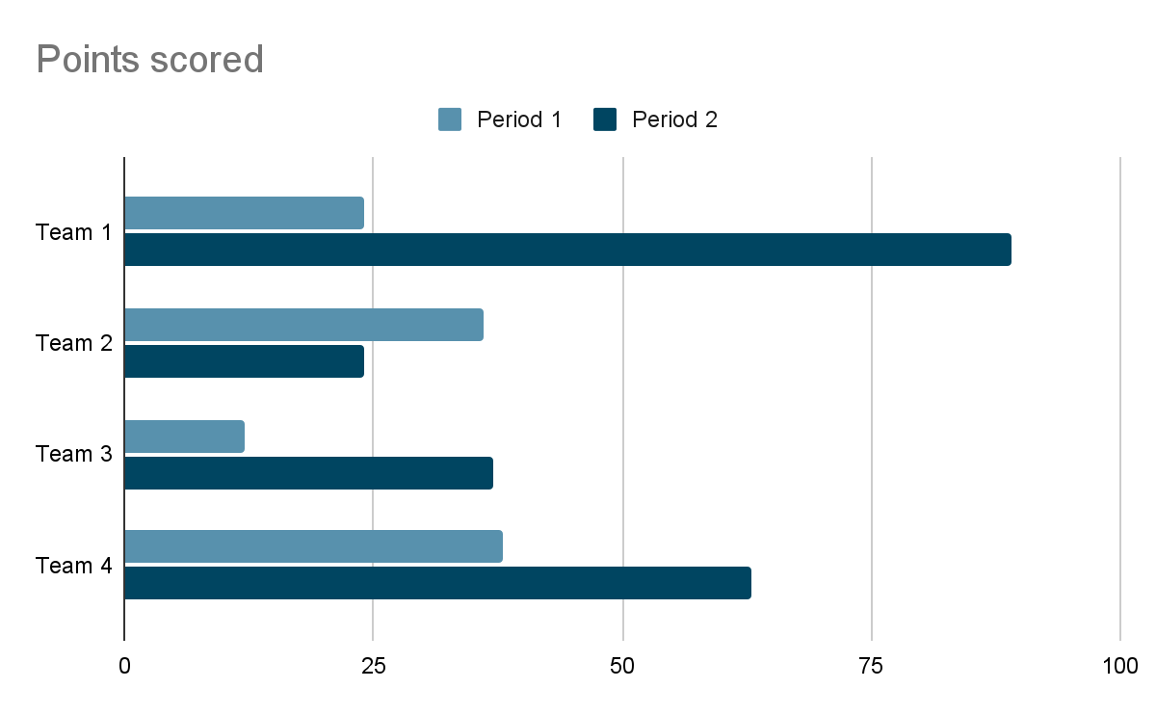

{placeholder}
{placeholder2}

