Slide 1

CESSDA
What we do
Eleanor Smith / CESSDA
04 December 2019 / General presentation

Slide 2
CESSDA
What we do
Eleanor Smith / CESSDA
04 December 2019 / General presentation

Slide 3

Our vision is that the provision of access to social science data and metadata is vital – for both science and society.
For this we must offer services to data producers to easily describe and store their data – if needed in a secured environment.
We will adhere to the FAIR (Findable, Accessible, Interoperable, Reusable) data principles to make data findable and provide information about the data, where they are, how they can be accessed.
We will also focus on providing training and enabling the transfer of expertise and sharing of knowledge on data, as well as relevant rules and regulations.

Slide 4
Cross-European resource discovery
Improved quality of data and metadata
A wider selection of comparable data
Certification of data archiving organisations
Professional training for data archivists and scientific community
Improved mechanisms for data access and analysis
Strong involvement of organisations outside Europe

Slide 5
Mission of CESSDA
Provide a distributed and sustainable research infrastructure
enabling the research community to conduct high-quality research in the social sciences,
contributing to the production of effective solutions to the major challenges facing society today.
Facilitate teaching and learning in the social sciences.

Slide 6
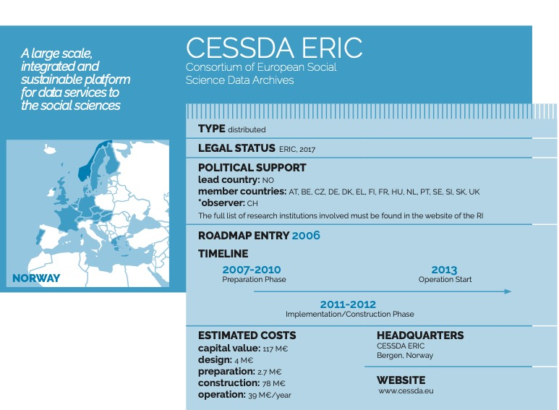
CESSDA in ESFRI Roadmap 2018

Slide 7
Members
Austria
Belgium
Croatia
Czech Republic
Denmark
France
Finland
Germany
Greece
Hungary
North Macedonia
Netherlands
Norway
Portugal
Serbia
Slovakia
Slovenia
Sweden
Switzerland (Observer)
UK

Slide 8
Governance

Slide 9





Tools & services

Slide 10
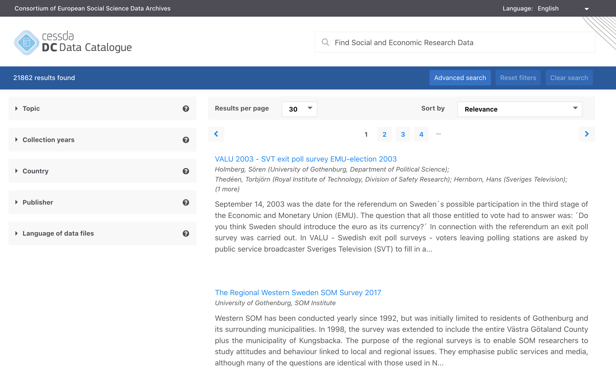
https://datacatalogue.cessda.eu/
CESSDA Data Catalogue

Slide 11
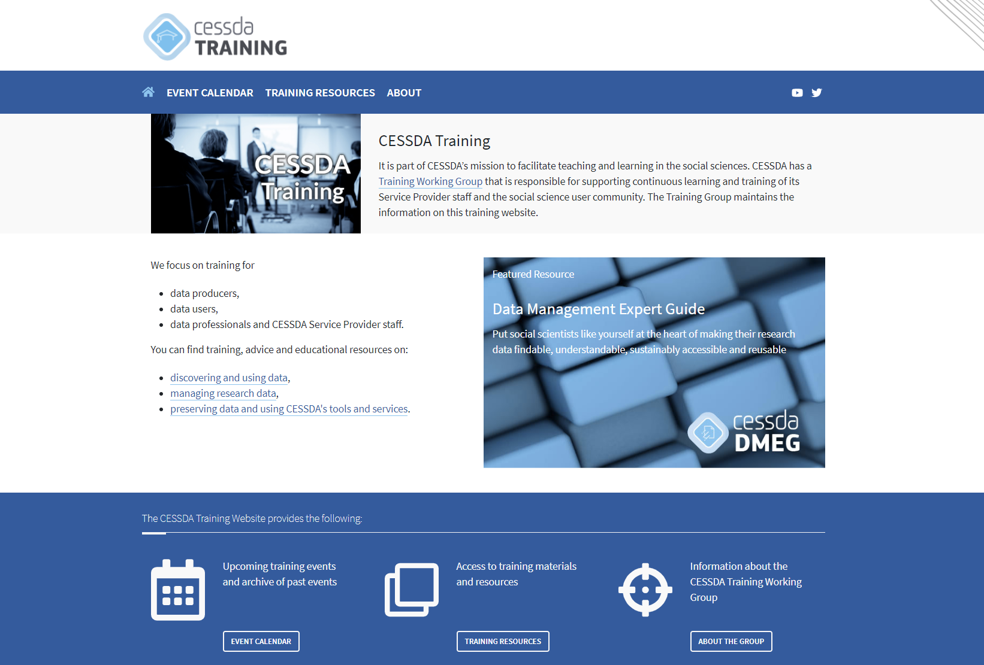
https://www.cessda.eu/Training

Slide 12
Licence: CC-BY 4.0

