Slide 1
Web Scraping Intro

Slide 2
What is web scraping
Automated extraction of data from websites
Data can be text, images, links, and more
Alternative to manually copying information from websites
  → Enabling the extraction of large amounts of up to date data

Slide 3
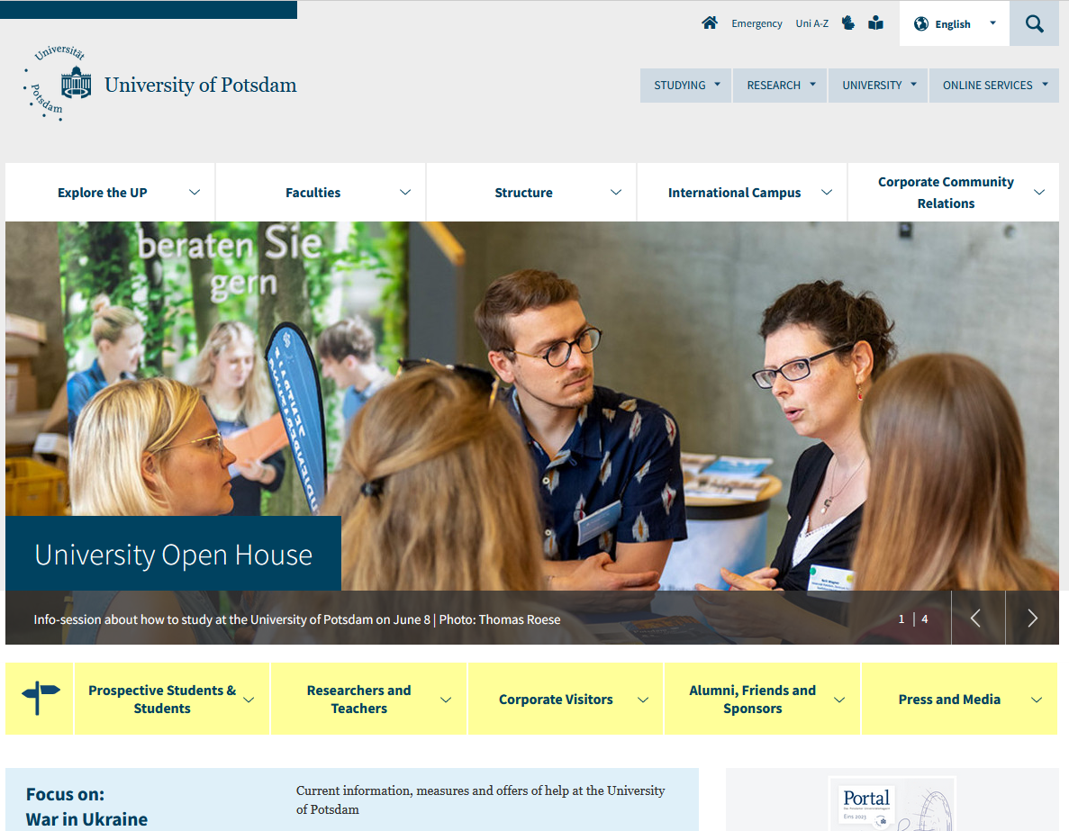
Background Info: HTML

Slide 4
Background Info: HTML
<!DOCTYPE html><html dir="ltr" lang="en-GB"><head><meta charset="utf-8"><!-- benaja - web solutions (www.benaja-websolutions.com) Markus Meier, Roland Brandt und Tobias Gaertner GbR This website is powered by TYPO3 - inspiring people to share! TYPO3 is a free open source Content Management Framework initially created by Kasper Skaarhoj and licensed under GNU/GPL. TYPO3 is copyright 1998-2023 of Kasper Skaarhoj. Extensions are copyright of their respective owners. Information and contribution at https://typo3.org/ --><meta http-equiv="x-ua-compatible" content="IE=edge"/><meta name="generator" content="TYPO3 CMS"/><meta name="description" content="Where Knowledge Grows: The University of Potsdam convinces with its great variety of programs and courses as well as with its distinct interdisciplinary research profile. "/><meta name="viewport" content="width=device-width, initial-scale=1.0"/><meta name="author" content="Sabine Schwarz"/><meta name="keywords" content="University, Potsdam, Sciences, Research, Studies, International Campus, Potsdam Transfer, Alumni, Teaching, Press Releases, News and Featured Stories, Events, Where Knowledge Grows, Neues Palais, Park of Sanssouci, Bergholz-Rehbrücke campus, Golm, Griebnitzsee, Brandenburg"/><meta property="og:title" content="Homepage"/><meta property="og:description" content="Where Knowledge Grows: The University of Potsdam convinces with its great variety of programs and courses as well as with its distinct interdisciplinary research profile."/><meta name="twitter:card" content="summary"/><link rel="stylesheet" type="text/css" href="/typo3conf/ext/up_template/Resources/Public/Css/print.css?1685599215" media="print"><link rel="stylesheet" type="text/css" href="/typo3conf/ext/up_template/Resources/Public/Css/app.css?1685599215" media="screen"><link rel="stylesheet" type="text/css" href="/typo3conf/ext/up_template/Resources/Public/Fonts/fontawesome/css/all.min.css?1639489011" media="screen"><link rel="stylesheet" type="text/css" href="/typo3conf/ext/orcid/Resources/Public/Css/layout.css?1685599292" media="all"><script src="/typo3temp/assets/compressed/merged-319258a7150a153f83ed9302a6acbce3-min.js.gzip?1685673086"></script><scriptsrc="/typo3temp/assets/compressed/jquery-3.6.0.min-min.js.gzip?1627621359"></script><script src="/typo3temp/assets/compressed/merged-1528869fa471e0d0c733a4148d937aef-min.js.gzip?1685599220"></script><title>University of Potsdam</title><link rel="canonical" href="https://www.uni-potsdam.de/en/university-of-potsdam"/></head><body class="up-section-university"><noscript><div id="up_nojs"><div class="row"><div class="twentyfour columns"><p> JavaScript is not activated in your browser. <span class="up-nojs-hint"> Please activate JavaScript </span> to use the whole functionality of this website! </p></div></div></div></noscript><a href="#up_content" class="up-skip-link">Skip to main content</a><div id="up_overlay_for_search"></div><div id="up_overlay_for_navs"></div><nav id="up_mobilenav_wrapper_small" class="show-for-small" aria-label="Main"><div class="row collapse"><div class="twentyfour columns"><div id="up_mobilenav_small"><ul class="up-mobilenav-level-1"><li id="up_mobilenav_mainnav_item" class="up-mobilenav-target-mainnav"><button...
[+905 lines of code]

Slide 5
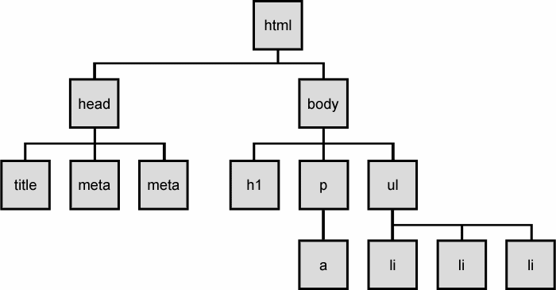
Background Info: HTML

Slide 6
Background Info: HTML
<html>
<head>
[Metadata of webpage]
<title>Title of page</title>
<style> … </style>
</head>
https://codebeautify.org/htmlviewer
<body>
[Content of the webpage]
<h1>Title of paragraph</h1>
<p>Content of paragraph</p>
<a href=„url“>link text</a>
</body>
</html>

Slide 7
Background Info: HTML
Let‘s look at the code again
https://codebeautify.org/htmlviewer

Slide 8
Example 1:
Faculties of the University of Potsdam
Extract Names, Chair holders, and URLs from all the faculty chairs of the Faculty of Economics and Social Sciences
https://www.uni-potsdam.de/en/wiso/faculty/professorships/chairs
(You can find a second example of simple web scraping, that includes a loop in moodle)

Slide 9
Tempering Expectations
Web scraping is legally murky
Web scraping can be difficult
Web scraping can be messy
Web scraping can be very time consuming
Notes:
Many conflicting court rulings
In Germany: web scraping for academic purposes generally allowed
BUT exceptions
Ask the legal department of your institution before you start a project.
More on this: Ethics Session at the WZB, 3.7., 13:00
Web scraping can be difficult
Older pages with simple html-structure are generally easy
Newer pages challenging
More complicated structure
Interactive designs
Protection against scraping
Requires more advanced programming abilities

Slide 10
Example 3:
Comments from ZEIT Online live thread
Extract comments from Ukrain live thread
https://www.zeit.de/politik/ausland/ukraine-krieg-russland-newsblog-live

Slide 11
Until next time
Until Friday (09 June):
Upload your exercises to Moodle (in session 9)
Email armin.sauermann@wzb.eu if there are any R-related issues that are not clear or that you would like to discuss further.

