Slide 1

SICSS Berlin – Day 3

Slide 2
Wednesday – Updated
09:00 – 09:45 Continue web scraping from yesterday
09:45 – 10:30 Web browser automation – presentation
11:00 – 12:30 Regular Expressions
13:30 – 14:45 String operations / Data cleaning
Additional update: Teambuilding on Thursday not Friday!

Slide 3
Web Scraping Cont’d

Slide 4
Web Browser Automation
Using RSelenium

Slide 5
(R)Selenium
Used to automate web browsers
But why?
But how?
! Only installing the package is not enough !
! See task or cheatsheet for more info !

Slide 6
Preprocessing
Cleaning, preparing, ..

Slide 7
Regular Expressions
"pattern-matching notation"¹
"is a sequence of characters that specifies a match pattern in text"²
Very important for string operations
But intimidating on first sight:
"^(.[A-Za-Z]+(\\s[A-Za-Z]\\.)?(?!,))\\s(.+(-.+)?)"
Easier example:
"^\w+\.\d+@\w+\.\w{2}"
sicss.2023@wzb.eu
peter.92@gmx.de
houses.123@hotmail.de

Slide 8
Regular Expressions – Exercise
https://regexone.com/

Slide 9
Regular Expressions
Groups
"\s([A-C]).{2}([Ff].)\."
Group \1 and group \2
Look arounds
Take into account what appears before or after the pattern of interest.
a(?=c) a followed by c
a(?!c) a not followed by c
(?<=b)a a preceded by b
(?<!b)a a not preceded by b

Slide 10
Regular Expressions – Notes on R
Instead of one slash to escape a character, you need two \\s instead of \s
Some functions do not recognize line breaks as "Any character", you have to add \\n explicitly.

Slide 11
String operations – Exercise
Complete the tasks in 2_string_operations.R
The stringr cheat sheet will help you figure out what to do.

Slide 12
Cleaning scraped data – Exercise
Now for the real challenge.
Solve the tasks in the 3_cleaning.R script using the CNN_cleaning.Rds dataset provided in the data folder.

Slide 13
Appendix

Slide 14
Data formats
API response normally in JSON or XML format
R functions automatically translate these into lists (if not, you can use packages like jsonlite, xml2)
We will not deal with either format directly.
Instead, transform into data frames.

Slide 15
From list to data frame
Yesterday: Extracted lists of US congress members via API
Instead use list that I provide
Large list of 2516 elements

Slide 16
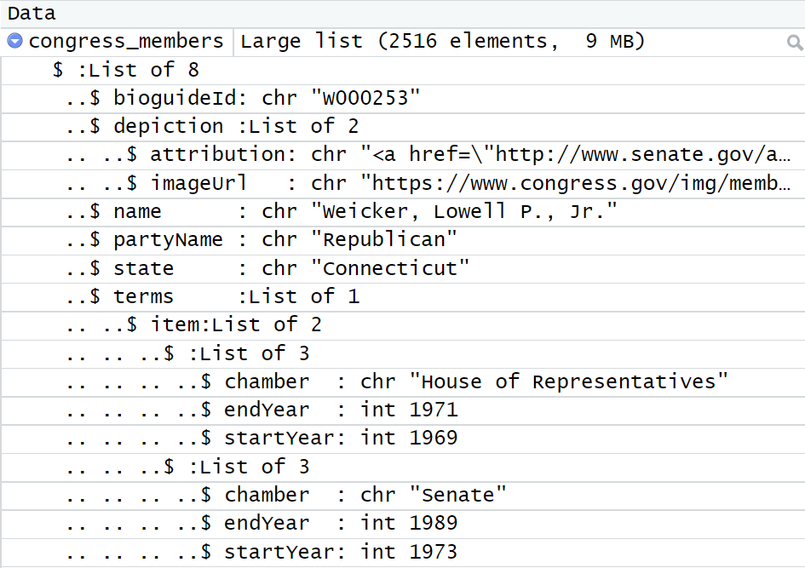
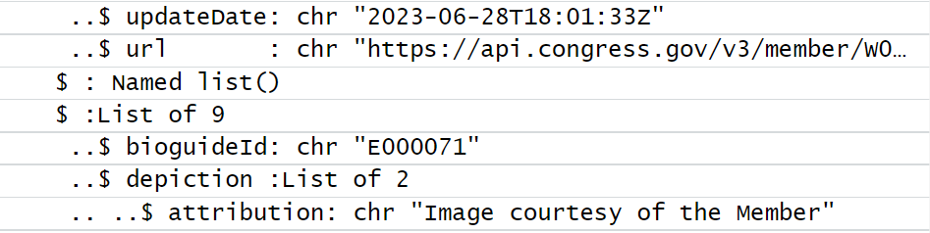
First member
Second member

Slide 17
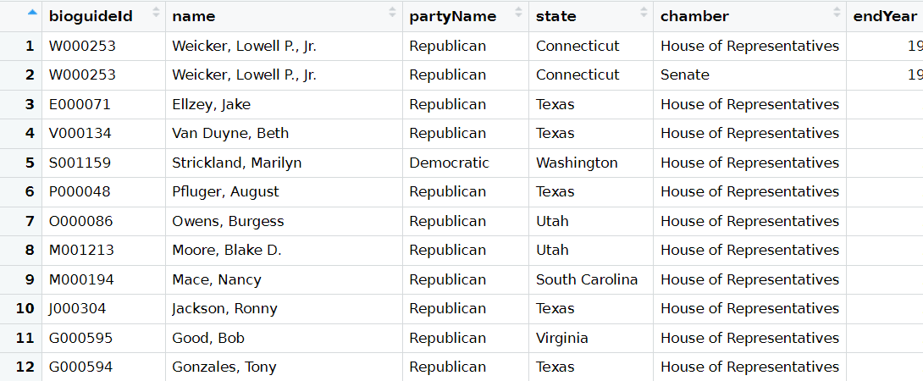

Slide 18

From list to data frame – Exercise
Use congress_members.Rds
Goal:
Data should be in data frame format and
should not not include any nested lists and
should not include redundant rows
Information it should hold in the end:
ID, name, party name, state, district, URL, update date and start and end year of the members term.

