Slide 1
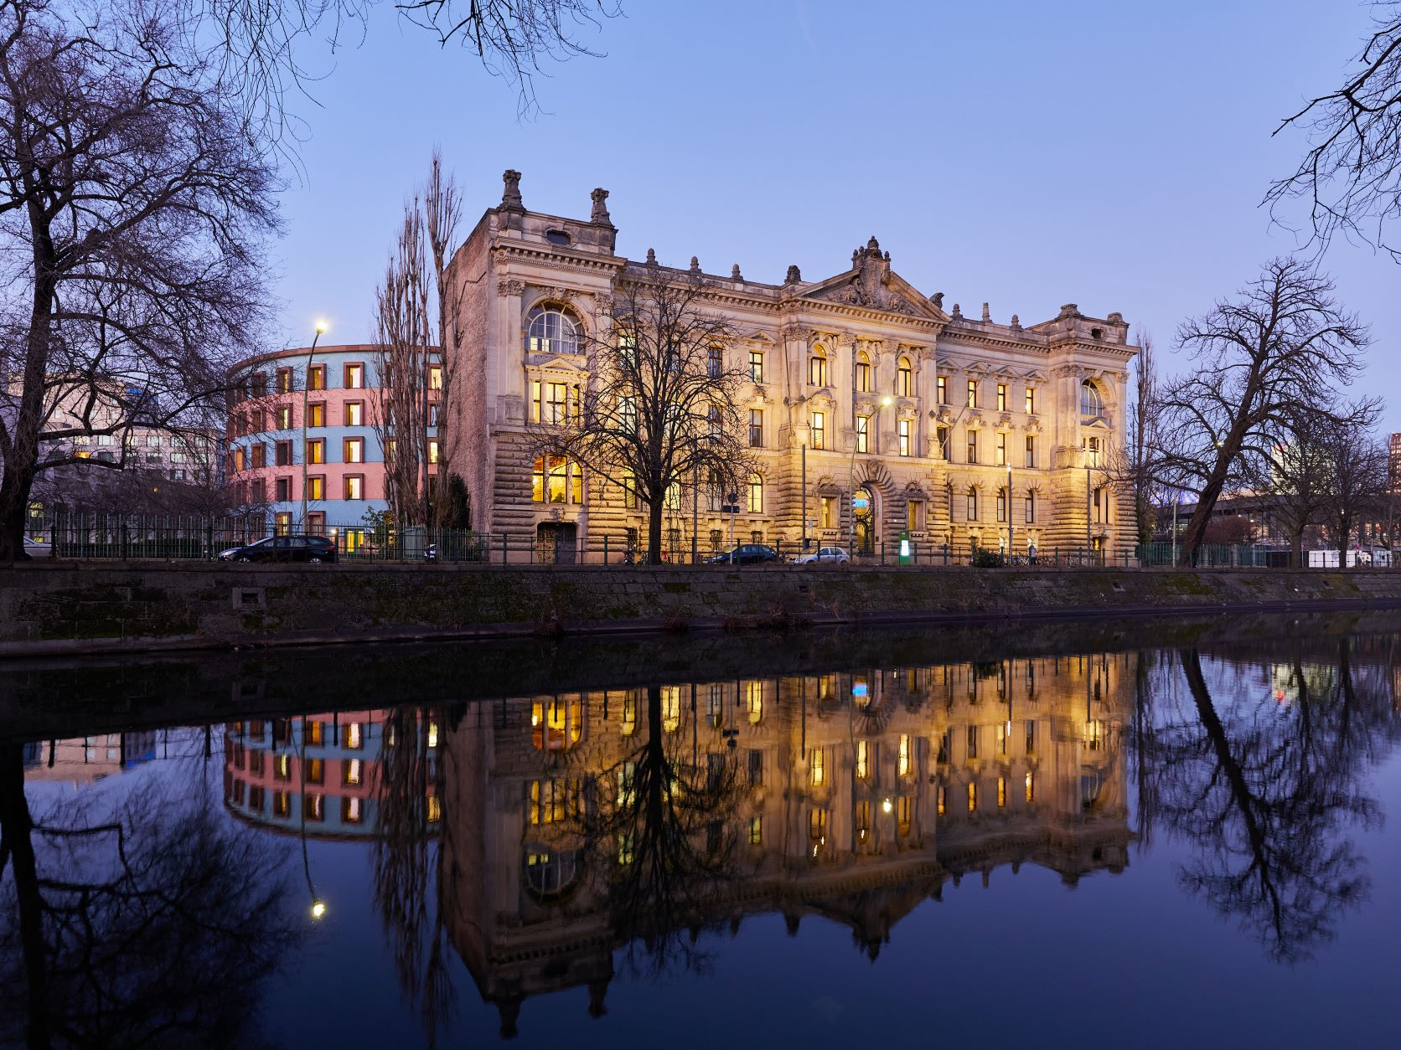
SICSS Berlin – Day 2

Slide 2
What is digital trace data and how do we collect it?

Slide 3
Game plan
Tuesday
Wednesday
Collecting data: API
Collecting data: Web Scraping
Collecting: Browser Automation
Cleaning: String Operations
Cleaning: Regular Expressions

Slide 4
Game plan
Alternating between lecture-style introduction and exercises
Starting real basic!
But tasks are not easy.

Slide 5

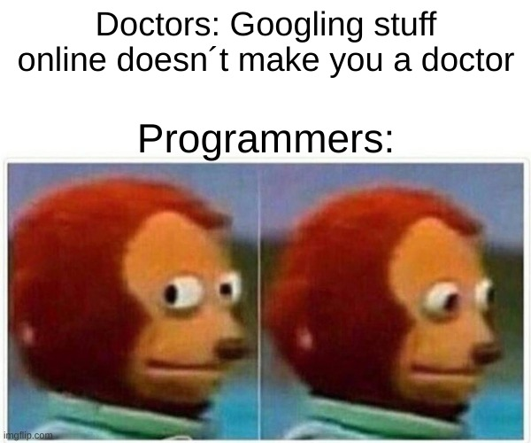


Problem solving
But!
But!

Slide 6
Problem solving
Most importantly:
Support each other!

Slide 7

Why ?
Click!

Slide 8
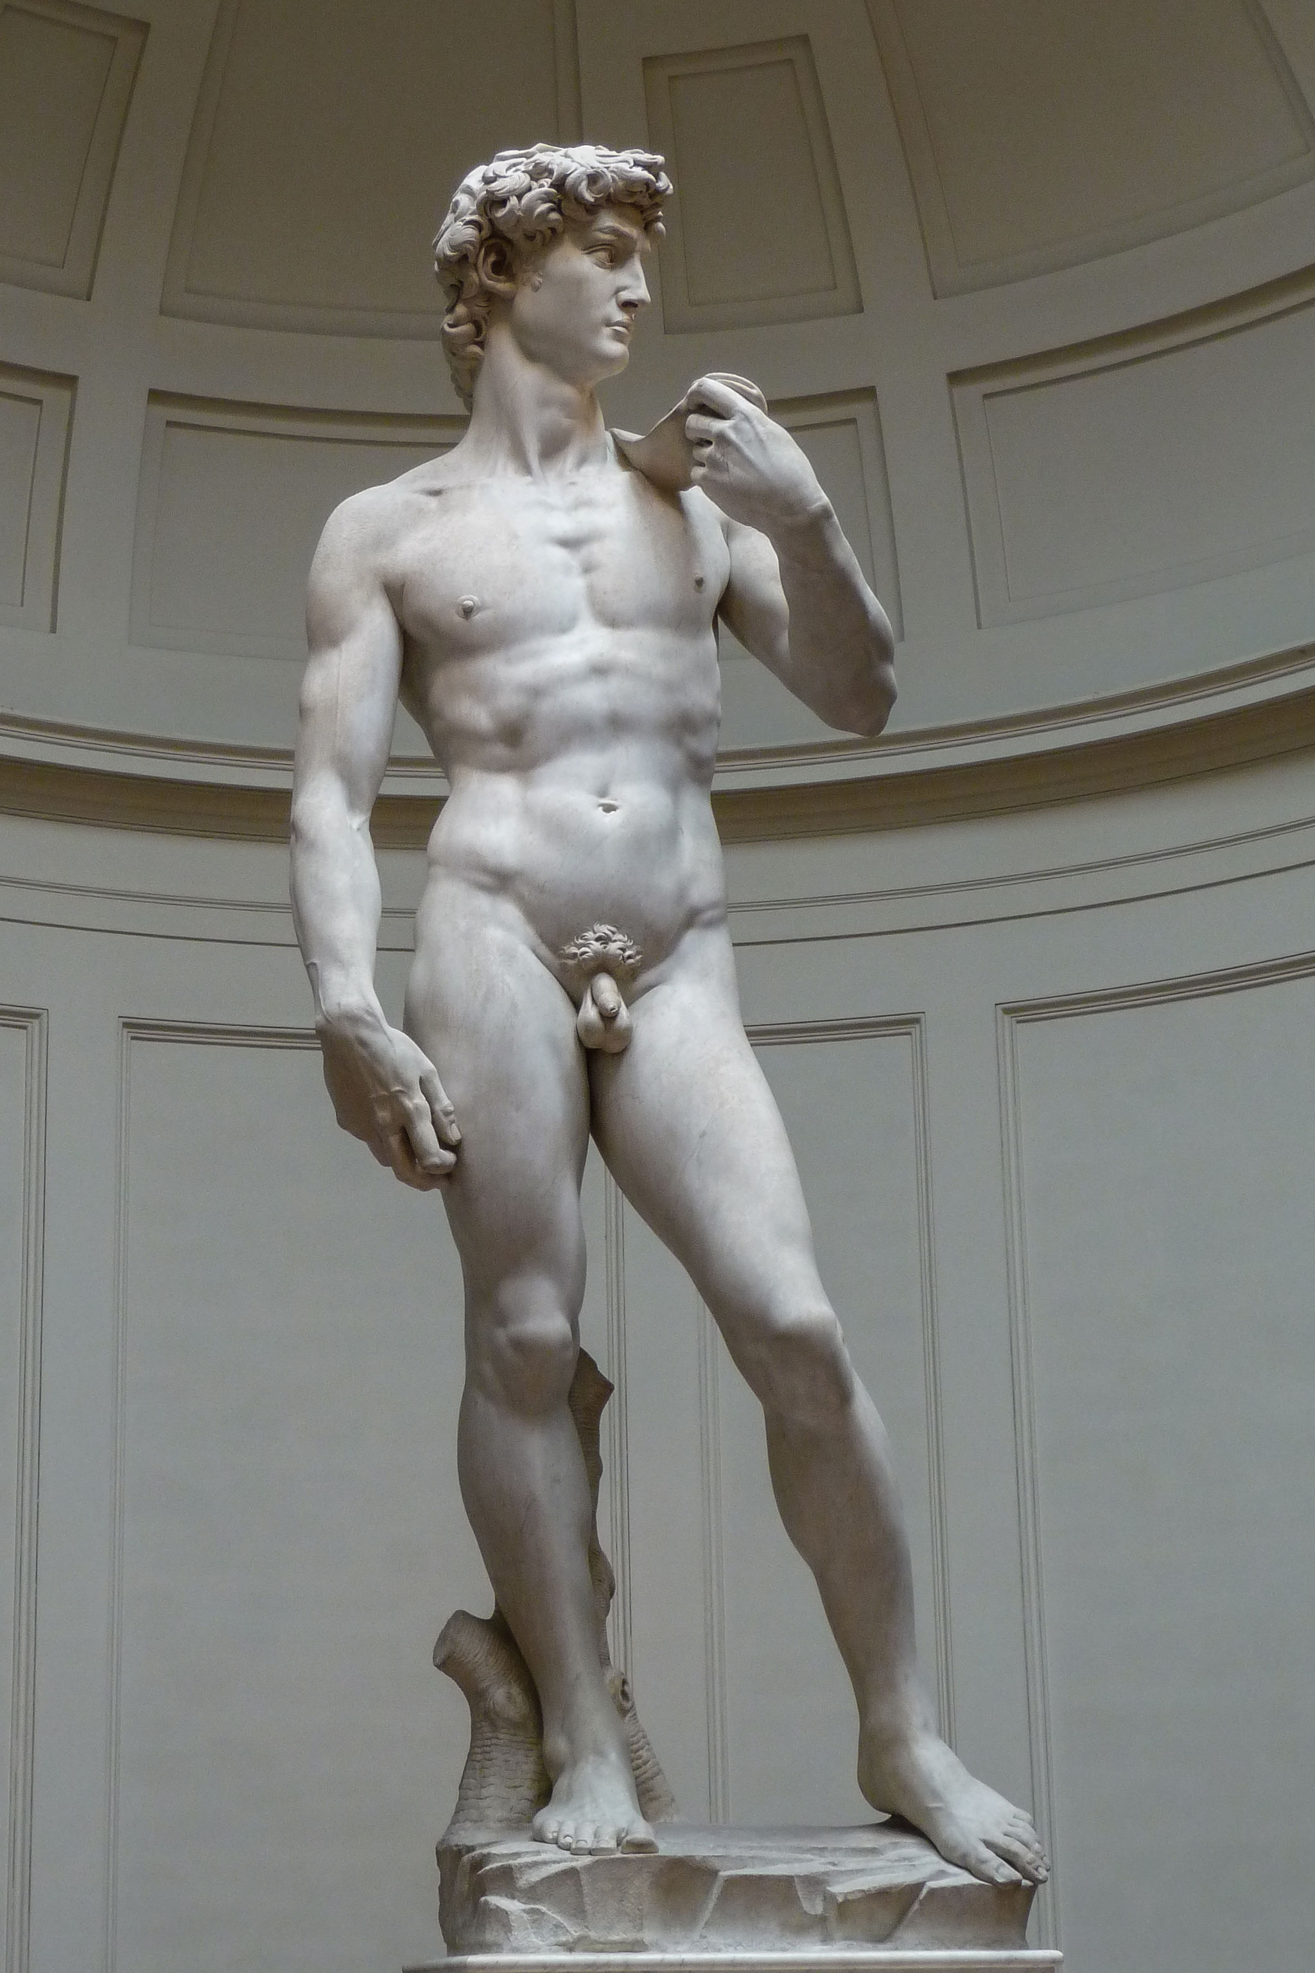
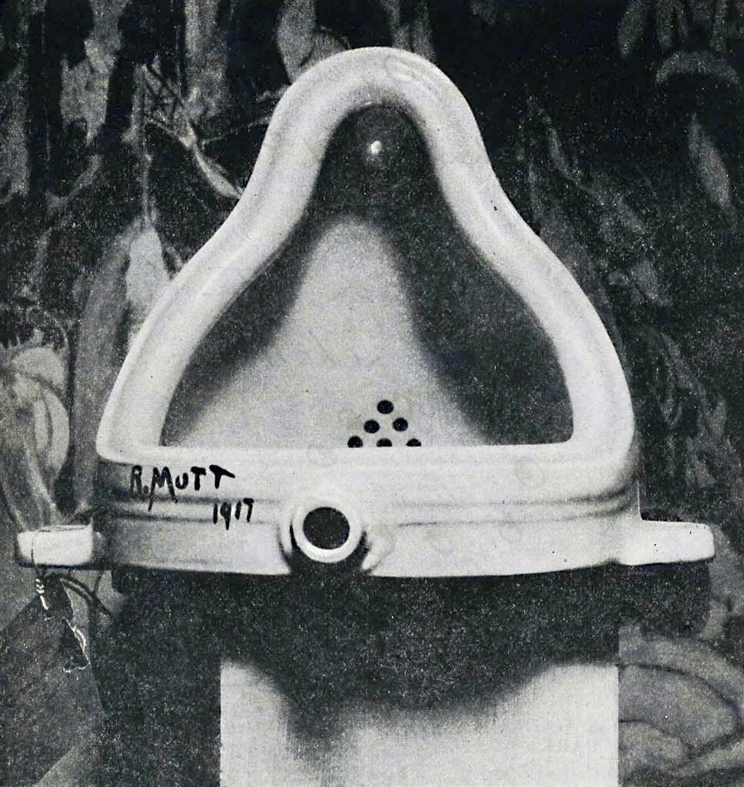
What is digital trace data?
https://commons.wikimedia.org/wiki/File:Duchamp_Fountaine.jpg
https://commons.wikimedia.org/wiki/File:%27David%27_by_Michelangelo_JBU0001.JPG

Slide 9
What is digital trace data?
For our purposes:
Data that is not created for the purpose of being analyzed by social science researchers, but is a byproduct of everyday online activity.

Slide 10
Benefits and issues of digital trace data
Big (enables analysis of small differences/prevalence)
Always on (enable capturing of rare and surprising events)
Non-Reactive
Captures Social Relationships
Big (difficult to handle)
Unstructured and noisy
Incomplete (e.g., demographic info)
Non-Representative (not a random sample)
Biases depending on platform
Privacy, security, and ethical concerns
Algorithmic Confounding
Fake data (?)
Accessibility

Slide 11
Collecting digital trace data
Our focus: Textual data
Two main ways of collecting text data online:
API
Web
scraping

Slide 12
API Intro

Slide 13
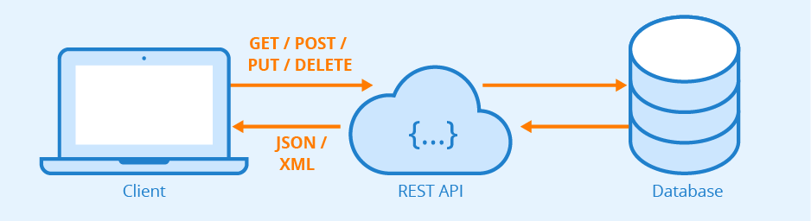
What is an API
Aplication Programming Interface
An interface provided by the data base owner which enables you to access data on their server conveniently

Slide 14
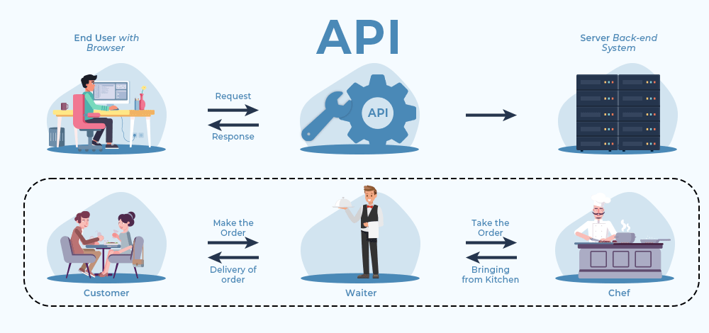
What is an API

Slide 15
How do we make an order?
https://api.genderize.io?name=anna&country_id=DE

Slide 16
What is an URL
APIs are always accessed via an URL, therefore it is important to know how an URL is actually structured.
Protocol/
scheme
Domain
Path
Query
https://www.website.com/api/cheese/cheesecake?color=yellow&form=circular
https://www.website.com/api/cheese/cheesecake?color=yellow&form=circular
1
n

Slide 17
What is an URL
Protocol
Domain
Query
https://api.genderize.io?name=anna&country_id=DE

Slide 18
How do we know which queries to use?
Documentation!
Example: https://api.congress.gov/

Slide 19
API Authentification
Different forms of authentication.
None
API key (fully open, registration)
Client key + secret key (mostly for sensitive or paid data)
OAuth2 (most secure, involves separate authentication server)

Slide 20
API Authentification
Do not save your key directly in your script.
Instead you can use environment variables:
Run: savefile.edit("~/.Renviron")
Write: "key = [your key]“
Save and restart R
Run: viaSys.getenv("key")

Slide 21
API call, example with httr
https://www.website.com/api/cheese/cheesecake?color=yellow&form=circular
httr_rec <- GET(
"https://www.website.com/",
path = "api/cheese/cheesecake",
query = list(color = yellow, form = circular,
api_key = viaSys.getenv("key")))
Note, that in some cases you may want to also supply a header
(mostly for authentication), see ?httr::add_headers

Slide 22
API call, example with httr
https://www.website.com/api/cheese/cheesecake?color=yellow&form=circular
httr_rec <- GET(
"https://www.website.com/api/cheese/cheesecake",
query = list(color = yellow, form = circular,
api_key = viaSys.getenv("key")))
Note, that in some cases you may want to also supply a header
(mostly for authentication), see ?httr::add_headers

Slide 23
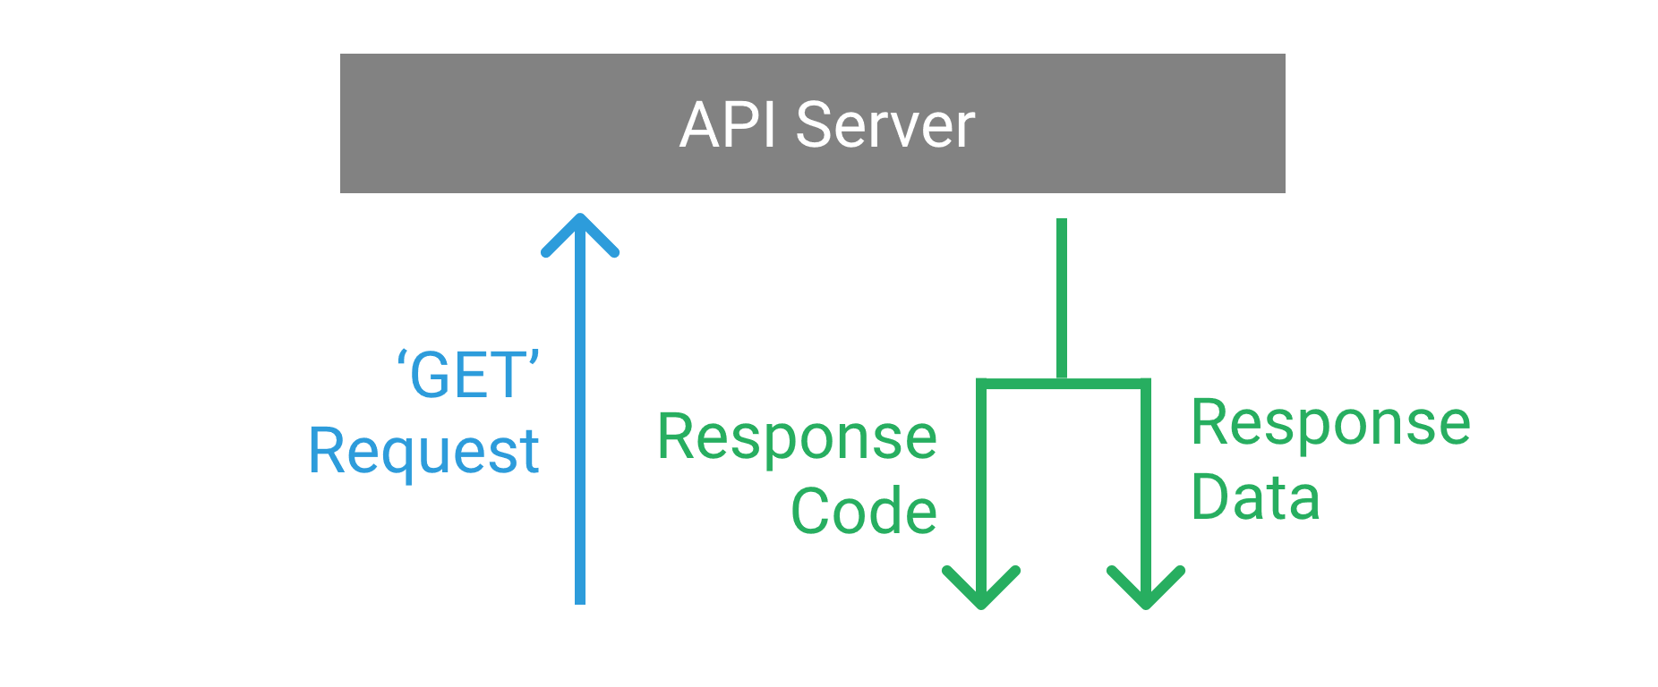
API Response
An HTTP status code (200 is what you want)
Headers
A body typically consisting of XML, JSON, plain text, HTML, or some kind of binary representation.
Extract body using content() from the httr package

Slide 24
API – Example
Example script
https://api.congress.gov/
API-KEY: https://api.congress.gov/sign-up/

Slide 25
API – Tasks
/sessions/day2_webdata/
PLEASE ALWAYS COPY THE EXERCISES TO YOUR OWN FOLDER BEFORE OPENING AND CHANGING THEM!
Open 1_2_api_exercise.qmd and/or 1_2_api_exercise.html
Copy liberally from 1_1_api_example.R, but try to understand what you are doing!

Slide 26
Web Scraping Intro

Slide 27
What is web scraping
Automated extraction of data from websites
Data can be text, images, links, and more
Alternative to manually copying information from websites
→ Enabling the extraction of large amounts of up to date data

Slide 28
Why is web scraping
If there is a (functioning) API, always use the API!
It’s easier
It basically gives you ready-to-use data
It’s definitely legal
Web scraping is useful if there is no API or if the API is really bad/restrictive.
BUT: Legal issues that I can’t go into.
BUT: What you see is what you get (although sometimes even what you see is hard to get)

Slide 29
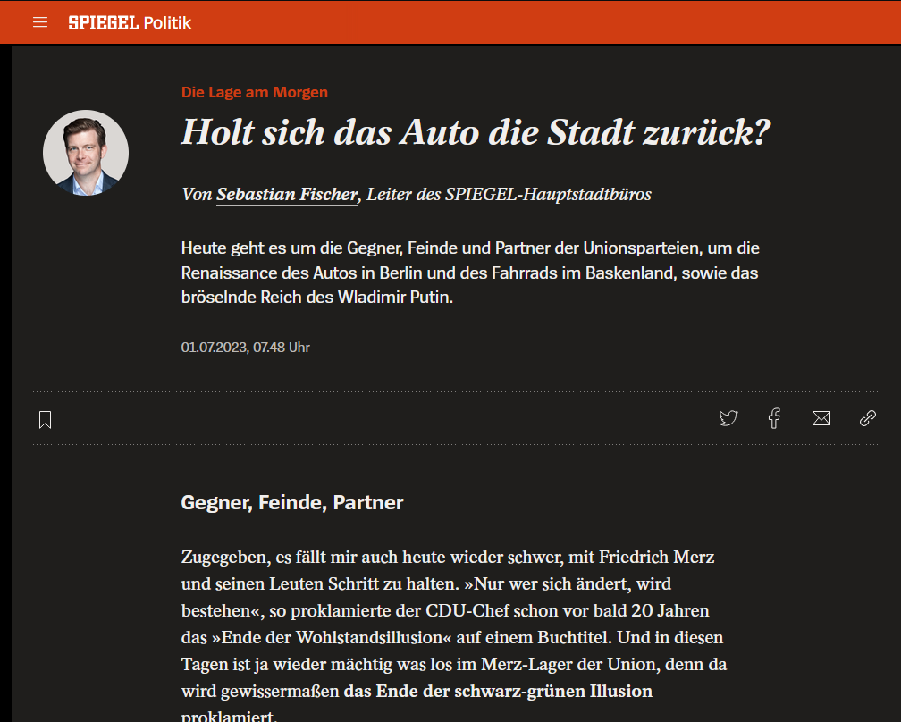
But how?

Slide 30
Background Info: HTML
<!doctype html><html x-data lang="de" :class="{ 'audio-player-open': !!$store.WebAudio.clip }"><head><title>News: CDU-Chef Friedrich Merz und die Grünen, Berliner Friedrichstraße, Wladimir Putin - DER SPIEGEL</title><meta charset="utf-8"><meta name="viewport" content="width=device-width,initial-scale=1,user-scalable=no"><meta name="MSSmartTagsPreventParsing" content="true"><meta http-equiv="imagetoolbar" content="no"><meta name="apple-itunes-app" content="app-id=424881832"><link rel="manifest" href="https://www.spiegel.de/public/spon/json/manifest.json"><meta name="theme-color" content="#e64415" media="(prefers-color-scheme: light)"><="2023-07-01T07:48:02+02:00"><meta name="locale" content="de_DE"><meta name="description" content="Die Unionsparteien ringen mit Gegnern, Feinden und Partnern. In Berlin gewinnt das Auto heute 500 Meter zurück. Und Putins Reich bröselt. Das ist die Lage am Samstag."><meta name="news_keywords" content="Politik, Deutschland, Die Lage am Morgen"><meta name="twitter:card" content="summary_large_image"><meta name="twitter:site" content="@derspiegel"><meta name="twitter:title" content="Die Lage am Morgen - CDU-Chef Friedrich Merz und die Grünen, Berliner Friedrichstraße, Putins Reich"><meta name="twitter:creator" content="@sefi99"><meta name="twitter:image" content="https://cdn.prod.www.spiegel.de/images/dd17189a-707c-4b57-af32-bf59855d3d25_w1195_r1.77_fpx28.09_fpy49.93.png"><meta property="og:title" content="Die Lage am Morgen - CDU-Chef Friedrich Merz und die Grünen, Berliner Friedrichstraße, Putins Reich"><meta property="og:type" content="article"><meta property="og:url" content="https://www.spiegel.de/politik/deutschland/news-cdu-chef-friedrich-merz-und-die-gruenen-berliner-friedrichstrasse-putins-reich-a-aff057e5-4db6-4055-8d12-85cf8bc1fe2c"><meta property="og:image" content="https://cdn.prod.www.spiegel.de/images/dd17189a-707c-4b57-af32-bf59855d3d25_w1195_r1.77_fpx28.09_fpy49.93.png"><meta property="og:description" content="Die Unionsparteien ringen mit Gegnern, Feinden und Partnern. In Berlin gewinnt das Auto heute 500 Meter zurück. Und Putins Reich bröselt. Das ist die Lage am Samstag."><script type="application/ld+json">[{"@context":"http://schema.org","@type":"NewsArticle","articleSection":"Politik","author":{"@type":"Person","name":"Sebastian Fischer"},"dateCreated":"2023-07-01T05:27:01+02:00","dateModified":"2023-07-01T07:48:02+02:00","datePublished":"2023-07-01T05:27:01+02:00","headline":"Die Lage am Morgen: Holt sich das Auto die Stadt […] <span class="bg-gradient-to-r from-white dark:from-dm-shade-darkest w-24 lg:h-56 md:h-56 sm:h-40"></span></div></div></div><nav role="navigation" class="polygon-swiper flex items-center grow relative overflow-hidden h-full bottom-negative"><ul class="polygon-swiper-wrapper flex items-center lg:h-56 md:h-56 sm:h-40 relative bottom-px:focus:border-white hover:border-shade-light border-transparent inline-flex items-center text-black dark:text-shade-lightest text-s h-full px-4"><span class="border-b whitespace-nowrap border-inherit">Politik</span><span class="leading-none ml-8"><svg width="16" height="16"><use xlink:href="#spon-chevron-right-m"/></svg></span></a></li><li class="polygon-swiper-slide flex items-center h-full shrink-0"><a href="https://www.spiegel.de/politik/deutschland/" target="_self" title="Deutschland" class="focus:border-black dark:focus:border-white hover:border-shade-light border-transparent inline-flex items-center text-black dark:text-shade-lightest text-s h-full px-4"><span class="border-b whitespace-nowrap border-inherit">Deutschland</span><span class="leading-none ml-8"><svg width="16" height="16"><use xlink:href="#spon-chevron-right-m"/></svg></span></a></li><li class="polygon-swiper-slide flex items-center h-full shrink-0"><a href="https://www.spiegel.de/thema/morningbriefing/" target="_self" title="Die Lage am Morgen" class="focus:border-black dark:focus:border-white hover:border-shade-light border-transparent inline-flex items-center text-black dark:text-shade-lightest text-s h-full px-4"><span class="border-b whitespace-nowrap border-inherit">Die Lage am Morgen</span><span class="leading-none ml-8"><svg width="16" height="16"><use xlink:href="#spon-chevron-right-m"/></svg></span></a></li>
+ a few hundred lines of html

Slide 31
Background Info: HTML
html
head
body
title
meta
meta
h1
p
ul
a
li
li

Slide 32
Background Info: HTML
<html>
<head>
<title>Title of page</title>
<style> … </style>
…
Meta data of website
</head>
<body>
<h1>Title of paragraph</h1>
<p>Content of paragraph</p>
<a href=„url“>link text</a>
…
Content of website
</body>
</html>

Slide 33
Background Info: HTML
Opening tag
Closing tag
<a id="link1" class="title-link" href="https://www.xy.com">Display Text</a>
<a id="link1" class="title-link" href="https://www.xy.com">Display Text</a>
Attributes
Content
Element
See https://developer.mozilla.org/en-US/docs/Learn/HTML/Introduction_to_HTML/Getting_started for more info

Slide 34
Background Info: HTML
id="link1" class="title-link"
id and class can both point to a specific style
id can only appear once per document
class can be used multiple times
Targeting class is especially useful if you want to scrape
multiple similar elements on the same page or
across the entire website
Targeting id is the easiest way to get one specific element

Slide 35
But how?
Inspect in browser
Add-on like SelectorGadget
https://www.spiegel.de

Slide 36
Targeting HTML Elements (with rvest)
<a id="link1" class="title-link" href="https://www.xy.com">Display Text</a>
*Let's imagine that this link has the underlying CSS class ".title-link"
You could target this using
html_node("a")
as it is an <a> element
There are many more options
See (for example) https://jtr13.github.io/cc19/web-scraping-using-rvest.html for a more detailed list of options.
html_node(".title-link")
as it has the CSS class .title-link
html_node(xpath = "//a[@id='link1']")
as it is an <a> element and has the id "link1"
html_node(xpath =
"//*[contains(text(),'Display Text')]")
as the text shown on the webpage is "Display Text".
Here we just target any element with that text.
html_node(xpath =
"//*[contains(text(),'Display Text')
and not(contains(text(),'Cheesecake')]")
as the text shown on the webpage is "Display Text" and not "Cheesecake". Here we just target any element with that text.

Slide 37
Extracting HTML Elements (with rvest)
html_text()
Extract the displayed text
html_table()
Extract a table
html_attr()
Extract by attribute
html_attr("href")
Extract by attribute, in this case a link (i.e., most likely an URL)

Slide 38
One last note on limits
Both web scraping and APIs have some limits that you need to be aware of.
APIs have explicit limits (how much you are allowed to download and how fast) and you should always adhere to them.
Web scraping has implicit limits on the number and speed of requests you can make to their server. Implicit, because they don't tell you and will just block you if you exceed the limit. Always make use of waiting periods (~1 sec) between requests!

Slide 39
Web Scraping – Tasks
PLEASE ALWAYS COPY THE EXERCISES TO YOUR OWN FOLDER BEFORE OPENING AND CHANGING THEM!
Open 2_2_scraping_exercise.qmd and/or 2_2_scraping_exercise.html
Copy liberally from 2_1_scraping_example.R, but try to understand what you are doing!

