Slide 1

EWZ Challenge 3
Virtual Energy Storage
Team “Energy Online”
Jiggar Shah (DMAVT),
Michael Jordi (DMTEC),
Michael Stemmle (DINFK),
Simon Oeschger (DMTEC),
Stefan Zemljic (DINFK)

Slide 2
Problem
- Today, 40% nuclear energy → goal: 0% by 2034
- Slow growth of renewables (incentives, storage)
Solution
- Create an incentive system to grow renewables (DAO)
- Store “the right to obtain energy” as a token

Slide 3

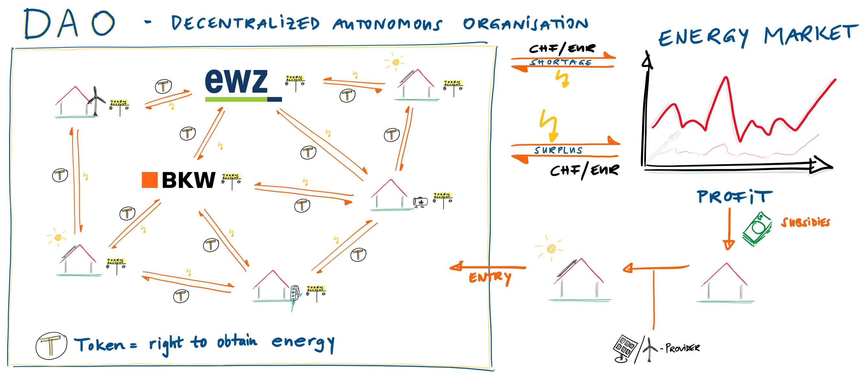

Slide 4
Disruption Potential
- Power suppliers lose monopolistic positions
- P2P trading without (cantonal) borders
- DAO acts as a very efficient self growing system
- DAO acts as a virtual power plant for power suppliers
- EWZ = Participant in DAO + grid, pv, meter provider
Difficulties / Open Challenges
- Secure smart meters and information transfer
- Legal uncertainty (Certificates, Token-qualification, …)

Slide 5

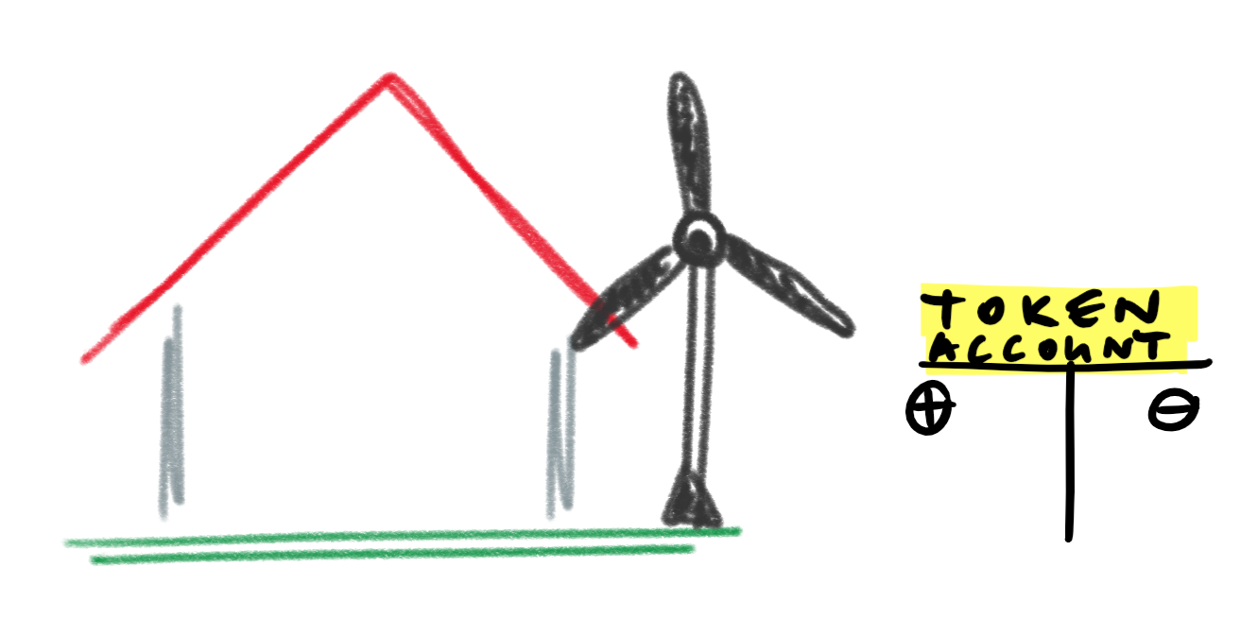

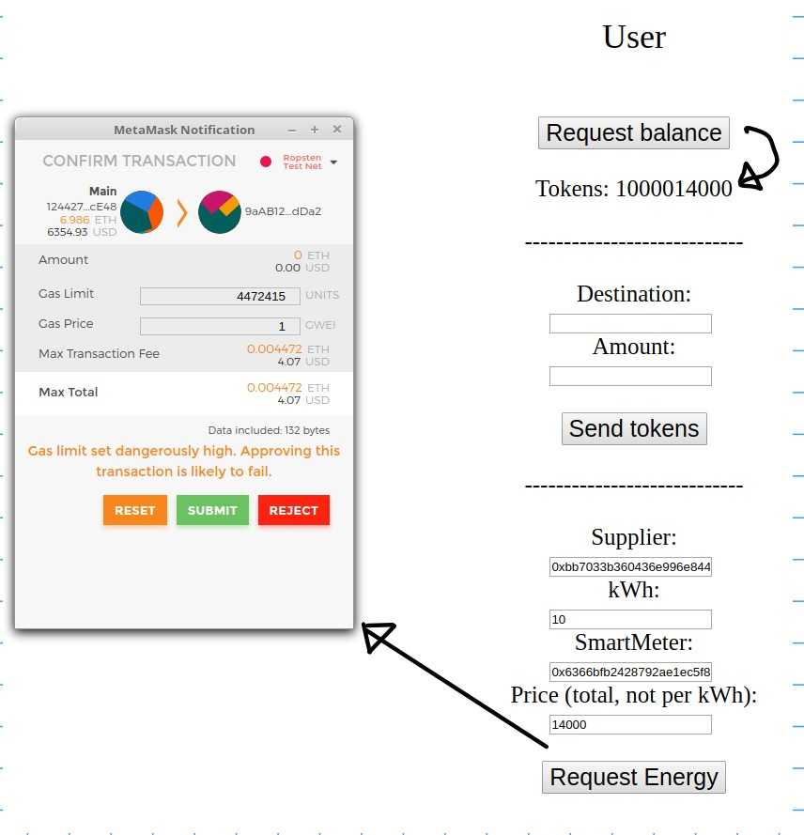
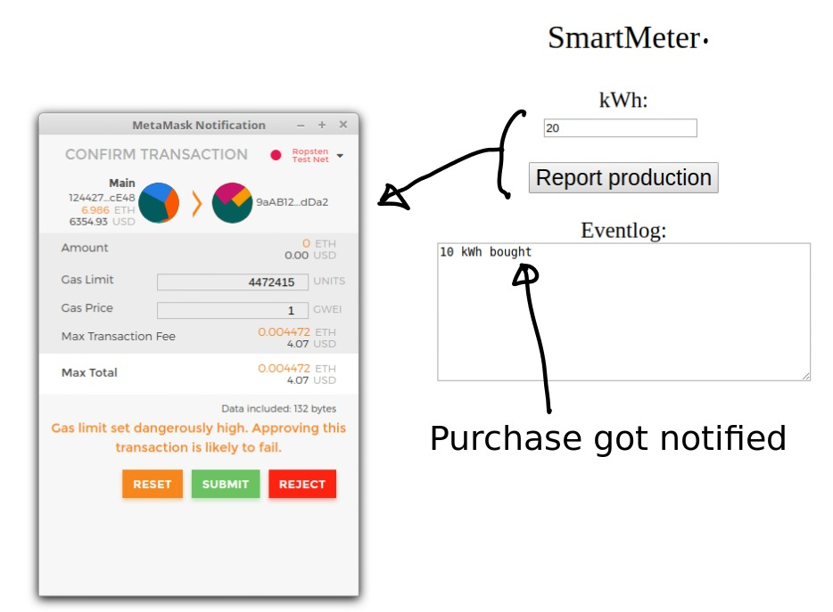
Software Demo

