Slide 1
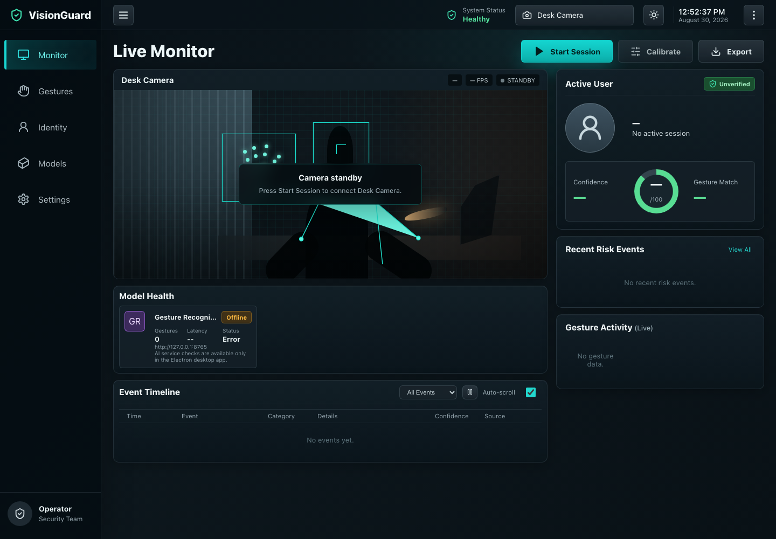
VisionGuard
Gesture recognition and continuous user authentication with local computer vision
Summer Bachelor Semester Project
University of Luxembourg
Stefan Penchev
01
Notes:
[Sources]
- Project report source: docs/report/visionguard_report.tex
- Screenshot: docs/report/figures/visionguard-monitor.png

Slide 2
VISIONGUARD
Desktop security needs context after login
One-time checks are limited
Traditional login verifies a moment, not the full session.
Project question
Hands-free control is useful
Can a local desktop app connect camera monitoring, gesture training, live inference, and action execution in one understandable workflow?
Repeated desktop actions can be faster through reliable gestures.
Camera input is sensitive
A practical system should process frames locally and expose clear state.
02
Notes:
[Sources]
- Project report sections: Introduction and Background in docs/report/visionguard_report.tex
- Repository README: README.md

Slide 3
VISIONGUARD
One loop connects gestures, identity, and actions
01
Monitor
Start a camera session and show readiness state.
02
Record
Capture 12 valid hand samples for a gesture.
03
Train
Create a dataset and run a local training job.
04
Verify
Track user presence and identity state.
05
Infer
Predict gestures from live camera frames.
06
Act
Trigger desktop actions after a confident match.
03
Notes:
[Sources]
- Project objectives summarized from docs/report/visionguard_report.tex
- Repository README demo flow: README.md

Slide 4
VISIONGUARD
UI, desktop control, and AI stay separate
React renderer
Electron main
Shared kernel
FastAPI service
Camera UI, gesture library, model health
IPC, sample files, desktop actions
Typed AI service contract
Datasets, jobs, hand checks, inference
Camera frames, model calls, and biometric data stay on the local machine through http://127.0.0.1:8765.
04
Notes:
[Sources]
- Desktop app source: apps/desktop/src/renderer/app/App.tsx
- Shared contract source: packages/shared-kernel/src/contracts/ai/model-contract.ts
- AI service source: services/ai-models/src/interfaces/api/state.py

Slide 5
VISIONGUARD
Docker makes the AI service reproducible
Stable service setup
Why containers are used
OpenCV, MediaPipe, and model dependencies run in a controlled environment.
The Python AI service depends on computer-vision libraries. Docker reduces setup differences between machines and keeps those dependencies isolated from the host system.
Cleaner separation
Electron handles desktop and camera permissions; the container handles AI processing.
Future deployment path
Docker Compose can later start the AI service and storage layer together.
05
Notes:
[Sources]
- Docker/container content summarized from docs/report/visionguard_report.tex
- AI service architecture summarized from docs/report/visionguard_report.tex and packages/shared-kernel/src/contracts/ai/model-contract.ts

Slide 6
VISIONGUARD
Samples become confident actions
Capture
Validate
Train
Execute
User shows a hand gesture to the camera.
Hand presence is checked before saving samples.
Samples become a local gesture model artifact.
High-confidence matches trigger mapped actions.
Execution threshold: 0.92 confidence with a cooldown to avoid repeated commands.
06
Notes:
[Sources]
- Inference and cooldown logic: apps/desktop/src/renderer/app/App.tsx
- Hand presence logic: services/ai-models/src/application/training/gesture_training_worker.py

Slide 7
VISIONGUARD
The live monitor makes system state visible
Readiness
Camera, AI service, trained model, and inference state are visible.
Feedback
Prediction, confidence, model health, and event timeline are shown together.
Control
The user starts sessions, calibrates, exports, and changes views.
07
Notes:
[Sources]
- Screenshot: docs/report/figures/visionguard-monitor.png
- Live monitor component: apps/desktop/src/renderer/app/components/LiveVisionPanel.tsx
- Model health and event timeline rendered from apps/desktop/src/renderer/app/App.tsx

Slide 8
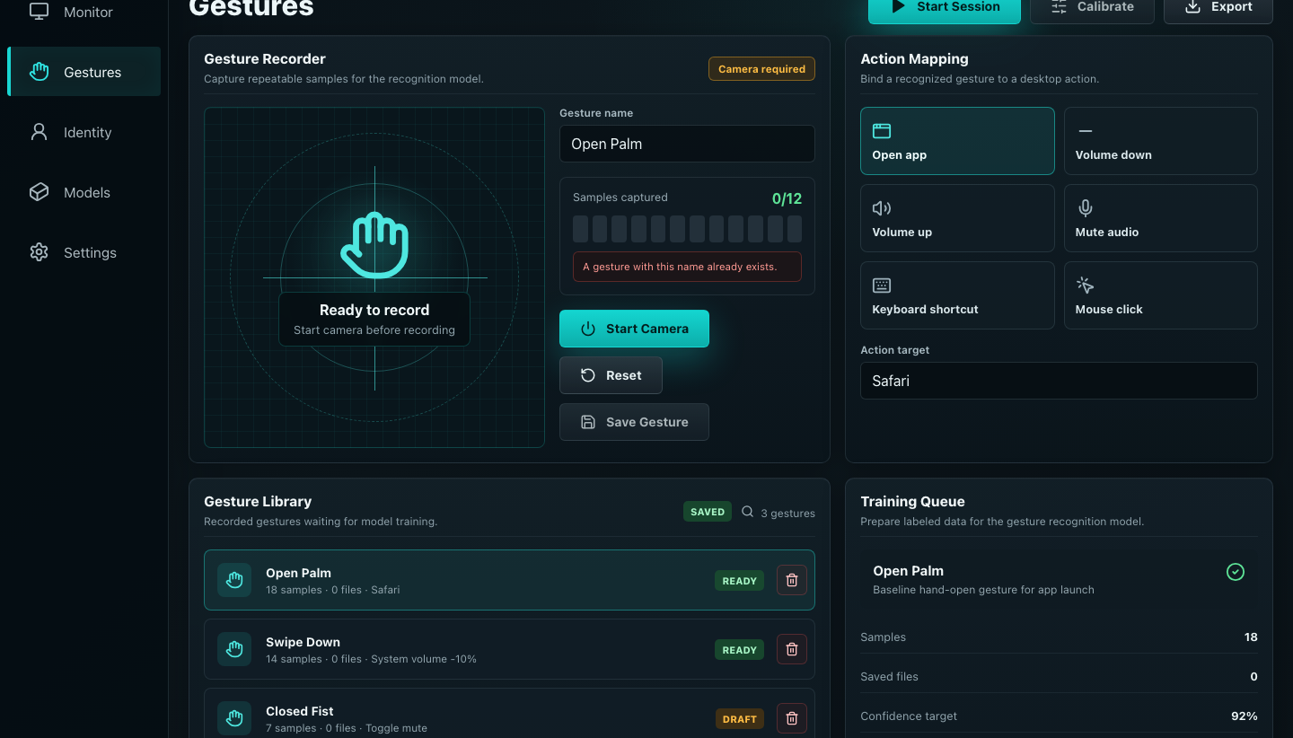
VISIONGUARD
Recording, mapping, and training stay connected
Six action types
Open app, volume down, volume up, mute, shortcut, and mouse click.
Sample rule
A gesture needs 12 captured hand samples before saving.
Training state
Saved gestures move from draft or ready into training and trained states.
08
Notes:
[Sources]
- Screenshot: docs/report/figures/visionguard-gestures.png
- Gesture component: apps/desktop/src/renderer/app/components/GesturesPanel.tsx
- Desktop action support: apps/desktop/src/main/application/actions/execute-gesture-action.ts

Slide 9
VISIONGUARD
A small contract drives model operations
Dataset
Create dataset from gesture labels and sample references
Training job
Queue, run, poll, and complete model training
Model status
Report not-trained, loading, ready, degraded, or error
Hand presence
Reject frames that do not contain a detectable hand
Inference
Return predictions, best match, confidence, and latency
Authentication
Return face and presence state for the active session
09
Notes:
[Sources]
- Shared AI model contract: packages/shared-kernel/src/contracts/ai/model-contract.ts
- FastAPI routes: services/ai-models/src/interfaces/api/routes/inference.py
- AI service state and training job flow: services/ai-models/src/interfaces/api/state.py

Slide 10
VISIONGUARD
The prototype shows a local pipeline
5
6
8
App views
Action types
Contract operations
Monitor, Gestures, Identity, Models, Settings
Application, audio, keyboard, and mouse actions
Dataset, training, model status, hand checks, inference, authentication
10
Notes:
[Sources]
- App views: apps/desktop/src/renderer/app/data.ts
- Action types: apps/desktop/src/main/application/actions/execute-gesture-action.ts
- Contract operations: packages/shared-kernel/src/contracts/ai/model-contract.ts

Slide 11
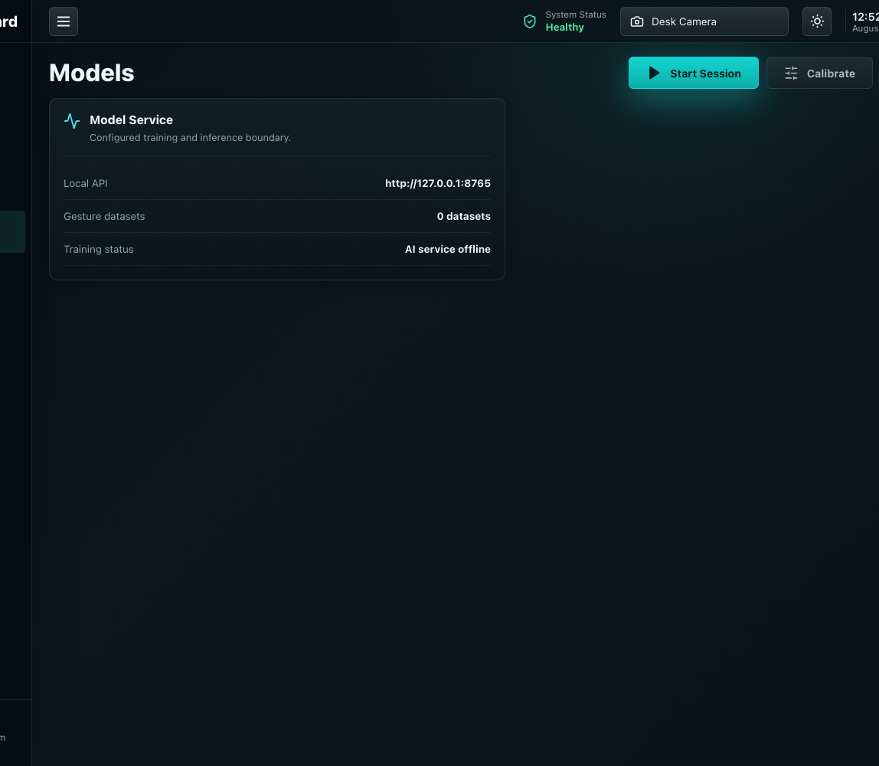
VISIONGUARD
Next steps: identity, models, and containers
Continuous authentication
Add identity-specific signals beyond gesture recognition.
Temporal gesture model
Use frame sequences for dynamic movements like swipes.
Cross-platform actions
Add Windows and Linux adapters instead of macOS-only commands.
Container setup
Document Docker profiles and service startup for repeatable demos.
11
Notes:
[Sources]
- Future work summarized from docs/report/visionguard_report.tex
- Screenshot: docs/report/figures/visionguard-models.png

Slide 12
VISIONGUARD
Evaluation should prove the system is reliable
Gesture quality
Measure correct detections, missed gestures, and accidental activations.
Authentication behavior
Test authorized user, absent user, and different-user cases.
Responsiveness
Record frame processing, inference time, action time, and end-to-end latency.
Platform readiness
Check what works on macOS now and what adapters are needed for Windows and Linux.
12
Notes:
[Sources]
- Evaluation method summarized from docs/report/visionguard_report.tex

