Slide 1






Database
Enables you to model data structure artifacts in JSON format, and to create actual tables and views during activation/publishing.
Database perspective is full-fledged including Database Explorer view, SQL Console, meta-data inspectors, and more.
You can auto-generate mock-up data based on given table layout.
Server-Side
Uses some of the most popular dynamic languages such as JavaScript, Groovy and Ruby for creating server-side services.
Client-Side
Supports user interface generation for the RESTful services based on widely used frameworks, such as Bootstrap, jQuery, AngularJS, and OpenUI5.
Establishes an Enterprise JavaScript API that can be used via the CommonJS modularization.
Generates fully compliant RESTful services, including meta-data support on existing database artifacts.
It provides WYSIWYG editor for both standard HTML5 and Bootstrap-based complex controls.
It supports wiki scripting via Confluence format.
Connectivity
Provides built-in micro ESB based on declarative definitions of integration and orchestration of business process flows.
Extensions
Supports declarative definition of extension points and extensions in order to achieve:
Mobile
Provides an integration with Tabris.js mobile framework that allows you to develop native iOS and Android mobile applications, written entirely in JavaScript.
Better adaptability
Better visibility of dependencies
Simplified life-cycle management.

Slide 2

Client-Side
Server-Side
Supports user interface generation for the RESTful services based on widely used frameworks, such as Bootstrap, jQuery, AngularJS, and OpenUI5.
It provides WYSIWYG editor for both standard HTML5 and Bootstrap-based complex controls.
It supports wiki scripting via Confluence format.
Supports user interface generation for the RESTful services based on widely used frameworks, such as Bootstrap, jQuery, AngularJS, and OpenUI5.
It provides WYSIWYG editor for both standard HTML5 and Bootstrap-based complex controls.
It supports wiki scripting via Confluence format.
Features
Database
Mobile
Enables you to model data structure artifacts in JSON format, and to create actual tables and views during activation/publishing.
Database perspective is full-fledged including Database Explorer view, SQL Console, meta-data inspectors, and more.
Provides an integration with Tabris.js mobile framework that allows you to develop native iOS and Android mobile applications, written entirely in JavaScript.

Slide 3
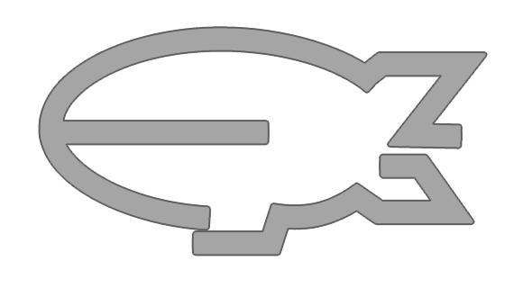
Features

