Slide 1
CS1022 Computer Programming & Principles
Lecture 2.1
Introduction to Algorithms

Slide 2
Plan of lecture
What this lecture is NOT
What’s an algorithm?
How detailed should an algorithm be
Why should you care about algorithms?
Representing algorithms
Variables in algorithms
Statements to perform operations
Statements to control algorithms

Slide 3
What this lecture is NOT...
Not a comprehensive “crash-course” on algorithms
The topic of algorithms could fill out a whole degree
Not “formal models of computation”
Turing machine
Lambda calculus
What the lecture/course is:
Introduction to concepts and issues of algorithms
Not exhaustive – many interesting aspects omitted!
Informal/intuitive computational model (procedural)

Slide 4
What’s an algorithm?
Many definitions – here’s a simple/useful one:
“a description of the sequence of steps
required to solve a problem”
Examples:
How you get to Uni in the morning
How you register for a course
How we can change a flat tyre

Slide 5
What’s an algorithm? (Cont’d)
Example: an “algorithm” to come to this lecture
Walk to bus stop
Catch bus
Get off near Uni
Walk to lecture theatre
Is this enough as directions to give someone?
What about: (supposing you live near Morrisons)
Walk to bus stop in King’s Street, in front of Morrisons
Catch bus number 1 or 2
Get off at bus stop “Playing Fields”
Walk to main gate in King’s Street
...

Slide 6
How detailed should an algorithm be?
First answer: “there should be enough detail”
How “enough” is “enough”?
Depends on who will read the algorithm (audience)
Depends on what the algorithm is for (problem to solve)
Depends on why someone will read algorithm (purpose)
Second answer: “it should have enough detail so as to allow someone to
Understand each and every step
Follow the algorithm (manually) to work out a solution
Implement it, adapt it, extend it, embed it,...”

Slide 7
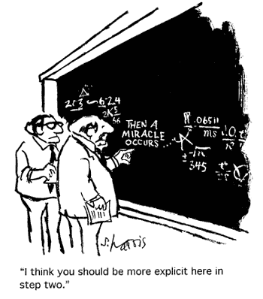
How detailed should an algorithm be?

Slide 8
How detailed should an algorithm be?
An algorithm to win the lottery:
Visit local bookmaker
Buy winning lottery ticket
Wait for announcement of winning ticket
Go get the prize
An algorithm to win the lottery:
Visit local bookmaker
Buy winning lottery ticket
Wait for announcement of winning ticket
Go get the prize
Alternative: an algorithm to play the lottery:
Visit local bookmaker
Buy a lottery ticket
Wait for announcement of winning ticket
if yours is a winning ticket then go get the prize
else go to step 1

Slide 9
Is any process an algorithm?
An algorithm to win the lottery:
Visit local bookmaker
Buy winning lottery ticket
Wait for announcement of winning ticket
Go get the prize
What is the difference between an heuristic and an algorithm?
Heuristic – a practical method to problem solving which is not guaranteed to give the correct output for a given input, but it is likely to be correct. Might not be optimally efficient (space/time). Predicting winner in a football match, e.g. score is 5-1, 5 minutes before end of game.
Algorithm – a method to problem solving which is guaranteed to give the correct output for a given input, e.g. adding two numbers. Might not be optimally efficient (space/time).

Slide 10
Properites of algorithms?
Each step of an algorithm must be clearly defined
The algorithm must use finite resources (time and memory) efficiently (optimality).
Solve a problem (correctness)

Slide 11
Why should you care about algorithms?
Many problems have classic solutions
Shortest route between two locations
How to organise (sort) records according to their date
Find the best combination of flight/hotel
Sorting
Classic solutions are represented as algorithms
Sometimes as a program too
You should care because
Re-use and create them
Describe program
Evaluate correctness and optimality

Slide 12
Why should you care about algorithms?
Job market requires “soft skills”
Team work
Time-management
Communication
Being able to understand and write algorithms is key to communication of ideas in computing
Code is often too verbose and detailed
Diagrams may hide complexity
English (or other languages) are vague or ambiguous
Pseudo-code (as we’ll see) is an important tool

Slide 13
Representing algorithms
Various ways to represent algorithms
We will look at “pseudo-code”
Sometimes we will also make use of flowcharts
Algorithms are made up of
Basic operations
Statements to control its “execution”
Algorithms use variables to
Input and output values
Compute and store values

Slide 14
Representing algorithms: pseudo-code
Pseudo-code:
“Almost” code, but not quite...
Needs to be expanded and further detailed to become programs
Our algorithms in pseudo-code will have the form
Next slides explain what each “statement” can be
begin
statement 1;
...
statement n;
end

Slide 15
Variables in algorithms
Algorithms should be generic
They should work for all/many different cases
Example: count customers with less than £50 in account
Instead of “£50” in algorithm, we could use generic value
Value stored in variable “Limit”
Solution now works for any limit we want to check
Variables give generality to algorithms
Naming convention:
Variables start with a letter; they can be of any length
Variables cannot be
Numbers
Any of our keywords “begin”, “end”, “if”, “else”, and others

Slide 16
Variables in algorithms (Cont’d)
Why a naming convention for variables?
Here’s why
begin
input input, begin, 12
output := begin + input + 12
output output
end
begin
input input, begin, 12
output := begin + input + 12
output output
end
To avoid confusing reader (that’s YOU)
Most programming languages impose restrictions on the names of variables

Slide 17
Statements to perform operations (1)
Input statement:
input Var₁, Var₂,..., Var_{n}
Meaning:
Values input from somewhere (e.g., keyboard, database)
Values assigned to variables Var₁, Var₂,..., Var_{n}
Purpose (pragmatics):
Many algorithms need input values
Input values are parameters
Variables store values during execution of algorithm

Slide 18
Statements to perform operations (2)
Assignment statement:
Variable := Expression
where
Variable is any variable name
Expression is any arithmetic expression
Meaning:
Expression will be evaluated/computed
The value of Expression will be assigned to Variable
Purpose (pragmatics):
Compute and store values

Slide 19
Statements to perform operations (2)
Example of algorithm with assignment statement:
{Algorithm to add two numbers, First and Second, assign result to Sum and output result}
begin
input First, Second
Sum := First + Second
output Sum
end

Slide 20
Statements to control algorithms
Ways to control algorithm “execution”:
Compound statements
Conditional statements
Iterative statements
Important: conventions on presentation
Indentation (spaces and tabs) help visualisation
Line breaks also help make sense of algorithm
Comments further clarify “tricky bits”
Check this out: previous algorithm, without conventions
begin input Fst, Snd; Sum := Fst + Snd; output Sum; end

Slide 21
Statements to control algorithms (1)
Compound statement
Sequence of statements preceded by “begin” and followed by “end”
Executed as a single unit in the order given
General format (with “execution” points)
begin
statement 1;
statement 2;
...
statement n;
end

Slide 22
Statements to control algorithms (2)
Example
{Algorithm to swap values of 2 variables}
begin
input One, Two;
Temp := One;
One := Two;
Two := Temp;
end
How it works
One Two Temp
Line 1 – – –
Line 2
Line 3
Line 4
How it works
One Two Temp
Line 1 5 7 –
Line 2
Line 3
Line 4
How it works
One Two Temp
Line 1 5 7 –
Line 2 5 7 5
Line 3
Line 4
How it works
One Two Temp
Line 1 5 7 –
Line 2 5 7 5
Line 3 7 7 5
Line 4
How it works
One Two Temp
Line 1 5 7 –
Line 2 5 7 5
Line 3 7 7 5
Line 4 7 5 5

Slide 23
Statements to control algorithms (3)
Notice “nesting of statements”
begin
statement 1;
statement 2;
begin
statement 3;
begin
statement 4;
statement 5;
end
end
end

Slide 24
Statements to control algorithms (4)
Conditional statement
Represent choices in execution
A condition (test) specifies conditions of choice
General format (two possibilities)
where
condition is a test which is either true or false
If condition is true, statement 1 is executed
If condition is false, statement 2 is executed
if condition then statement 1
if condition then statement 1
else statement 2

Slide 25
Statements to control algorithms (5)
Example
{Algorithm to compute absolute value of input}
begin
input n;
if n < 0 then abs := –n;
else abs := n;
output abs;
end
Suppose we input -2 (n = -2) (case 1)
Test n < 0 (-2 < 0) is true so abs = -n = -(-2) = 2
Line 3 is skipped
Line 4 is executed and “2” is output

Slide 26
Statements to control algorithms (2)
Example
{Algorithm to compute absolute value of input}
begin
input n;
if n < 0 then abs := –n;
else abs := n;
output abs;
end
Suppose we input 4 (n = 4) (case 2)
Test n < 0 (4 < 0) is false; “then” part is skipped
Line 3, the “else”, is executed abs = n = 4
Line 4 is executed and “4” is output

Slide 27
Iterative statements (loops)
Algorithms need to repeat (iterate) commands
Example: count records of a database
We will use three kinds of iterative statements
“for” loops
“while” loops
“repeat-until” loops
We could do with just “while” or “repeat-until”
Different options help create more “compact” solutions
So they help us understand algorithms better

Slide 28
“For” loop
Iterate a fixed, previously known, number of times
Used to process data collections of fixed size
For instance, to process a vector or matrix
General format
where
variable is any variable name
initial_value and final_value are discrete values
statement is any statement (including other loops)
for variable := initial_value to final_value do
statement

Slide 29
“For” loop (2)
General format
means
variable := initial_value
perform statement
variable := next_value
if variable < final_value then go to 2
else go to 6
end
for variable := initial_value to final_value do
statement

Slide 30
“For” loop (3)
Example
{Algorithm to sum first n integers}
begin
input n;
sum := 0;
for i := 1 to n do
sum := sum + i;
output sum;
end

Slide 31
“For” loop (4)
Why “discrete” values in “for” loop?
At each iteration, “next_value” assigned to variable
Real numbers are not discrete values
What is the “next value” of the real number 1.2?
Is it 1.3?
What about 1.21, 1.211, 1.211, 1.2111,...?
Discrete values have a unique “next value”
Integers, letters of alphabet are discrete values
Our previous algorithm loops over 1, 2, ..., n
Some sets also contain discrete values
We’ll see more about sets later in the course

Slide 32
“For” loop (5)
Sets used to “store” values in algorithms
Alternative format of “for” loop
Example
meaning that
statement will be performed 5 times
First time with value 2, second time with value 4, etc.
for all elements of set do
statement
for all elements of {2, 4, 6, 8, 10} do
statement

Slide 33
“While” loop
Iterate a statement an unknown number of times
General format
where
condition is a test (as in the “if-then-else” statement)
Meaning:
if condition holds then
begin
perform statement
go to 1
end
else
end
while condition do
statement

Slide 34
“While” loop (2)
Notice:
if condition holds then
begin
perform statement
go to 1
end
else
end
condition tested before each loop
statement may not be performed at all
“while” loops execute statement 0 or more times

Slide 35
“Repeat-until” loop
Iterate a statement an unknown number of times
General format
where
condition is a test (as in the “if-then-else” statement)
Meaning:
perform statement
if condition holds then
end
else
go to 1
repeat
statement
until condition

Slide 36
“Repeat-until” loop (2)
Notice:
perform statement
if condition holds then
end
else
go to 1
statement executed at start
condition tested after loop
“repeat-until” loops execute statement one or more times
CS1022
36

Slide 37
Summary: what you now know
What an algorithm is and how detailed it should be
How to write algorithms (pseudo-code)
Variables in algorithms
Statements to perform operations
Statements to control algorithms
Compound statements
Conditional statements
Iterative statements
“for” loops
“while” loops
“repeat-until” loops

Slide 38
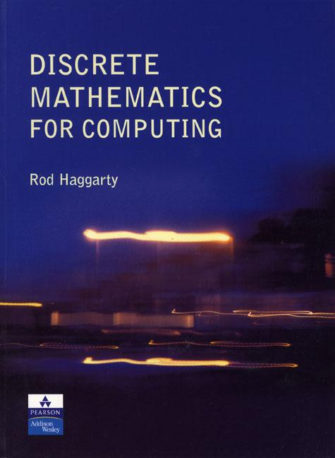
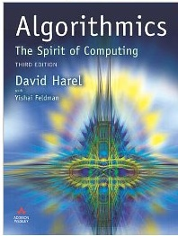
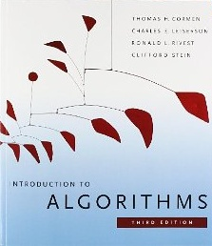
Further reading
R. Haggarty. “Discrete Mathematics for Computing”. Pearson Education Ltd. 2002.
D. Harel. “Algorithmics – the spirit of computing”. Addison-Wesley, 3rd Edition, 2004.
T. H. Cormen, C. E. Leiserson, R. L. Rivest. “Algorithms”, MIT Press, 1990.
Wikipedia article. http://en.wikipedia.org/wiki/Algorithm

