Slide 1
CS1022 Computer Programming & Principles
Lecture 1.1
Introduction to Course

Slide 2
A word of caution...
A blend of computing and mathematics, the mathematics of computing....
Moved away from focus on specific technologies
Used to be a course on Java programming
Selling point of maths: essential knowledge
It will outlive technologies and trends
It will help you learn specific technologies faster
It is the foundation of software engineering. Safety critical systems, quality control

Slide 3
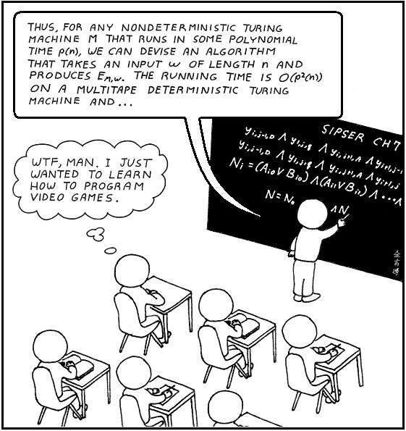
What’s in your mind?

Slide 4
Plan of lecture
Teaching team
Course organisation
What should you know about computing?
What professional associations say...
Trends, fashion, technologies and you
The past, the present and the future
“Future-proofing” your education
Discrete mathematics and logics
What this course will do for you

Slide 5
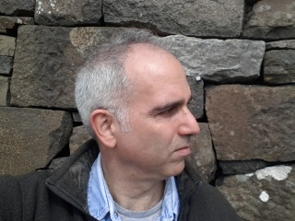
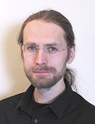
Teaching team
Adam Wyner
Email: azwyner@abdn.ac.uk
Dept. of Computing Science, Meston Bldg. Room 226
Frank Guerin
Email: f.guerin@abdn.ac.uk
Dept. of Computing Science, Meston Bldg. Room 227

Slide 6
Course organisation
Lectures:
Thursday 4-5, Fraser Noble 2
Friday 4-5, Fraser Noble 2
Wyner drop-in session: Wednesday 10:00-11:00
Meston 226
Students can turn up without an appointment
First-come-first-served
Questions related with course, practicals, labs, assessments, etc.
Notice:
We won’t be keeping attendance records of lectures
Students who do not attend lectures miss out on
Opportunities to ask questions
Opportunities to hear other people’s questions
Reality-check about being able to follow material
Humorous comments and occasional (lame) jokes
Another `angle' on the material

Slide 7
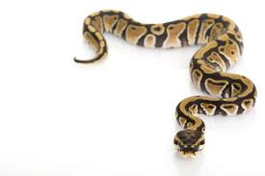
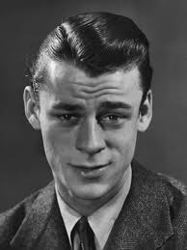
Course organisation (2)
Practicals:
Computer-based sessions to support learning Python.
Every other week, starting next week
On weeks 2, 4, 6, 8, 10 of teaching
Tutorials:
Tutorials and group discussions about theoretical work.
Every other week, starting in two weeks
On weeks 3, 5, 7, 9, 11 of teaching
Various times and locations
You *have* registered, haven't you?
These sessions are compulsory – you must attend them
If you miss two or more sessions without a good cause you will be “flagged” as falling behind with your work. C6! C7!

Slide 8
Course organisation (3)
Demonstrators
See web site below
Web site
MyAberdeen only as an “entry-point”
Actual web site is
http://homepages.abdn.ac.uk/azwyner/pages/teaching/CS1022/index.html
In-course, online assessments
Ten of them (one every week starting in two weeks)
Each contributing with 2.5% of overall course marks
Covering maths and programming

Slide 9
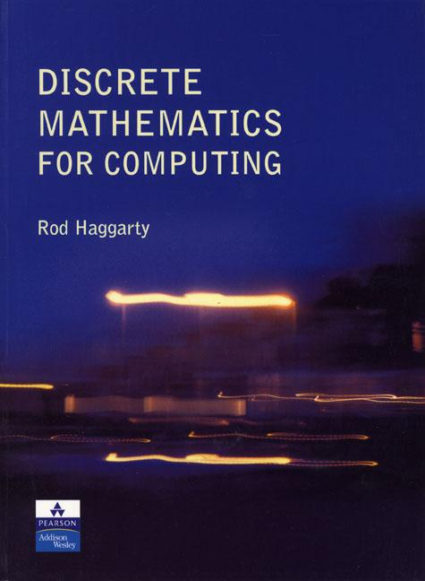
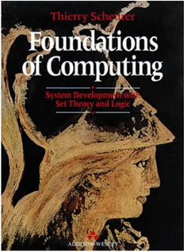
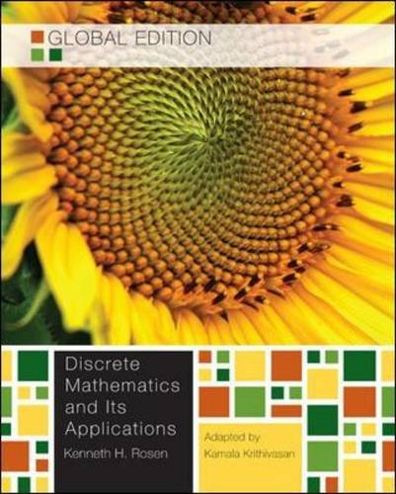
Course organisation (4)
Recommended reading:
R. Haggarty. “Discrete Mathematics for Computing”. Pearson Education Ltd. 2002.
T. Scheuer. “Foundations of Computing”. Addison-Wesley. 1994.
Another good textbook:
K. Rosen. “Discrete Mathematics and its Applications”. McGraw-Hill. 2012

Slide 10
Course organisation (5)
We need 2 class representatives (“reps”)
First year Computing Science courses
For 1st and 2nd half-sessions
Good for your CV, learning experience
Required to
Communicate with classmates (to gather comments)
Attend two SSLC meetings (one in each half-session)
Represent students taking computing courses
If you are interested, then visit
www.ausa.org.uk/elections

Slide 11
Motivation for the course
In the next slides we make a case for the course
Why isn’t this course about Java?
Why isn’t it about programming apps for smart-phones?
Design principles for the course
Minimal (if you won’t need it, it won’t be here)
Long “shelf-life” (stuff that will be around for a while)
Simple (if you can read, you can learn this stuff)
Fun (it’s possible to learn to enjoy it)

Slide 12
What you think you should you know about computing?
How to design and run Web sites
How to program computer games
How to develop apps for smart phones and tablets
How to protect computers (security)
How to select a computer (hardware)
How to impress your friends with little devices

Slide 13


What professional associations say...
British Computing Society (www.bcs.org)
How to specify, design, construct and evaluate computer systems
How to manage projects to develop computer systems, working as part of a team
Association for Computing Machinery (www.acm.org)
Discrete mathematics
Programming fundamentals
Social & professional issues

Slide 14
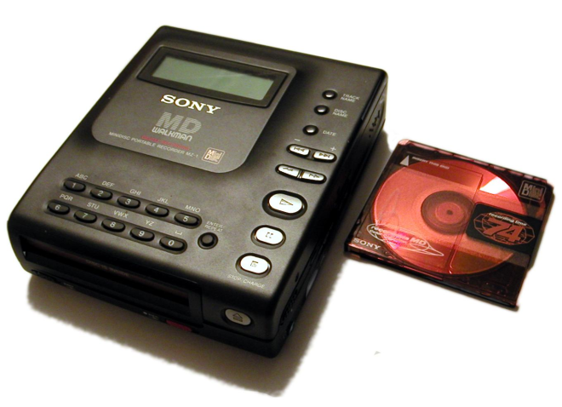
Trends, fashions, technologies and you
Technologies come and go
Who remembers Sony’s MiniDisc?
What about videotapes?
Similarly with computers
Hardware and software are changing quickly
“Old” programming languages: Cobol, Fortran, Pascal
Who would have thought of tablets 5 years ago?
Mobile phones and computers are converging
Million pound question:
“what skills do you need in order to survive in such a quick-changing field?”

Slide 15
The past, the present and the future
The past
Stand-alone PCs or mainframes
Clear separation of devices (phones did not play music)
The present
Computer networks everywhere
Devices are merging (smart-phones are computers)
The future
Who knows?
Communication, entertainment and information provision are shaping technologies
... and technologies change the way we communicate, are entertained and access information

Slide 16
“Future-proofing” your education
“Soft” skills for life (a very short list)
Learn to learn – know what you don’t know (and do something about it)
Teamwork – group dynamics, relating to people, dealing with conflicts
Communication skills – written/spoken communication, culture awareness, foreign languages
Communication skills cannot be emphasised enough
How can you explain 1,500 lines of code to your boss?!
How to express computational processes in a precise and compact way, without resorting to showing code?
Answer: with mathematics!

Slide 17
Discrete mathematics & logics
Discrete maths and logic: core of computer science
Discrete = “made of distinct parts”
Collections of objects called sets
Structures and relations defined over sets
Collections are finite or countable
Digital devices (PCs, laptops, tablets, smartphones)
Essentially finite discrete mathematical systems
We must see beyond fancy graphics, sound effects, etc.
Aim:
Study discrete maths and logics to acquire skills, tools, and techniques to model and understand computers

Slide 18
Mathematical modelling
Skill needed for problem solving
When proposing computer-based solutions to problems
We first need to understand the problem well!
Mathematical modelling:
Helps us to focus on important aspects of problem
Clarifies parts of problem and how they relate
Provides building blocks to propose a solution
Is a basic skill in analysis

Slide 19
Mathematical modelling (2)
Given the distance between 6 Scottish towns
Problem:
Find road network of minimal total length connecting all six towns
What is the problem and what it is not? A single 'path' through all six towns? A network connecting all six towns?
 | Aberdeen | Edinburgh | Ft. William | Glasgow | Inverness | Perth
Aberdeen | — | 120 | 147 | 142 | 107 | 81
Edinburgh | 120 | — | 132 | 42 | 157 | 45
Ft. William | 147 | 132 | — | 108 | 66 | 105
Glasgow | 142 | 42 | 108 | — | 168 | 61
Inverness | 107 | 157 | 66 | 168 | — | 112
Perth | 81 | 45 | 105 | 61 | 112 | —

Slide 20
Mathematical modelling (3)
Model problem as a graph:
Model problem as a graph:
Vertices represent towns (NB: it is not a map!)
Edges represent connecting roads (NB: no scale!)
Edges with associated weight (representing distance)
Aberdeen
81
120
107
147
Perth
45
Edinburgh
105
157
112
132
142
Inverness
Ft. William
66
61
42
168
108
Glasgow

Slide 21
Mathematical modelling (4)
Solution:
Select a vertex and connect it to its nearest neighbour
Find an unconnected vertex closest to previously connected vertices and connect it to network
Repeat step 2 until all vertices are connected

Slide 22
Mathematical modelling (5)
Solution:
Aberdeen
81
120
107
147
Perth
45
Edinburgh
105
157
112
132
142
Inverness
Ft. William
66
61
42
168
108
Glasgow

Slide 23
What this course will do for you
It will equip you with essential mathematical skills
Sets, logics, functions, relations and how these can be used to model problems and represent computations
These are very popular in the computing literature
Many of you are familiar with these
You should be able to express computational solutions and understand other people’s solutions too
Why mathematics? Are there alternatives?
English (or other languages): verbose and ambiguous
Diagrams/graphics: useful but time-consuming to draw
Both can be misinterpreted.

Slide 24

Additionally...
You will be exposed to a programming language
Python
Growing popularity
Simple, powerful, multi-paradigm (OO, functional)
It is too much for one course to teach maths in detail and programming in detail. Learning python is by supported self-learning. Itself, self-learning is very important in computing, where so much is available only online.

Slide 25
Next Lecture
A bit of Python to get you started.

