Slide 1
CS1022 Computer Programming & Principles
Lecture 1.2
A brief introduction to Python

Slide 2
Plan of lecture
Motivation
From pseudo-code to Python
Variables in Python
Input statements
Assignment statements
Formatting your program
Conditional statement
Loops
Instructions for next lecture

Slide 3
Motivation
Pseudo-code is for humans
“Running” pseudo-code: time-consuming & error-prone
Solution: use a programming language
We can “implement” pseudo-code
Easily run the program and see whether it works.
Various choices of programming languages:
Java
C, C++ and C#
Visual Basic
Haskell and Scala
Any others?

Slide 4
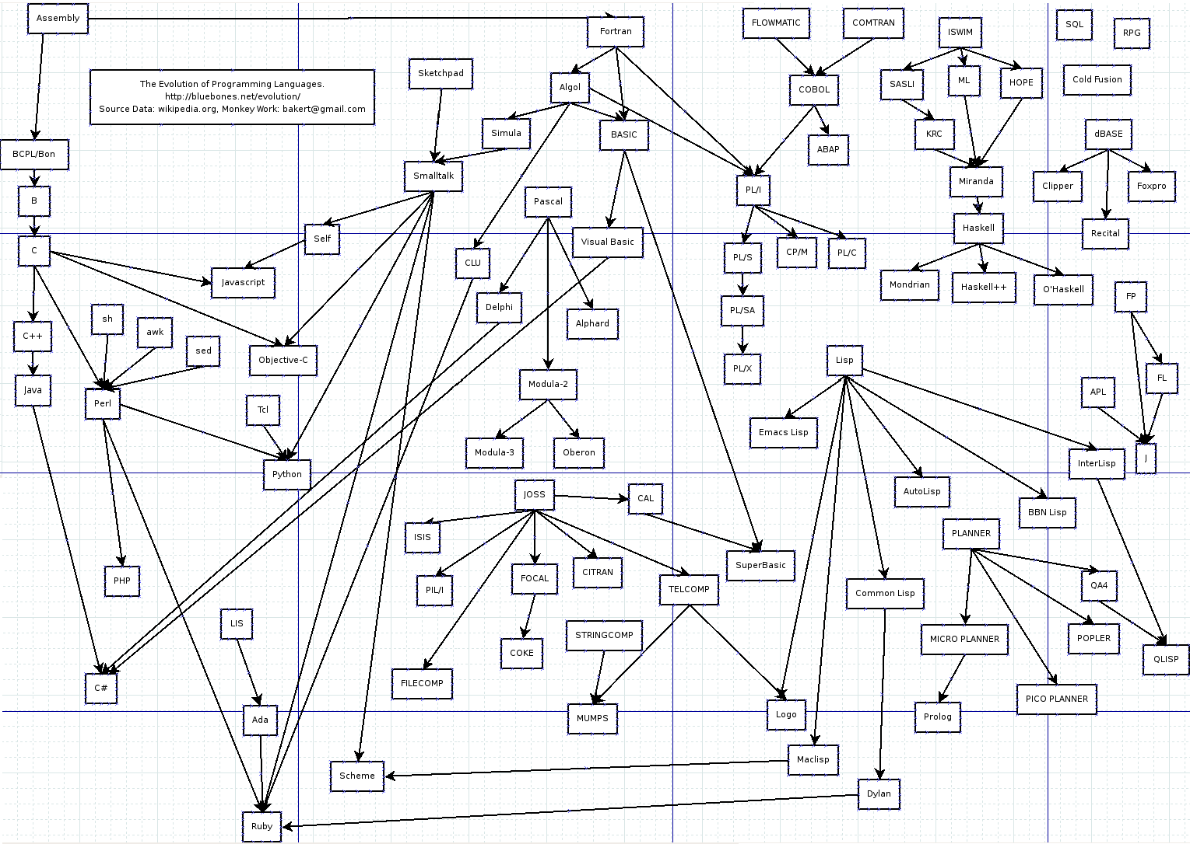
Motivation (2)
A family tree of programming languages:

Slide 5
Motivation (3)
We’ll be using Python as a programming language
We chose Python for various reasons:
Widely used, general-purpose and high-level
Emphasises code readability
Compact programs (fewer lines of code)
Simple yet powerful
Multi-paradigm: object-oriented and functional
Well supported (tutorials, free books, etc.)
Growing community of users

Slide 6
From pseudo-code to Python
The pseudo-code control structures have Python counter-parts
Some of them are quite close to each other
Let’s look at them, one by one
We’ll use this kind of font (teletype) to write Python code
Indicates it’s something typed onto a computer
Generally accepted convention in books, Web pages, etc.

Slide 7
Variables in Python
Strings of letters, numbers and “_” (underscore)
Must start with a letter
Examples:
x y12 a_variable valueOfPurchase
Important: variables names are case-sensitive
“numCreds” is not the same as “numcreds”
Some strings are reserved words for Python
Python needs these to make sense of your program
You should not use these reserved words as variables

Slide 8
Variables in Python (2)
Reserved words in Python:
and
as
assert
break
class
continue
def
del
elif
else
except
exec
finally
for
from
global
if
import
in
is
lambda
not
or
pass
print
raise
return
try
while
with
yield
Do not use any of these strings as variable names!!

Slide 9
Input statements
Pseudo-code:
input Var₁, Var₂,..., Var_{n}
Python:
var_1 = argv[1]
var_2 = argv[2]
...
var_n = argv[n]
Values from keyboard, Web form, database, etc.
Get values from keyboard
Assign them to variables
In this order

Slide 10
Assignment statements
Pseudo-code:
Variable := Expression
where
Variable is any variable name
Expression is any arithmetic expression
Python:
Variable = Expression
where
Variable is any Python variable name (see above)
Expression is any Python expression

Slide 11
Assignment statements (2)
Sample assignment statements in Python:
value = arg[1]
date = '12/03/2034'
expr = value * 2
value = value + 1
y = f(value)
X = Y = 20

Slide 12
Assignment statements (3)
Wrong assignment statements in Python:
myString = 'pugs are cool
if = '12/03/2034'
expr+2 = value * 2

Slide 13
Back to variables
Variables have associated types:
Boolean
Numeric
Integer
Float
Long
Complex
Strings
Some built-in functions require specific types
Arithmetic operators with numbers
If you try to use an operator with the wrong kind of variable Python will complain about it

Slide 14
Example of a Python program
Example of algorithm with assignment statement:
{Algorithm to add two numbers}
begin
input First, Second
Sum := First + Second
output Sum
end
# Program to add 2 numbers
First = argv[1]
Second = argv[2]
Sum = First + Second
print(Sum)

Slide 15
Formatting your program
Spaces and line breaks are important in Python
In some languages (Java, C) these only separate things
In pseudo-code these help visualise constructs
Indentation define “begin ... end” :
if n < 0 then
begin
abs := –n;
x := x + 1;
end
if n < 0:
abs = -n
x = x + 1

Slide 16
Formatting your program (2)
Nesting of statements:
Algorithm
Python
begin
statement 1;
statement 2;
begin
statement 3;
begin
statement 4;
statement 5;
end
end
end
statement1
statement2
statement3
statement4
statement5

Slide 17
Conditional statement (if-then-else)
if condition then statement 1
Algorithmic
notation
if condition then statement 1
else statement 2
if condition:
statement1
Python
if condition:
statement1
else:
statement2

Slide 18
Conditional statement (2)
Algorithm
Python
{Absolute value of input}
begin
input n;
if n < 0 then
abs := –n;
else
abs := n;
output abs;
end
# absolute value
n = int(argv[1])
if n < 0:
abs = -n
else:
abs = n
print(abs)

Slide 19
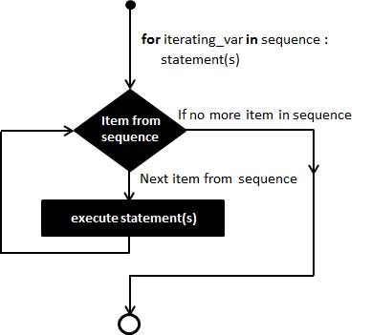
“For” loop
Algorithmic
notation
for var := init_val to final_val do
statement
for var in range(init_val,final_val):
statement
Python

Slide 20
“For” loop (2)
Algorithm
Python
{Sum first n integers}
begin
input n;
sum := 0;
for i := 1 to n do
sum := sum + i;
output sum;
end
# sum first n integers
n = int(argv[1])
sum = 0
for i in range(1,n):
sum = sum + i
print(sum)

Slide 21
“For” loop (3)
Algorithmic
notation
for all elements of set do
statement
for w in set:
statement
Python
Important:
Sets are unorder items and represented as
[1, a, ‘cat’, 12.3, 5]
Square brackets, items separated by commas
Sets may contain elements of different types

Slide 22
“For” loop (4)
Some issues with for-loops
Is the final value still part of the loop?
What is the final value of n below (initialised as 0)?
for i in range(1,100): n = n + 1
Loop performed up to 99, but not with 100
Other languages are different (e.g., Java)
Full syntax is
for var in range(initial,final,increment):
Example: range(100,1,-1) is count down

Slide 23
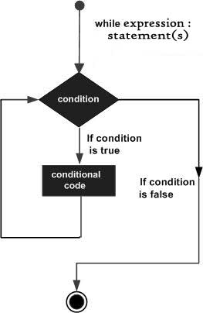
“While” loop
Algorithmic
notation
while condition do
statement
while condition:
statement
Python

Slide 24
“Repeat-until” loop
repeat
statement
until condition
Algorithmic
notation
while True:
statement
if condition: break
Python
There is no built-in “repeat-until” in Python
Re-purpose “while” loop for a similar effect

Slide 25
Summary
Basics of Python programming
An “entry-point” to learn more about Python
Informally have seen something about algorithms

Slide 26
Next
CodeAcademy on-line Python training
http://www.codecademy.com/en/tracks/python
Get started down the track.
The practical next week is all about getting started in Python. Looking at it now will prepare you for the practical.
You can work together in learning Python, which is better for some people.
Signup is optional. Advantage is that you can monitor your progress.

Slide 27




Further reading
Python’s official Web site
https://www.python.org/
Wikipedia’s entry on Python
http://en.wikipedia.org/wiki/Python
Python Humour! (who said we are not fun/funny?)
https://www.python.org/doc/humor/

